Slide 1
CCP-LAW
Curricula development on Climate Change Policy and Law
Subject title: Climate Change Policy
Instructor Name: Dr. Rahul Nikam
Project No of Reference: 618874-EPP-1-2020-1-VN-EPPKA2-CBHE-JP:
The European Commission's support for the production of this publication does not constitute an endorsement of the contents, which reflect the views only of the authors, and the Commission cannot be held responsible for any use which may be made of the information contained therein.

Slide 2
Defining the precautionary principle
Definition
It's the common sense idea: "Be careful." "Better safe than sorry." "Look before you leap." "First do no harm."
Origins
German law as the Vorsorgeprinzip (which can also be translated as the 'foresight principle') during the preparation of legislation on air pollution in the 1970s.
At the international level, references to the 'precautionary principle' or 'precautionary measures' appeared in the environmental agreements of the 1980s, starting with the 1985 Vienna Convention.
The 1987 Ministerial Declaration of the Second International Conference on the Protection of the North Sea notes that:
'in order to protect the North Sea from possibly damaging effects of the most dangerous
substances, a precautionary approach is necessary which may require action to control
Inputs of such substances even before a causal link has been established by absolutely
clear scientific evidence'

Slide 3
Defining the precautionary principle
Origins
The 1990, the Ministerial Declaration of the Third International Conference on the Protection of the North Sea expands the concept, stating that the contracting governments:
'will continue to apply the precautionary principle, that is to take action to avoid
potentially damaging impacts of substances that are persistent, toxic and liable to
bioaccumulate even where there is no scientific evidence to prove a causal link
between emissions and effects’
The 1992 Rio Declaration on Environment and Development
‘In order to protect the environment, the precautionary approach shall be widely applied
by States according to their capabilities. Where there are threats of serious or
irreversible damage, lack of full scientific certainty shall not be used as a reason for
postponing cost-effective measures to prevent environmental degradation.
At the European level, the precautionary principle was enshrined in the Maastricht Treaty in 1992.
It is now included in Article 191 of the Treaty on the Functioning of the European Union among the principles underpinning EU environmental policy.

Slide 4
Whether the precautionary principle can be considered as a general principle of law.
The Precautionary Principle in EU and International Law
EU
Reference in the Maastricht Treaty.
EU Court of Justice 'the precautionary principle can be defined as a general principle of Community law requiring the competent authorities to take appropriate measures to prevent specific potential risks to public health, safety and the environment, by giving precedence to the requirements related to the protection of those interests over economic interests
'Competent authorities' refers to European institutions involved in preparing and applying secondary legislation, as well as Member States when acting within the scope of EU law.
IL
Still in dispute.
A non-binding political guideline which is not recognised in customary international law, basing their reasoning mainly on the legal weakness of the precautionary principle in the area of international trade, particularly in the context of the WTO.
Widely adopted at international level, particularly since its inclusion in multilateral treaties such as the Convention on Biological Diversity and the United Nations Framework Convention on Climate Change, thus becoming a general principle of international law

Slide 5
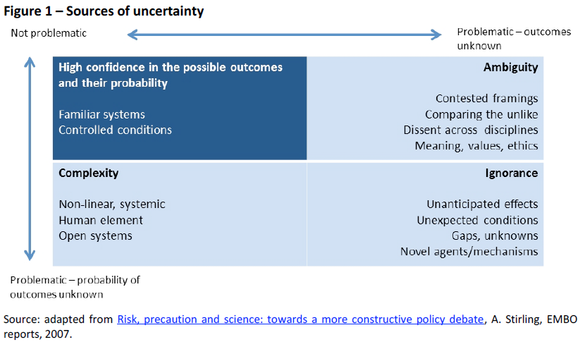
Main interpretations of the precautionary principle
One way of looking at the precautionary principle might be to classify situations of uncertainty according to the sources of uncertainty, complexity, ambiguity and ignorance

Slide 6
Main interpretations of the precautionary principle
Another way of looking based on three schematic interpretations depending on the degree of uncertainty, obligation and stringency.
First/minimal interpretation: uncertainty does not justify inaction and warrants legislation despite the absence of complete scientific evidence concerning a particular hazard;
Second/median interpretation: uncertainty justifies action and warrants legislation even if the link between cause and effect has not been fully established;
Third/maximal interpretation: uncertainty necessitates legislation until the absence of hazard has been proven.

Slide 7
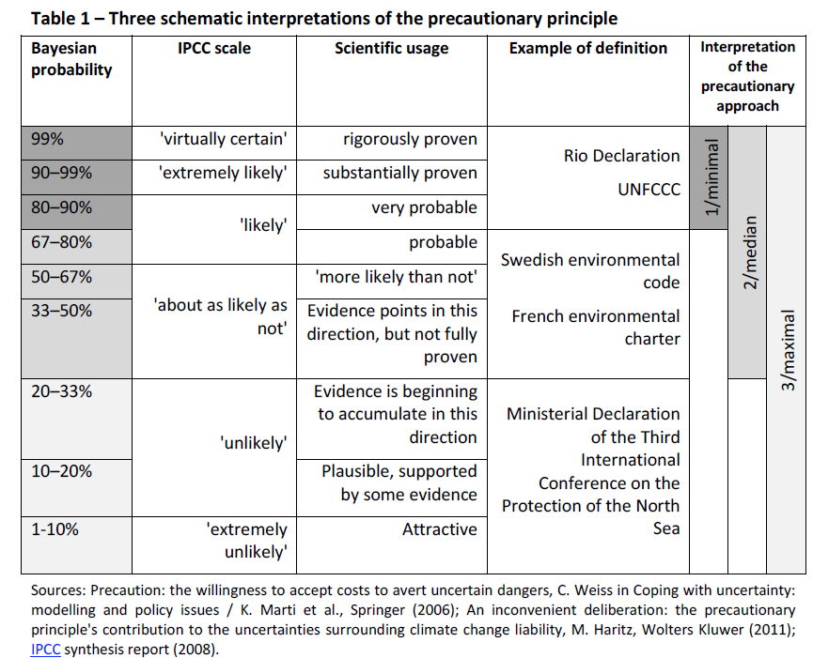
Main interpretations of the precautionary principle

Slide 8
Main interpretations of the precautionary principle
One last way of looking at the precautionary principle might be based on a procedural interpretation characterized by four elements:
the potential hazards are characterized by serious, irreversible and uncertain consequences;
Dynamic decision-making processes are both iterative and informative to allow learning overtime;
The burden of proof is shared between the regulator and the proponent; and
No decision is prescribed a priori

Slide 9
The positions of different institutions
1. European Commission
adopted a Communication on the precautionary principle early in 2000.
The Commission put forward the following definition.
'Whether or not to invoke the precautionary principle is a decision exercised where
scientific information is insufficient, inconclusive, or uncertain and where there are
indications that the possible effects on the environment, or human, animal or plant health
may be potentially dangerous and inconsistent with the chosen level of protection.’
The Commission states that precautionary measures should respect other principles. Inter alia, they should be:
Proportional to the chosen level of protection;
Non-discriminatory;
Consistent with measures already taken;
Based on an examination of the benefits and costs of action or lack of action;
Subject to review in the light of new scientific data; and
Capable of assigning responsibility for producing the scientific evidence necessary for a more comprehensive risk assessment.

Slide 10
The positions of different institutions
2. UNESCO
In its 2005 report on the precautionary principle, UNESCO's World Commission on the Ethics of Scientific Knowledge and Technology (COMEST) put forward a 'working definition’:
'When human activities may lead to morally unacceptable harm that is scientifically plausible but uncertain, actions shall be taken to avoid or diminish that harm.’
The plausibility of harm should be based on scientific analysis subject to review. Measures taken as a result of a participatory process, must be proportional to the seriousness of the potential hazard and take into consideration their positive and negative consequences and moral implications.
3. European Environment Agency
The European Environment Agency's 2013 report on the precautionary principle suggests a 'working definition' that avoids negatives (unlike other definitions such as the Rio Declaration’s):
'The precautionary principle provides justification for public policy and other actions in
situations of scientific complexity, uncertainty and ignorance, where there may be a
need to act in order to avoid, or reduce, potentially serious or irreversible threats to
health and/or the environment, using an appropriate strength of scientific evidence,
and taking into account the pros and cons of action and inaction and their distribution.'

Slide 11
The positions of different institutions
2. UNESCO
In its 2005 report on the precautionary principle, UNESCO's World Commission on the Ethics of Scientific Knowledge and Technology (COMEST) put forward a 'working definition’:
'When human activities may lead to morally unacceptable harm that is scientifically plausible but uncertain, actions shall be taken to avoid or diminish that harm.’
The plausibility of harm should be based on scientific analysis subject to review. Measures taken as a result of a participatory process, must be proportional to the seriousness of the potential hazard and take into consideration their positive and negative consequences and moral implications.
3. European Environment Agency
The European Environment Agency's 2013 report on the precautionary principle suggests a 'working definition' that avoids negatives (unlike other definitions such as the Rio Declaration’s):
'The precautionary principle provides justification for public policy and other actions in
situations of scientific complexity, uncertainty and ignorance, where there may be a
need to act in order to avoid, or reduce, potentially serious or irreversible threats to
health and/or the environment, using an appropriate strength of scientific evidence,
and taking into account the pros and cons of action and inaction and their distribution.'

Slide 12
Conflicting viewpoints
A pointless and potentially dangerous principle
It is arbitrary and unscientific. Since it is based on ideological value judgments, it may lead to paralysis and threaten human progress.
Since absolute scientific certainty can never be achieved, the precautionary principle could logically be applied to any activity since its consequences would always include an element of uncertainty.
A stringent application of the precautionary principle would not only undermine progress by depriving society of useful products (such as antibiotics and vaccines), but would also deprive it of a source of knowledge.
The precautionary principle could isolate the European Union internationally, damage world trade and complicate international regulatory cooperation to a considerable extent.
Alternatives to the precautionary principle have been suggested. These include an anticatastrophe principle with a narrow scope and strong focus on costs and benefits.

Slide 13
Conflicting viewpoints
2. Useful principle for averting complex hazards
Others see the precautionary principle as reducing serious and irreversible environmental and public health hazards, including by drawing lessons from past mistakes. They argue that this helps society address the evolving, complex and systemic challenges currently facing it by facilitating people-centric progress.
This view mainly refers to the minimalist interpretations of the precautionary principle.
It is partly based on the following premise: scientists cannot accurately predict environmental and health threats; the environment is inherently vulnerable; there are alternative procedures and products that are less hazardous.

Slide 14
Applying the precautionary principle
Possible Precautionary Measures
The strictest interpretation of the precautionary principle does not require or advocate any specific measure (such as a ban).
Applying the precautionary principle can result in a reversal of the burden of proof.
Several methods can be used to determine whether it is appropriate to take precautionary measures.
Cost-benefit analysis incorporating Bayesian risk assessment.
Risk trade-off analysis is another method that is sometimes used in administrative law in the United States.
Cost-effectiveness analysis is another method, which aims to enable policy-makers to pre-establish an acceptable level of risk at the lowest cost, without however specifying how this level is determined.
The European Environment Agency recommends assessing the pros and cons of action and inaction more broadly by including also the unquantifiable aspects.

Slide 15
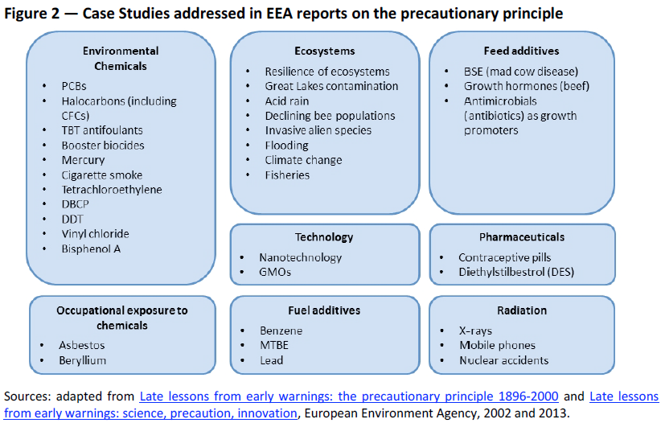
Applying the precautionary principle
2. Examples of the precautionary principle's application

Slide 16
Application of precautionary measures in the United States and Europe
EU
Europe adopted a stricter approach than the US and enshrined the precautionary principle in the Maastricht Treaty.
The difference lies mainly in the issues to which precautions are applied (the EU is more cautious than the US with regard to growth hormones in beef whereas the US has taken more precautions than the EU with respect to BSE). Some consider that certain US food safety laws, for instance, apply the precautionary principle without explicitly mentioning it. Furthermore, the Silver Book of the National Research Council advises the US Environmental Protection Agency to take into account and report on uncertainty and variability in all stages of the risk assessment, which suggests that these factors can be taken into account.
US
Applied a general approach whereby a hazard must be proved before public measures can be taken.
The term 'precautionary approach’ is more readily used than 'precautionary principle'. Other approaches have been put forward, such as the concept of 'prudent vigilance', which combines self-regulation and careful monitoring, advocated by the US Commission for the Study of Bioethical Issues in 2010.
Although there is no fundamental difference between this concept and the precautionary principle, it clearly reflects a US preference for a pragmatic rather than a regulatory approach, and a willingness to allow companies more freedom.

Slide 17
Further Reading
The precautionary principle: Definitions, applications, and governance by Think Tank European Parliament https://www.europarl.europa.eu/thinktank/en/document/EPRS_IDA(2015)573876

