Slide 1
CCP-LAW
Curricula development on Climate Change Policy and Law
Subject title: Climate Change Policy
Instructor Name: Dr. Rahul Nikam
Project No of Reference: 618874-EPP-1-2020-1-VN-EPPKA2-CBHE-JP:
The European Commission's support for the production of this publication does not constitute an endorsement of the contents, which reflect the views only of the authors, and the Commission cannot be held responsible for any use which may be made of the information contained therein.

Slide 2
Climate Change & Financial Stability
To Protect Financial Stability, Confront Climate Change
Climate change puts global financial stability at risk
the increasingly destructive impacts if hurricanes and wildfires illustrate that even seemingly well-known types of risks can take us by surprise.
Policy makers ae started to recognize the dramatic implications of climate change for financial stability, and the urgency of speeding the low-carbon transition.
IMF is helping countries better understand the macro-financial transmission of climate risks.
Only with accurate and standardized reporting of climate risks in financial statements can investors discern companies exposures to climate related risks .
The standardization of climate risk disclosures would improve the comparability of information in financial statements across markets and jurisdictions.

Slide 3
Climate Change & Financial Stability
More broadly, the IMF can help by providing advice to policymakers on climate-related macro-financial policies.
The Covid-19 pandemic reminds us that crisis preparedness and resilience are essential to manage risks from uncertain , complex events that can have extreme economic and human costs.
The pandemic-induced economic crisis dose not change the fundamental climate challenge, or the proper response it.
Taking action to address climate change demands the mobilization of both public and private finance.

Slide 4
Climate Change & Financial Stability
How to defuse the “Double jeopardy” of climate and financial risks in developing countries
Strengthen macro-financial resilience
Assess and disclose climate related risks
Incorporate impacts of climate change in growth diagnostics
Promote green finance

Slide 5
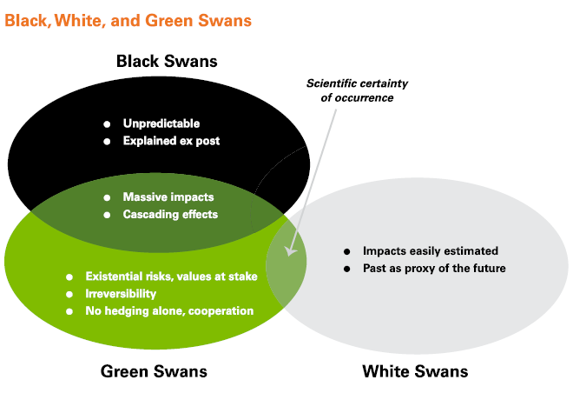
Climate Change & Financial Stability
Financial stability in the age of global and systemic ecological risks (green swans)

Slide 6
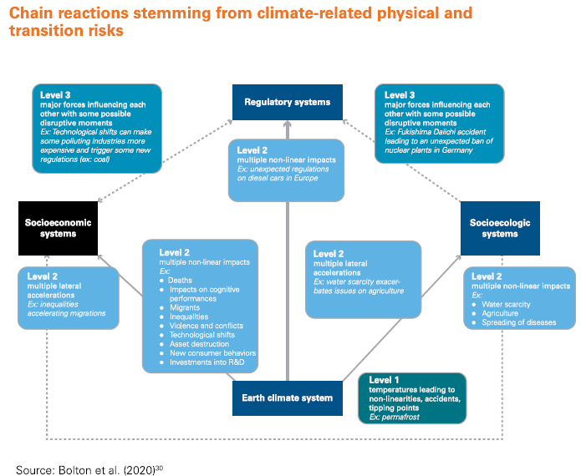
Climate Change & Financial Stability
Financial stability in the age of global and systemic ecological risks (green swans)

Slide 7
Further Reading
21st Century Diplomacy: Foreign Policy is Climate Policy Full Report https://www.wilsoncenter.org/publication/21st-century-diplomacy-foreign-policy-climate-policy-full-report

