Slide 1
CCP-LAW
Curricula development on Climate Change Policy and Law
Subject title: CLIMATE CHANGE DISPUTE RESOLUTION
Instructor Name: Tran Anh Tuan
Project No of Reference: 618874-EPP-1-2020-1-VN-EPPKA2-CBHE-JP:
The European Commission's support for the production of this publication does not constitute an endorsement of the contents, which reflect the views only of the authors, and the Commission cannot be held responsible for any use which may be made of the information contained therein.

Slide 2
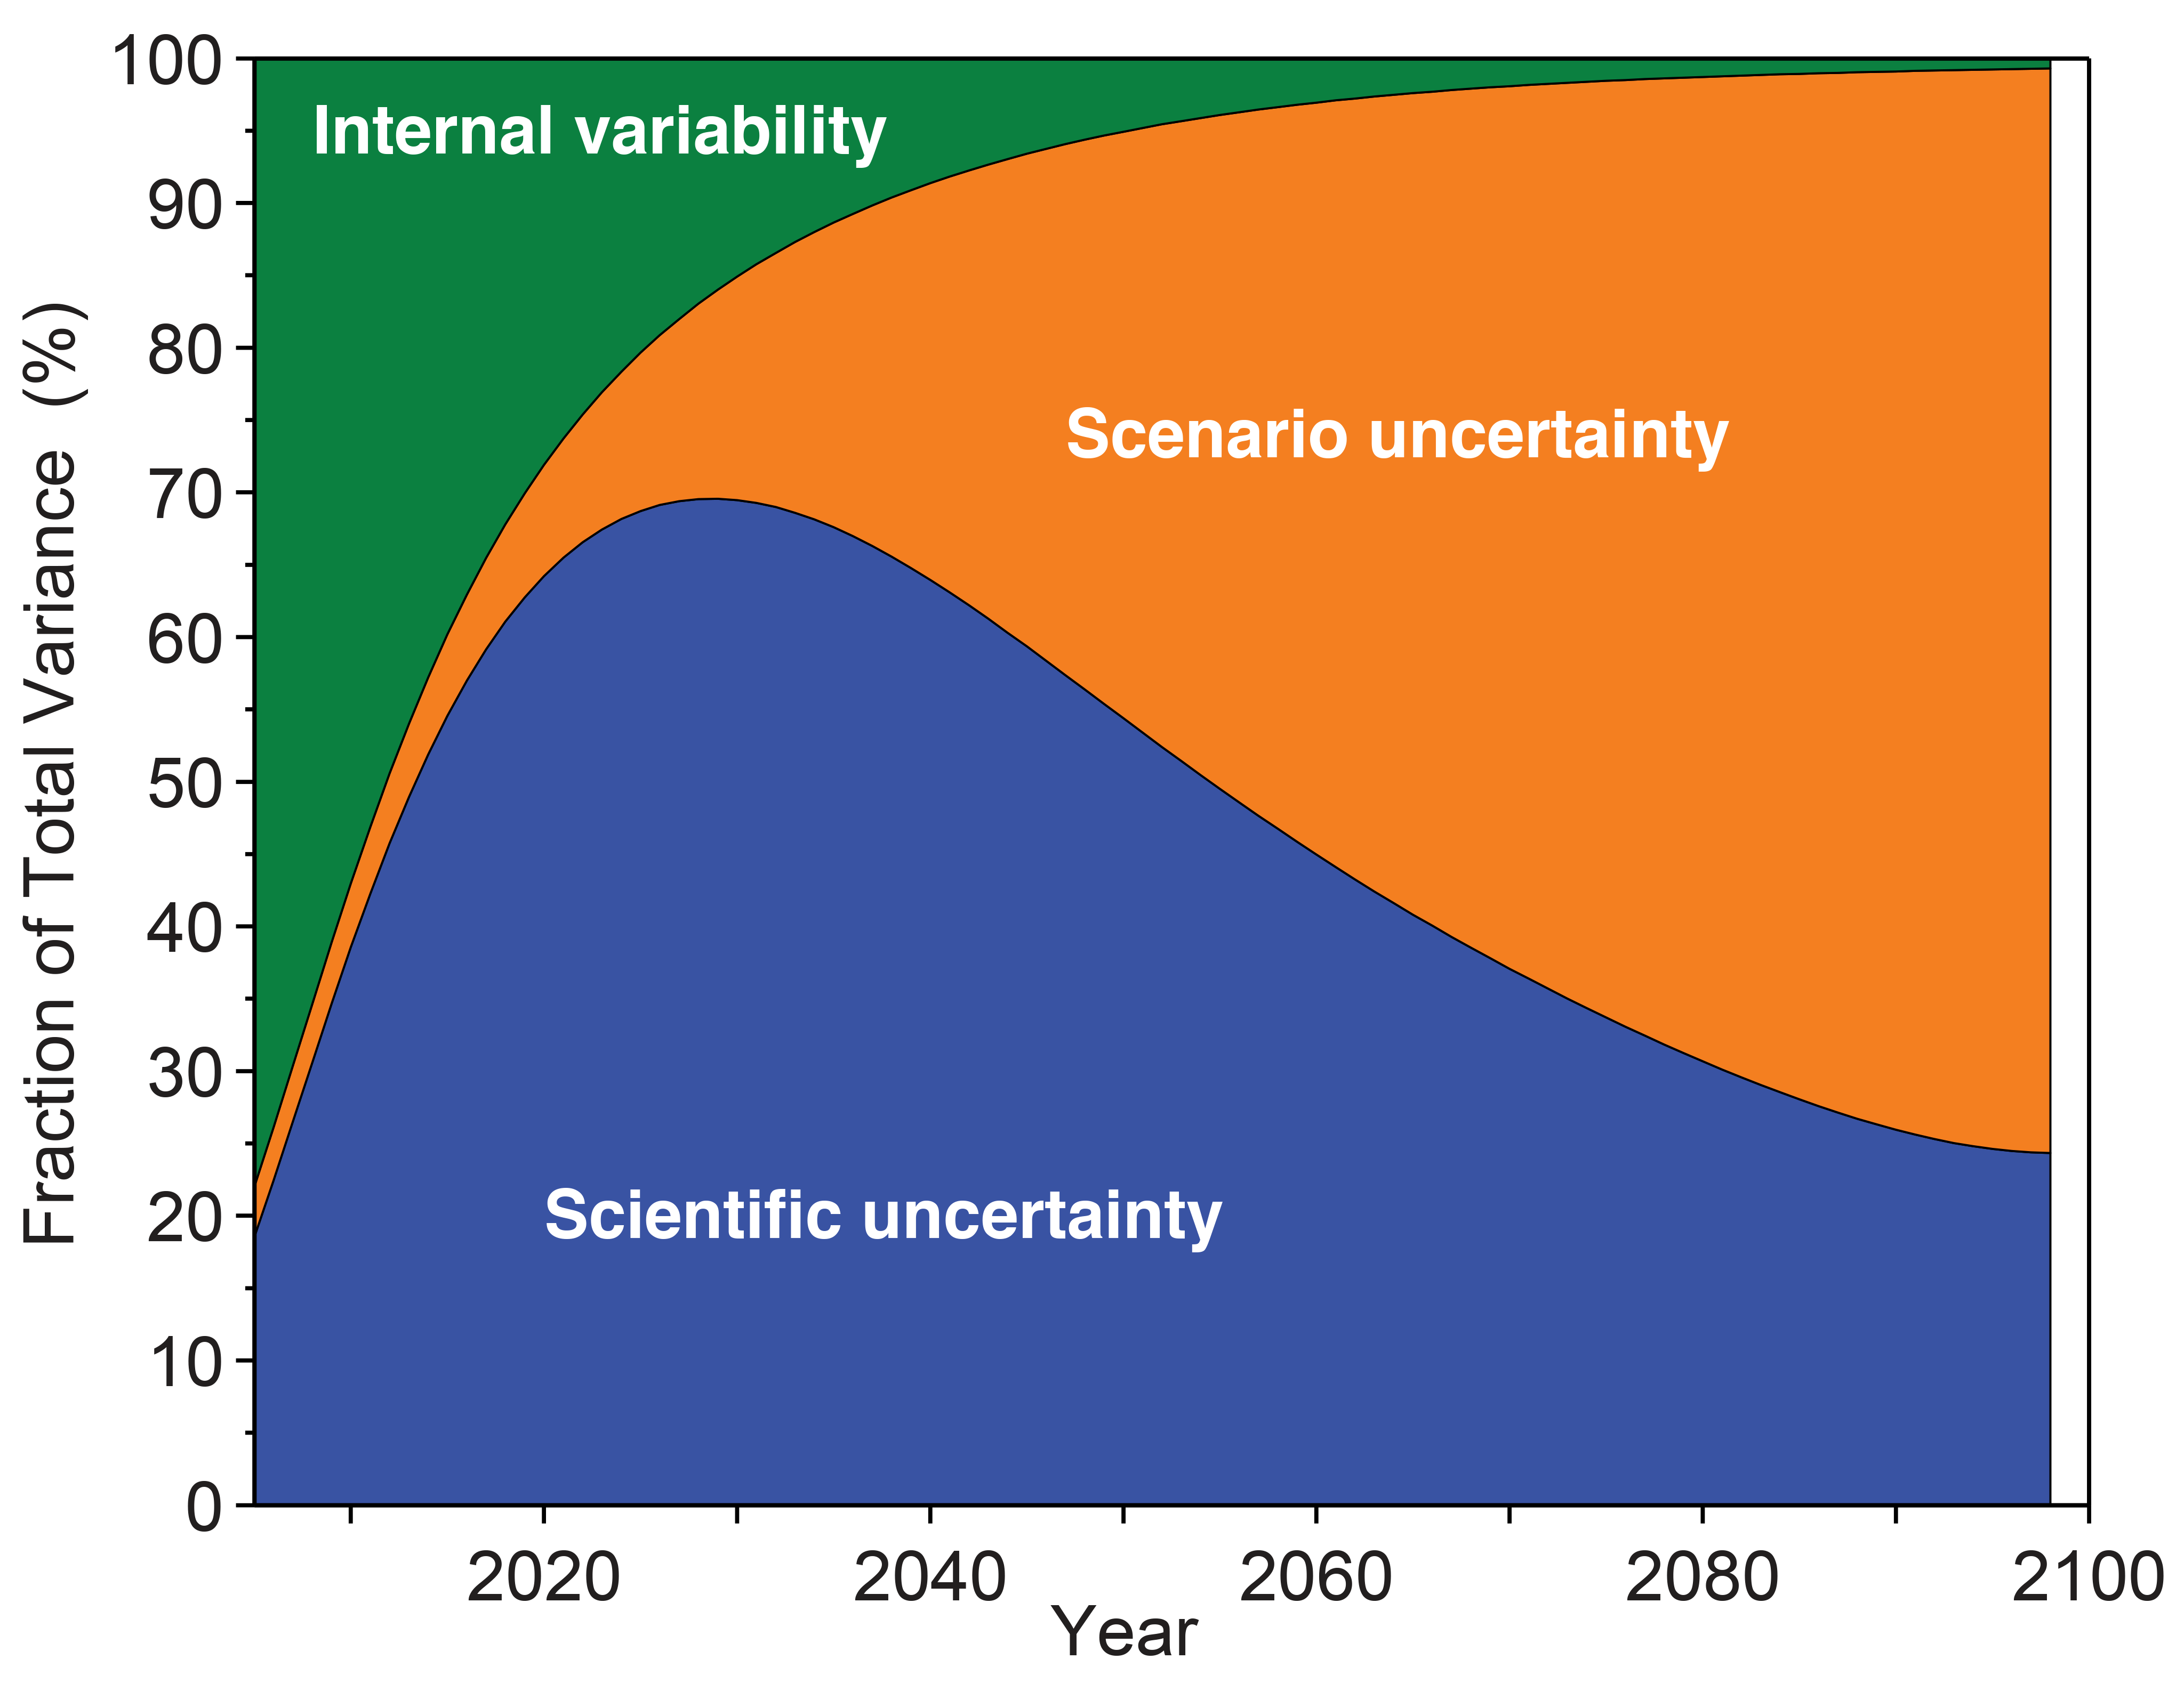
7.1. Scientific uncertainty and interpretation
Module 7. Challenges in resolving climate change disputes
Key challenges:
Attribution:
Pinpointing the specific contribution of a particular entity (e.g., a country, corporation) to climate change impacts is often difficult due to the complex interplay of natural variability.
Uncertainties in climate models and data limitations further complicate this process.

Slide 3
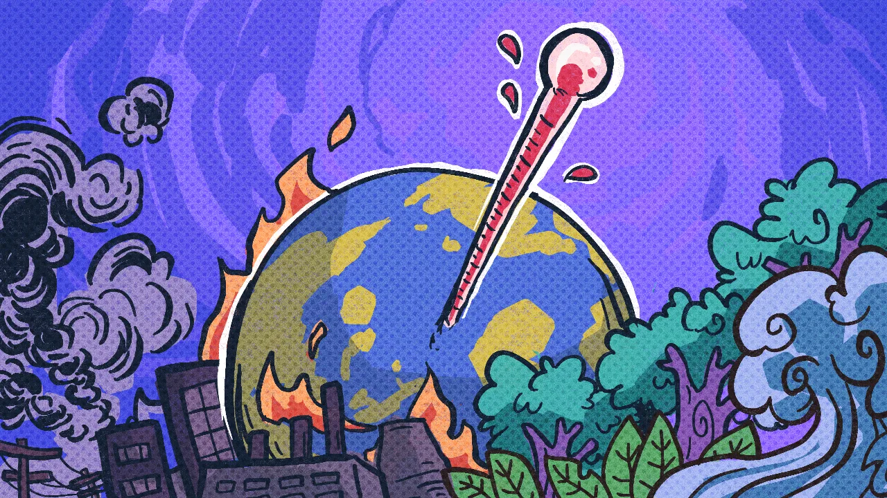
7.1. Scientific uncertainty and interpretation
Module 7. Challenges in resolving climate change disputes
Key challenges
Conflicting interpretations:
Experts with diverse viewpoints can interpret scientific data differently, leading to conflicting assessments and undermining the legitimacy of evidence in disputes.
This can create confusion for decision-makers and fuel arguments used by those seeking to deflect responsibility.

Slide 4
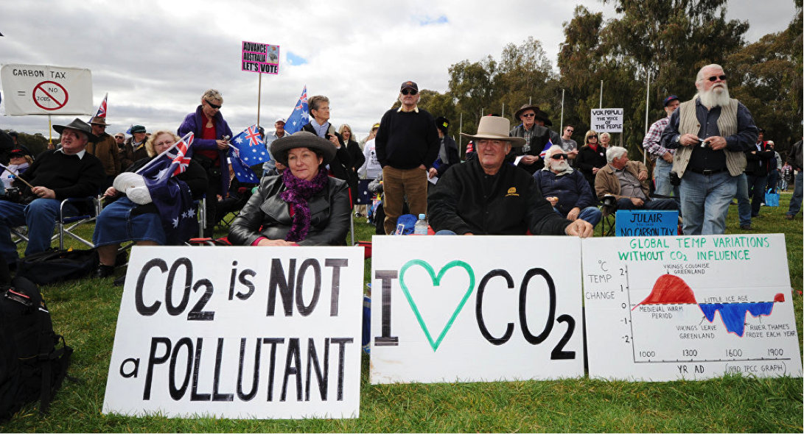
7.1. Scientific uncertainty and interpretation
Module 7. Challenges in resolving climate change disputes
Key challenges
Undermining trust and legitimacy:
When uncertainties are misinterpreted or exploited, it can undermine trust in scientific evidence and the legitimacy of dispute resolution processes.
This can hinder productive dialogue and delay necessary action.

Slide 5
7.1. Scientific uncertainty and interpretation
Module 7. Challenges in resolving climate change disputes
Examples:
Loss and Damage Claims: When seeking compensation for climate-related losses and damages, it's often hard to attribute specific impacts to individual emitters due to uncertainties, posing challenges in determining fair compensation.
Environmental Impact Assessments: Uncertainties in future climate projections can hinder the accuracy of environmental impact assessments for projects like infrastructure development, potentially leading to unforeseen consequences and increased disputes.

Slide 6
7.1. Scientific uncertainty and interpretation
Module 7. Challenges in resolving climate change disputes
Addressing the challenges:
Transparency and communication: Transparent communication of science's scope, methods, and analytical assumptions is vital for trust, clarifying evidence certainty.
Peer review and consensus building: Established scientific methods, thorough peer review, and consensus from bodies like the IPCC are key for sound, evidence-based decisions.

Slide 7
7.1. Scientific uncertainty and interpretation
Creating legal frameworks that recognize and address uncertainties fairly improves dispute resolution, potentially varying proof standards by case context and gravity.
Module 7. Challenges in resolving climate change disputes
Addressing the challenges:
Developing robust methodologies: Investing in data collection, climate model refinement, and attribution methods helps reduce uncertainties and sharpen assessments.
Legal frameworks and standards: Creating legal frameworks that recognize and address uncertainties fairly improves dispute resolution, potentially varying proof standards by case context and gravity.

Slide 8
7.1. Scientific uncertainty and interpretation
Module 7. Challenges in resolving climate change disputes
Key takeaways:
Scientific uncertainty, while challenging, shouldn't be an excuse for inaction in addressing climate change.
By employing transparency, building consensus, and developing robust methodologies, we can navigate these uncertainties effectively.
Moreover, legal frameworks need to adapt and evolve to address these challenges in a fair and just manner.

Slide 9
7.2. Ambiguity and complexity of agreements
Module 7. Challenges in resolving climate change disputes
Roots of Ambiguity and Complexity
Balancing Diverse Interests: International climate agreements must accommodate nations' diverse economies, emissions histories, and climate vulnerabilities, balancing these leads to wording that may be ambiguous.
Scientific and Technical Jargon: Climate science's complexity and varied concepts make it challenging to encapsulate in universally clear, legally binding language, risking diverse interpretations.

Slide 10
7.2. Ambiguity and complexity of agreements
Module 7. Challenges in resolving climate change disputes
Roots of Ambiguity and Complexity
Intentional Vagueness: Ambiguity in agreements can be strategic, allowing nations to agree or retain flexibility, yet it may also lead to debates about the true intent.
Evolving Science and Solutions: As knowledge of climate change and mitigation evolves, agreements need to adapt, though frequent updates can complicate and introduce loopholes or inconsistencies.

Slide 11
7.2. Ambiguity and complexity of agreements
Module 7. Challenges in resolving climate change disputes
How These Impacts Dispute Resolution
Disagreements on Obligations: Vague wording about what actions a nation must take ("best efforts", "as appropriate") leads to debates about whether parties are meeting their commitments. Lack of quantifiable targets complicates assessment.
Differing Timelines: Phrases like "as soon as possible" or "long-term goals" can be interpreted differently, leading to disputes over when targets should be achieved and what constitutes reasonable progress.

Slide 12
7.2. Ambiguity and complexity of agreements
Module 7. Challenges in resolving climate change disputes
How These Impacts Dispute Resolution
Conflicting Priorities: Agreements often enshrine competing goals, like economic development versus stringent emission cuts. This leaves governments justifying actions based on their interpretation of which goals hold priority, fueling disputes.
Shifting the Burden: Ambiguity allows room for nations to creatively interpret agreements to shift the burden of action onto others, arguing their efforts are sufficient compared to the 'real' intent of the agreement.

Slide 13
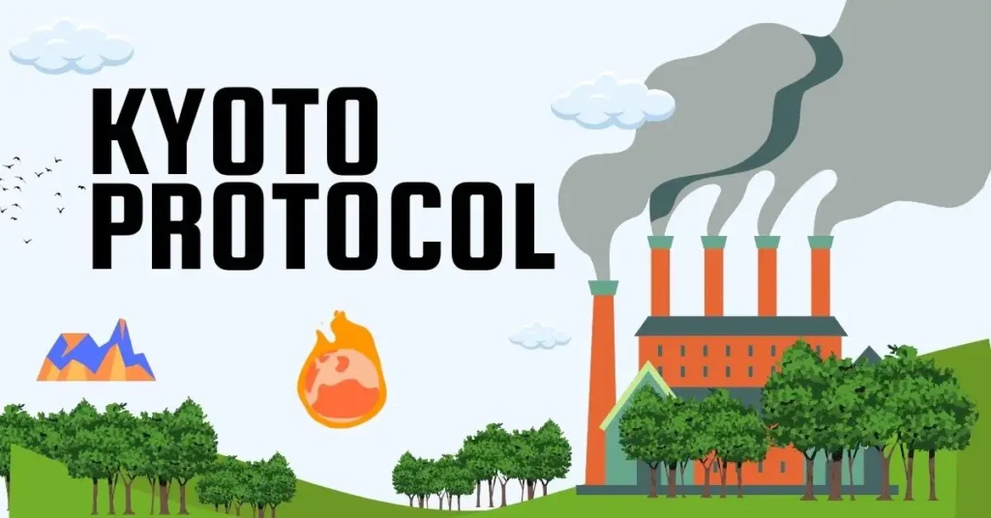
7.2. Ambiguity and complexity of agreements
Module 7. Challenges in resolving climate change disputes
Examples
Paris Agreement's NDCs: (NDCs) are the heart of the Paris Agreement, but lack standardization. Countries decide the format and targets, leading to debates on whether collective goals are being met and who needs to step up ambition.
Kyoto Protocol's Flexibility Mechanisms: Mechanisms like carbon trading were intended to provide cost-effective pathways to reduce emissions. However, complexity in verification and fears of loopholes created disputes over their true effectiveness.

Slide 14
7.2. Ambiguity and complexity of agreements
Module 7. Challenges in resolving climate change disputes
Addressing the challenges:
Clear and precise language: Using clear and concise language in agreements, avoiding ambiguity, and defining key terms are crucial for minimizing room for misinterpretation.
Regular reviews and updates: Regularly reviewing and updating agreements to reflect evolving scientific knowledge, technological advancements, and changing geopolitical contexts can help address ambiguities and ensure their continued relevance.

Slide 15
7.2. Ambiguity and complexity of agreements
Module 7. Challenges in resolving climate change disputes
Addressing the challenges:
Transparency and inclusivity: Engaging stakeholders in the drafting process, promoting transparency, and ensuring inclusivity can help build consensus and reduce ambiguity from the outset.
Dispute resolution mechanisms: Establishing effective dispute resolution mechanisms within agreements, such as conciliation or arbitration, can provide avenues for resolving conflicts arising from ambiguity in a timely and efficient manner.

Slide 16
7.2. Ambiguity and complexity of agreements
Module 7. Challenges in resolving climate change disputes
Key takeaways:
Ambiguity in agreements may appease negotiators in the short term, but it spawns future headaches.
Dispute resolution becomes a game of interpretation rather than action.
Climate action urgently needs greater clarity and precision in the agreements that govern it.

Slide 17
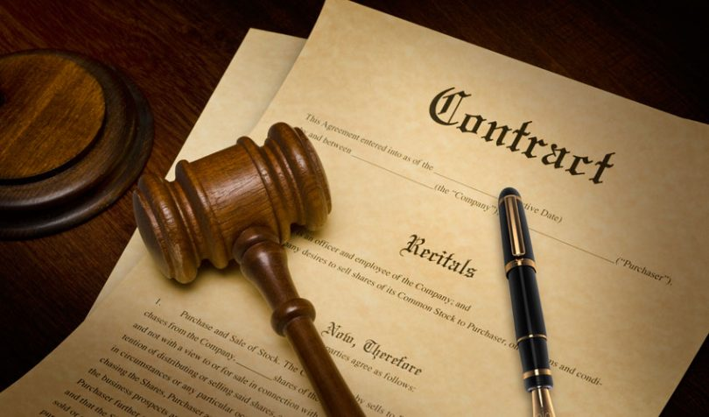
7.3. Enforcement and compliance
Module 7. Challenges in resolving climate change disputes
Roadblocks to Enforcement
Lack of Legally Binding Provisions:
Many international agreements, like the Paris Agreement, rely on voluntary commitments rather than legally binding obligations.
This weakens their enforceability and allows nations to interpret and implement them at their own pace, potentially jeopardizing collective efforts.

Slide 18
7.3. Enforcement and compliance
Module 7. Challenges in resolving climate change disputes
Roadblocks to Enforcement
Sovereignty Concerns: National sovereignty is a sensitive topic. Enforcing measures perceived as infringing on a nation's sovereign right to manage its resources or priorities can trigger resistance and impede cooperation.
Limited enforcement mechanisms: Existing international mechanisms for enforcing environmental agreements are often weak and lack authority to impose sanctions on non-complying states.

Slide 19
7.3. Enforcement and compliance
Module 7. Challenges in resolving climate change disputes
Consequences of Non-Compliance:
Eroded Trust and Cooperation: When parties fail to comply with agreements, it undermines trust and discourages others from upholding their commitments.
Unequal Burden and Ineffectiveness: If some nations comply while others do not, the burden of climate change falls disproportionately on the former
Loss of Credibility and Legitimacy: Frequent non-compliance weakens the effectiveness of international agreements and complicates the collective response to climate change.

Slide 20
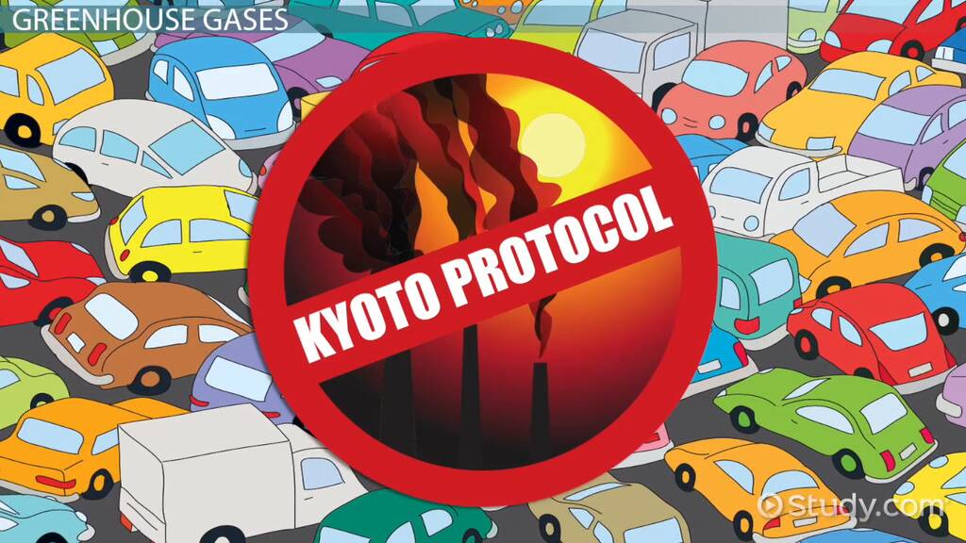
7.3. Enforcement and compliance
Module 7. Challenges in resolving climate change disputes
Examples:
Differing National Ambitions: The Paris Agreement allows nations to set their own NDCs for emissions reductions. However, some NDCs lack ambition or clarity, raising concerns about their effectiveness and potential for non-compliance.
Challenges in Implementing the Kyoto Protocol: The Kyoto Protocol had stricter binding targets and penalties for non-compliance. However, enforcement was hindered by complex procedures and the withdrawal of major emitters.

Slide 21
7.3. Enforcement and compliance
Module 7. Challenges in resolving climate change disputes
Prospects for Improvement:
Strengthening existing mechanisms: Enhancing international environmental law authority and effectiveness may involve creating stronger enforcement and clear consequences for non-compliance.
Building trust and partnerships: Fostering trust and cooperation through open dialogue, transparency in reporting, and promoting global partnerships can incentivize nations to comply with agreements out of a sense of shared responsibility and collective benefit.

Slide 22
7.3. Enforcement and compliance
Module 7. Challenges in resolving climate change disputes
Prospects for Improvement:
Promoting transparency and accountability: Establishing robust and transparent monitoring, reporting, and verification (MRV) systems can shed light on compliance gaps and hold nations accountable for their actions, while also encouraging positive competition and peer pressure towards collective goals.

Slide 23
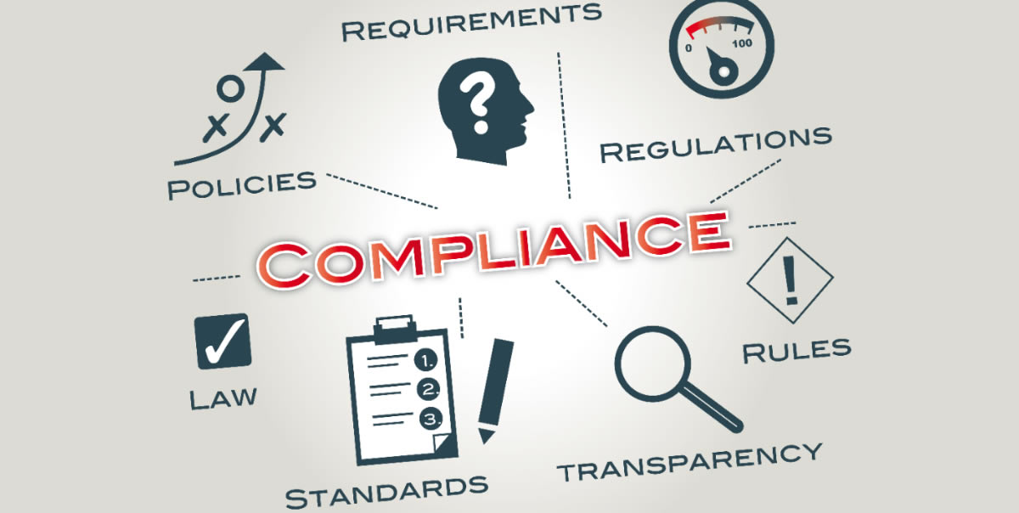
7.3. Enforcement and compliance
Module 7. Challenges in resolving climate change disputes
Key takeaways:
Effectively resolving climate change disputes hinges largely on the ability to enforce agreements and ensure compliance from all parties involved.
Ensuring effective enforcement and compliance with climate change agreements remains a complex challenge. Yet, it is crucial for achieving the collective action needed to address this global problem.
Exploring solutions that combine legal frameworks, trust-building strategies, and domestic accountability mechanisms can help pave the way for a more robust and enforceable global response to climate change.

Slide 24
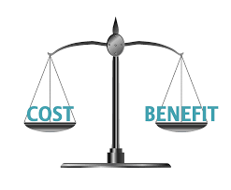
7.4. Economic implications and power dynamics
Module 7. Challenges in resolving climate change disputes
Economic Concerns:
Costs and benefits: Moving to a low-carbon future entails major investments in renewables, infrastructure, and adaptation, with uneven cost distribution raising concerns about national economic competitiveness and sector-specific job losses.
Fairness and burden sharing: Developed nations are expected to contribute more to the transition in developing countries due to their larger historical emissions. Yet, the degree and fairness of this support often cause contention.

Slide 25
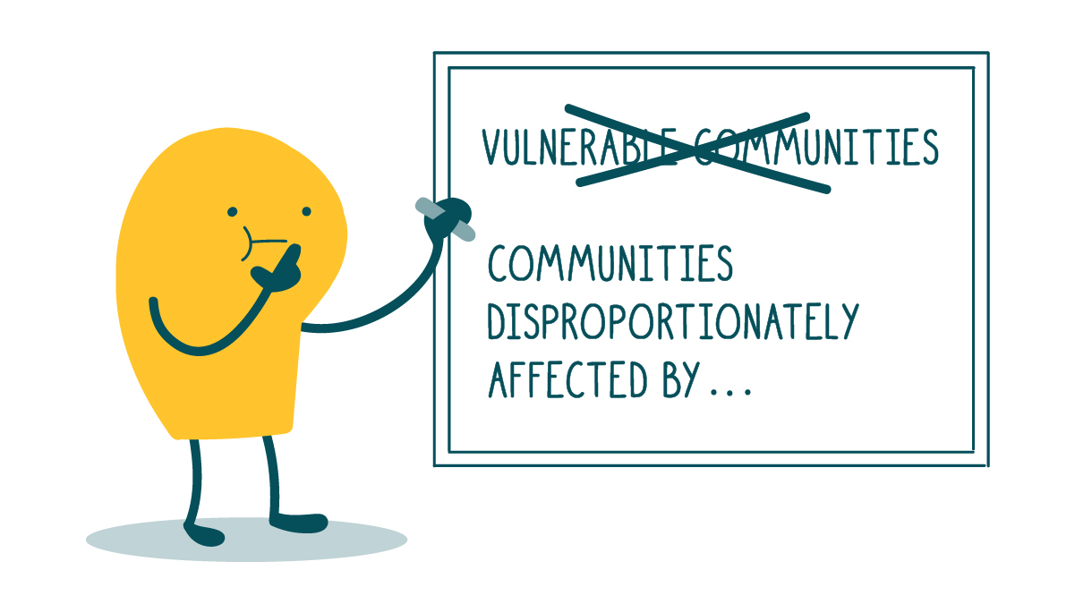
7.4. Economic implications and power dynamics
Module 7. Challenges in resolving climate change disputes
Economic Concerns
Differing vulnerabilities: The economic fallout from climate change hits developing countries and vulnerable populations hardest, often exacerbating existing inequalities. Addressing this imbalance demands deliberate and equitable actions.
Power Dynamics
Influence of powerful industries: Businesses in carbon-intensive sectors may exert political influence to resist or weaken climate action, hindering progress and complicating dispute resolution.

Slide 26
7.4. Economic implications and power dynamics
Module 7. Challenges in resolving climate change disputes
Power Dynamics:
Unequal bargaining power: Developed nations, often with greater economic and technological resources, may hold greater sway in negotiations, potentially pushing for solutions that prioritize their interests or neglecting the specific needs of developing countries.
Access to resources: Unequal access to technology, finance, and legal expertise can disadvantage developing countries in dispute resolution processes, hindering their ability to effectively advocate for their interests.

Slide 27
7.4. Economic implications and power dynamics
Module 7. Challenges in resolving climate change disputes
How these factors impact disputes:
Fueling opposition: Concerns about economic costs and potential job losses can be used strategically to garner opposition to climate action and exacerbate existing power imbalances in negotiations.
Impeding progress: Disputes arising from economic concerns and power dynamics can stall progress on reaching agreements or impede their effective implementation, delaying the urgent transition needed to address climate change.
Undermining trust and cooperation: Power imbalances and perceived unfairness can erode trust and discourage cooperation, hindering collective efforts in resolving disputes and achieving global climate goals.

Slide 28
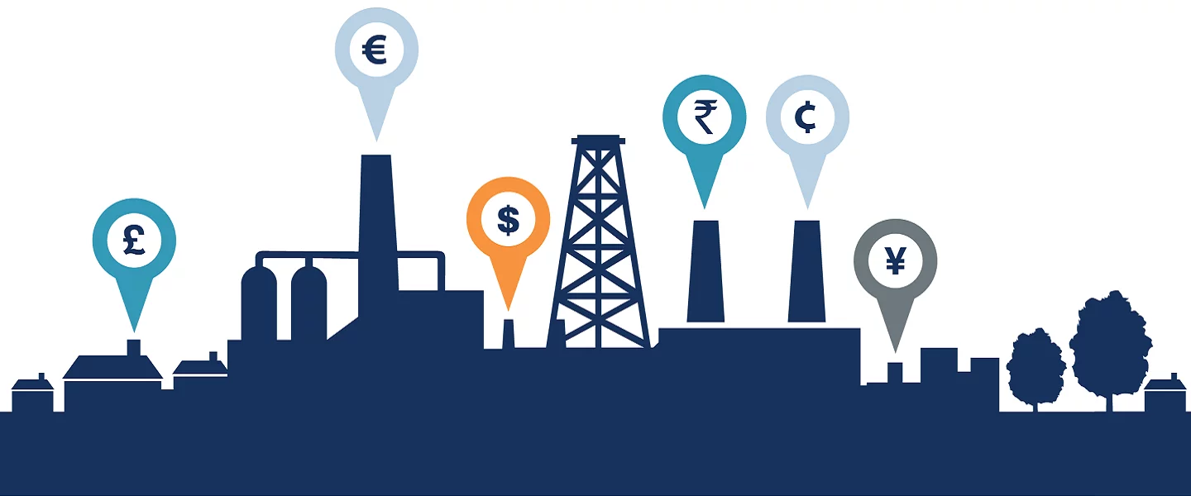
7.4. Economic implications and power dynamics
Module 7. Challenges in resolving climate change disputes
Examples:
Disagreements over carbon pricing: Carbon pricing debates reflect the tension between developed and developing countries, with competitiveness and fairness at the heart of international negotiation challenges and dispute resolutions.
Technology transfer conflicts: Clean technology access is key for developing nations' low-carbon shifts, but intellectual property rights and equitable tech distribution can spark disputes, affecting economic progress and climate action.

Slide 29
7.4. Economic implications and power dynamics
Module 7. Challenges in resolving climate change disputes
Examples
Loss and damage claims:
Developing countries and vulnerable communities, already facing significant economic losses due to climate change, may seek compensation from developed nations.
However, disputes arise around the extent of liability, financial burden sharing, and the effectiveness of existing mechanisms for addressing loss and damage.

Slide 30
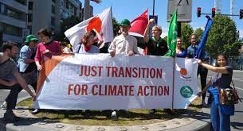
7.4. Economic implications and power dynamics
Module 7. Challenges in resolving climate change disputes
Potential solutions
Just transition strategies: Developing and implementing just transition strategies that address potential job losses and ensure workers are not left behind are crucial for gaining broader support for climate action.
Equity-based approaches: Negotiating agreements that prioritize fairness and address historical responsibility through financial and technological support for developing countries can contribute to more equitable and resilient outcomes.

Slide 31
7.4. Economic implications and power dynamics
Module 7. Challenges in resolving climate change disputes
Potential solutions
Transparency and accountability: Ensuring transparency in decision-making processes, holding powerful actors accountable, and prioritizing the needs of vulnerable communities can foster trust and facilitate more inclusive and equitable solutions.
Strengthening international cooperation: Building stronger international partnerships and collaborative initiatives can help overcome power imbalances and foster collective action towards tackling climate change.

Slide 32
7.4. Economic implications and power dynamics
Module 7. Challenges in resolving climate change disputes
Key takeaways:
When navigating the complexities of climate change disputes, the interplay of economic implications and power dynamics emerges as a substantial challenge.
Resolving climate change disputes effectively requires navigating the complex interplay of economic implications and power dynamics.
By acknowledging these challenges, prioritizing fairness, and fostering international cooperation, we can work towards more equitable and sustainable solutions for a collective future.

Slide 33
7.5. Differing national interests and lack of trust
Module 7. Challenges in resolving climate change disputes
Clashing Priorities and Self-Interest
Economic Development vs. Climate Action: Developing countries may see strict climate measures as hindering economic growth and poverty reduction, while developed countries might endorse bold changes yet hesitate if economic competitiveness is at risk.
Resource Competition: Climate change aggravates conflicts over vital resources like water or the right to use carbon-heavy fuels, often leading nations to prioritize self-interest, which can undermine collective efforts.

Slide 34
7.5. Differing national interests and lack of trust
Module 7. Challenges in resolving climate change disputes
Clashing Priorities and Self-Interest
Historical Responsibility vs. Current Needs: Developed nations bear historical responsibility for the bulk of greenhouse gas emissions. However, rapidly developing nations are now major emitters, leading to arguments about who should shoulder the greater burden of mitigation costs and restrictions.
How Self-Interest Fuels Mistrust
Fear of Exploitation: Nations may fear that agreements will be used to their disadvantage, either economically or politically, hindering commitment and fueling suspicions

Slide 35
7.5. Differing national interests and lack of trust
Module 7. Challenges in resolving climate change disputes
How Self-Interest Fuels Mistrust
Inconsistent Actions: When countries backtrack on pledges or prioritize national interests over agreed-upon targets, it erodes trust and weakens the foundation for future cooperation and dispute resolution.
The "Free Rider" Problem: Nations may be tempted to benefit from collective climate action without taking on proportionate responsibility, expecting others to do the heavy lifting. This breeds resentment and makes agreements less effective.

Slide 36
7.5. Differing national interests and lack of trust
Module 7. Challenges in resolving climate change disputes
Impacts on Dispute Resolution
Negotiation Stalemates: Mistrust hinders good faith negotiations, leading to watered-down agreements or a lack of progress altogether.
Impasse on Implementation: Even with agreements in place, lack of trust prevents nations from believing others will deliver, hindering coordinated action and making dispute resolution more likely.
Shifting Blame: Nations may use disputes to deflect responsibility and focus on the perceived failings of others, rather than seeking collaborative solutions.

Slide 37
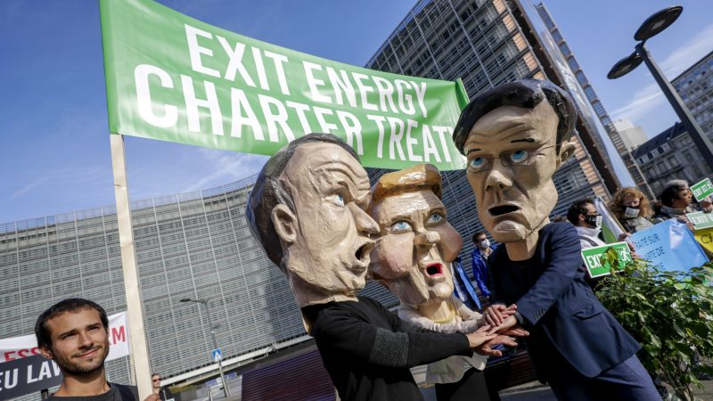
7.5. Differing national interests and lack of trust
Module 7. Challenges in resolving climate change disputes
Examples
Withdrawal from International Agreements: Exits like the US temporarily withdrawing from the Paris Agreement are often a symptom of prioritizing perceived national interests over international cooperation, and deeply erode trust.
Disputes over Technology Transfer: Developed nations may be protective of intellectual property related to clean technology, whereas developing nations demand access for rapid transition. Lack of trust hinders mutually agreeable solutions.

Slide 38
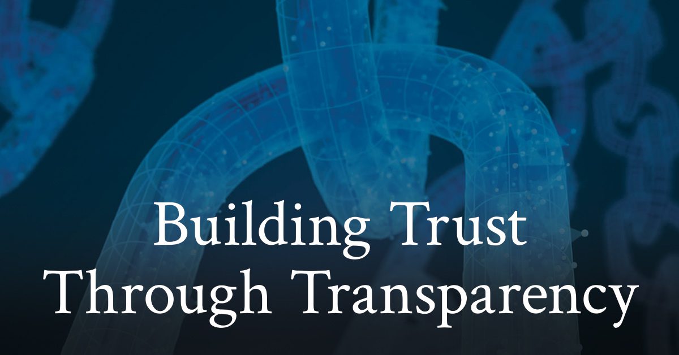
7.5. Differing national interests and lack of trust
Module 7. Challenges in resolving climate change disputes
Ways to Address the Challenge
Building Trust through Transparency: Clear reporting, open dialogue, and demonstrating commitment through actions are vital to rebuilding trust amongst parties.
Emphasis on Equity and Fairness: Agreements must acknowledge historical responsibility and differing capabilities, while finding just ways to distribute the burdens of climate action.

Slide 39
7.5. Differing national interests and lack of trust
Module 7. Challenges in resolving climate change disputes
Ways to Address the Challenge
Benefits-Focused Approach: Highlighting the economic and social co-benefits of climate action (e.g., green jobs, improved public health) can align national interests with global needs.
International Support Mechanisms: Financial aid, technology transfer, and capacity-building initiatives offered in good faith can foster trust and collaboration, especially with vulnerable nations.

Slide 40
7.5. Differing national interests and lack of trust
Module 7. Challenges in resolving climate change disputes
Key takeaways:
Differing national interests and the lack of trust they can foster form a significant barrier when it comes to resolving climate change disputes.
Climate change is a global problem demanding cooperation, but self-preservation instincts often drive nations apart.
Building trust is a slow process, but essential. Without it, dispute resolution becomes an adversarial exercise rather than a collaborative path towards solutions.

