Slide 1
CCP-LAW
Curricula development on Climate Change Policy and Law
Subject title: Topic 3_Climate Change Policy and Regulation
Instructor Name: Filio Petridou_ PEDMEDE
Project No of Reference: 618874-EPP-1-2020-1-VN-EPPKA2-CBHE-JP:
The European Commission's support for the production of this publication does not constitute an endorsement of the contents, which reflect the views only of the authors, and the Commission cannot be held responsible for any use which may be made of the information contained therein.

Slide 2
Contents
1. Overview of climate change policy and regulation……….………………………….
2. The role of the United Nations Framework Convention on Climate Change (UNFCCC) and the Paris Agreement……………………………………………………………………….
3. National policies and regulations governing climate change………………..……..
Reference List………………………………………………………………………………………

Slide 3
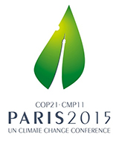
1. Overview of climate change policy and regulation
The term climate ‘framework legislation’ describes an important subset of climate laws that link national and international agendas.
World leaders first expressly recognised that climate change needed to be tackled with institutions, rules and procedures at the Rio Earth Summit in 1992. The United Nations Framework Convention on Climate Change (UNFCCC) was subsequently established, with the primary goal of promoting international action to stabilise greenhouse gas emissions. The convening of the UNFCCC parties has led to several milestones, most notably the 2015 Paris Agreement﻿.
The Agreement covers mitigation, adaptation and financial burden-sharing, and relies on pledges (the so-called Nationally Determined Contributions – NDCs) made by each UNFCCC party to achieve its goal of limiting global warming to well below 2°C, preferably 1.5°C, above pre-industrial levels.

Slide 4
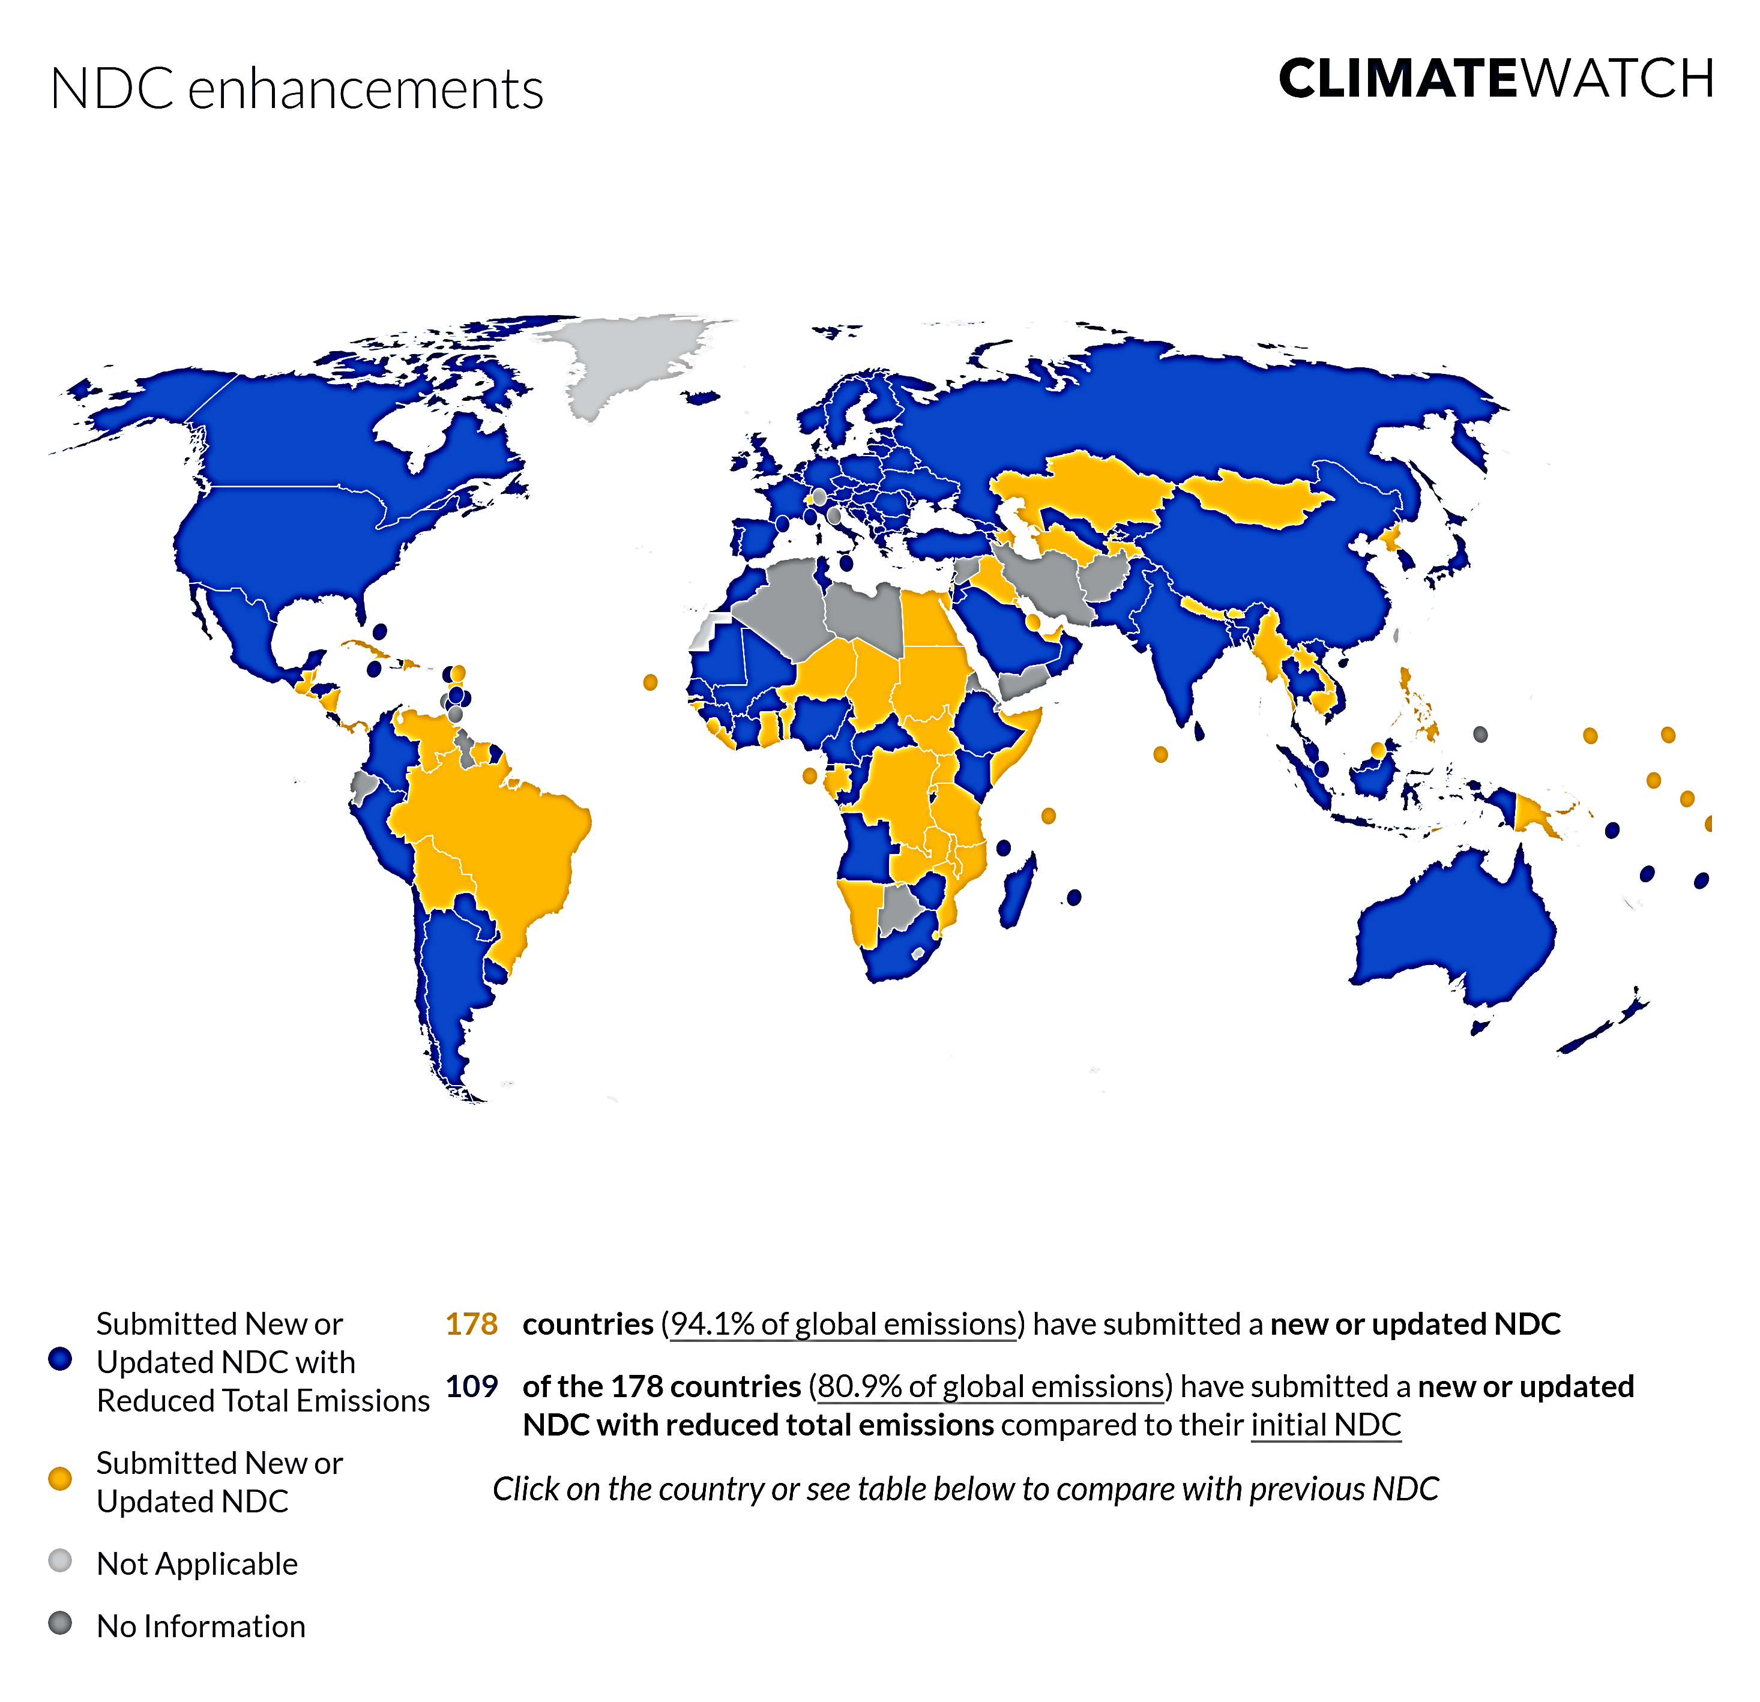
All countries have promised to reduce their greenhouse gas emissions to stop climate change.
Eight years after the 2015 Paris Agreement set ambitious, achievable goals to curb emissions and adapt to global climatic shifts, the world is still on track for unprecedented climate change -- and bureaucratic, political, and financial hurdles have stymied thousands of climate-friendly policies around the world.
Yet governments across the globe have made tangible progress and many climate policies have been successfully implemented.
Climate policies typically try to achieve multiple objectives at once, such as reducing air pollution or building energy security or competitiveness.
Successful climate policymaking often involves finding middle ground, so policies are easier to implement and win support, according to the World Bank 2023 report on Climate Policies with Real-World Results.

Slide 5
Climate-related laws and policies around the world
The Climate Change Laws of the World (CCLW) database﻿ lists and classifies more than 2,860 climate-related laws and policies in force around the world (as of September 2022).
All 193 Parties (192 countries plus the European Union) that have joined the Paris Agreement have at least one law addressing climate change or the transition to a low-carbon economy.
At least 2,203 laws and policies deal with mitigation, 1,338 have an adaptation component, and 424 address disaster risk management.
Most laws and policies focus on energy, transport, economy-wide issues, and land use, land use change and forestry (LULUCF) (see Figure 1).
Recently, there has been growing coverage of social development and the ‘just transition’ to a low-carbon economy, gender and equality, human rights, and food security, with links to climate change.

Slide 6
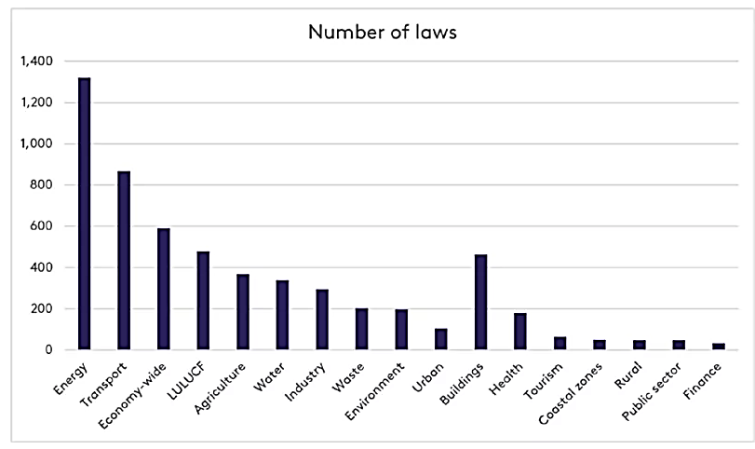
Data source: CCLW database﻿
Worldwide climate-related laws and policies (per economic sector 2022)

Slide 7
Main instruments in climate laws and policies worldwide
To achieve their aims, climate laws rely on the creation of policy ‘instruments’ or ‘tools’ that can be broadly classified under five categories:
Regulations set standards and norms that require actors to adopt certain behaviours and prohibit others. These include obligations to disclose emissions, moratoria and bans on fossil fuel production or use, and spatial planning laws.
Economic incentives aim to shift demand to sustainable solutions. Governments may introduce subsidies or carbon pricing (e.g. Chile﻿), or develop climate finance tools (e.g. EU﻿).
Direct investment by state actors might be made where economic incentives are proving insufficient, and could target, for example, nature-based solutions and ecosystem restoration (e.g. Georgia﻿), or early warning systems for disasters (e.g. Cambodia﻿).
Information tools seek to raise education and awareness of climate change issues, enhance research and development efforts, and increase transparency so that citizens and consumers are aware of the climate impact of specific policies and products.
Governance measures are designed to boost institutions’ ability to deal with climate change. This comprises the granting of new responsibilities to existing bodies, the creation of new institutions, the development of governance plans and strategies, and Monitoring, Reporting and Verification clauses in compliance procedures. Processes involving the cooperation of international actors, subnational levels of government and citizens are also key to a wide range of climate measures (Koehl A, 2022).

Slide 8
Regulatory Instruments
Regulatory approaches include non-tradable permits, technology and emissions standards, product bans, and government investment.
Voluntary Agreements
Voluntary agreements are generally made between a government agency and one or more private parties to “achieve environmental objectives or to improve environmental performance beyond compliance.”
The Kyoto Protocol
The Kyoto Protocol came into force on February 16, 2005, and established mandatory, enforceable targets for GHG emissions. Initial emissions reductions for participating countries ranged from –8% to +10% of 1990 levels, while the overall reduction goal was 5% below the 1990 level by 2012. The Protocol was amended for a second commitment period; the new overall reduction goal is 18% below 1990 levels by 2020.
The Paris Agreement
In December of 2015, all Parties of the UNFCCC reached a climate change mitigation and adaptation agreement, called The Paris Agreement, in order to keep the global temperature increase (from pre-industrial levels) below 2°C. The Paris Agreement entered into force on November 4, 2016. As of May 2023, The Paris Agreement had 198 signatories, 195 of which have ratified the agreement.
Market-Based Instruments
Market-based approaches include carbon taxes, subsidies, and cap-and-trade programs.
In a tradable carbon permit system, permits equal to an allowed level of emissions are distributed or auctioned. Parties with emissions below their allowance may sell their excess permits to other parties that have exceeded their emissions allowance. Market-based instruments are recognized for their potential to reduce emissions by allowing for flexibility and ingenuity in the private sector.
Data source: Center for Sustainable Systems, 2023

Slide 9
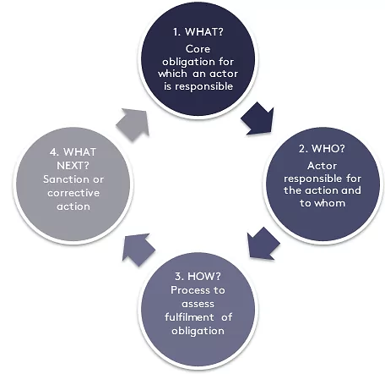
Framework climate laws and accountability
Framework climate laws share some or all of the following characteristics:
they set out the strategic direction for national climate change policy;
are passed by the legislative branch of government;
contain national, long-term and/or medium targets and/or pathways for change;
set out institutional arrangements for climate governance at the national level;
are multi-sectoral in scope;
and involve mechanisms for transparency and/or accountability.
The four accountability elements can be identified by the following questions:
What obligations are created? What are actors required to do?
Who is accountable to whom? Does the law specify who is responsible for fulfilling obligations and to whom that responsibility is owed?
How is compliance assessed? Does the law specify the process for determining compliance?
What happens in the case of non-compliance? Does the law specify what happens? What are the penalties for failing to meet obligations or processes for correction? (Higham et al. 2021)

Slide 10
"Reality Check: Lessons from 25 Case Studies Advancing a Low-Carbon Future"
World Bank Report 2023

Slide 11
2. The role of the United Nations Framework Convention on Climate Change (UNFCCC) and the Paris Agreement
The ultimate objective of the Convention is to stabilize greenhouse gas concentrations "at a level that would prevent dangerous anthropogenic (human induced) interference with the climate system."
It states that "such a level should be achieved within a time-frame sufficient to allow ecosystems to adapt naturally to climate change, to ensure that food production is not threatened, and to enable economic development to proceed in a sustainable manner.“
The UNFCCC entered into force on 21 March 1994. Today, it has near-universal membership.

Slide 12
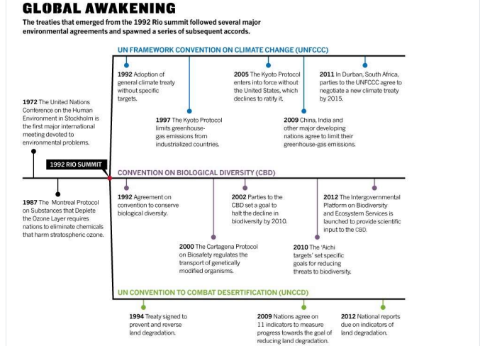
Source: TNPSC 2024

Slide 13
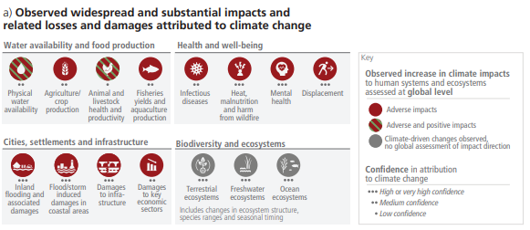
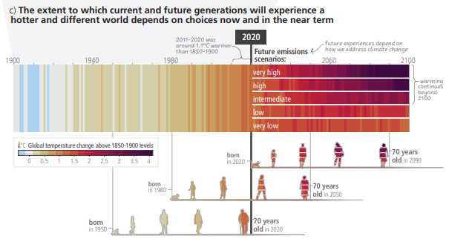
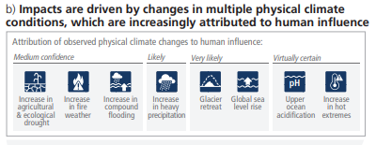
Intergovernmental Panel on Climate Change (IPCC)
IPCC is the United Nations body for assessing the science related to climate change. According to 2023 IPCC Report:

Slide 14
Global Stocktake
“The global stocktake is a critical turning point when it comes to efforts to address climate change – it’s a moment to take a long, hard look at the state of our planet and chart a better course for the future.”
Decision 19/CMA.1 notes that the global stocktake “will be a Party-driven process conducted in a transparent manner and with the participation of non-Party stakeholders” (para. 10), it enables countries and other stakeholders to see where they’re collectively making progress toward meeting the goals of the Paris Agreement – and where they’re not. It’s like taking inventory. It means looking at everything related to where the world stands on climate action and support, identifying the gaps, and working together to agree on solutions pathways (to 2030 and beyond).
The first-ever global stocktake is set to conclude at the UN Climate Change Conference (COP28) at the end of this year. The global stocktake is a process for countries and stakeholders to see where they’re collectively making progress towards meeting the goals of the Paris Climate Change Agreement – and where they’re not. Governments will take a decision on the global stocktake at COP28, which can be leveraged to accelerate ambition in their next round of climate action plans due in 2025 (United Nations Framework Convention on Climate Change, 2024).

Slide 15
The Kyoto Protocol
The Kyoto Protocol was adopted on 11 December 1997. Owing to a complex ratification process, it entered into force on 16 February 2005. Currently, there are 192 Parties to the Kyoto Protocol.
In short, the Kyoto Protocol operationalizes the United Nations Framework Convention on Climate Change by committing industrialized countries and economies in transition to limit and reduce greenhouse gases (GHG) emissions in accordance with agreed individual targets. The Convention itself only asks those countries to adopt policies and measures on mitigation and to report periodically.
The Kyoto Protocol is based on the principles and provisions of the Convention and follows its annex-based structure. It only binds developed countries, and places a heavier burden on them under the principle of “common but differentiated responsibility and respective capabilities”, because it recognizes that they are largely responsible for the current high levels of GHG emissions in the atmosphere.
In its Annex B, the Kyoto Protocol sets binding emission reduction targets for 37 industrialized countries and economies in transition and the European Union. Overall, these targets add up to an average 5 per cent emission reduction compared to 1990 levels over the five year period 2008–2012 (the first commitment period).

Slide 16
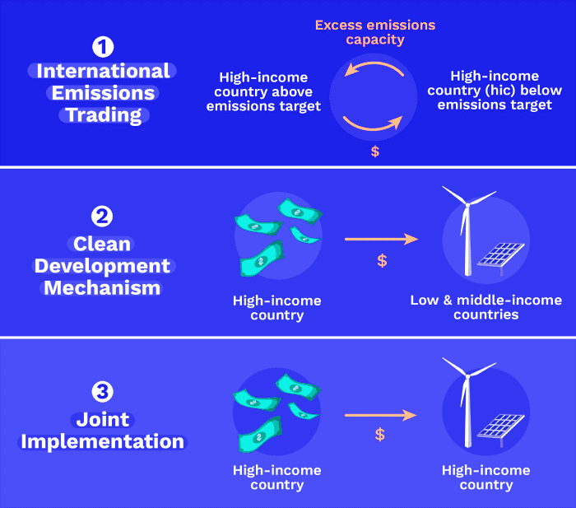
One important element of the Kyoto Protocol was the establishment of flexible market mechanisms, which are based on the trade of emissions permits. Under the Protocol, countries must meet their targets primarily through national measures. However, the Protocol also offers them an additional means to meet their targets by way of three market-based mechanisms:
International Emissions Trading is a system where parties that have exceeded their emission reduction commitments under the Kyoto Protocol may sell excess “assigned amount units” (AAUs).
Clean Development Mechanism (CDM)
The CFM allows emission-reduction projects in developing countries to earn certified reduction (CER) credits, each equivalent to one tonne of CO2. These CERs can be traded and sold and used by idnustrializes countries to meet a part of their emission reduction tarets under the Kyoto Protokol
Joint implementation (JI)
Allows a country with an emission reduction or limitation commitment under the Kyoto Protocol to earn emission reduction units (ERUs) from an emission-reduction or emission removal project in another Party, each equivalent to one tonne of CO2, which can be counted towards meeting its Kyoto target.
Joint implementation offers Parties a flexible and cost-efficient means of fulfilling a part of their Kyoto commitments, while the host Party benefits from foreign investment and technology transfer.
Source: TNPSC 2024

Slide 17
The Paris Agreement
At the UN Climate Conference in Paris, the Paris Agreement (L’Accord de Paris) was adopted as the successor to the Kyoto Protocol, which was in force until 2020. Unlike the Kyoto framework, the agreement does not differentiate between industrial countries and developing countries, so for the first time there are common principles that apply to all signatories.
The agreement for the reduction of greenhouse gas emissions is legally binding and came into existence as part of the United Nations Framework Convention on Climate Change (UNFCCC). In October 2016, a key threshold was met: a minimum of 55 states, collectively responsible for at least 55 per cent of global greenhouse gas emissions, ratified the treaty. This meant the agreement could come into force.

Slide 18
The Paris Agreement
The Paris Agreement coined the term “net zero”. The agreement stipulates that the global net greenhouse gas emissions should fall to zero in the second half of the century. For the first time, the signatories agreed a specific target to limit global warming, preferably to 1.5°C and significantly below 2°C, compared to the pre-industrial age.
To achieve this, all countries that have ratified the agreement set their own reduction targets (Nationally Determined Contributions, NDCs). The climate protection efforts are to be revised and strengthened every five years, whereby the goals must reflect the highest possible ambition of each country. The reduction target for each nation should correspond with its changing climate responsibility and capacity for action. In addition to the reduction of greenhouse gas emissions, the Paris Agreement also deals with improving capabilities for adapting to a changing climate. The treaty also emphasises that private and government funding should be directed towards development that produces minimal greenhouse gas emissions.
In Paris it was also established that signatories, states and other stakeholders may collaborate with one another in order to achieve their climate targets. Mechanisms for collaboration under Article 6 form the legal basis for market-based climate protection, but specific implementation regulations were not adopted until the Climate Change Conference in Glasgow in 2021.

Slide 19
Nationally Determined Contributions
In the run-up to the COP21, parties to the UNFCCC conceived Intended Nationally Determined Contributions (INDCs) as a means for countries to communicate the steps they will take to address climate change. NDCs reflected the level of ambition by each country in reducing emissions, taking into account its national circumstances and capabilities. NDCs summarise how governments plan to meet their commitments made under the UNFCCC.
However, alone they are not enough to ensure that domestic action will take place: in most cases NDCs are not legally binding, so countries failing to abide by their pledges cannot be obliged to change tack. Further, they usually offer an overview of intended actions, but they are not granular enough to provide details on how efforts to meet targets will be implemented in practice. Furthermore, they do not necessarily represent the intentions of key stakeholders such as citizens, the private sector and non-governmental political bodies, who are frequently not consulted on their content.

Slide 20
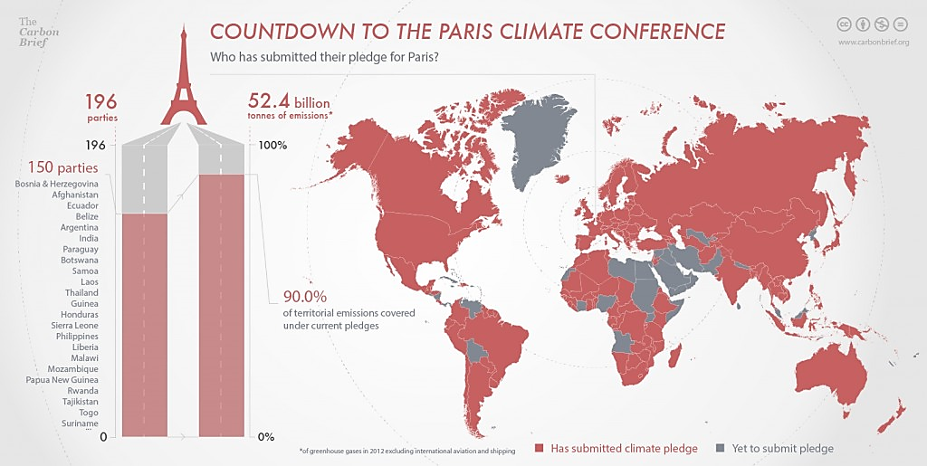
NDC’s use standardized information that includes:
A reference point (i.e, the base year from which emissions will be reduced)
Time frame
Scope and coverage
Methodological approach towards calculating emissions
How the contribution is fair and ambitious
How it contributes towards achieving the objective of the UN’s climate convention
The binding nature of national legislation, coupled with the political accountability that tends to underscore decisions made by executive branches of government, make climate laws and policies well-placed to fill these gaps in countries’ NDCs.
Data source: https://www.carbonbrief.org/explainer-what-are-intended-nationally-determined-contributions/, Access 03.2023

Slide 21
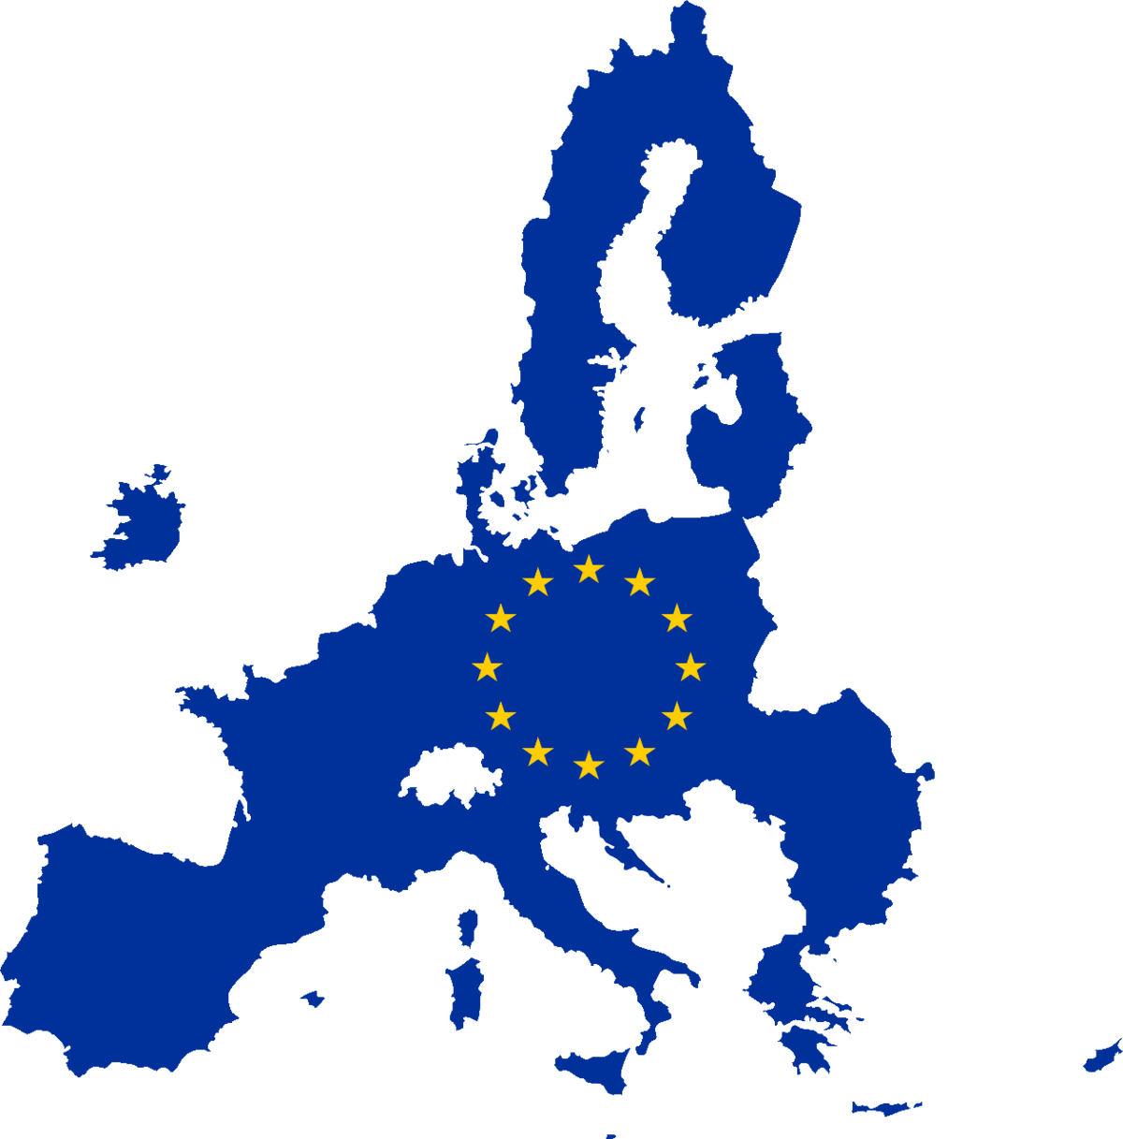
3. National policies and regulations governing climate change
Europe
The European Climate Law writes into law the goal set out in the European Green Deal for Europe’s economy and society to become climate-neutral by 2050. The law also sets the intermediate target of reducing net greenhouse gas emissions by at least 55% by 2030, compared to 1990 levels.
Climate neutrality by 2050 means achieving net zero greenhouse gas emissions for EU countries as a whole, mainly by cutting emissions, investing in green technologies and protecting the natural environment.
The law aims to ensure that all EU policies contribute to this goal and that all sectors of the economy and society play their part.

Slide 22
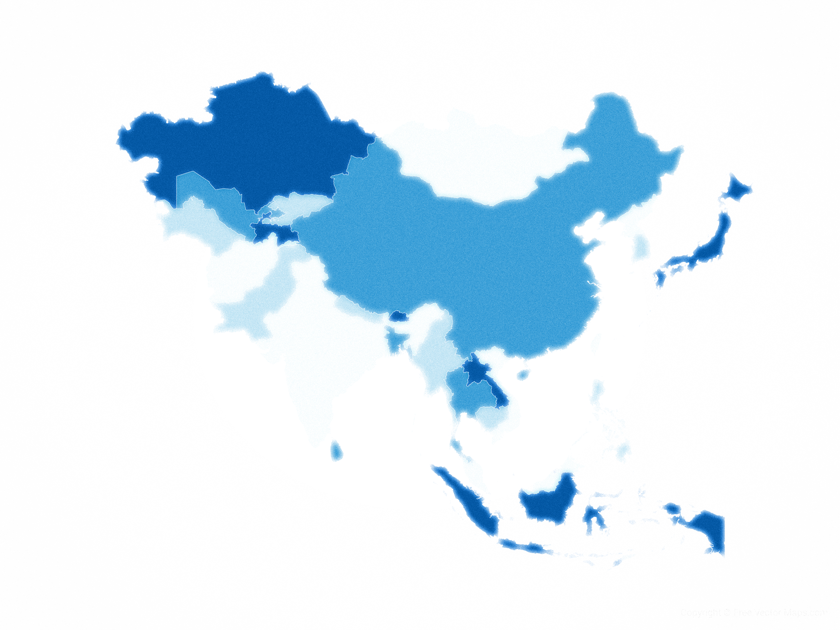
ASIA
Gaps in laws and policies on adaptation persist in Asia and the Pacific, an undesirable state for a climate-vulnerable region. Five of the 10 countries most affected by climate change globally in 2018 were in Asia and the Pacific.
Domestic law and policy frameworks in Asia and the Pacific tend to focus on early warning systems for disasters. However, few laws and policies work to enhance or require the construction of resilient infrastructure, which mitigates the loss of life and property during disasters.
Policies and laws regulating energy infrastructure also lack adaptation components. These gaps in adaptation law and policy reflect international trend. Globally, legal frameworks still lack incentives for investment in the physical and social infrastructure needed for climate change adaptation.
Image source: Free Vectors Maps

Slide 23
GREECE
The National Climate Law, adopted in 2022 (Law 4936/2022/17.5.2022), stipulates, inter alia, a reduction in greenhouse gas emissions by 55% by 2030 and by 80% by 2040, compared to 1990, with the ultimate goal of climate neutrality by 2050.
The National Energy and Climate Plan (NECP) provides a detailed roadmap for achieving specific Energy and Climate Targets by the year 2030. The NECP presents and analyzes Policy Priorities and Measures across a wide range of developmental and economic activities for the benefit of Greek society. The revised National Plan for Energy and Climate (NECP), aligned with the new national and European climate targets, is expected to be ratified within 2023.
Image source: Free Vectors Maps

Slide 24
The National Climate Law, adopted in May 2022, sets a clear direction for Greece's energy transition. It aims to cut greenhouse gas emissions by 55% by 2030 and achieve net zero emissions by 2050. Greece has already achieved a very significant reduction in the share of electricity generation based on lignite, or brown coal, from 60% in 2005 to 10% in 2021. The Climate Law requires to a complete phase-out of lignite-fired generation by 2028.
Greek National Adaptation Strategy, 2016
Paris Agreement NDC, 2020
National Climate Law 2022

Slide 25
INDIA
India has shown strong support for climate action, adopting climate adaptation and awareness strategies early.
Instead of developing binding climate legislation, India has taken a policy‑based approach to tackle climate change. In 2006, India released its National Environment Policy, which guides action on sustainability.
The policy articulates key elements of India’s climate response. For example, it notes the principle of common but differentiated responsibilities; recognizes the need for climate change adaptation; and identifies India’s vulnerabilities to climate change and the impact on agriculture, health, the coasts, forests, and water resources.
Critically, the policy encourages Indian industries to take part in the CDM of the Kyoto Protocol, to which India had no binding emissions targets as a non-Annex I country.
Image source: Free Vectors Maps

Slide 26
In 2008, India issued its most crucial executive policy on climate change: the National Action Plan on Climate Change (NAPCC). The NAPCC provides a framework and guiding principles for sectors creating low-carbon growth strategies. It focused on improving climate change understanding and initiating action on mitigation, energy efficiency, adaptation, and conservation of natural resources while simultaneously promoting economic growth.
It set a target of 5% renewable energy in the national grid by 2010 and aimed to increase the share of renewable energy by 1% annually to reach a 15% share of the grid by 2020.
The NAPCC’s eight strategic missions concern solar, enhanced energy efficiency, sustainable habitat, water, sustaining Himalayan ecosystems, Green India, sustainable agriculture, and strategic knowledge. After the NAPCC was released, states were asked to prepare action plans. All Indian states have completed or are preparing their own State Action Plans on Climate Change.
The Constitution of 1949
Twelfth 5year Plan (2012-2017), 2013
Paris Agreement NDC 2016
Source: Asian Development Bank 2020

Slide 27
MALAYSIA
Malaysia has undertaken mitigation measures for Climate change mitigation and adaptation that remain a priority, alongside poverty eradication and development.
As part of the Paris Agreement, Malaysia’s NDC set a target for reducing GHG emissions by 45% by 2030, compared with 2005 emissions intensity of the gross domestic product (GDP).
Although this includes an unconditional reduction by 35%, the remaining 10% in emissions reduction is conditional upon receiving financing, technology, and capacity building assistance from developed countries.
Malaysia also intends to reduce flood risks, prioritize water and food security, protect coastlines, and address climate-related public health issues like increased vector-borne diseases.
Image source: Free Vectors Maps

Slide 28
Malaysia launched the National Policy on Climate Change to mainstream and organize its various activities on climate change.
This policy articulates 5 principles, 10 strategic thrusts or policy goals, and 43 key actions, all centered on climate change mitigation, adaptation, and capacity building.
The National Green Technology and Climate Change Council and Malaysian Green Technology Corporation (GreenTech Malaysia) provide institutional support for the policy.
GreenTech Malaysia promotes and coordinates programs that help realize the country’s potential for green technology.
The Federal Constitution of Malaysia and Constitution (Amendment) Act 1963
Eleventh Malaysia Plan (2016-2020), 2016
Paris Agreement NDC 2020
Source: Asian Development Bank 2020

Slide 29
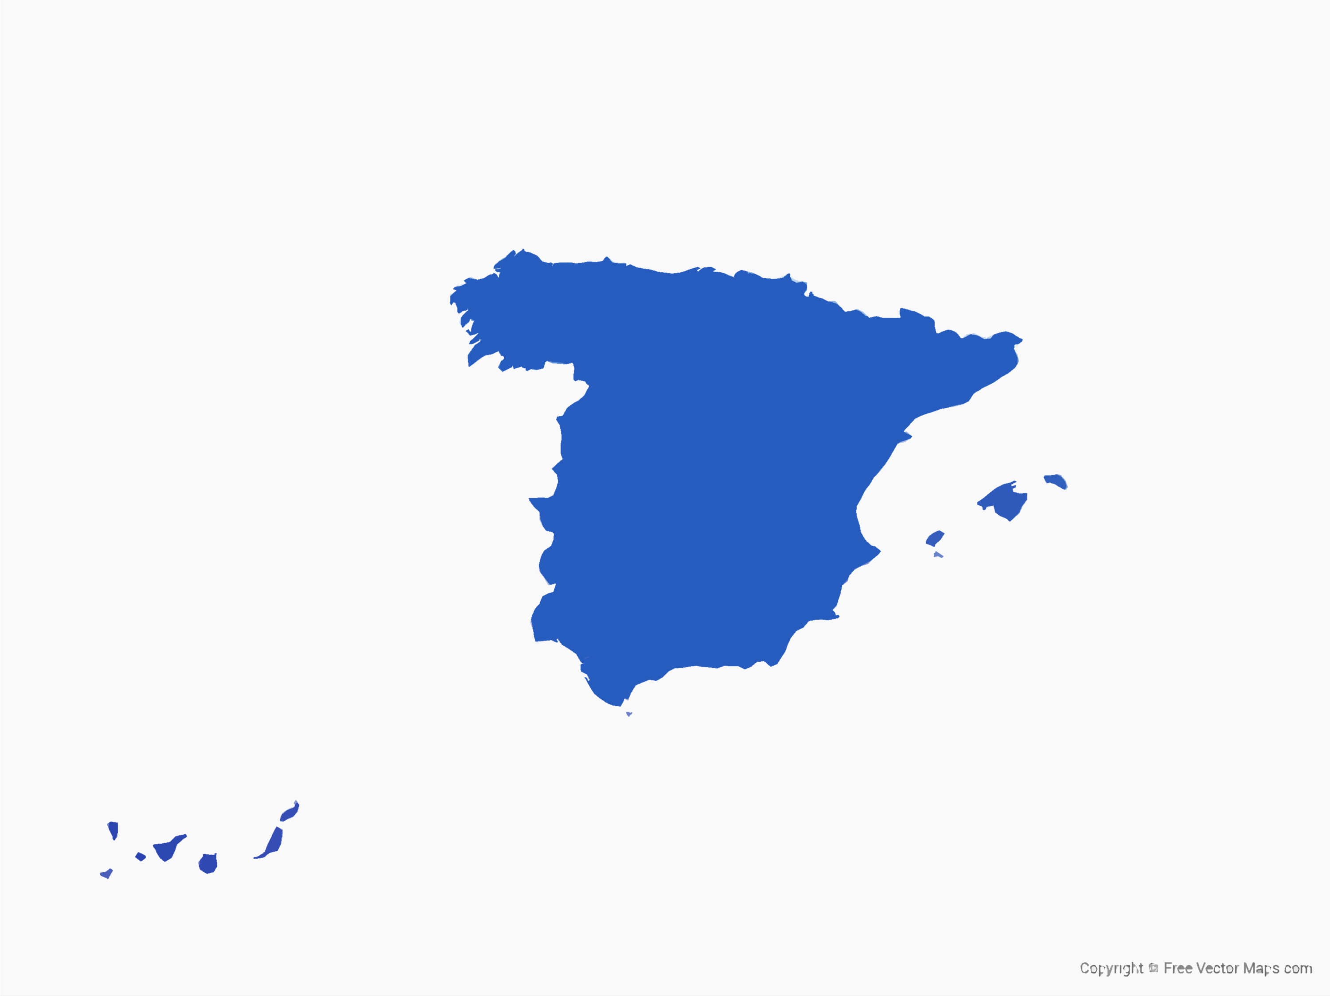
SPAIN
The Climate Change and Energy Transition Law entered into force on May 20th 2021. This law enshrines into Spanish normative the target of reaching climate neutrality by 2050 at the latest.
The long-term objective is the decarbonization of the economy by 2050 with a 100% renewable electricity system. It sets goals by 2030 of reducing greenhouse gas emissions by at least 23% with respect to 1990, achieve 42% renewables in final energy consumption and 74% renewable electricity generation, and improving energy efficiency by reducing primary energy consumption by at least 39.5%. These goals will be reviewed upward periodically starting in 2023.
No new exploration authorisations will be allocated for hydrocarbon research permits or exploitation concessions. Renewable gases, including biogas, biomethane, hydrogen and other renewable fuels will be encouraged. By 2040, new passengers cars and light commercial vehicles must be emissions free.
Municipalities with more than 50,000 inhabitants and island territories will have to implement a sustainable urban mobility plan by 2023, and introduce mitigation measures.
Image source: Free Vectors Maps

Slide 30
In December 2020, Spain adopted its National Integrated Energy and Climate Plan (ENCP) 2021 – 2030. The long-term goal of the plan is to make Spain carbon neutral by 2050, to achieve a 90% reduction in GHG emissions from 1990 levels by 2050, and to base the electricity system exclusively on renewable sources of generation.
The ambitious National Plan for Adaptation to Climate Change for the period 2021 – 2030 was also approved in 2020. This plan establishes strategic objectives and defines an assessment system as well as indicators for impact and adaptation to climate change.
Spanish Constitution 1978
Paris Agreement NDC 2020
Climate Change and Energy Transition Law 2021

Slide 31
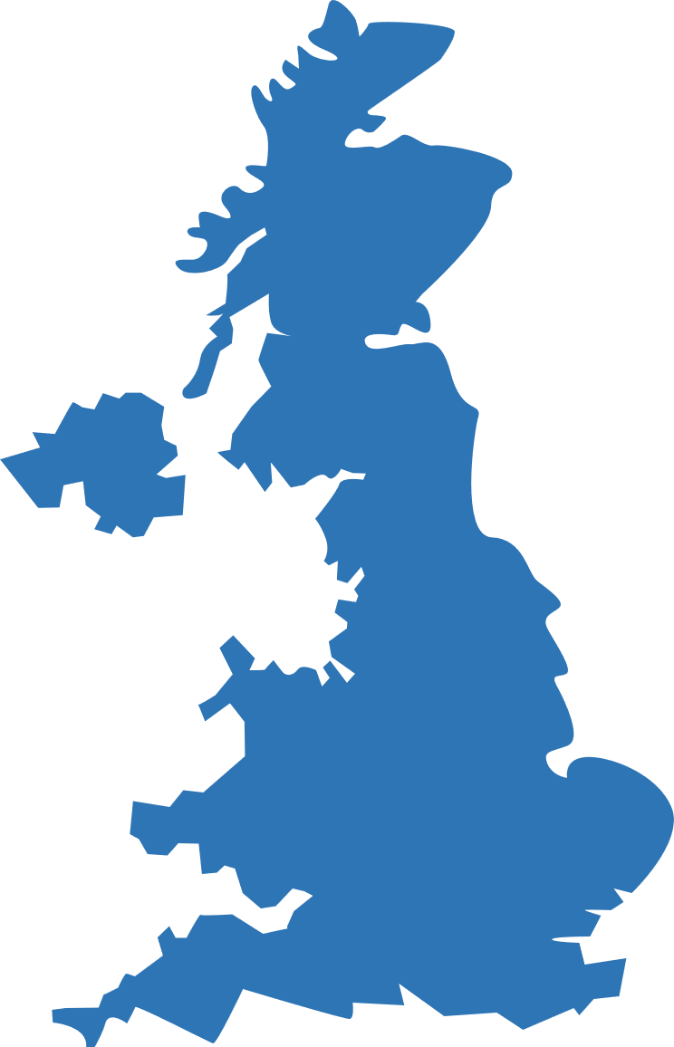
UK
The 2008 Climate Change Act, which was the first law of its kind in the world, formed the policy base for cutting emissions and preparing for the impact of climate change. It set a long-term goal to reach net zero emissions by 2050, and obliged government to achieve interim 5-year carbon budgets.
In its NDC, updated in September 2022, the UK commits to reducing economy-wide GHG emissions by at least 68 % by 2030, using a mix of sectoral as well as cross-cutting actions. It will implement a range of targeted strategies, such as reforming the energy system and decarbonising industry, transport, and housing and heating.
In April 2018, the UK submitted to the UNFCCC its first long-term strategy, the clean growth strategy, followed in October 2021 by the UK net zero strategy with decarbonisation pathways to net zero emissions by 2050. In July 2022, the English High Court ruled that the net zero strategy fails to comply with the obligations of the Climate Change Act because it lacks detail on emissions savings for individual measures.

Slide 32
UK
The Climate Action Tracker rates UK climate policy as 'almost sufficient', praising some elements, such as the domestic emissions reduction targets, to be world-leading, while deeming its contributions to global climate finance inadequate.
The Climate Change Performance Index ranked the UK seventh in the world, with high ratings in GHG emissions, energy use, and climate policy. At the same time, it underlined the country's lack of energy efficiency policy and high environmental footprint in the heating sector.
Climate-focused corporate governance continues to be a key focus for businesses. There is no single piece of legislation or regulation in the UK that addresses environment, social and governance (ESG). The main sources include:
Climate Change Act 2008
UK Corporate Governance Code 2018
Paris Agreement NDC (updated) 2022
Companies Act 2006

Slide 33
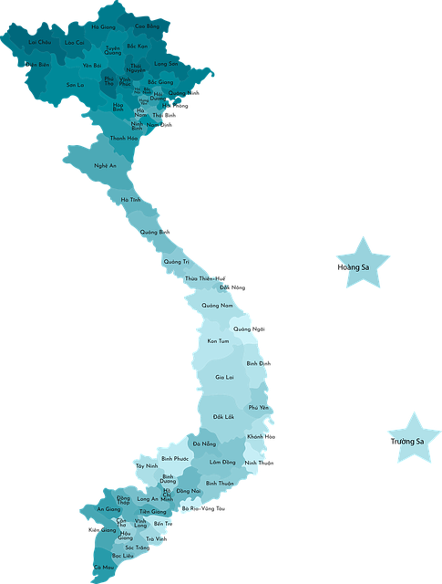
VIETNAM
Viet Nam has issued more climate change policies than most other countries in Asia and the Pacific. Most of these policies were formally launched through a prime ministerial decision.
The government’s climate change efforts focus on developing a low-carbon economy; mitigating emissions in the energy, industry, transport, agriculture, and waste sectors; and adapting the most vulnerable areas, namely agriculture, natural ecosystems, biodiversity, water resources, public health, and infrastructure.
Viet Nam’s first nationally determined contribution (NDC) pledges an unconditional 8% reduction in GHG emissions by 2030. However, the government aims to reduce GHG emissions by 25% by 2030 subject to receiving international support.

Slide 34
Reductions in emission intensity per unit of GDP also have unconditional and conditional targets—20% by 2030 compared with 2010 levels (unconditional) and 30% compared with 2010 levels, conditional upon receiving financial support. Viet Nam also intends to increase forest cover to 45%. The NDC aims to integrate disaster risk management and climate change adaptation into 90% of socioeconomic development plans by 2030.
The NDC includes a range of targets related to social development: (i) reduce the national poverty rate by 2% each year, (ii) provide 100% of the population with access to health care, and (iii) ensure that 90% of city dwellers and 80% of rural inhabitants have access to clean water by 2030.
The Constitution of the Socialist Republic of Viet Nam, 2013
The 5year Socio-economic Development Plan 2013
Paris Agreement First NDC 2016 (updated in 2020)
Source: Asian Development Bank 2020

Slide 35
Reference List
Barsalou O, and Picard M, International Environmental Law in an Era of Globalized Waste, Chinese Journal of International Law, 17(3), 887-906, 2018.
Center for Sustainable Systems, Climate Change: Policy and Mitigation Factsheet, University of Michigan, Pub. No. CSS05-20, 2023.
Chaudhary K, and Vrat P, Overview and Critical Analysis of National Law on Electronic Waste Management, Environmental Policy and Law, 47(5-6), 181-188, 2017.
Higham C, Averchenkova A, Setzer J and Koehl A, Accountability Mechanisms in Climate Change Framework Laws. London: Grantham Research Institute on Climate Change and the Environment and Centre for Climate Change Economics and Policy, London School of Economics and Political Science, 2021.
Koehl A, What is climate change legislation? Grantham Research Institute on Climate Change and the Environment and Centre for Climate Change Economics and Policy, London School of Economics and Political Science, 2022, Access March 2024.
IPCC, Summary for Policymakers. In: Climate Change 2023: Synthesis Report. Contribution of Working Groups I, II and III to the Sixth Assessment Report of the Intergovernmental Panel on Climate Change [Core Writing Team, H. Lee and J. Romero (eds.)]. IPCC, Geneva, Switzerland, pp. 1-34, 2023.
Aidun H, Adler D, Eales B. et al. Climate change, coming soon to a court near you: National climate change legal frameworks in Asia and the Pacific, Asian Development Bank Report 3, 2020.

