Slide 1
CCP-LAW
Curricula development on Climate Change Policy and Law
Subject title: EU Climate Change Policies to mitigate negative effects of climate change
Instructor Name: PROF. ABHINAV SHRIVASTAVA & PROF. RAJ VARMA
Project No of Reference: 618874-EPP-1-2020-1-VN-EPPKA2-CBHE-JP:
The European Commission's support for the production of this publication does not constitute an endorsement of the contents, which reflect the views only of the authors, and the Commission cannot be held responsible for any use which may be made of the information contained therein.

Slide 2
INTRODUCTION
The European Union (EU) has taken a leading role in addressing the global challenge of climate change. Through comprehensive policies and ambitious targets, the EU aims to transition to a sustainable, lowcarbon economy and mitigate the negative impacts of global warming.

Slide 3
Reducing Greenhouse Gas Emissions
1. Set ambitious targets to cut carbon emissions across key sectors like energy, transportation,
and industry.
2. Promote renewable energy sources like solar, wind, and hydropower to replace fossil fuels.
3. Improve energy efficiency in buildings, factories, and appliances to reduce overall energy
demand.
4. Support the development and adoption of low-emission technologies such as electric
vehicles and carbon capture systems.
5. Implement carbon pricing mechanisms like emissions trading schemes to incentivize
emissions reductions.

Slide 4
Promoting Renewable Energy
The EU is accelerating the transition to renewable energy sources to
reduce greenhouse gas emissions and combat climate change. This
includes ambitious targets for solar, wind, hydroelectric, and other
clean power generation to supply a growing share of the region's
energy needs.
Key initiatives focus on expanding renewable infrastructure,
supporting research and innovation, and creating incentives for
businesses and households to adopt renewable technologies.

Slide 5
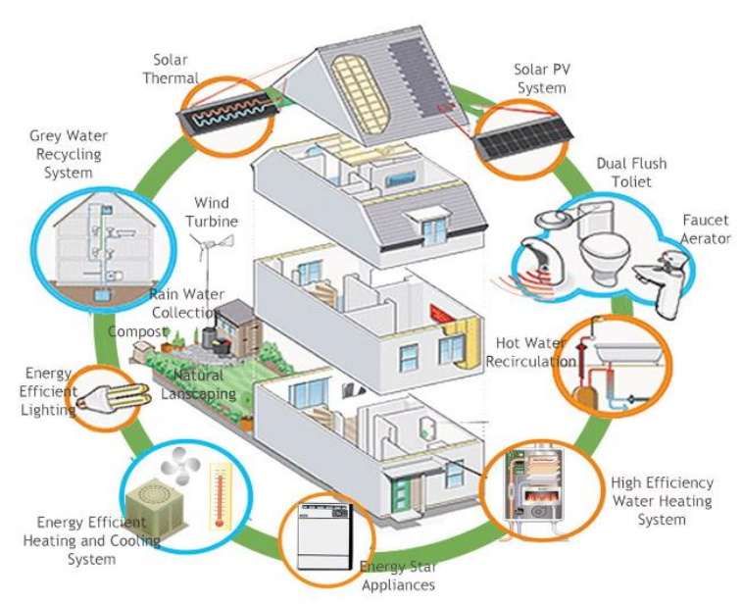
Improving Energy Efficiency
The EU is driving efforts to improve energy efficiency across various sectors, including buildings, industry, and transportation. This involves promoting the use of energy-efficient technologies, optimizing processes, and transitioning to smart energy management systems. By reducing energy waste and consumption, the EU aims to lower greenhouse gas emissions, alleviate energy costs for consumers and businesses, and enhance the continent's energy security.

Slide 6
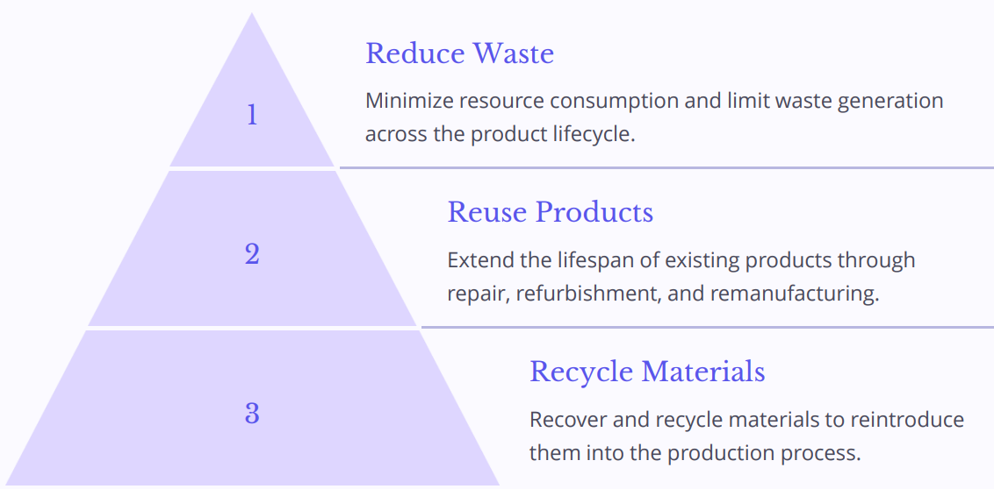
Transitioning to a Circular Economy
The transition to a circular economy is a fundamental shift away from the traditional linear "take-make-waste" model. By prioritizing reduce, reuse, and recycle, the EU is working to keep resources in use for as long as possible, extract maximum value from them, and recover and regenerate products and materials at the end of each service life.

Slide 7
Sustainable Transportation Initiatives
Electrification
Promoting the adoption of electric vehicles through incentives, charging infrastructure, and emissions regulations.
Public Transport
Investing in efficient, affordable, and accessible public transportation systems, including buses, trains, and metro networks.
Active Mobility
Encouraging walking, cycling, and other forms of active transportation through improved infrastructure, bike-sharing programs, and pedestrian-friendly urban design.
Intermodal Connectivity
Enabling seamless integration between different modes of transport, such as linking rail stations with bike-sharing and ride-hailing services.

Slide 8
Protecting and Restoring Ecosystems
Protecting Biodiversity
The EU is committed to safeguarding endangered species and habitats, preserving the rich biodiversity that underpins the health of our ecosystems.
Restoring Degraded Ecosystems
Major initiatives are underway to revitalize wetlands, forests, and other natural environments damaged by human activity, helping to regenerate vital ecological functions.
Promoting Sustainable Land Use
The EU encourages sustainable forestry, agriculture, and urban planning practices that preserve the integrity of ecosystems and the vital services they provide.
Engaging Citizens in Conservation
Citizens are empowered to participate in local conservation efforts, from tree-planting to habitat restoration, fostering a sense of stewardship over the natural world

Slide 9
Adaptation Strategies for Climate Change
Enhancing Infrastructure Resilience
Redesigning buildings, transportation systems, and utilities to withstand extreme weather events and adapt to changing climate conditions.
Improving Early Warning Systems
Deploying advanced monitoring and forecasting technologies to provide timely alerts for communities at risk of climate-related disasters.
Implementing Ecosystem-Based Adaptation
Leveraging the natural protective functions of forests, wetlands, and other ecosystems to enhance community resilience.

Slide 10
Financing the Green Transition
1. Mobilizing Investments The EU has established innovative financing mechanisms to mobilize public and private investments for climate action and the transition to clean energy.
2. Just Transition Fund This fund supports workers and communities affected by the shift away from fossil fuels, ensuring a fair and inclusive transition.
3. Carbon Pricing The EU Emissions Trading System (EU ETS) puts a price on carbon, creating incentives for businesses to reduce emissions and invest in green technologies.
4. Blended Finance The EU leverages public funding to derisk and attract private investment for sustainable infrastructure and clean energy projects.

Slide 11
Engaging Citizens and Businesses
The EU has launched initiatives to engage citizens and businesses in the fight against climate change. These include public awareness campaigns, community-based projects, and incentives for green investments. By empowering individuals and organizations, the EU aims to create a bottomup movement towards sustainability. By fostering a sense of shared responsibility, the EU aims to mobilize all parts of society to contribute to the transition to a low-carbon, resilient future.

Slide 12
International Cooperation on Climate Action
1. Shared Responsibilities: Countries collaborate to reduce emissions
2. Technology Transfer: Developed nations support clean tech adoption
3. Climate Finance: Funding for mitigation and adaptation in developing countries
The EU recognizes that combating climate change requires global cooperation. It engages in multilateral agreements to establish shared responsibilities, facilitate technology transfer, and mobilize climate finance to support developing nations in their transition to a low-carbon future.

Slide 13
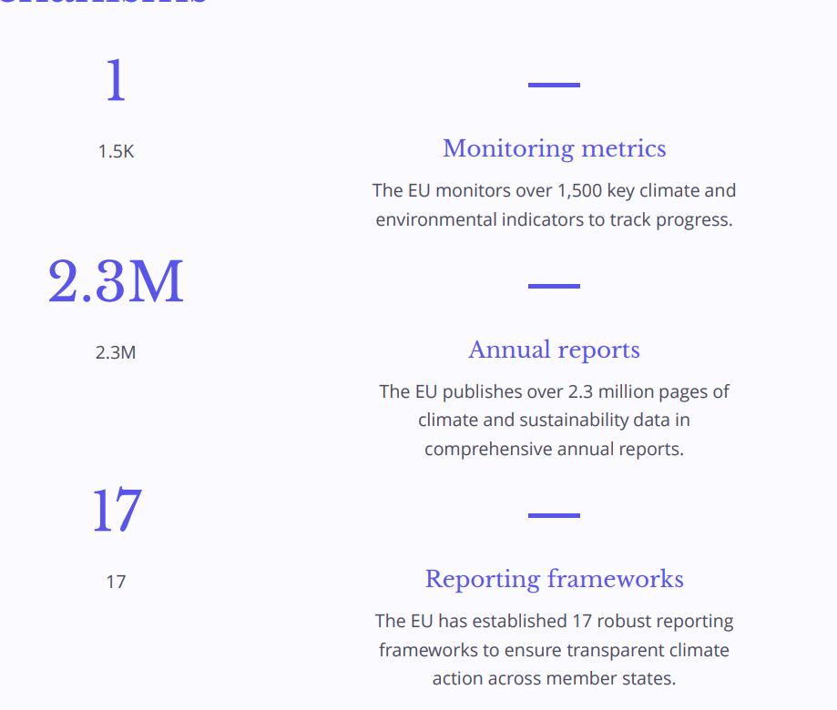
Monitoring and Reporting Mechanisms

Slide 14
Promoting Climate-Smart Agriculture
Sustainable Farming Practices
The EU encourages farmers to adopt climate-smart agricultural techniques, such as conservation tillage, cover cropping, and precision farming. These practices help reduce greenhouse gas emissions and improve soil health.
Boosting Resilience
EU policies support the development of drought-resistant crop varieties and livestock breeds that can better withstand the impacts of climate change. This strengthens the resilience of agricultural systems.
Agroforestry Initiatives
The EU promotes agroforestry, which integrates the cultivation of trees and shrubs with traditional crop and livestock production. This approach can enhance carbon sequestration, biodiversity, and ecosystem services.
Reducing Food Waste
Policies encourage food waste reduction across the supply chain, from production to consumption, to cut down on the greenhouse gas emissions associated with wasted food.

Slide 15
Investing in Clean Energy Research and Innovation
1. Funding Breakthrough Technologies
The EU invests heavily in research and development of innovative clean energy solutions, from advanced solar panels to next-generation biofuels, to drive the transition to a carbon-neutral economy.
2. Accelerating Commercialization
EU initiatives help promising clean tech startups and companies scale up their operations, bridging the gap between laboratory breakthroughs and market-ready products and services.
3. Fostering Collaboration
Cross-border research collaborations and knowledge-sharing platforms bring together universities, businesses, and government agencies to tackle climate challenges through innovative solutions.

Slide 16
Addressing Climate-Related Risks and Disasters
Disaster Preparedness
Developing early warning systems and emergency response plans to minimize the impact of extreme weather events like floods, droughts, and storms.
Risk Assessments
Conducting comprehensive risk assessments to identify vulnerable populations and infrastructure, enabling targeted adaptation strategies.
Resilient Infrastructure
Investing in climate-resilient infrastructure like flood barriers, reinforced buildings, and sustainable water management systems.
Insurance Schemes
Promoting affordable and accessible insurance programs to help communities recover from climate-related disasters and minimize economic losses.

Slide 17
Integrating Climate Policies Across Sectors
The EU recognizes that effective climate action requires a holistic, cross-sectoral approach. By integrating climate considerations into policymaking across diverse domains, such as energy, transportation, agriculture, and urban planning, the EU aims to drive systemic change and ensure the alignment of all policies with its ambitious climate goals. This integrated approach allows the EU to harness synergies, address trade-offs, and maximize the co-benefits of climate action. For example, policies that promote renewable energy can also support job creation, improve air quality, and enhance energy security - all while reducing greenhouse gas emissions.

Slide 18
Empowering Local and Regional Authorities
The EU empowers local and regional governments to take climate action by providing funding, policy guidance, and technical support. This enables cities, towns, and regions to develop and implement their own innovative solutions tailored to local needs and conditions

Slide 19
Ensuring a Just Transition for Affected Communities
As the EU transitions to a sustainable, low-carbon economy, it is crucial to ensure that the process is equitable and inclusive. This means supporting workers and communities that may be disproportionately impacted by the shift, providing retraining, job placement assistance, and social safety nets. A just transition requires close collaboration with local stakeholders, labor unions, and civil society to understand the unique needs of affected regions and develop tailored solutions. Delivering on this commitment is essential for a fair and socially-conscious green transformation.

Slide 20
Enhancing Climate Diplomacy and Negotiations
Global Partnerships
Strengthening international cooperation and diplomacy to address climate change through multilateral agreements and coordinated actions.
Negotiation Strategies
Developing effective negotiation tactics and compromise solutions to advance ambitious climate goals and secure commitments from all parties.
Policy Alignment
Aligning domestic climate policies with international frameworks to ensure coherence and facilitate progress on shared objectives.
Climate Finance
Mobilizing and distributing climate finance to support mitigation and adaptation efforts in developing countries.

Slide 21
Mainstreaming Climate Considerations in Policymaking
Integrating Climate Goals
The EU is working to embed climate action at the core of policymaking across all sectors, from energy and transport to agriculture and trade.
Climate Governance
Climate policies are overseen by dedicated EU bodies and Climate Commissioners to ensure coherent, ambitious, and effective climate action.
Climate Risk Analysis
Robust climate risk assessments inform policymaking, helping the EU prepare for and mitigate the impacts of climate change.
Stakeholder Engagement
The EU actively engages citizens, businesses, and other stakeholders in developing and implementing climate policies through consultations.

Slide 22
Conclusion and Next Steps
Reaffirm the EU's unwavering commitment to ambitious climate action and the goals of the Paris Agreement.
Emphasize the need to accelerate the transition to a climate-neutral and resilient economy through bold, decisive policies and innovative solutions.
Encourage continued collaboration between the EU, member states, local authorities, businesses, and citizens to drive the green transition and create a sustainable future.

