Slide 1
Ecological Footprint

Slide 2
Introduction
Ecological footprint is a measure of human demand on nature's resources, including land, water, and energy, required to support a particular lifestyle or activity
Components of calculating an ecological footprint include: consumption patterns, production methods, and waste generation contribute to the ecological footprint
It is an important concept for helping us understand and reduce our environmental impacts, so as to achieve sustainability and mitigate climate change

Slide 3
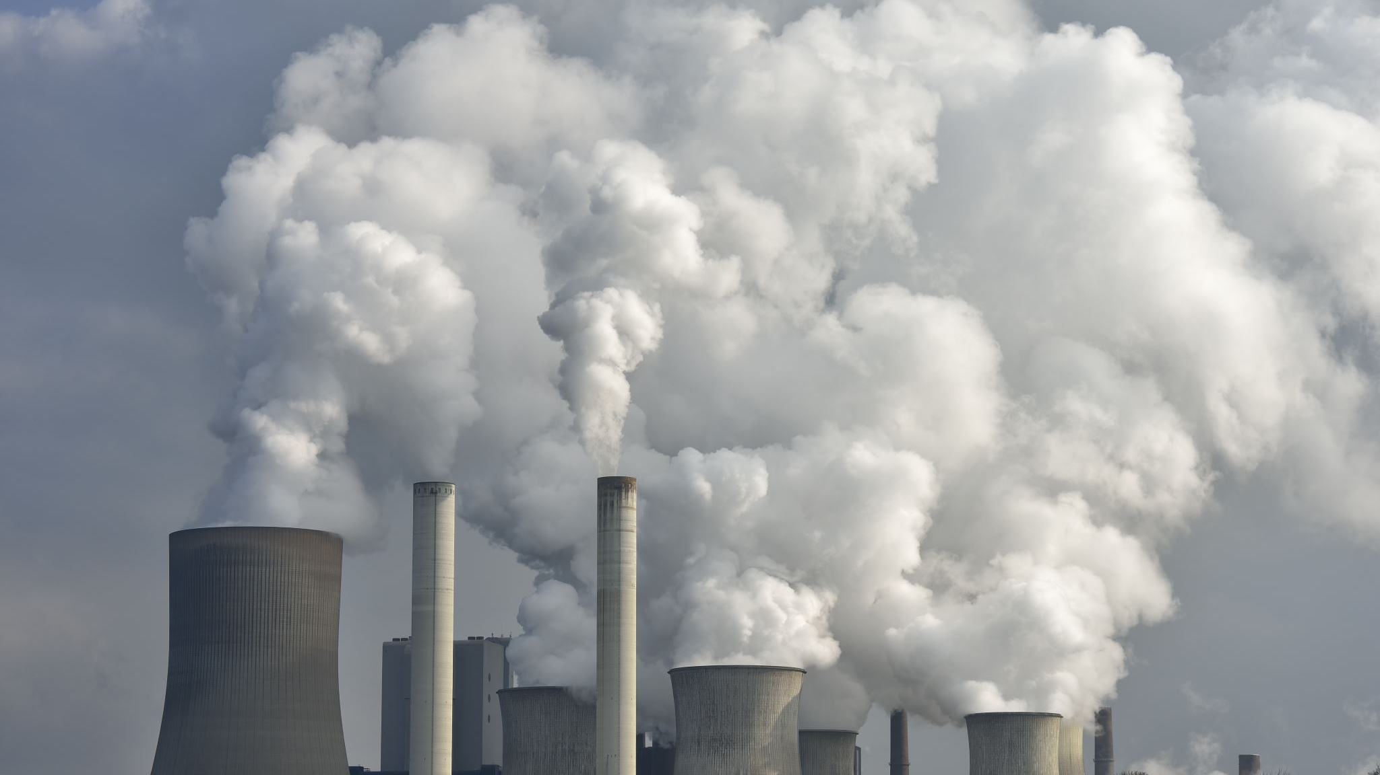
Understanding Ecological Footprint
Ecological footprint measures the amount of biologically productive land and water a population requires to produce the resources it consumes and to absorb its waste, using prevailing technology and resource management practices
Key Components
Consumption: Resources used
Waste: Emissions and pollutants produced
Biocapacity: Earth's capacity to regenerate renewable resources and absorb waste
Importance
Provides a comprehensive measure of human impact on the environment
Helps in assessing sustainability and identifying areas for improvement
Offers insights into resource management and ecological balance
Units: Typically measured in global hectares per capita or total global hectares required to support a given population

Slide 5
Factors Affecting Ecological Footprint #1
Consumption Patterns
Type and quantity of goods and services consumed
Lifestyle choices
Economic factors influencing consumer behaviour

Slide 6
Factors Affecting Ecological Footprint #2
Technological Advancements
Efficiency of resource use
Adoption of renewable energy sources
Sustainable practices in agriculture, industry, and waste management

Slide 7
Factors Affecting Ecological Footprint #3
Population Growth
More people mean greater demand for resources
Urbanization and its impact on resource consumption
Demographic trends affecting consumption patterns

Slide 8
Factors Affecting Ecological Footprint #4
Ecological Efficiency
Ability of ecosystems to regenerate and absorb waste
Preservation of biodiversity and ecosystem services
Impact of human activities on natural habitats

Slide 9
Factors Affecting Ecological Footprint #5
Take time to read Ahmed et al (2020) for a perspective on what increases and decreases it in G7 countries

Slide 10
Calculate your ecological footprint
You will do this by using one of the global standard products: https://www.footprintcalculator.org/home/en
Important definition: Overshoot day
Earth Overshoot Day is the point in the year when human consumption outstrips the resources nature can regenerate
Tasks:
Work through the interface and calculate your own footprint, with as much detail as you can, and not down the various outputs you get
You will present back to the group, your personal footprint and personal Overshoot day, with a critique of how yours compares with other’s

Slide 11
Compare the ecological footprints of different countries
A lot of data is available at the https://www.footprintcalculator.org/ for all countries
Tasks:
Choose three countries and explore all the data available, making sure you look at trends over time. Data to consider and compare should include
Biocapacity per person
Ecological Footprint per person
Biocapacity deficit or reserve
Ecological Footprint vs Biocapacity
Ecological Footprint vs Biocapacity
Ecological Footprint
2. Present your comparison back to the group, attempting to rationalise the differences

Slide 13
Ecological Footprint and Sustainability
Sustainability Goals aim to:
Reduce the ecological footprint to within Earth's biocapacity
Ensure equitable distribution of resources globally
Preserve biodiversity and ecosystem health
And of course: to reduce the ecological footprint to within Earth's biocapacity
Key reading: Syrovátka (2020)

Slide 14
Ecological Footprint and Sustainability
How to reduce our footprint:
Transitioning to renewable energy sources
Promoting sustainable agriculture and land use practices
Implementing circular economy principles to reduce waste

Slide 15
Ecological Footprint and Sustainability
Policy Interventions
Environmental regulations and incentives
International agreements to address global challenges
Investment in research and development for sustainable technologies

Slide 16
Ecological Footprint and Sustainability
Individual and Collective Actions
Educating and raising awareness about ecological footprint
Encouraging responsible consumption and lifestyle choices
Engaging in advocacy and community initiatives for sustainability

Slide 17
Future Outlook and Challenges
Emerging Trends
Increasing awareness and concern about environmental issues
Technological innovations driving sustainability efforts
Shifting consumer preferences towards eco-friendly products and services

Slide 18
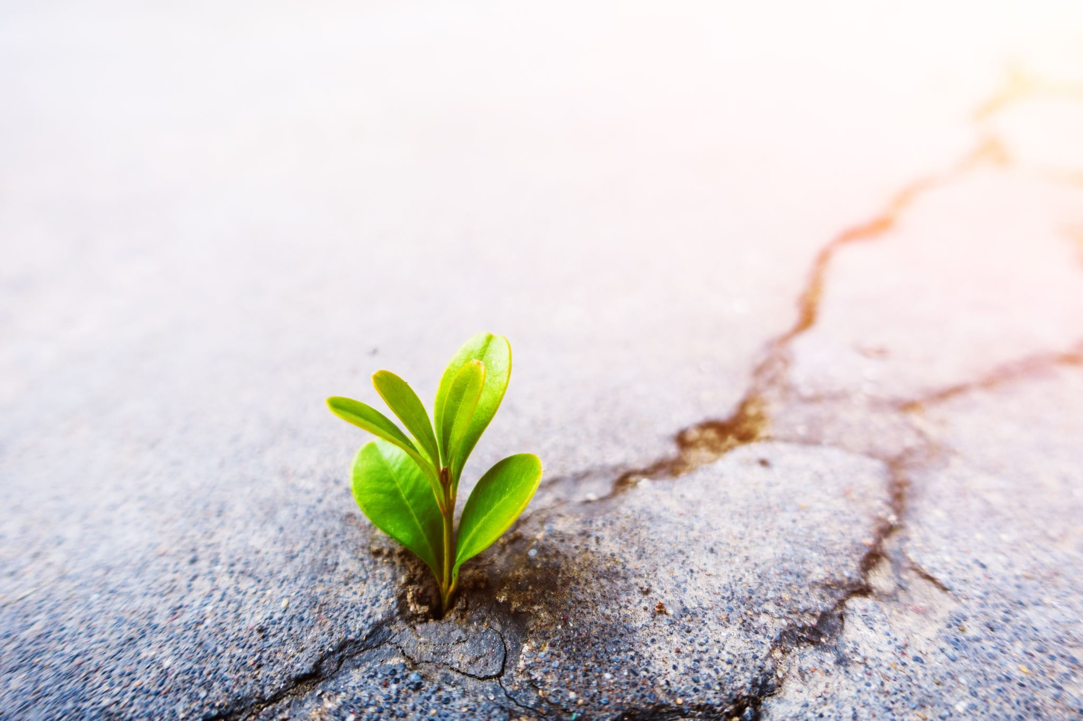
Future Outlook and Challenges
Persistent Challenges
Economic growth vs. environmental conservation dilemma
Disparities in resource consumption and access
Addressing systemic barriers to sustainable development

Slide 19
Future Outlook and Challenges
Collaborative Solutions
Multi-stakeholder partnerships for sustainable development
Integrating environmental considerations into policymaking and business strategies
Empowering local communities and indigenous peoples in conservation efforts

Slide 20
Future Outlook and Challenges
Call to Action
Urgent need for collective action at all levels
Embracing a holistic approach to sustainability
Every individual and organization has a role to play in reducing ecological footprint and preserving the planet for future generations

