Slide 1
CCP-LAW
Curricula development on Climate Change Policy and Law
Subject title: Climate Justice
Instructor Name: Dr. Shashikala Gurpur, Dr. Sujata Arya
Project No of Reference: 618874-EPP-1-2020-1-VN-EPPKA2-CBHE-JP:
The European Commission's support for the production of this publication does not constitute an endorsement of the contents, which reflect the views only of the authors, and the Commission cannot be held responsible for any use which may be made of the information contained therein.

Slide 2
Climate Change and Human Rights
Perspectives of Climate Justice
Climate change refers to the long-term alteration of temperature and typical weather patterns in a specific region or globally. It is primarily driven by human activities, particularly the emission of greenhouse gases such as carbon dioxide and methane, which trap heat in the Earth's atmosphere. This leads to a range of effects, including rising temperatures, changes in precipitation patterns, more frequent and severe extreme weather events like storms, floods, and droughts, as well as shifts in ecosystems and habitats. Climate change is recognized as one of the most pressing global challenges of our time, with far-reaching impacts on the environment, economy, and society.

Slide 3
Climate Change and Human Rights
Perspectives of Climate Justice
Human rights are fundamental rights and freedoms inherent to all human beings, regardless of nationality, ethnicity, religion, gender, or other characteristics. These rights are enshrined in international human rights instruments such as the Universal Declaration of Human Rights (UDHR) and encompass civil, political, economic, social, and cultural rights. Examples of human rights include the right to life, liberty, and security of person; the right to freedom of speech and expression; the right to education; the right to work and fair wages; and the right to a standard of living adequate for health and well-being. Human rights provide the moral and legal foundation for dignity, equality, and justice, serving as a cornerstone of democratic societies and international cooperation.

Slide 4
Importance to understand Relation between Climate Change and Human Rights
Perspectives of Climate Justice
Recognition of Inherent Linkages: Understanding the relationship between climate change and human rights is imperative as it acknowledges the inherent linkages between environmental degradation and social justice issues.
Disproportionate Impact on Vulnerable Communities: Climate change exacerbates existing inequalities, disproportionately affecting marginalized and disadvantaged communities who often lack resources and infrastructure to adapt.
Threat to Fundamental Human Rights: The consequences of climate change pose a significant threat to fundamental human rights, including the right to life, health, food, water, housing, and self-determination.
Holistic and Equitable Solutions: Recognizing this relationship facilitates the development of holistic and equitable solutions that address both environmental sustainability and social justice concerns simultaneously.
.

Slide 5
Importance to understand Relation between Climate Change and Human Rights
Perspectives of Climate Justice
Inclusive Decision-making Processes: Integrating human rights considerations into climate action strategies ensures inclusive decision-making processes that prioritize the needs and rights of all individuals, particularly those most affected by climate change.
Responsive Policy Frameworks: By understanding the interplay between climate change and human rights, policymakers can craft responsive policy frameworks that mitigate vulnerabilities and enhance resilience in communities.
Promotion of Environmental Justice: Understanding the relationship underscores the importance of promoting environmental justice and ensuring that responses to climate change uphold principles of fairness, equity, and inclusivity.
Long-term Sustainability: Addressing both climate change and human rights in tandem is essential for building a more resilient, equitable, and sustainable future for present and future generations. It fosters a holistic approach to sustainable development that integrates environmental, social, and economic dimensions

Slide 6
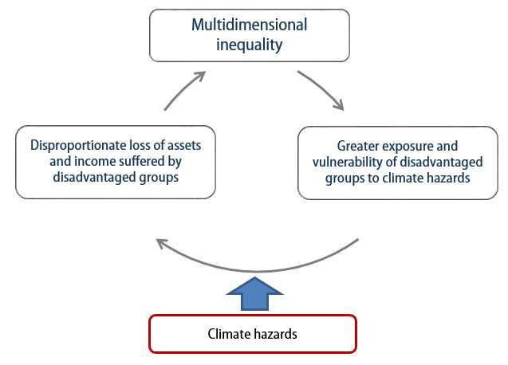
Inequality and climate change vicious cycle
Perspective of Climate Justice
Climate Change and Social Inequality S. Nazrul Islam and John Winkel (2017) DESA Working Paper No. 152

Slide 7
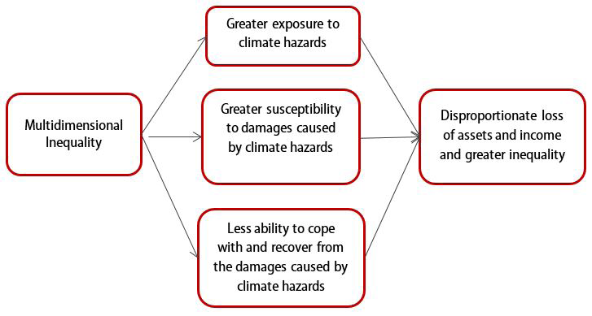
The effects of inequality on disadvantaged groups
Perspective of Climate Justice
Climate Change and Social Inequality S. Nazrul Islam and John Winkel (2017) DESA Working Paper No. 152

Slide 8
Call to Action: Building a Sustainable and Just Future
Perespective of Climate Justice
Prioritize Human Rights: It's time to prioritize human rights, environmental sustainability, and social justice in all climate action efforts. Every decision and policy must consider the well-being and rights of all individuals, particularly those most vulnerable to the impacts of climate change.
Advocate for Policies: Government bodies need to urge individuals and organizations to advocate for policies that address the intertwined challenges of climate change and human rights. Support initiatives that promote equity, justice, and resilience in the face of environmental threats.
Collaborate for Change: Various organisations shoulf collaborate across sectors and borders to build a more equitable and resilient world. By working together, we can amplify our impact and create meaningful change for current and future generations.

Slide 9
Climate Change and Trade
Perspective of Climate Justice
Climate change is affecting prospects for trade and economic development around the world. Extreme weather can disrupt supply chains, damage the transport infrastructure necessary for trade in goods, and restrict people’s ability to travel. Changing climatic conditions and the policies introduced to address them are shifting the patterns of comparative advantage, creating risks for countries that rely on climate-vulnerable sectors but also new economic opportunities for countries with plentiful renewable energy sources such as wind, sunlight and minerals critical to the manufacture of clean infrastructure.

Slide 10
Climate Change and Trade
Perspective of Climate Justice
Maritime transport is particularly exposed to climate-related risks. Sea level rise represents a direct threat to the operation of ports, while changes in precipitation affect the viability of critical shipping hubs and passages. For example, the Panama Canal – which handles around 6% of global maritime commerce﻿ – directly depends on the availability of freshwater for its operation and is therefore highly vulnerable to changes in precipitation patterns and drought. The Canal authority has had to impose restrictions on the﻿ largest ships passing through because of falling water levels in nearby lakes. Low rainfall and heat-related evaporation have caused﻿ similar shipping disruptions in China’s Yangtze river. Both small island states and landlocked countries and regions are particularly vulnerable to this type of disruption given their reliance on a limited number of trade routes.

Slide 11
Climate Change and Trade
Perspective of Climate Justice
Maritime transport is particularly exposed to climate-related risks. Sea level rise represents a direct threat to the operation of ports, while changes in precipitation affect the viability of critical shipping hubs and passages. For example, the Panama Canal – which handles around 6% of global maritime commerce﻿ – directly depends on the availability of freshwater for its operation and is therefore highly vulnerable to changes in precipitation patterns and drought. The Canal authority has had to impose restrictions on the﻿ largest ships passing through because of falling water levels in nearby lakes. Low rainfall and heat-related evaporation have caused﻿ similar shipping disruptions in China’s Yangtze river. Both small island states and landlocked countries and regions are particularly vulnerable to this type of disruption given their reliance on a limited number of trade routes.

Slide 12
Climate Change and Agriculture
Perspective of Climate Justice
Changes in temperature, resulting in heatwaves and degraded land, and changes in precipitation levels, causing water stress and drought, can all damage agricultural output and drive up food prices. Heat stress also affects agricultural workers﻿, impacting productivity. These factors affect the trade of food products and manufacturing sectors, such as food processing, that are dependent on climate-sensitive agricultural inputs. Developing economies in sub-Saharan Africa and South Asia are particularly vulnerable to this kind of damage, as they are heavily dependent on agricultural exports and large proportions of their populations are employed in the sector. Concerns about food insecurity exacerbated by climate change can cause countries to restrict crop exports in times of stress: for example, in May 2022 India, a major wheat producer, banned exports﻿ of the cereal on the grounds of protecting national food security during a heatwave.
Ocean warming and acidification associated with climate change are also negatively impacting fisheries, in turn affecting trade in ocean products and food security. This harms the livelihoods of rural, small-scale fishers﻿ and those involved in food supply chains in particular.

Slide 13
Climate Change and Manufacturing
Perspective of Climate Justice
As well as the disruption to manufacturing supply chains via problems caused to transport and agricultural inputs, temperature increases can result in productivity losses and the number of hours worked by exposing workers to heat exhaustion and causing equipment to malfunction, creating shortages in production and further damaging supply chains. High temperatures can also make trade more expensive by increasing the costs of cooling in storage facilities.

