Slide 1
CCP-LAW
Curricula development on Climate Change Policy and Law
Subject title: Climate Change and Migration
Instructor Name: Dr. Shashikala Gurpur
Project No of Reference: 618874-EPP-1-2020-1-VN-EPPKA2-CBHE-JP:
The European Commission's support for the production of this publication does not constitute an endorsement of the contents, which reflect the views only of the authors, and the Commission cannot be held responsible for any use which may be made of the information contained therein.

Slide 2
TOPIC 1: Introduction to Climate Change and Migration Theory
Total Allocated Hours: 28 hrs
Number of Sessions: 5

Slide 3
Definition of Migration
Geographic Movement
Population Shifts
Temporary vs. Permanent
Migration can involve the movement of entire populations, such as when people flee war, persecution, or natural disasters, or when individuals or families seek better economic opportunities.
Migration can be either temporary, such as seasonal work or student exchanges, or permanent, where people relocate to a new country or region to live and work long-term.
Migration refers to the movement of people from one place to another, often across national borders, with the intention of settling, temporarily or permanently, in a new location.

Slide 4
UNDERSTANDING MIGRATION
There are two ways in which migration can be looked at:
Migration refers to the movement of individuals or groups of people from one place to another, often with the intention of settling temporarily or permanently in the new location.
Migration is a multidimensional process that involves social, economic, political, and cultural factors shaping the movement of individuals or groups.
Migration is a dynamic process influenced by structural forces, institutional frameworks, and individual agency.

Slide 5
Scope of Migration
Geographical Scope
Demographic Scope
Migration can occur at the local, regional, national, or international level, involving movement within or across borders.
Migration impacts people of all ages, genders, and socioeconomic backgrounds, shaping the demographic composition of communities.
Economic Scope
Social and Cultural Scope
Migration has significant economic implications, influencing labor markets, remittances, and the global flow of goods, services, and capital.
Migration leads to the exchange of ideas, traditions, and values, shaping the social and cultural fabric of societies.

Slide 6
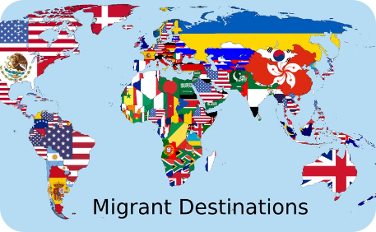
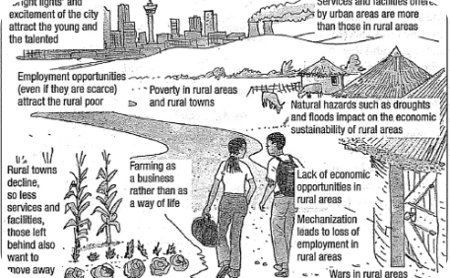
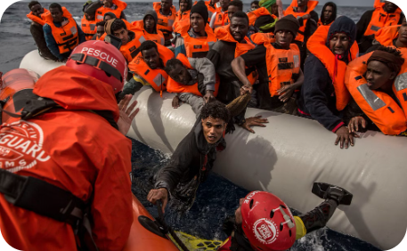
Types of Migration
Geographic Migration
Rural to Urban Migration
Forced Migration
Geographic migration refers to the movement of people or animals from one region or country to another, often driven by factors like economic opportunities, political instability, or environmental changes.
Rural to urban migration is the movement of people from rural, agricultural areas to urban, industrialized areas in search of better economic and social opportunities.
Forced migration refers to the involuntary movement of people due to factors such as war, natural disasters, or persecution, often leading to the status of refugees or internally displaced persons.

Slide 7
Causes of Migration
Political Instability
Economic Opportunities
People often flee their home countries due to war, persecution, human rights violations, and other forms of political turmoil and unrest.
The pursuit of better economic prospects, such as higher-paying jobs or improved living standards, drives many individuals to migrate to new regions or countries.
Environmental Factors
Family and Social Ties
Natural disasters, climate change, and environmental degradation can make living conditions unsustainable, leading people to seek more habitable areas.
The desire to reunite with family members or to join existing social networks in other locations can be a significant catalyst for migration.

Slide 8
Consequences of Migration
Economic Impacts
Social & Cultural Changes
Demographic Shifts
Environmental Impacts
Migration can have significant economic impacts, both positive and negative. Migrants may fill labor shortages, contribute to economic growth, and send remittances back home. However, they can also face exploitation, unemployment, and strain public services.
The influx of migrants can lead to cultural exchanges, diversity, and the sharing of traditions. But it can also create tension, discrimination, and challenges with social integration.
Migration can alter the demographic composition of both origin and destination countries, impacting age distributions, population growth, and workforce dynamics.
Large-scale migration, especially to urban areas, can strain natural resources and lead to environmental degradation through increased consumption, waste, and housing demands.

Slide 9
Concepts of Migration
Push and Pull Factors
Circular Migration
Transnationalism
Brain Drain/Brain Gain
This concept describes the temporary, often repetitive, movement of a migrant worker between home and host areas, typically for the purpose of employment.
Migrants often maintain strong social, economic, and political ties with their country of origin, leading to the concept of transnationalism - the idea that migrants live in two or more societies simultaneously.
Migration is driven by a combination of "push" factors, such as economic hardship or political instability, and "pull" factors, like job opportunities or family reunification, which attract people to a new location.
The migration of highly skilled individuals from developing to developed countries, known as "brain drain," can lead to "brain gain" for the host country but a loss of human capital for the country of origin.

Slide 10
Concepts of Migration
Networks
Diaspora
Vulnerability
Diaspora: A dispersed population with a common origin or heritage, often maintaining connections with their homeland and contributing to both their host and home countries.
Migrants often face social, cultural, economic and political vulnerability.
Social connections and relationships that facilitate migration, including family ties, social networks, and migration networks.

Slide 11
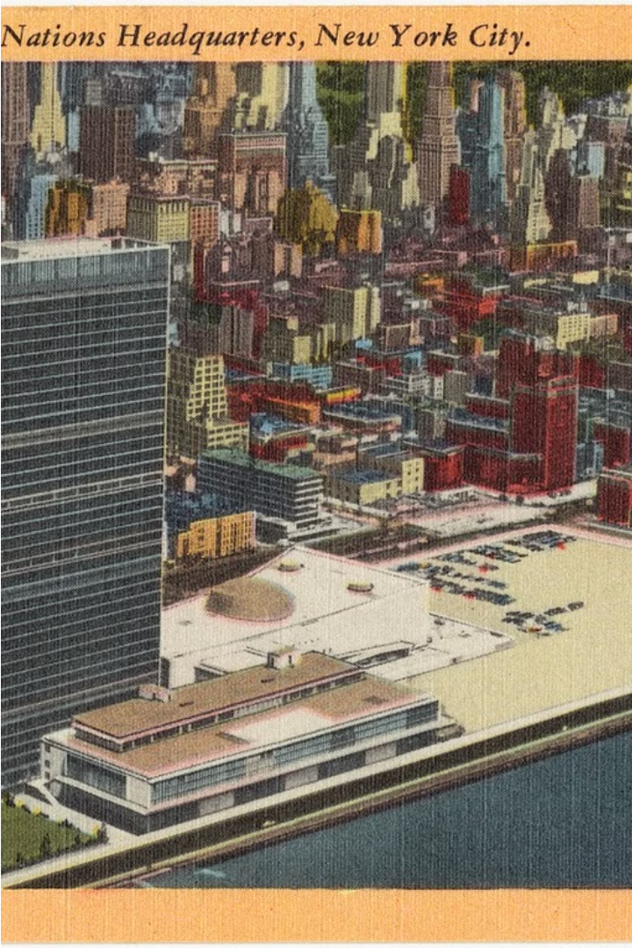
United Nations and Migration
The United Nations plays a crucial role in addressing global migration challenges. As an intergovernmental organization, the UN coordinates efforts to protect the rights and wellbeing of migrants worldwide, advocating for humane and orderly migration policies.
Through initiatives like the Global Compact for Safe, Orderly and Regular Migration, the UN works with member states to promote international cooperation and ensure the dignity and human rights of all migrants are upheld.

Slide 12
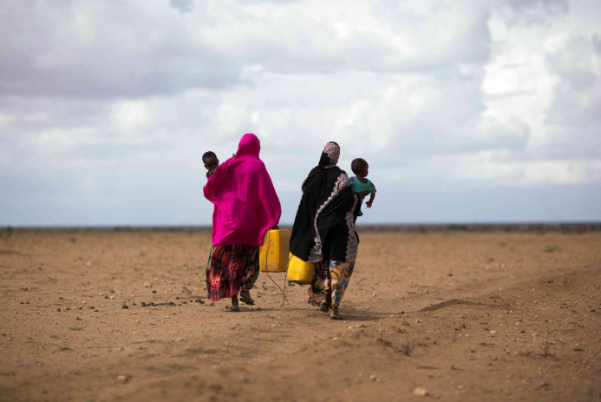
Climate Change and Migration
Climate change is a major driver of human migration, as extreme weather events, rising sea levels, and environmental degradation force people to flee their homes in search of safety and stability. This has profound implications for individuals, communities, and nations around the world.

Slide 13
Defining Climate Change
The question of climatic change is perhaps the most complex and controversial. No strict criteria exist on how many dry years should occur to justify the use of the words ‘climatic change’. There is no unanimous opinion and agreement among climatologists on the definition of the term climate, let alone climatic change, climatic trend or fluctuation
How to define climate and climate change is conceptually interesting, but choosing good definitions is also important for being able to make true statements about our climate system.
Climate change refers to long-term shifts in temperatures and weather patterns. Such shifts can be natural, due to changes in the sun’s activity or large volcanic eruptions.
Anthropogenic climate change, or ‘global warming’, is caused by increasing concentrations of greenhouse gases. These gases trap the heat in our atmosphere by preventing radiation from escaping into space. The main greenhouse gas, carbon dioxide (CO2 ), is emitted when fossil fuels, like coal and oil, are burned.

Slide 14
Climate Change, Migration and United Nations
Increased Displacement
1
Climate change leads to more frequent natural disasters and resource scarcity, forcing people to migrate.
UN Response
2
The UN is working to address climate migration through policies, humanitarian aid, and international cooperation.
Global Collaboration
3
Addressing climate migration requires coordinated global action and support for affected communities.
As the impacts of climate change worsen, the United Nations is playing a crucial role in addressing the growing challenge of climate-induced migration. Through international frameworks, humanitarian assistance, and collaborative policymaking, the UN is working to support those displaced by environmental factors and build resilience in vulnerable communities.

