Slide 1
CCP-LAW
Curricula development on Climate Change Policy and Law
Subject title: The Science of Climate Change: Mitigation and Adaptation
Instructor Name: Dr. Mohamad Farhan Mohamad Mohsin
Project No of Reference: 618874-EPP-1-2020-1-VN-EPPKA2-CBHE-JP:
The European Commission's support for the production of this publication does not constitute an endorsement of the contents, which reflect the views only of the authors, and the Commission cannot be held responsible for any use which may be made of the information contained therein.

Slide 2
Introduction to Climate Change Science
Part I
Definition of Climate Change
Key Climate Concepts
Climate vs. Weather
Understanding Climate Zones
Köppen Climate Classification
Climate vs. Weather Examples

Slide 3
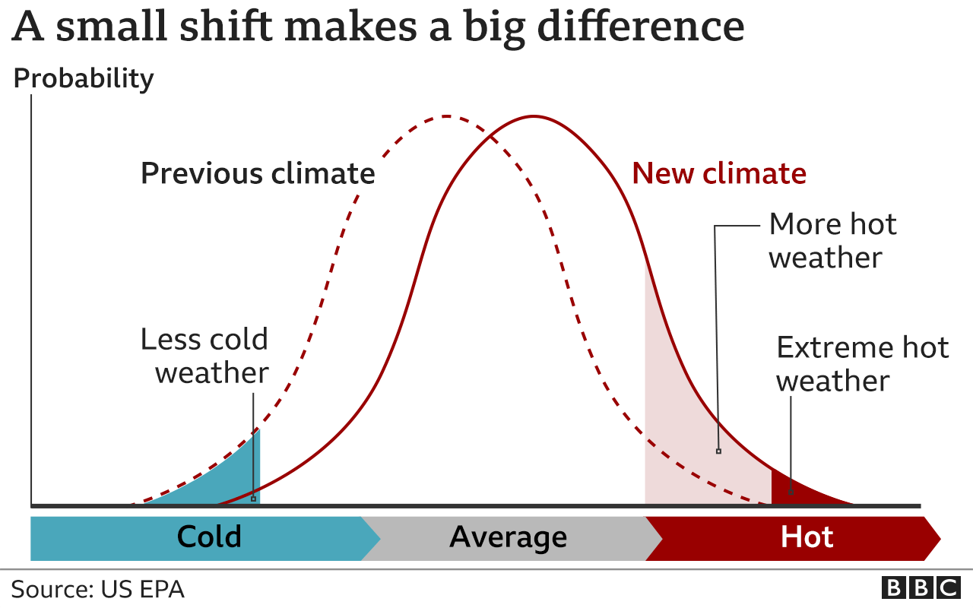
Definition of Climate Change
Introduction to Climate Change Science
Definition: Substantial alterations in Earth's climate system, primarily caused by human activities like burning fossil fuels and deforestation, leading to increased concentrations of greenhouse gases. These changes result in long-term shifts in weather patterns, impacting ecosystems, weather events, sea levels, and human societies.
Significance: Understanding climate change is critical due to its multifaceted impacts on agriculture, water resources, biodiversity, health, economies, and geopolitical stability.

Slide 4
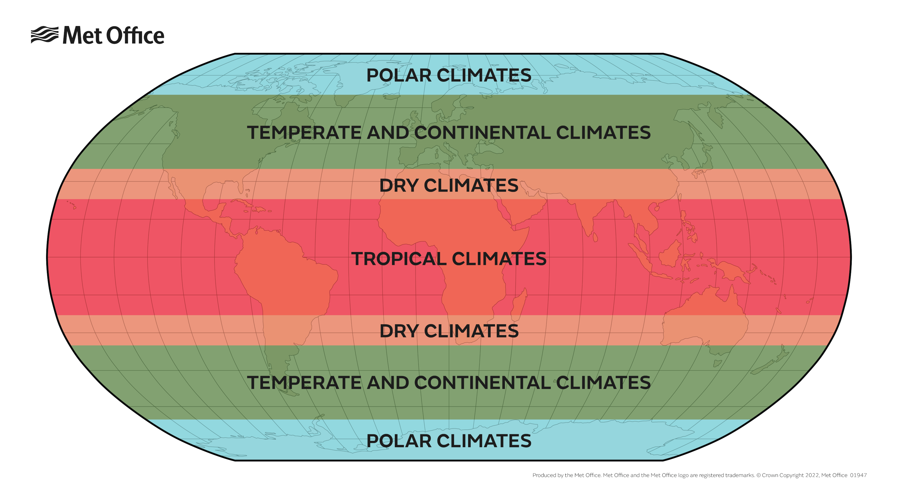
Key Climate Concepts
Introduction to Climate Change Science
Climate Zones: Geographical areas characterized by specific climate patterns determined by factors like temperature, precipitation, latitude, and altitude. They include Tropical (warm and humid), Temperate (moderate), and Polar (cold) zones, each with distinct environmental conditions.
Climate Classifications: Various classification systems exist, such as the Köppen climate classification, which categorizes climates based on temperature and precipitation patterns, resulting in symbols representing climate types globally.
https://www.metoffice.gov.uk/weather/climate/climate-explained/climate-zones

Slide 5
Climate vs. Weather
Introduction to Climate Change Science
Climate: the average weather patterns observed in a region over an extended period, typically 30 years or more.
Weather: denotes short-term atmospheric conditions that change rapidly over hours, days, or weeks and can include temperature, precipitation, wind, and humidity.
Emphasis: Distinguishing between climate and weather aids in understanding long-term trends (climate) versus immediate conditions (weather), influencing societal planning, agriculture, and disaster preparedness.

Slide 6
Introduction to Climate Change Science
Climate vs. Weather
Climate scientists split the Earth into approximately five main types of climates
A: Tropical. In this hot and humid zone, the average temperatures are greater than 64°F (18°C) year-round and there is more than 59 inches of precipitation each year.
B: Dry. These climate zones are so dry because moisture is rapidly evaporated from the air and there is very little precipitation.
C: Temperate. In this zone, there are typically warm and humid summers with thunderstorms and mild winters.
D. Continental. These regions have warm to cool summers and very cold winters. In the winter, this zone can experience snowstorms, strong winds, and very cold temperatures—sometimes falling below -22°F (-30°C)!
E: Polar. In the polar climate zones, it’s extremely cold. Even in summer, the temperatures here never go higher than 50°F (10°C)!

Slide 7
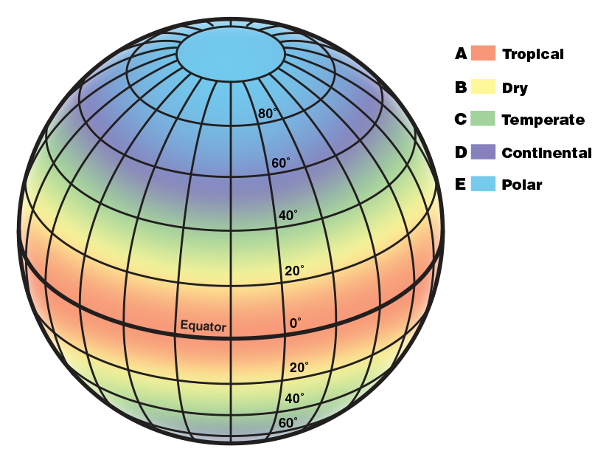
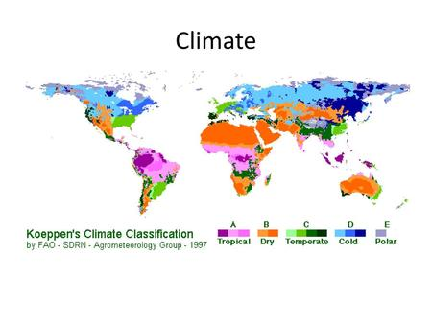
5 Climate Zones
Introduction to Climate Change Science

Slide 8
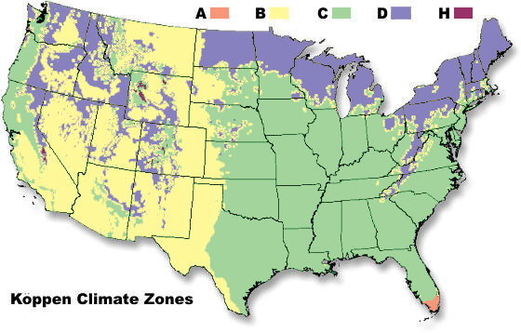
Introduction to Climate Change Science
Köppen Climate Classification
Overview: The Köppen climate classification system categorizes climates based on temperature, precipitation, and vegetation patterns. It identifies climate types using letters and symbols, facilitating the understanding and communication of climatic differences worldwide.
Classification Criteria: Köppen's system includes categories like Tropical (A), Dry (B), Temperate (C), Continental (D), and Polar (E) climates, further divided into subcategories based on specific climate characteristics.

Slide 9
Climate vs. Weather Examples
Introduction to Climate Change Science
Climate:
Visualization: Graph representing temperature averages and precipitation trends over several decades in a hypothetical region (Graph showing average temperatures and precipitation from 1950 to 2020).
Description: The graph illustrates long-term climate trends, showcasing the average temperatures and precipitation levels recorded over many years, indicating patterns and variability.
Weather :
Visualization: Weekly bar graph or icons displaying day-to-day variations in temperature and rainfall for a specific week in the same hypothetical region (Bar graph showing daily temperature fluctuations and rainfall amounts for a week in 2021).
Description: This visual representation highlights short-term variations in temperature and rainfall observed over a week, demonstrating day-to-day weather changes that differ from the long-term climate patterns depicted in the previous graph.

Slide 10
Introduction to Climate Change Science
Summary
Key Concepts Covered:
Defined Climate Change: Emphasized as significant alterations in Earth's climate system due to human activities.
Climate vs. Weather: Distinguished between long-term climate patterns and short-term atmospheric conditions.
Understanding Climate Zones: Explored Tropical, Temperate, and Polar zones with distinct characteristics.
Köppen Climate Classification: Introduced a system categorizing climates based on temperature and precipitation.
Importance of Concepts:
Impacts of Climate Change: Discussed effects on agriculture, water resources, biodiversity, health, economies, and global stability.
Human Influence: Highlighted human activities as major contributors to climate change.
Necessity for Mitigation and Adaptation: Stressed urgency in implementing strategies for sustainable solutions.

Slide 11
Introduction to Climate Change Science
Part II
Evidence of Contemporary Climate Change
Impacts of Climate Change
Risk Assessment

Slide 12
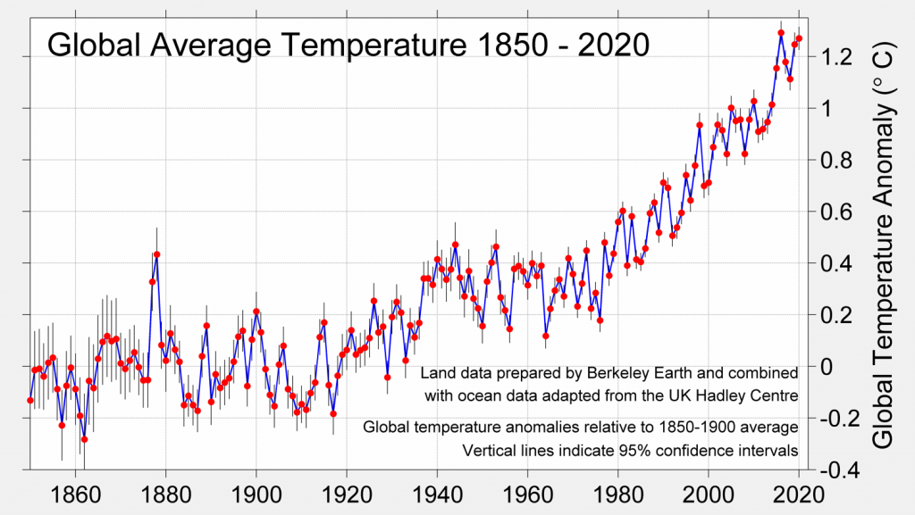
Observational Evidence of Climate Change
Introduction to Climate Change Science
Temperature Trends:
Global averages: Data from various sources consistently shows a rise in global average temperatures over the past century. This increase is attributed to greenhouse gas emissions from human activities, trapping heat in the atmosphere.
Regional variations: While the global average is rising, some regions experience more extreme temperature changes than others due to local geographical and climatic factors.
Sea Level Rise:
Impact and measurements: Sea levels have been rising due to melting ice caps and glaciers, as well as thermal expansion of seawater caused by warming temperatures. This rise threatens coastal communities, leading to increased flooding, erosion, and risks to infrastructure.
Measurements: Scientific measurements using satellite data and tide gauges confirm a steady increase in sea levels globally.

Slide 13
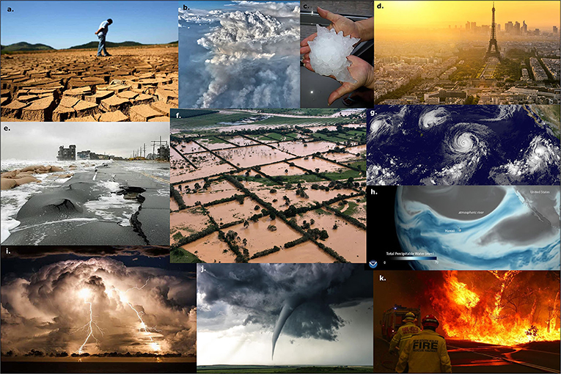
Introduction to Climate Change Science
Köppen Climate Classification
Extreme Weather Events:
Increased frequency and intensity: Scientific observations confirm a rise in the frequency and intensity of extreme weather events like hurricanes, heatwaves, floods, and droughts. These events have become more severe, causing significant damage to infrastructure and posing risks to human lives.

Slide 14
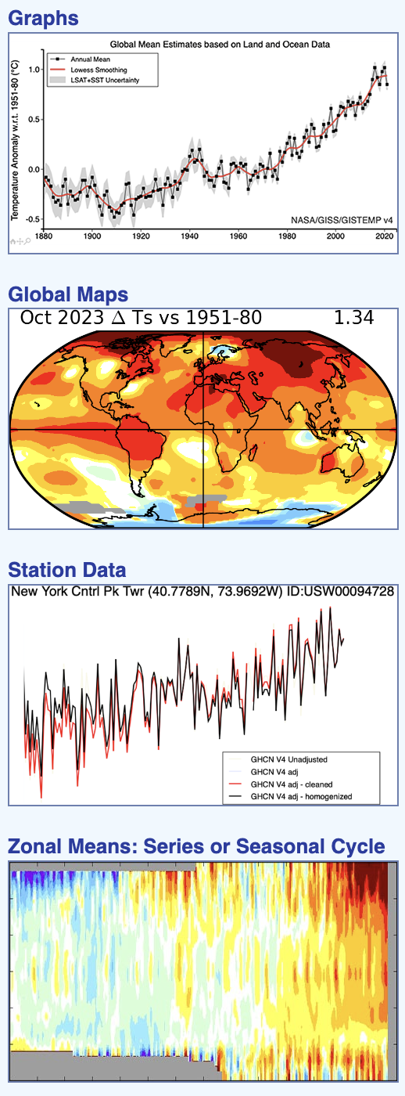
Observational Evidence of Climate Change
Introduction to Climate Change Science
Sources: Credible scientific organizations such as NASA, NOAA, and IPCC compile and analyze vast amounts of data from various sources worldwide.
Sources: Credible scientific organizations such as NASA, NOAA, and IPCC compile and analyze vast amounts of data from various sources worldwide.

Slide 15
Introduction to Climate Change Science
Impacts of Climate Change
Environmental Consequences:
Ecosystem disruptions: Climate change causes disruptions in ecosystems, leading to shifts in habitats, loss of biodiversity, and endangerment or extinction of species.
Habitat loss: Melting polar ice, deforestation, and altered weather patterns threaten the habitats of various species, affecting their survival.
Societal Impacts:
Economic consequences: Climate-related disasters damage infrastructure, agriculture, and industries, resulting in economic losses, increased insurance costs, and reduced productivity.
Health effects: Changing climates contribute to the spread of diseases, heat-related illnesses, and mental health issues, impacting human well-being.

Slide 16
Introduction to Climate Change Science
Risk Assessment
Potential Future Scenarios:
Projected scenarios: Climate models predict various potential future scenarios based on different emissions trajectories. These scenarios include potential temperature increases ranging from moderate to extreme, changes in precipitation patterns, and accelerated sea level rise.
Uncertainty: While projections provide insights, uncertainties exist due to the complexity of Earth's climate system and the unpredictability of human actions.
Associated Risks:
Food security: Changing climates may disrupt agricultural patterns, leading to decreased crop yields, affecting food availability and prices globally.
Water resources: Shifts in precipitation patterns and melting glaciers can impact freshwater availability, potentially leading to water shortages in some regions.
Human health: Rising temperatures and changing weather patterns contribute to heat-related illnesses, the spread of vector-borne diseases, and mental health challenges.
Migration: Environmental changes, such as sea-level rise and extreme weather events, can force populations to migrate, leading to potential social and political challenges.
Geopolitical tensions: Competition for resources and displacement due to climate impacts could escalate tensions between regions and nations.

Slide 17
Introduction to Climate Change Science
Risk Assessment
Mitigation and Adaptation:
Mitigation strategies: Efforts to reduce greenhouse gas emissions through cleaner energy sources, sustainable practices, and international agreements like the Paris Agreement are crucial to mitigate future risks.
Adaptation measures: Building resilient infrastructure, implementing sustainable water management strategies, developing early warning systems, and enhancing community preparedness are essential for adapting to changing climates and reducing vulnerabilities

Slide 18
Introduction to Climate Change Science
Summary
The compelling evidence of contemporary climate change and its consequences:
Evidence: Analyses of temperature trends, sea level rise, and extreme weather events from reputable sources like NASA and NOAA highlighted undeniable climate shifts.
Impacts: Environmental disruptions, biodiversity loss, economic setbacks, and health implications underscored the far-reaching effects of climate change.
Risks: Identified risks included threats to food security, water resources, human health, migration pressures, and geopolitical tensions.
Action: Emphasized the urgent need for mitigation strategies, adaptation measures, and sustainable practices to combat climate-related risks and build resilience.

