Slide 1
Climate Change: Cost-Benefit Analysis

Slide 2
Introduction
Cost Benefit Analysis (CBA) is a systematic approach to evaluating the potential costs and benefits of a proposed policy or project, with the goal of informing decision-making
Climate change policies often involve substantial investments and trade-offs
Objectives of the Lecture
Understand the basics of CBA
Explore the economic impacts of climate change
Examine the costs and benefits of climate change mitigation strategies

Slide 3
The Basics of Cost-Benefit Analysis
CBA involves comparing the total expected costs of a policy or project with the total expected benefits, both expressed in monetary terms
Costs may include initial investments, operational expenses, and externalities
CBA accounts for the fact that a dollar received or spent in the future is worth less than a dollar received or spent today, due to factors such as inflation and the opportunity cost of capital

Slide 4
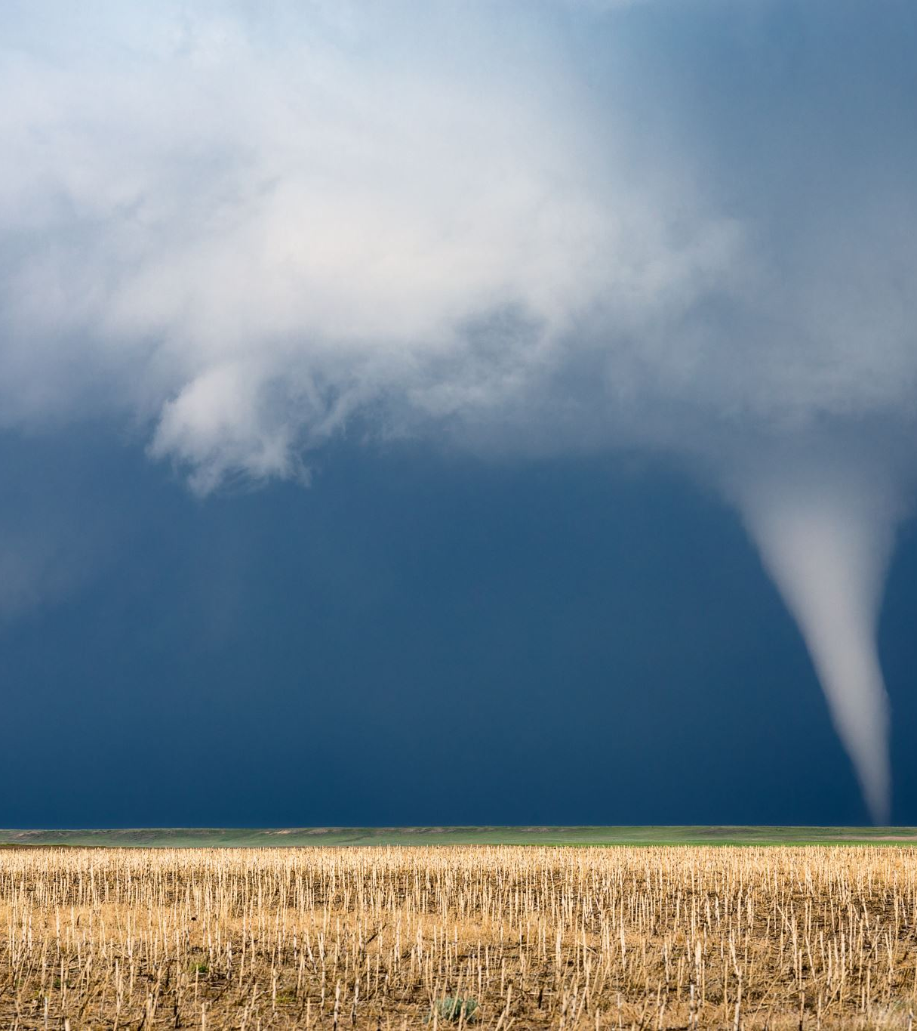
Climate Change Impacts
Climate change leads to a range of impacts, including rising temperatures, changing precipitation patterns, and more frequent extreme weather events e.g.
Rising temperatures
Changing weather patterns
Extreme Weather Events
Sea Level Rise
Crop Failure
The economic implications of these impacts include property damage, crop loss, increased healthcare costs, and disruption of supply chains

Slide 5
Examples of economic Costs of Climate Change
Direct Costs
Infrastructure damage due to extreme weather events can result in significant repair and reconstruction costs
Climate-related health impacts, such as heat-related illnesses and the spread of vector-borne diseases, impose financial burdens on healthcare systems
Indirect Costs
Population displacement due to sea-level rise or extreme weather events can lead to economic losses, including loss of property value and disruption of livelihoods
Loss of biodiversity can have economic consequences, including reduced ecosystem services and impacts on industries such as tourism and agriculture
Discounting Future Costs
Future costs and benefits are typically discounted to reflect their present value, accounting for factors such as time preference and risk

Slide 6
Potential Economic Benefits of Climate Change Mitigation
Reduction of Future Costs: By reducing greenhouse gas emissions and limiting global warming, climate change mitigation measures can help avoid or reduce the severity of future climate impacts
Improved Public Health: Many climate change mitigation strategies, such as reducing air pollution from fossil fuel combustion, have co-benefits for public health, leading to savings in healthcare costs and improved productivity
Environmental Preservation: Climate change mitigation efforts often involve conservation and restoration of ecosystems, which provide valuable services such as carbon sequestration, flood control, and habitat preservation

Slide 7
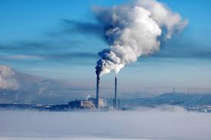
Activity 1: Carbon Trading & Pricing
Carbon pricing involves putting a price on carbon emissions, either through a carbon tax or a cap-and-trade system
Carbon pricing can lead to higher energy costs for consumers and increased operating costs for businesses
Exercise: Watch the following video and use a Padlet to post the pros and cons of the carbon markets

Slide 9
Case Study 2: Renewable Energy Investments
Benefits of Renewable Energy Adoption: Renewable energy sources such as solar, wind, and hydroelectric power offer clean alternatives to fossil fuels, reducing greenhouse gas emissions and air pollution
Costs of Transitioning from Fossil Fuels: While renewable energy technologies have become increasingly cost-competitive, the transition from fossil fuels to renewables requires upfront investments in infrastructure and may involve challenges such as intermittency and grid integration

Slide 10
Case Study 2: Renewable Energy Investments
Exercise: Undertake research to compare the costs and benefits of different energy sources, considering factors such as capital costs, operating costs, and environmental impacts
In groups, focus on either: wind, solar, hydro, tidal, geothermal or biomass
Take a slide in the interactive ppt and you will present it back to the group

Slide 11
Uncertainty and Risk
Dealing
Dealing with Uncertainty: Climate change presents significant uncertainties, including future emissions trajectories, climate sensitivity, and the effectiveness of mitigation measures
Incorporating
Incorporating Risk: Decision makers may have different attitudes toward risk, ranging from risk-averse to risk-seeking

Slide 12
Equity Considerations
Climate policies can have distributional impacts, affecting different groups and communities unequally
Vulnerable populations, including marginalized communities, indigenous peoples, and future generations, may face heightened risks from climate change and may have limited capacity to adapt
Policymakers must balance equity concerns with efficiency considerations, ensuring that climate policies achieve both environmental and social objectives while minimizing unintended consequences

Slide 13
Co-benefits and Trade-offs
Identifying Co-benefits of Climate Policies: Many climate policies have co-benefits for human health, environmental conservation, and economic development
Trade-offs between Short-term Costs and Long-term Benefits: Climate policies often involve short-term costs for long-term benefits
Discuss your thoughts on Karlsson et al (2020)

Slide 14
Discounting and Intergenerational Equity
Discounting future benefits raises ethical questions about intergenerational equity
Future generations will bear the brunt of climate change impacts, yet their voices are often marginalized in decision-making processes
Discount Rate Debate: The choice of discount rate can have significant implications for CBA results, with lower discount rates leading to greater weight given to future benefits

Slide 15
Policy Implementation
Incorporating CBA into Policy Making: CBA provides valuable insights for policymakers but should be used in conjunction with other decision-making criteria, such as equity, feasibility, and political acceptability
Role of Government Regulations: Government regulations play a crucial role in shaping incentives and driving investment in climate-friendly technologies and practices
Public vs. Private Sector Initiatives: Both public and private sector actors have a role to play in addressing climate change

Slide 16
Conclusion
CBA provides a systematic framework for evaluating the costs and benefits of climate change policies
Climate change poses significant economic risks, including direct and indirect costs, but also offers opportunities for innovation and investment
Equity considerations, uncertainty, and intergenerational equity are critical issues in climate policy decision making
Importance of CBA in Climate Policy: Informed decision making is essential for designing effective climate policies that achieve environmental objectives while maximizing social welfare and minimizing unintended consequences

Slide 17
Call to Action
Climate change requires collective action at the local, national, and global levels. By incorporating CBA principles into policy making and investing in sustainable solutions, we can mitigate the impacts of climate change and build a more resilient and prosperous future for all

