Slide 1
CCP-LAW
Curricula development on Climate Change Policy and Law
Subject: Corporate Governance and Climate Change
Topic 2: Sustainable Corporate Governance
Instructor Name: …
Project No of Reference: 618874-EPP-1-2020-1-VN-EPPKA2-CBHE-JP:
The European Commission's support for the production of this publication does not constitute an endorsement of the contents, which reflect the views only of the authors, and the Commission cannot be held responsible for any use which may be made of the information contained therein.

Slide 2
In this topic, we will cover…
Climate change and its impact on corporations
Embedding sustainability elements in Corporate Governance

Slide 3
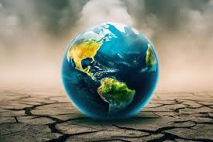
Climate change and its impact on corporations

Slide 4
UNDERSTANDING CLIMATE CHANGE
Climate change refers to long-term shifts in temperatures and weather patterns (UN)
The average temperature of the Earth’s surface is now about 1.2°C warmer than it was in the late 1800s (before the industrial revolution) and warmer than at any time in the last 100,000 years.
The last decade (2011-2020) was the warmest on record, and each of the last four decades has been warmer than any previous decade since 1850.
Limiting global temperature rise to no more than 1.5°C would help us avoid the worst climate impacts and maintain a livable climate

Slide 5
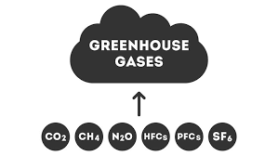
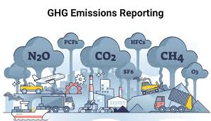
UNDERSTANDING CLIMATE CHANGE - CAUSE
Greenhouse Gas Emissions
The primary driver of recent climate change is the increase in greenhouse gases (GHGs) like carbon dioxide (CO2), methane (CH4), and nitrous oxide (N2O) in the atmosphere. These gases trap heat from the sun, leading to a warming effect known as the greenhouse effect.
Human Activities
Industrial activities, deforestation, agriculture, and the burning of fossil fuels (coal, oil, and natural gas) significantly contribute to the increase in GHG emissions.
Natural Factors
Natural processes such as volcanic eruptions and variations in solar radiation also affect the climate, but their impact is relatively small compared to human activities..

Slide 6
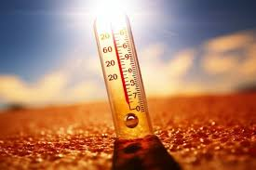
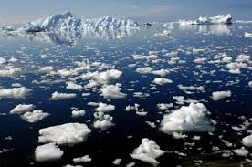
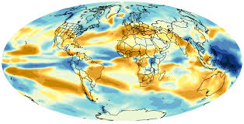
UNDERSTANDING CLIMATE CHANGE - INDICATORS
Rising Temperatures
Global average temperatures have increased significantly over the past century. The past few decades have seen some of the highest temperatures on record.
Melting Ice Caps and Glaciers
The Arctic and Antarctic ice sheets, as well as glaciers worldwide, are melting at alarming rates, contributing to rising sea levels.
Changing Precipitation Patterns
Climate change has led to more extreme weather patterns, including intense rainfall, droughts, and shifts in seasonal weather.

Slide 7
IMPACT ON CORPORATION-Regulatory and Policy Changes
Emissions Regulations
Renewable Energy Mandates
Governments are implementing stricter limits on greenhouse gas emissions, requiring businesses to reduce their carbon footprint through efficient operations and clean technologies.
Policies are being enacted to increase the use of renewable energy sources like solar and wind, forcing corporations to adapt their energy mix.
Sustainable Finance Initiatives
Carbon Pricing Schemes
Financial regulations are being introduced to steer investment towards sustainable and climate-resilient projects, impacting corporate funding and reporting.
The implementation of carbon pricing, through taxes or emissions trading systems, creates financial incentives for corporations to cut emissions.

Slide 8
IMPACT ON CORPORATION-Shifts in Consumer Preferences and Demands
Sustainable Products
Carbon Consciousness
Renewable Energy
Consumers are increasingly seeking out products and services that are environmentally friendly and socially responsible.
Buyers are demanding transparency around a company's carbon emissions and commitment to reducing its environmental impact.
There is a growing preference for corporations that utilize renewable energy sources and promote sustainability.

Slide 9
IMPACT ON CORPORATION-Disruptions to Supply Chains
and Operations
Unpredictable Sourcing
Transportation Challenges
Climate change can disrupt the availability and pricing of raw materials, forcing companies to find alternative suppliers and rethink their procurement strategies.
Extreme weather events can damage transportation infrastructure and disrupt logistics, leading to delays and increased costs for moving goods.
Production Interruptions
Energy Volatility
Flooding, droughts, and other climate-related disasters can shut down manufacturing facilities, impacting a company's ability to meet customer demand.
Climate change can cause fluctuations in energy prices and availability, forcing companies to adapt their energy management and seek more sustainable solutions.

Slide 10
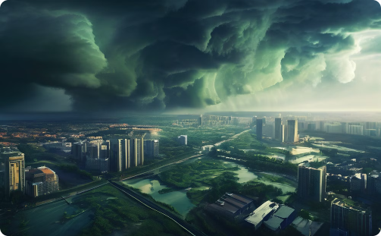
IMPACT ON CORPORATION- Increased Risk of Extreme
Weather Events
Disruptive Storms
Devastating Flooding
Destructive Wildfires
Extreme weather events like hurricanes, typhoons, and blizzards are becoming more frequent and intense due to climate change, causing widespread damage to infrastructure and disrupting business operations.
Rising sea levels and heavy rainfall are leading to more frequent and severe flooding events, which can cripple transportation networks, contaminate water supplies, and force evacuations of entire communities.
Prolonged droughts and heatwaves, exacerbated by climate change, are causing an increase in the frequency and intensity of wildfires, which can destroy critical infrastructure and disrupt business operations.

Slide 11
Embedding Sustainability Elements in Corporate Governance

Slide 12
1. Board Composition and Diversity
Inclusion of Sustainability Experts: Appoint board members with expertise in environmental, social, and governance (ESG) issues to provide informed guidance and oversight.
Diverse Perspectives: Ensure a diverse board to bring a range of perspectives and innovative solutions to sustainability challenges.
Training and Education: Regularly train board members on sustainability trends and best practices to enhance their understanding and decision-making capabilities.

Slide 13
2. ESG Integration into Corporate Strategy
Strategic Alignment: Integrate ESG goals into the overall corporate strategy to ensure alignment with business objectives and long-term vision.
Performance Metrics: Develop and implement ESG performance metrics to track progress and drive accountability across the organization.
Sustainability Committees: Establish dedicated sustainability committees at the board level to oversee ESG initiatives and ensure they are prioritized.

Slide 14
3. Stakeholder Engagement
Regular Communication: Engage with stakeholders, including investors, employees, customers, and communities, to understand their concerns and expectations related to sustainability.
Feedback Mechanisms: Implement robust feedback mechanisms to gather stakeholder input and incorporate it into corporate policies and practices.
Transparency: Maintain transparency in communications with stakeholders about the company's sustainability efforts and progress

Slide 15
4. Transparency and Reporting
Sustainability Reporting: Publish regular sustainability reports that adhere to international standards such as the Global Reporting Initiative (GRI), Sustainability Accounting Standards Board (SASB), and Task Force on Climate-related Financial Disclosures (TCFD).
Clear Communication: Ensure that sustainability reports are clear, comprehensive, and accessible to all stakeholders.
Continuous Improvement: Use the insights from sustainability reporting to drive continuous improvement in ESG practices.

Slide 16
5. Embedding Sustainability in Corporate Culture
Leadership Commitment: Demonstrate strong commitment from top leadership to sustainability goals and values.
Employee Engagement: Foster a culture of sustainability by engaging employees at all levels and encouraging sustainable practices within the organization.
Incentives and Recognition: Implement incentive programs to reward employees for their contributions to sustainability initiatives.

Slide 17
6. Risk Management and Compliance
Climate Risk Assessment: Regularly assess and address climate-related risks as part of the overall risk management framework.
Regulatory Compliance: Ensure compliance with relevant environmental and social regulations to avoid legal and reputational risks.
Sustainable Supply Chain: Promote sustainability across the supply chain by working with suppliers who adhere to ESG standards.

Slide 18
7. Innovation and Investment in Sustainable Practices
R&D for Sustainability: Invest in research and development to create sustainable products and services.
Renewable Energy: Transition to renewable energy sources to reduce carbon footprint and operational costs.
Circular Economy: Implement circular economy principles to minimize waste and maximize resource efficiency.

