Slide 1
CCP-LAW
Curricula development on Climate Change Policy and Law
Subject title: Climate Change and Human Rights
Instructor Name: Dr. Albert Lladó Martínez
Project No of Reference: 618874-EPP-1-2020-1-VN-EPPKA2-CBHE-JP:
The European Commission's support for the production of this publication does not constitute an endorsement of the contents, which reflect the views only of the authors, and the Commission cannot be held responsible for any use which may be made of the information contained therein.

Slide 2
Topic 1.2 Incorporation of Human Rights obligations
Into Climate Change actions
OVERVIEW
TOPIC 1.2 Study of human rights obligations related to the environment and climate change, focusing on the rights to food, water and sanitation, decent housing, health, personal safety, and life.

Slide 3
Topic 1.2 Incorporation of Human Rights obligations
Into Climate Change actions
INTRODUCTION 1/4
The Universal Declaration of Human Rights guarantees that all human beings are entitled to a social and international order in which their rights and freedoms can be fully realized. Climate change threatens this order and the rights and freedoms of all people. Without drastic action now, it will create dreadful harm.
International cooperation and solidarity are vital for climate change mitigation and adaptation.

Slide 4
Topic 1.2 Incorporation of Human Rights obligations
Into Climate Change actions
INTRODUCTION 2/4
It is equally important to approach climate action from a human rights perspective, as “human rights obligations, standards and principles have the potential to inform and strengthen international, regional and national policymaking in the area of climate change, promoting policy coherence, legitimacy and sustainable outcomes” (Human Rights Council resolution 41/21).

Slide 5
Topic 1.2 Incorporation of Human Rights obligations
Into Climate Change actions
INTRODUCTION 3/4
The integration of human rights obligations into climate change prevention is increasingly seen as a vital component of effective and equitable climate action. These obligations, ranging from emission reduction and adaptation to international cooperation and corporate accountability, form the basis of a rights-based approach that seeks to protect vulnerable populations while addressing the global climate crisis.

Slide 6
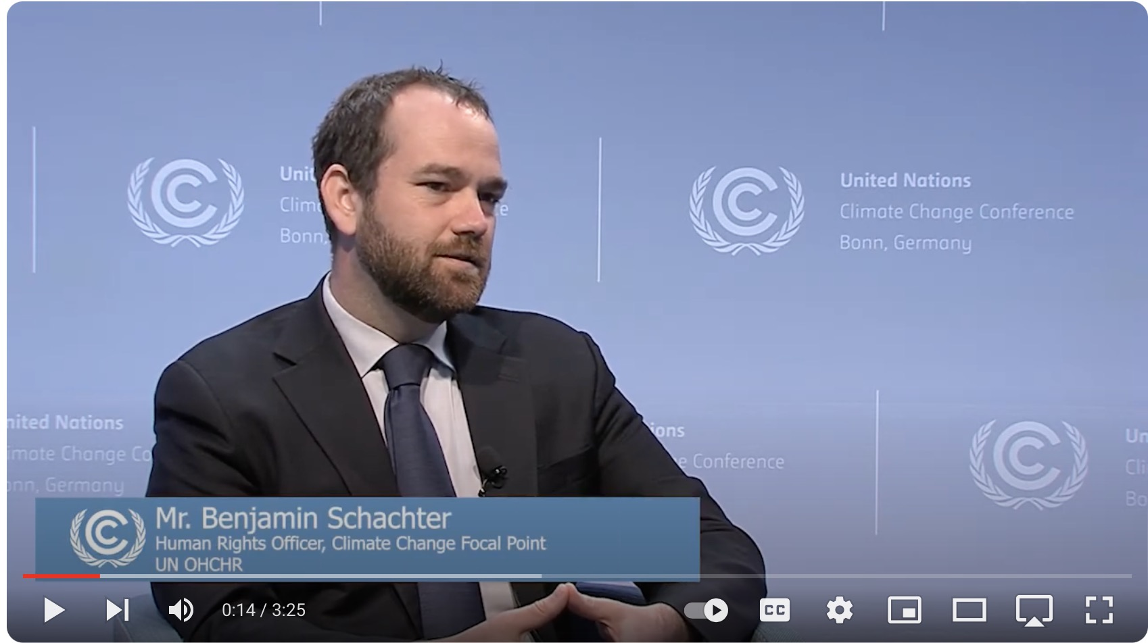
Topic 1.2 Incorporation of Human Rights obligations
Into Climate Change actions
INTRODUCTION 4/4
video (3.25 min.)
All States must respect, promote and consider human rights when taking climate action; climate change mitigation is a human rights obligation.
Mr. Benjamin Schachter
Human Rights Officer
Climate Change Focal Point
UN OHCHR
https://youtu.be/LdSzRLJt0TU?si=VapfmZabOQ3g2Rx1

Slide 7
Topic 1.2 Incorporation of Human Rights obligations
Into Climate Change actions
Obligations for the incorporation of Human Rights into Climate Change actions:
Obligation to Mitigate Climate Change and Prevent Negative Human Rights Impacts
Obligation to Ensure Adaptation to Climate Change
Obligation to Ensure Accountability and Provide Remedies
Obligation to Mobilize Resources for Sustainable Development
Obligation to Cooperate with Other States
Obligation to Ensure Equity in Climate Action
Obligation to Protect Human Rights from Business Harms
Obligation to Ensure Meaningful Participation
Obligation to Guarantee Benefits of Science

Slide 8
INCORPORATION OF HUMAN RIGHTS OBLIGATIONS
INTO CLIMATE CHANGE ACTIONS
Obligation to Mitigate Climate Change and Prevent
Negative Human Rights Impacts (1/2)
States' Duty to Mitigate:
States have a fundamental obligation to reduce greenhouse gas emissions to prevent the negative impacts of climate change on human rights. This includes both national actions and contributing to international efforts, as outlined in the Paris Agreement, which calls for the protection of rights such as the right to life, health, food, water, and housing during climate actions.

Slide 9
INCORPORATION OF HUMAN RIGHTS OBLIGATIONS
INTO CLIMATE CHANGE ACTIONS
Obligation to Mitigate Climate Change and Prevent
Negative Human Rights Impacts (2/2)
Prevent Loss of Life:
There is a clear obligation to take action that prevents foreseeable harm and loss of life from climate-related disasters like floods, storms, and droughts, as recognized under various human rights treaties, including the “International Covenant on Civil and Political Rights (ICCPR)”.

Slide 10
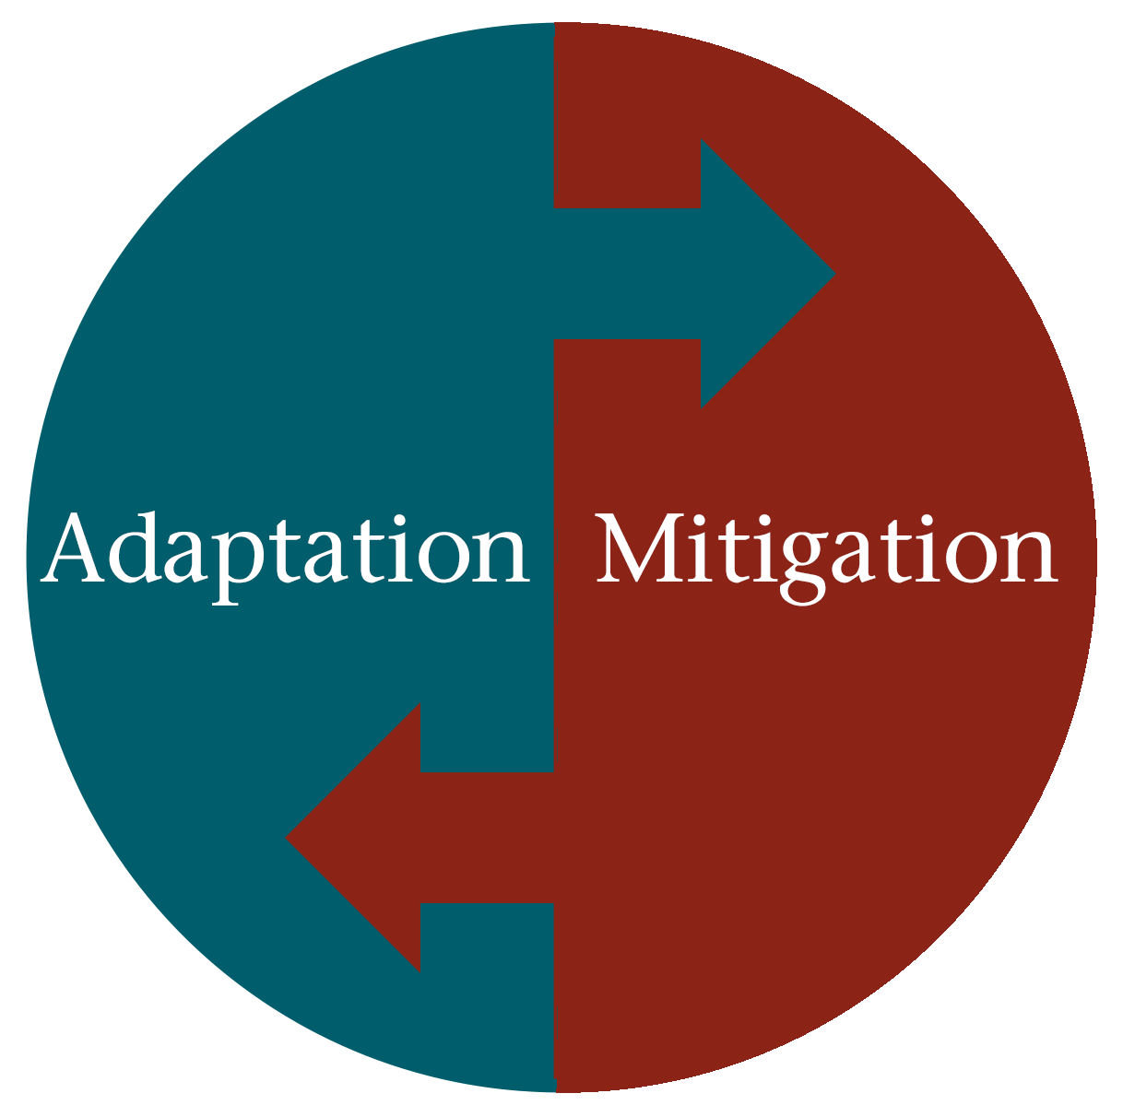
INCORPORATION OF HUMAN RIGHTS OBLIGATIONS
INTO CLIMATE CHANGE ACTIONS
Obligation to Ensure Adaptation to Climate Change (1/2)
Capacity Building for Adaptation:
States must ensure that individuals and communities have the capacity to adapt to the impacts of climate change. This includes enhancing resilience, providing financial and technical support, and ensuring access to essential resources like water, food, and adequate housing in vulnerable areas.

Slide 11
INCORPORATION OF HUMAN RIGHTS OBLIGATIONS
INTO CLIMATE CHANGE ACTIONS
Obligation to Ensure Adaptation to Climate Change (2/2)
Adaptation Strategies:
The incorporation of indigenous knowledge and a gender-responsive approach in climate adaptation strategies is essential. Indigenous communities, women, and vulnerable groups must be engaged in the design and implementation of climate actions.

Slide 12
INCORPORATION OF HUMAN RIGHTS OBLIGATIONS
INTO CLIMATE CHANGE ACTIONS
Obligation to Ensure Accountability and Provide Remedies
Access to Justice: States are obligated to ensure accountability for human rights violations caused by climate change. This involves providing effective legal remedies to individuals and communities suffering from climate impacts, such as forced displacement due to sea-level rise or loss of livelihoods.
Legal Frameworks for Redress: Courts in many countries are increasingly using human rights law to hold governments accountable for failing to take adequate climate action. This includes judicial oversight in climate policies to protect human rights.
https://www.bclaws.gov.bc.ca/civix/document/id/complete/statreg/07042_01

Slide 13
INCORPORATION OF HUMAN RIGHTS OBLIGATIONS
INTO CLIMATE CHANGE ACTIONS
Obligation to Mobilize Resources for Sustainable Development (1/2)
Maximization of Resources:
States are required to allocate the maximum available resources towards sustainable development that is both environmentally and socially equitable. This involves prioritizing funding for renewable energy projects, climate resilience infrastructure, and poverty alleviation programs in regions severely impacted by climate change.

Slide 14
INCORPORATION OF HUMAN RIGHTS OBLIGATIONS
INTO CLIMATE CHANGE ACTIONS
Obligation to Mobilize Resources for Sustainable Development (2/2)
Equitable Development:
Ensuring that climate change prevention does not exacerbate inequality is critical. States must implement climate policies that balance economic development with environmental sustainability, ensuring that all populations, particularly the most vulnerable, benefit.

Slide 15
INCORPORATION OF HUMAN RIGHTS OBLIGATIONS
INTO CLIMATE CHANGE ACTIONS
Obligation to Cooperate with Other States (1/2)
International Cooperation:
Climate change is a global problem that requires international solidarity. States must work together to share knowledge, resources, and technology to mitigate the global effects of climate change. This includes obligations under international treaties such as the Paris Agreement to assist less-developed nations that are disproportionately affected by climate change.

Slide 16
INCORPORATION OF HUMAN RIGHTS OBLIGATIONS
INTO CLIMATE CHANGE ACTIONS
Obligation to Cooperate with Other States (2/2)
Global Climate Justice:
Developed nations have a responsibility to support developing nations through financial assistance and technology transfer, acknowledging their historical role in contributing to global emissions.

Slide 17
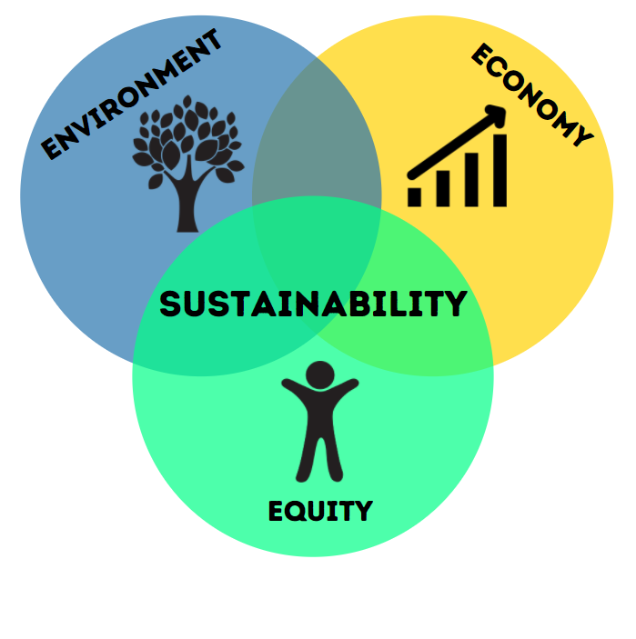
INCORPORATION OF HUMAN RIGHTS OBLIGATIONS
INTO CLIMATE CHANGE ACTIONS
Obligation to Ensure Equity in Climate Action (1/2)
Non-Discrimination:
Human rights obligations require that climate action be carried out equitably and without discrimination. Vulnerable groups -including indigenous peoples, women, children, and the poor- must be prioritized in climate strategies to avoid exacerbating existing inequalities.

Slide 18
INCORPORATION OF HUMAN RIGHTS OBLIGATIONS
INTO CLIMATE CHANGE ACTIONS
Obligation to Ensure Equity in Climate Action (2/2)
Gender and Indigenous Rights:
Climate policies must specifically address the unique vulnerabilities of women and indigenous peoples, ensuring their participation in decision-making processes and the protection of their traditional livelihoods and cultural rights.

Slide 19
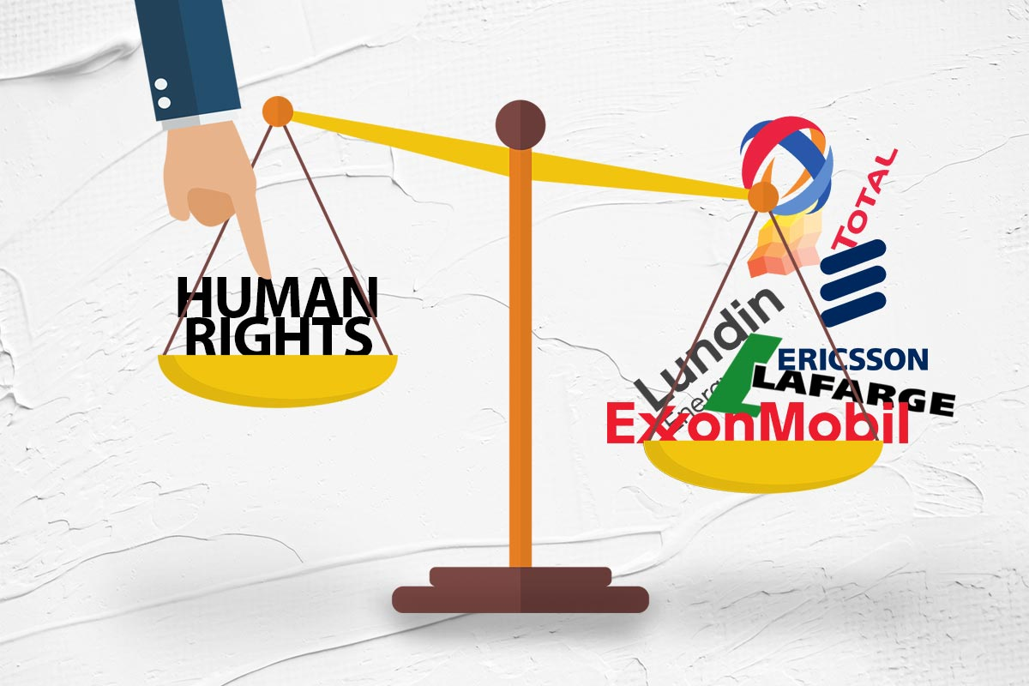
INCORPORATION OF HUMAN RIGHTS OBLIGATIONS
INTO CLIMATE CHANGE ACTIONS
Obligation to Protect Human Rights from Business Harms (1/2)
Corporate Accountability:
Businesses, particularly in high-emission industries, have a responsibility to respect human rights in their operations, especially in relation to climate change. States must enforce regulations that prevent corporate practices from contributing to environmental degradation that harms human rights.

Slide 20
INCORPORATION OF HUMAN RIGHTS OBLIGATIONS
INTO CLIMATE CHANGE ACTIONS
Obligation to Protect Human Rights from Business Harms (2/2)
Due Diligence:
The UN Guiding Principles on Business and Human Rights emphasize the need for corporations to conduct due diligence to prevent, mitigate, and address their impacts on climate change, ensuring that they do not violate the rights to health, water, and a clean environment.

Slide 21
INCORPORATION OF HUMAN RIGHTS OBLIGATIONS
INTO CLIMATE CHANGE ACTIONS
Obligation to Ensure Meaningful Participation (1/2)
Right to Participate:
A human rights-based approach to climate action requires that all individuals, especially those affected by climate change, have a meaningful role in shaping climate policies. Public participation is essential to ensuring transparency and accountability in climate decision-making processes.

Slide 22
INCORPORATION OF HUMAN RIGHTS OBLIGATIONS
INTO CLIMATE CHANGE ACTIONS
Obligation to Ensure Meaningful Participation (2/2)
Access to Information:
Governments are obligated to provide transparent and accessible information regarding climate risks and actions to enable communities to engage in climate policies that affect their lives.

Slide 23
INCORPORATION OF HUMAN RIGHTS OBLIGATIONS
INTO CLIMATE CHANGE ACTIONS
Obligation to Guarantee Benefits of Science
Right to Scientific Benefits:
States have an obligation to ensure that scientific advancements, particularly in the fields of renewable energy and climate adaptation technologies, are accessible to all people, especially those in vulnerable and marginalized communities. Climate actions should be informed by the best available scientific data.

