Slide 1
Introduction to EU Law and Climate Change governance
EU Law plays a pivotal role in addressing the complex challenges of climate change governance within the European Union. It encompasses a comprehensive framework of regulations, directives, and policies aimed at mitigating environmental impacts and fostering sustainable practices across member states.

Slide 2
Overview of the European Union and its legal framework
European Union
Legal Framework
The EU is a political and economic union of 27 member countries.
The EU's legal framework is based on supranational and intergovernmental principles.
Harmonization of Laws
Court of Justice
The European Court of Justice ensures the uniform interpretation and enforcement of EU law. ECHR-guide in HR matters.
EU laws harmonize national laws across member states for consistency.

Slide 3
The Role of the European Commission in Climate Change Governance
Policy Development: The European Commission plays a key role in developing and proposing EU climate change policies and regulations.
Coordination: It coordinates with member states to ensure the implementation and enforcement of climate change measures.
International Negotiations: The Commission represents the EU in international climate change negotiations, advocating for ambitious and effective global agreements.

Slide 4
The European Green Deal and its objectives
1
Reducing Greenhouse Gas Emissions
The European Green Deal aims to cut emissions by at least 55% by 2030.
2
Transitioning to Clean Energy
By promoting renewable energy, the EU intends to shift towards a carbon-neutral economy.
3
Promoting Sustainable Growth
The deal focuses on creating a circular economy that reduces waste and promotes eco-friendly practices.

Slide 5
Key EU Legislation on Climate Change Mitigation and Adaptation
Climate Change Mitigation
Climate Change Adaptation
EU legislation focuses on reducing greenhouse gas emissions through measures such as promoting renewable energy, improving energy efficiency, and setting emission reduction targets.
The EU has laws addressing the adaptation to climate change impacts, including strategies for managing water resources, protecting biodiversity, and enhancing resilience in infrastructure and agriculture.

Slide 6
The Paris Agreement and its implementation in the EU
1
Commitments to Mitigation
2
Adaptation Efforts
The EU and its member states are implementing measures to adapt to the impacts of climate change, ensuring resilience in various sectors.
The EU has committed to reduce greenhouse gas emissions by at least 40% by 2030 compared to 1990 levels.
3
Financial Contributions
4
International Collaboration
The EU is providing financial support to developing countries for climate action projects, aligning with the Paris Agreement's goals.
Collaborative efforts with other countries are integral in achieving the Paris Agreement's targets, forming global alliances for climate action.

Slide 7
The Role of the European Court of Justice in Enforcing Climate Change Laws
Legal Oversight
Enforcement Authority
Environmental Justice
The European Court of Justice ensures compliance with EU climate change laws.
Empowered to impose penalties for non-compliance with environmental regulations.
Resolves disputes related to climate policies and environmental protection.

Slide 8
EU funding for climate change projects and initiatives
$100M
500
Annual Funding
Projects Supported
EU allocated $100 million annually for climate change projects.
Over 500 climate change initiatives funded by the EU.

Slide 9
The European Climate Law and its implications
The European Climate Law, also known as the European Climate Law Regulation, is a significant legislative initiative aimed at achieving climate neutrality by 2050. It legally binds the EU to reduce greenhouse gas emissions and sets an ambitious target for net-zero emissions. This law impacts various economic sectors, policies, and member states.

Slide 10
The Role of Member States in Implementing EU Climate Change Policies
Transposing EU Laws
Reporting and Monitoring
Cooperation and Coordination
Member states must transpose EU climate change regulations into national law.
They are responsible for reporting on and monitoring the implementation of climate change policies.
Ensuring cooperation and coordination between the EU and member states in achieving climate goals.

Slide 11
The European Climate Pact and citizen engagement
Citizen Participation
1
Engaging citizens in climate action.
2
Community Initiatives
Supporting local sustainability projects.
Educational Outreach
3
Empowering individuals through education.
The European Climate Pact emphasizes citizen involvement through active participation in climate initiatives, supporting local community projects, and empowering individuals through educational outreach. This approach fosters a sense of collective responsibility and commitment to sustainable practices in addressing climate change.

Slide 12
The EU Emissions Trading System and Carbon Pricing
1
Origin of the System
Established in 2005 to combat greenhouse gas emissions.
2
Cap-and-Trade Mechanism
Set emission limits and trade allowances within the market.
Market Impact
3
Incentivizes carbon emission reductions and promotes innovation.
Global Influence
4
Model for international carbon pricing mechanisms.

Slide 13
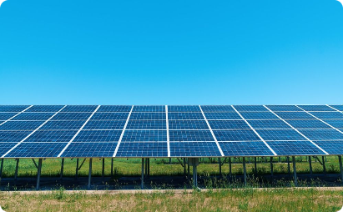
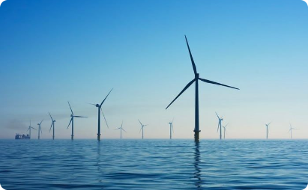
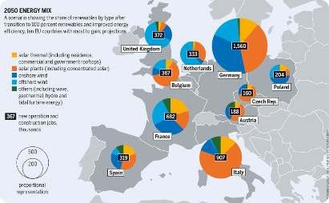
Renewable energy targets and policies in the EU
Solar Energy Targets
Wind Energy Policies
Hydropower Regulations
The EU has set ambitious targets for solar energy production, aiming to significantly increase its share in the energy mix.
Offshore wind farms and supportive policies play a vital role in the EU's renewable energy strategy and sustainability objectives.
Stringent regulations guide the development and operation of hydropower plants to ensure environmental protection and sustainability.

Slide 14
The Circular Economy Action Plan and sustainable resource management
The Circular Economy Action Plan
The European Union's strategic initiative to transition towards a sustainable, circular economy.
Sustainable resource management
Efforts to minimize resource consumption, promote recycling, and reduce environmental impact.

Slide 15
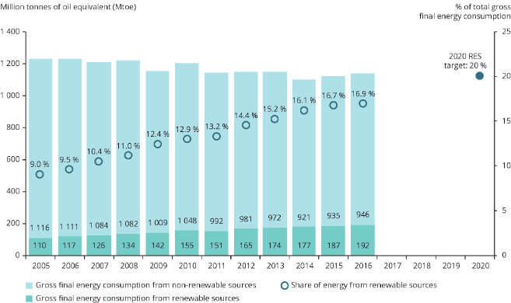
The Role of the European Investment Bank in Financing Climate Action
The European Investment Bank plays a pivotal role in financing climate action by providing funding for renewable energy projects, sustainable infrastructure, and environmental sustainability initiatives across the EU.

Slide 16
EU initiatives for sustainable transportation and mobility
Investing in Public Transport
The EU is investing in the expansion and modernization of public transportation systems.
Promoting Electric Vehicles
Encouraging the adoption of electric vehicles through incentives and charging infrastructure.
Cycling and Walking Infrastructure
Developing cycling and walking infrastructure to promote active and sustainable transport.

Slide 17
Climate change and agriculture in the EU
Impact on crop yields: Rising temperatures and changing precipitation patterns affect crop production.
Water management: Droughts and water scarcity challenge irrigation systems for agriculture.
Biodiversity loss: Changes in climate may disrupt ecosystems and impact pollinators.

Slide 18
The EU's International Climate Change Commitments and Negotiations
Diplomacy
Conferences
International Cooperation
Negotiating with global partners for climate agreements.
Active participation in UN climate conferences and agreements.
Building alliances for collective climate action on a global scale.

Slide 19
Challenges and opportunities for EU climate change governance
The European Union faces the challenge of balancing economic growth and environmental sustainability. Managing conflicting national interests within the EU is a key obstacle. However, it also presents opportunities for innovation and collaboration in green technologies and renewable energy sources.

Slide 20
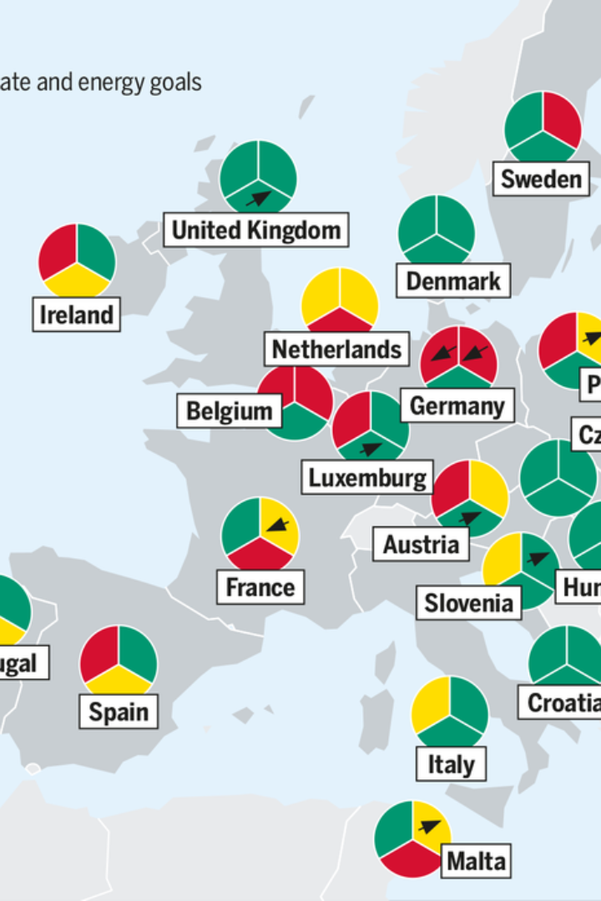
Future Prospects for EU Law and Climate Change Governance
As the European Union continues to prioritize climate change governance, future prospects involve heightened collaboration and innovation to meet ambitious emission reduction targets. Investment in renewable energy, sustainable transportation, and circular economy initiatives will play a pivotal role in shaping the EU's environmental policies. The integration of climate considerations into various sectors will drive the transformation towards a greener future.

