Slide 1
CCP-LAW
Curricula development on Climate Change Policy and Law
Module: Environmental Risk Prevention and Management
Topic: Introduction to the Concept of Vulnerability to Environmental Hazards with a focus on Politics
Instructor Name:
Project No of Reference: 618874-EPP-1-2020-1-VN-EPPKA2-CBHE-JP:
The European Commission's support for the production of this publication does not constitute an endorsement of the contents, which reflect the views only of the authors, and the Commission cannot be held responsible for any use which may be made of the information contained therein.

Slide 2
Aims of the Session
Explore
Critically explore what environmental hazards are
Examine
Critically examine how environmental hazards have varying impacts on societies, politically, socially and culturally (with a focus on the former)
Ascertain
Ascertain how vulnerability is understood and the factors or systems which exacerbate it for certain communities

Slide 3
What are Environmental Hazards?
Environmental Hazards are defined as "extreme events or substances in the Earth and its ecological system that may cause adverse consequences for humans and things they value."
The EM-Dat of CRED distinguishes two generic categories for disasters: natural (earthquakes, floods etc.) and technological (oil spills, gas explosions etc.)
These however cannot be looked at in silo but rather as a continuum of interactions as they can both influence and affect each other.

Slide 4
Environmental Risks – Discussion (15 mins)
Following your reading of Collins et al.'s (2015) and watching the following informative video, respond to the following questions:
What is Environmental Risk? (youtube.com)
How do you define environmental risk?
In what ways is anthropogenic activity contributing to this risk?
Can you think of any recent environmental disasters globally?
What were the impacts?
Consider how these disasters have been affected by political decisions?

Slide 5
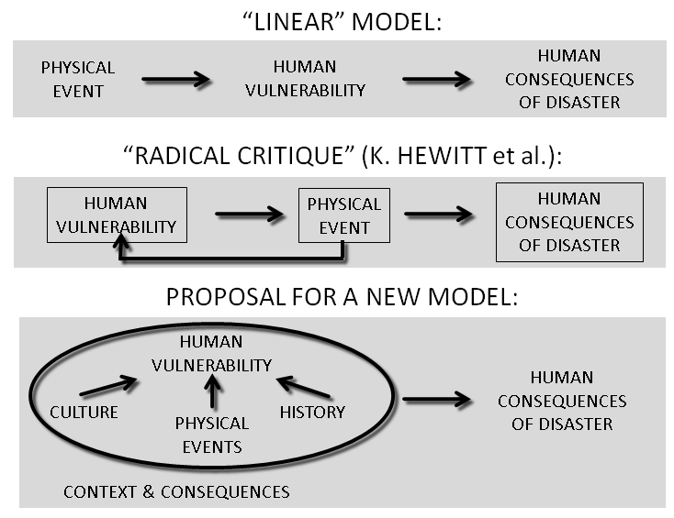

Slide 6
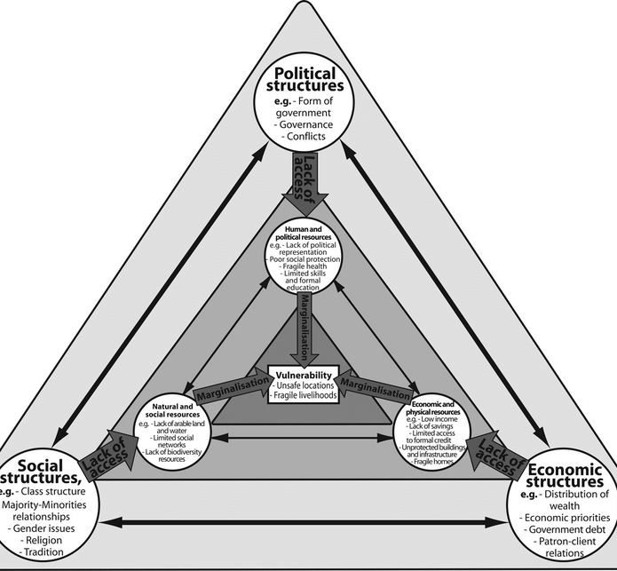
Triangle of Vulnerability

Slide 7
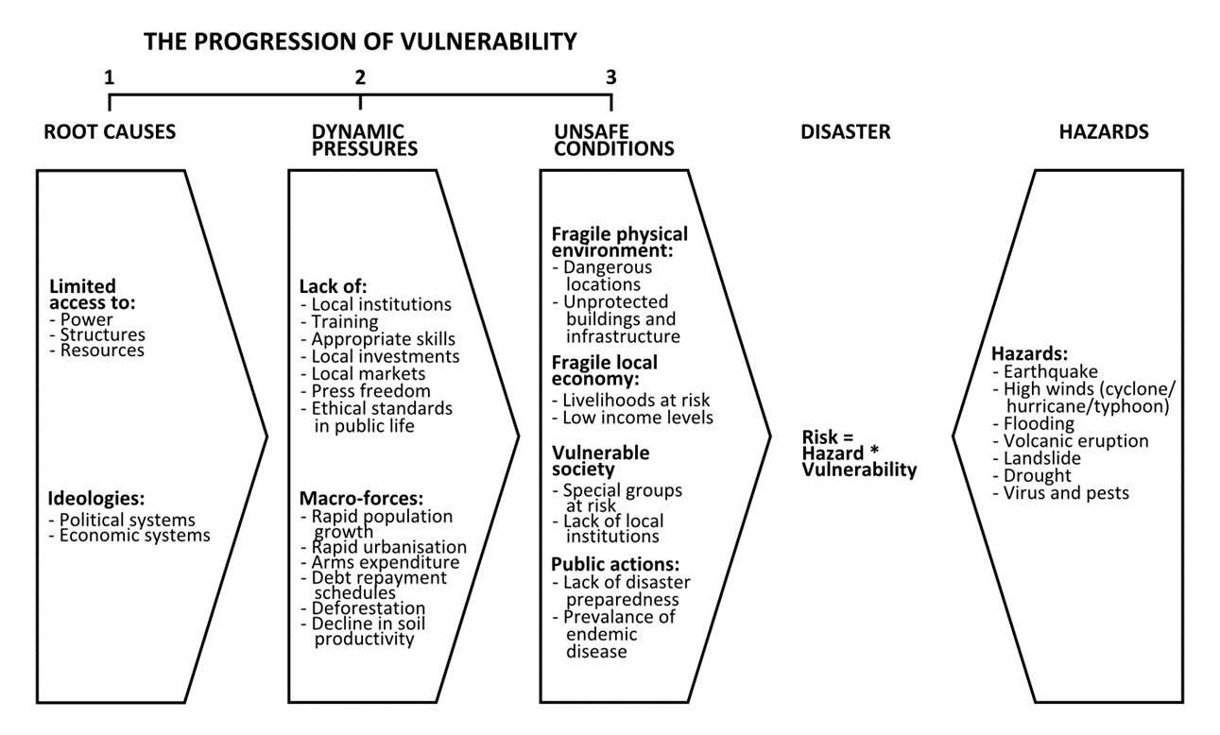
Vulnerability: Pressure and release models
Disasters sit at the intersection between the physical or environmental hazard and socio-economic and geo-political pressures.

Slide 8
Vulnerability
To determine people’s vulnerability, two questions need to be asked:
to what threat or hazard are they vulnerable?
what makes them vulnerable to that threat or hazard?
Counteracting vulnerability requires:
Reducing the impact of the Hazard itself where possible (through mitigation, prediction and warning, preparedness)
Building Capacities to withstand and cope with hazards
Tackling the root causes of vulnerability, such as poverty, poor governance, discrimination, inequality and inadequate access to resources and livelihoods.
Physical, economic, social and political factors determine people’s level of vulnerability and the extent of their capacity to resist, cope with and recover from hazards. Clearly, poverty is a major contributor to vulnerability. Poor people are more likely to live and work in areas exposed to potential hazards, while they are less likely to have the resources to cope when a disaster strikes.
(IFRC 2018)

Slide 9
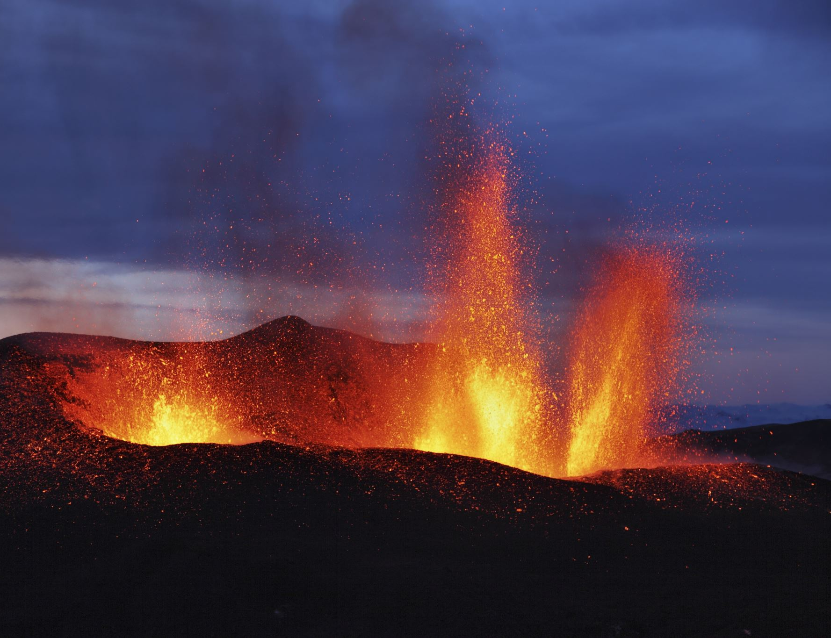
Vulnerability Exercise (40 minutes)
In small groups - consider what the direct and indirect economic, social, physical and cultural/environmental losses are for communities living in hazard prone areas.
Every type of hazard will have differing impacts so aim to explore a plethora of real-world examples to assist you in your discussions.

Slide 10
 | Human-Social | Physical | Economic | Cultural/ Environmental
Direct Losses
Indirect Losses

Slide 11
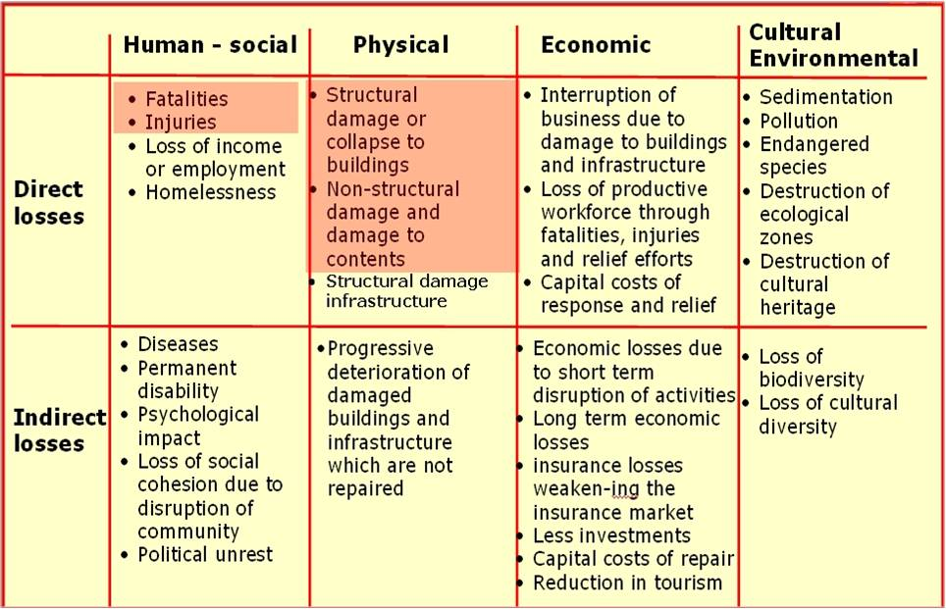

Slide 12
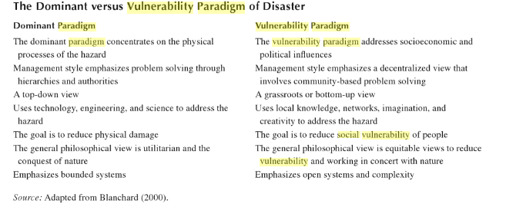
The Dominant vs Vulnerability Paradigm

Slide 13
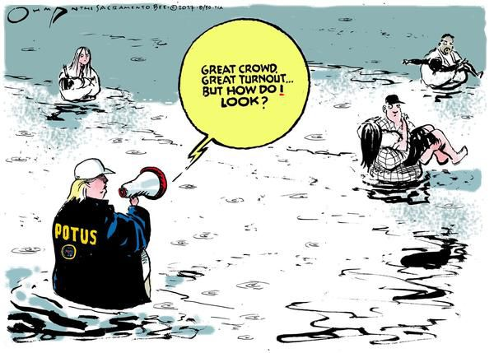
Disasters as Producing Politics
“Disasters as prime empirical sites to understand politics.”
Essentially disasters are prime events for understanding the current nature of politics in a place.
Reflective of positive or negative aspects of governance in other areas and highlight in many cases the need for wider change in the politics within that place.
Link to the notion of a ‘window of opportunity’ where it can be understood that disasters unveil wider problems in a place and therefore draw light on the need for further change.
(Guggenheim 2014)

Slide 14
Politics producing Disasters
“Politics itself as (producing disaster)”
“Politics as itself a disaster due to the effect of political decisions”
Could weak political decisions and poor governance be responsible for a disaster taking place or being exacerbated?
Obviously, this is more pertinent within humanitarian crises but what about in the event of a natural hazard?
Has a lack of guidance, efficient structures, preparation plans resulted in a disaster event?

Slide 15
International Politics and Economics
This image is from Jamaica in 1980's - Jamaica underwent significant structural adjustment to pay back a loan borrowed from the International Monetary Fund
What do you think structural adjustment might mean and how might that have an impact on Jamaica's vulnerability and capacity to cope with a natural hazard?

Slide 16
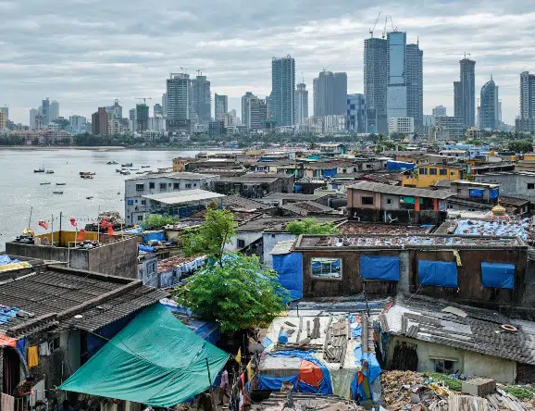
Disaster as Producing Politics
Disasters 'unmask the nature of society's social structure' (Oliver-Smith 2002:9)
What do we mean by this?

Slide 17
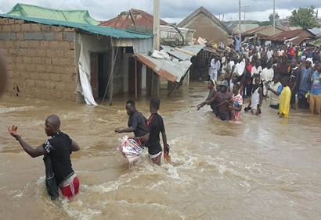
Politics and Spatial Marginalisation
This is annual flooding in Abuja, Nigeria.
Which communities may be recognised as spatially marginalised?
Consider the political support and economic assistance given to rural and spatially marginalised communities.
Do politics impact how resources and assistance are distributed to certain groups? Consider political strongholds/potential voters for example.
How do communities in these areas cope? Reciprocal support/shared resources? (i.e.: Social Capital).
Does this excuse a lack of support from Governments?

Slide 18
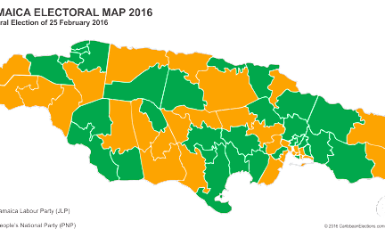
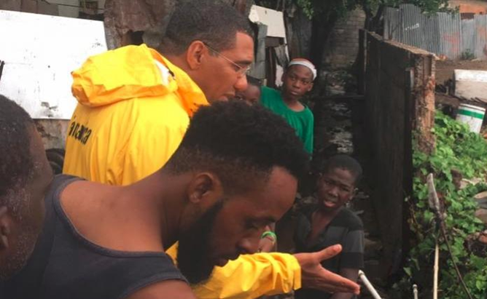
Disaster Politics
In Jamaica where clear divisions exist between communities across political divides, the PNP and JLP use their position to support their own communities before the opposition.
This means that a community who voted for the opposition party may receive aid, support and information later than other communities affected by disasters.

Slide 19
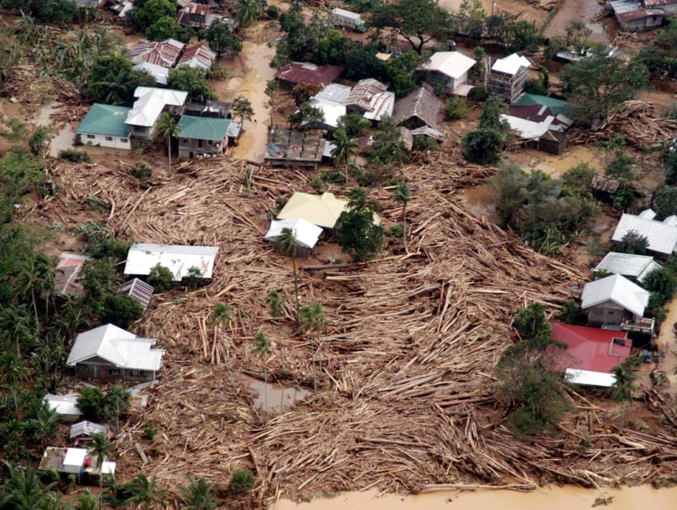
Politics affecting Nature
In November 1991, a 15-minute flash flood spawned by Typhoon Uring, devastated Ormoc City, killing an estimated 8,000 people.
Extensive illegal logging has occurred in the region for several years, reducing forest cover to less than 18% and this was blamed for the flooding and mudslides but what other role does the Government have here?
https://www.youtube.com/watch?v=MxMdWxM8FAI

Slide 20
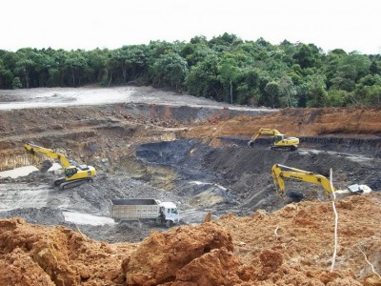
Politics affecting Nature
The Indonesian National Board for Disaster Management Agency (BNPB) said there had been a staggering 185 natural disasters in Indonesia in the first three weeks of 2021 alone.
In this case what disasters are happening?
Why are they happening?
What role does governance have in this?
What about the international community?

Slide 21
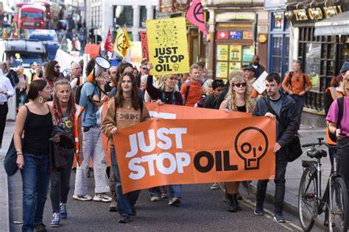
Politics affecting Nature
Governmental decisions around the use of oil as a fuel source.
What is being done to prevent major future oil spills?
What impacts do oil spills have on biodiversity?
What impact does this have for the environment?
What efforts are being made to source other renewable sources?
What about the question of human rights and arguably political violations in oil rich nations?
*This will be discussed further later in the module.

Slide 22
Disaster Policy and Frameworks
Why are frameworks for disaster risk reduction and management necessary?
Why might they be difficult to create and maintain?
Which frameworks are you aware of on Disasters?
Are you aware of any other strategies or frameworks which may influence how we approach or manage disasters?
Have you heard of the Sustainable Development Goals?

Slide 23
References
Albrecht, F. (2017). The Social and Political Impact of Natural Disasters Investigating Attitudes and Media Coverage in the Wake of Disasters. http://urn.kb.se/resolve?urn=urn:nbn:se:uu:diva-320680
Guggenheim, M. (2014). Introduction: Disasters as politics - politics as disasters. In Sociological Review (Vol. 62, Issue SUPPL1, pp. 1–16). Blackwell Publishing Ltd. https://doi.org/10.1111/1467-954X.12121
Little, D. I., Sheppard, S. R. J., & Hulme, D. (2021). A perspective on oil spills: What we should have learned about global warming. In Ocean and Coastal Management (Vol. 202). Elsevier Ltd. https://doi.org/10.1016/j.ocecoaman.2020.105509
Rydén, O., Povitkina, M., Jagers, S. C., & Sjöstedt, M. (2024). Political Consequences of Natural Disasters: Accidental Democratization? https://www.v-dem.net

