Slide 1
CCP-LAW
Curricula development on Climate Change Policy and Law
Climate Change and Energy
Topic 5:
ENERGY POLICY AND LAW IN MALAYSIA
Project No of Reference: 618874-EPP-1-2020-1-VN-EPPKA2-CBHE-JP:
The European Commission's support for the production of this publication does not constitute an endorsement of the contents, which reflect the views only of the authors, and the Commission cannot be held responsible for any use which may be made of the information contained therein.

Slide 2
Introduction
Malaysia's energy policy is shaped by the Malaysian Government, addressing aspects of energy production, distribution, and consumption.
The regulatory role in this sector is under the purview of Minister of Natural Resources and Environmental Sustainability and undertaken by various entities contribute to the energy landscape, including Energy Commission, energy supply and service companies, research and development institutions, and consumers.
Notable players in Malaysia's energy sector are government-linked companies such as Petronas and Tenaga Nasional Berhad.

Slide 3
The formulation and implementation of Malaysia's energy policy are significantly influenced by key governmental agencies, notably the Energy Commission (Suruhanjaya Tenaga) and the Malaysia Energy Centre (Pusat Tenaga Malaysia). These agencies play pivotal roles in shaping the regulatory framework and ensuring the efficiency and sustainability of the country's energy sector.
The foundation of Malaysia's energy policy is firmly established in a comprehensive set of legislative acts and regulations. These legal frameworks provide the necessary structure and guidelines for the energy industry to function effectively. Some of the key legislative acts and regulations that underpin Malaysia's energy policy include:
Petroleum Development Act 1974: This legislation outlines the framework for the exploration, development, and production of petroleum resources in Malaysia.
Electricity Supply Act 1990: Governing the electricity sector, this act provides the legal framework for the generation, transmission, and distribution of electricity in Malaysia.
Gas Supply Acts 1990: These acts establish the regulatory framework for the supply and distribution of natural gas, playing a crucial role in Malaysia's energy mix.
Electricity Regulations 1994: These regulations provide detailed guidelines and standards for the electricity sector, ensuring safety, reliability, and efficiency.

Slide 4
Gas Supply Regulation 1997: This regulation complements the Gas Supply Acts, offering specific guidelines for the supply and distribution of natural gas.
Energy Commission Act 2001: This act establishes the Energy Commission (Suruhanjaya Tenaga) as the regulatory authority overseeing the electricity and gas supply industries.
Renewable Energy Act 2011: Focused on promoting and regulating renewable energy sources, this act encourages the integration of sustainable and environmentally friendly energy options into the national energy mix.
Sustainable Energy Development Authority Act 2011: This legislation establishes the Sustainable Energy Development Authority (SEDA) as an entity responsible for promoting and developing sustainable energy in Malaysia.

Slide 5
In addition, there are policies that collectively address various facets of Malaysia's energy landscape, including fossil fuel management, sustainable resource use, energy diversification, efficiency, renewable energy promotion, green technology adoption, low-carbon urban development, and support mechanisms for renewable energy projects. The policies contribute to a comprehensive and sustainable approach to energy and environmental management in the country. Some of the examples are as follows:-
National Petroleum Policy 1975: This policy document sets out the overarching objectives and strategies for the development and management of Malaysia's petroleum resources.
National Depletion Policy 1980: Focused on sustainable resource management, this policy addresses the prudent utilization of natural resources to ensure long-term availability.
National Energy Policy 2022-2040 (NEP): The NEP outlines the overall energy strategy for Malaysia, including goals for energy security, sustainability, and affordability. It typically covers aspects such as energy production, consumption, efficiency, and diversification. NEP has the objectives of enhancing macroeconomic resilience and energy security, achieving social equitability and affordability and ensuring environmental sustainability.
Renewable Energy Policy and Action Plan (REAP): Malaysia has been working on promoting renewable energy sources to diversify its energy mix. The REAP provides a framework for the development and utilization of renewable energy, including solar, wind, biomass, and hydropower.
National Energy Efficiency Action Plan: A strategy for a well-coordinated and cost-effective implementation of energy efficiency measures in the industrial, commercial and residential sectors, which will lead to reduced energy consumption and economic savings for the consumers and the nation. However, it is only confined to electricity usage and does not cover the other aspects of the energy sector.

Slide 6
Energy Efficiency and Conservation Master Plan (EECMP): Focused on improving energy efficiency and reducing energy consumption, the EECMP outlines strategies and initiatives to enhance energy efficiency across various sectors, including industry, transportation, and buildings.
Electric Mobility Blueprint: Malaysia has been exploring policies and strategies to promote electric vehicles (EVs) and the development of electric mobility infrastructure. This is part of the government's efforts to reduce emissions and enhance sustainability in the transportation sector.
National Green Technology Policy (NGTP): This policy encourages the adoption and development of green technologies across various sectors, including energy. It aims to promote sustainable practices and reduce the environmental impact of economic activities.
Low Carbon Cities Framework (LCCF): As part of Malaysia's commitment to addressing climate change, the LCCF focuses on developing and promoting low-carbon cities. This involves integrating sustainable and energy-efficient practices into urban planning and development.
Feed-in Tariff (FiT) Mechanism: While not a policy per se, the FiT mechanism is an incentive program that supports the development of renewable energy projects by guaranteeing a fixed payment for the electricity generated from renewable sources.

Slide 7
National Energy Efficiency Action Plan

Slide 8
National Renewable Energy Policy
The policy vision
Achieving 20% renewable energy (RE) capacity mix by 2025
Implementing Enhanced Net Energy Metering (NEM) And Solar Leasing
Implementing Large Scale Solar Programme 3 (LSS3)
Implementing Non-Solar RE Projects
Establishing RE Facilitation Programmes In Sustainable Energy Development Authority (SEDA) Malaysia
Enabling Greater Access To Renewable Energy Sources
Objectives
To increase RE contribution in the national power generation mix;
To facilitate the growth of the RE industry;
To ensure reasonable RE generation costs;
To conserve the environment for future generations; and
To enhance awareness on the role and importance of RE.

Slide 10
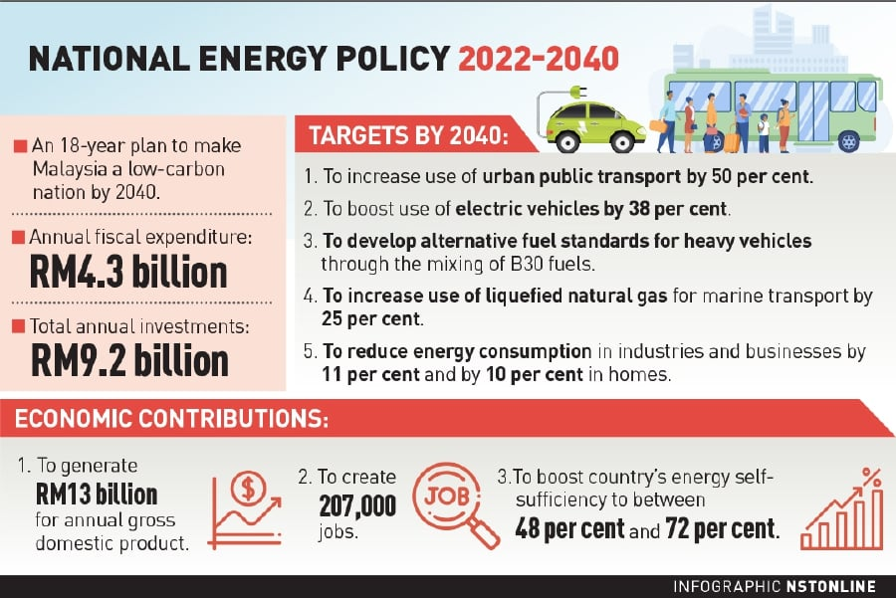

Slide 11
Low Carbon Nation Aspiration 2040 - under the National Energy Policy, 2022-2040
As part of the NEP, the Malaysian Government had developed the Aspiration which is aimed at producing a low carbon economy with particular focus on:
It is worth highlighting that one of the short-term implementation plan of the Aspiration is the creation of a new Energy Efficiency and Conservation Act ("EECA") which will set out minimum energy performance standards for a range of energy intensive industrial equipment, establish mandatory energy audits for certain categories of energy consumers (e.g. large industrial) as well as penalties for non-compliance.
It is expected that the Aspiration will create significant positive economic development impact with a higher GDP of RM13 billion per year for Malaysia and the creation of approximately 207,000 new jobs. The Government also intends to introduce new initiatives to attract investments to spur the development of low carbon technologies to achieve the goals and targets of the Aspiration.
Targets | 2018 | 2040
a. Increase in urban public transport modal share | 20% | 50%
b. Increase electric vehicle (EV) penetration | <1% | 38%
c. Alternative lower carbon fuels in heavy transport | B5 blend | B30 blend
d. Usage of LNG as alternative fuels in marine transport | 0% | 25%
e. Increase in percentage of industrial and commercial energy efficiency savings | <1% | 11%
f. Increase in percentage of residential energy efficiency savings | <1% | 10%
g. Increase in total installed capacity of renewable energy (RE) | 7,597MW | 18,431MW
h. Reduction of coal in installed capacity | 31.4% | 18.6%
i. Increase in percentage of RE in total primary energy supply | 7.2% | 17%

Slide 12
NEP Key Action Plans - under the National Energy Policy, 2022-2040
1. Energy
Long-term pipeline of large scale solar (LSS) projects to ensure domestic energy self-sufficiency and environmental sustainability. Incentivise dual-use-agri-voltaic solar farms to increase land productivity and environmental sustainability. Consider feasibility of the usage of floating solar including its synergy with hydropower. Extend net energy metering (NEM) to continue spur solar development prior to transitioning to an alternative form of compensation scheme. Increase capital access for distributed solar with rooftop solar aggregation and unlock attractiveness of distributed solar with P2P and virtual Power Purchase Agreements (VPPAs). Conduct studies to identify potential alternative energy supply such as waste-to-energy, 3rd generation bioenergy, solar thermal, ocean thermal, geothermal and wind energy in specific targeted regions. Match private sector investment with government grants especially in early proof-of-concepts as well as deployment and scale-up for high potential alternative energy supply sources. Identify bio-based resources strategy for energy and non-energy uses to utilise the advantage of having ample amount of bio-based feedstock. Improve the use of bioenergy for power generation (biomass or biogas plants) which may result in an increase of waste-to-energy projects, particularly to support cost-effective rural electrification. Improve the use of biofuels penetration in existing transport and industry uses. Invest in grid infrastructure upgrade and energy storage to accommodate greater variable RE penetration, including the digitalisation and modernisation of the power system (i.e. smart grids). Promote the implementation of green VPPAs to increase offtake choice to attract ESG investments (e.g. by RE100 companies). Undertake market reform studies in connection with electricity market liberalisation and a conducive third party grid access scheme. Invest into the timely expansion of cost-effective energy import infrastructure to improve security of supply.

Slide 13
2. Hydrogen
Establish a clear framework and strategy to encourage the development of a hydrogen economy. Develop a domestic hydrogen ecosystem supported by research and development (R&D), technology deployment and commercialisation capabilities across targeted areas along the hydrogen value chain of production, distribution and end-use application Develop hydrogen specific regulation which applies to production, transportation and end-use applications.
3. Carbon Footprint Reduction
Encourage, and gradually mandate private sector carbon footprint accounting and reporting through internationally recognised standards. Permit voluntarily certify carbon footprint position through endorsed certification entites. Ensuring the natural gas infrastructure build out (for both physical and virtual pipeline systems) is strategic, timely and cost-effective.

Slide 14
4. Energy Vehicle
Support the promotion of energy vehicles (EV) with investments, financing and capability building to enhance local EV manufacturing and supply chain ecosystem. Undertake focused planning and support with initial public-private funding to support charging infrastructure build out and other relevant physical enablers to achieve the desired EV penetration. Introduce regulations to assist in the development and adoption of EV.
5. Oil and Gas
Continue the development of petrochemical hubs in Sabah (Sipitang Oil and Gas Industrial Park) and Sarawak (Bintulu Petrochemical Hub) to improve and strengthened Malaysia's natural gas advantage. Enhance the positioning of existing Peninsular petrochemical hubs such as Kerteh and Pengerang to create spillover effects to local supply chains and communities to boost socioeconomic development. Ensuring the natural gas infrastructure build out (for both physical and virtual pipeline systems) is strategic, timely and cost-effective.

