Slide 1
CCP-LAW
Curricula development on Climate Change Policy and Law
Subject title: Climate Change Policy
Instructor Name : Dr. Rahul Nikam
Project No of Reference: 618874-EPP-1-2020-1-VN-EPPKA2-CBHE-JP:
The European Commission's support for the production of this publication does not constitute an endorsement of the contents, which reflect the views only of the authors, and the Commission cannot be held responsible for any use which may be made of the information contained therein.

Slide 2
The contribution of trade in environmental goods and services
Introduction
Climate change mitigation can be enhanced by developing, adopting, and deploying environmental technologies (ET).
2. There is scope for intensifying trade in environmental goods (EG) and services (EGS)
Environmental goods & services serve to improve environmental outcomes
Pollution management technologies and products
Cleaner technologies and products
Resources management technologies and products
B) Trade in environmental goods has been dynamic, but not equally so in all regions

Slide 3
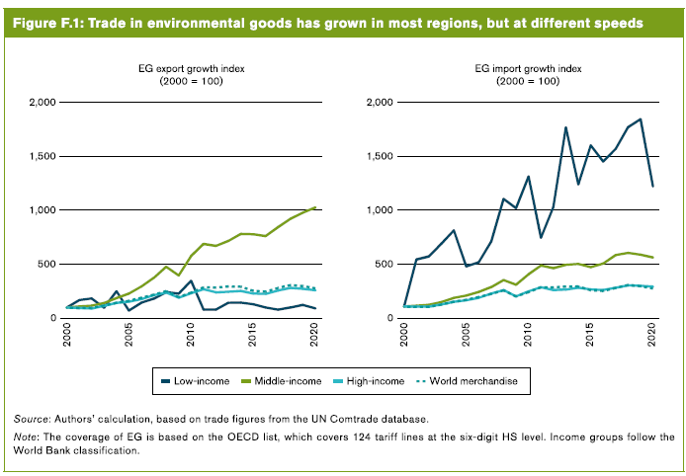
The contribution of trade in environmental goods and services

Slide 4
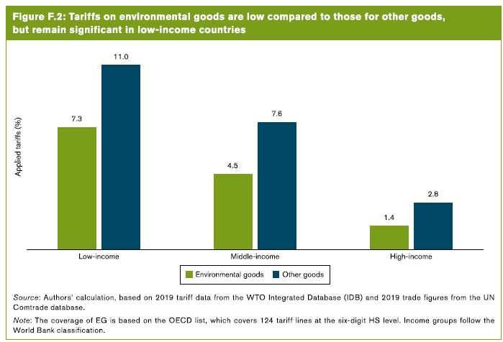
The contribution of trade in environmental goods and services
C) barriers to trade in environmental goods and services are still significant & Non-tariff Measures (NTMs)

Slide 5
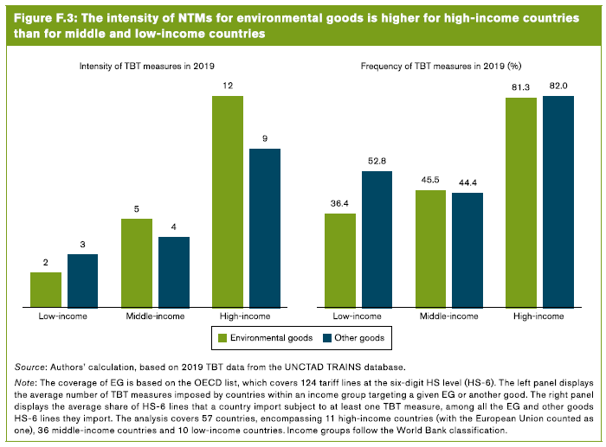
The contribution of trade in environmental goods and services
C) barriers to trade in environmental goods and services are still significant & Non-tariff Measures (NTMs)

Slide 6
The contribution of trade in environmental goods and services
3. Trade in environmental goods and services can contribute to climate change mitigation
Trade in EGS can contribute to climate change mitigation through three main channels i.e. Scale effect, composition effects, and technique effects
Opening up trade in energy-related environmental goods would reduce emissions and raise GDP in all regions. Four scenarios combining reductions in tariffs & NTMs for EREG and EPP are considered
Elimination of tariffs on EREG;
Elimination of tariff and a 25% reduction in the ad valorem equivalent of NTMs on ERGS;
Elimination of tariffs on EREG and EPP & a 25% reduction in the ad valorem equivalent of NTMs on EREG ; and
Elimination of tariffs and 25% reduction in the ad valorem equivalent of NTMs on EREG and EPP.

Slide 7
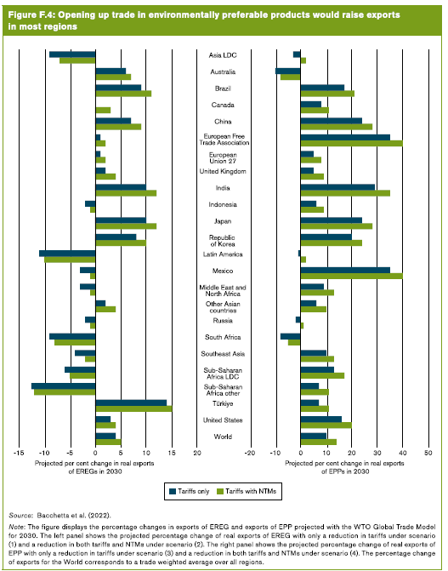
The contribution of trade in environmental goods and services

Slide 8
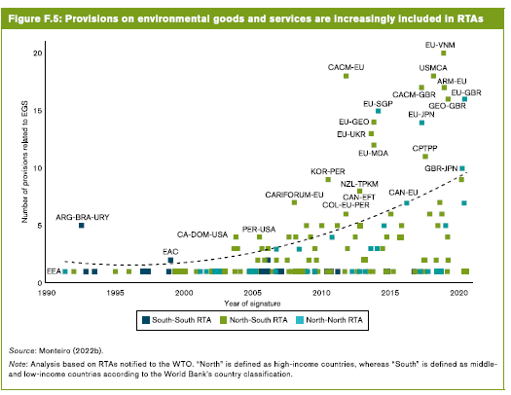
The contribution of trade in environmental goods and services
4. The development and deployment of environmental goods and services require greater international cooperation.
Facilitating trade and investment in environmental goods and services is essential

Slide 9
The contribution of trade in environmental goods and services & Overview of climate change-related non-tariff measures
B. Inclusive participation in developing and deploying environmental goods and services is important
c. More detailed data on trade and trade policy on EGS are needed

Slide 10
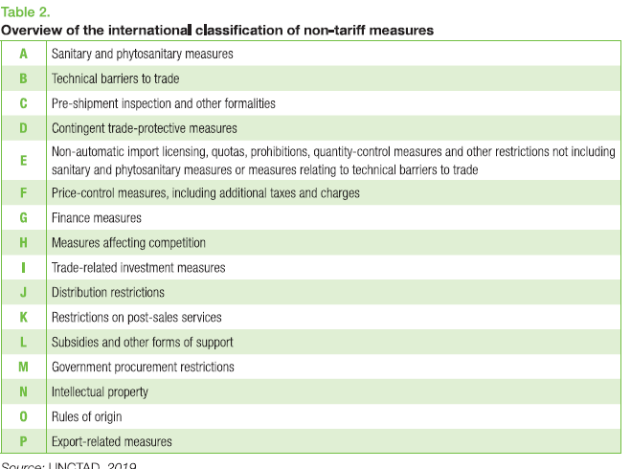
Overview of climate change-related non-tariff measures

Slide 11
Overview of climate change-related non-tariff measures
First, a significant number of climate change-related NTMs have been adopted by counties with the following regulatory objectives:
Reduce the emission of GHG from traded goods (including through the adoption of regulations on cars, fossil fuel, and biofuel)
Impose energy efficiency requirements on appliances.
Prevent deforestation and promote sustainable forest management
Ensure the quality and reliability of renewable energy production equipment
Restrict the use of plastics.

Slide 12
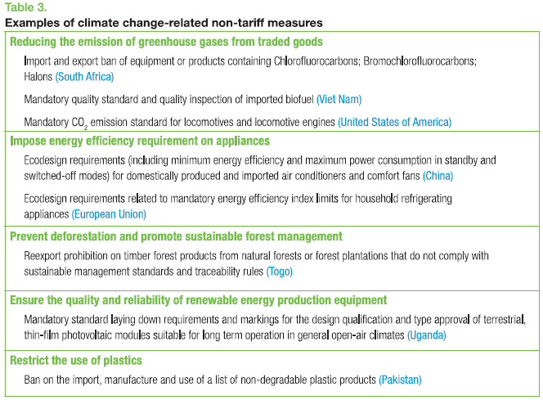
Overview of climate change-related non-tariff measures

Slide 13
Overview of climate change-related non-tariff measures
Second, TBTs account for a large majority of all identified climate change-related NTMs.
Third, in addition to TBTs, countries have adopted various other types of climate change-related NTMs such as Pre-shipment inspections; Non-automatic import licensing; Quotas and prohibitions; Price control measures; Finance measures; Measures affecting competition; Trade-related investment measures; and Export-related measures.

Slide 14
Overview of climate change-related non-tariff measures
2.1. Focus on climate change-related technical barriers to trade
Technical barriers to trade comprise technical requirements on product characteristics or production methods, as well as related conformity assessment procedures.
Over the last few decades, there has been a steady increase in the adoption and use of technical regulations, labeling schemes, and conformity assessment procedures to implement environmental (and climate change mitigation) objectives.
Climate change-related TBTs aim to decrease GHG emissions directly or indirectly arising from the production, use, and disposal of both domestically produced and imported goods (WTO/UNEP, 2009).

Slide 15
Overview of climate change-related non-tariff measures
2.1.1. Technical regulations
Technical regulations have been used in a wide variety of activities including those related to energy efficiency; forestry/deforestation; transportation and vehicles; renewable energy and biofuels; plastics; and sustainable production schemes.
Technical regulations to promote energy efficiency and reduce emissions levels have been adopted by most developed countries and increasingly by developing countries as well.
Climate change-related technical regulations can be classified according to different parameters:
First, they can be imposed on either products and/or process and production methods (PPMs).
Second, technical regulations can be based either on product characteristics or on performance.

Slide 16
Further Reading
Trade and climate change https://www.wto.org/english/tratop_e/envir_e/climate_intro_e.htm
World Trade Report 2022 Climate change and international trade https://www.wto.org/english/res_e/publications_e/wtr22_e.htm

