Slide 1
CCP-LAW
Curricula development on Climate Change Policy and Law
Subject title: Study of the contents of sustainable development as a key principle of EU primary and secondary legislation, describing its components (integration, intra- and inter-generational equity, precaution, the polluter-pays-principle, co-operation, sustainable use of natural resources).
Instructor Name: PROF. ABHINAV SHRIVASTAVA & PROF. RAJ VARMA
Project No of Reference: 618874-EPP-1-2020-1-VN-EPPKA2-CBHE-JP:
The European Commission's support for the production of this publication does not constitute an endorsement of the contents, which reflect the views only of the authors, and the Commission cannot be held responsible for any use which may be made of the information contained therein.

Slide 2
DEFINITION OF SUSTAINABLE DEVELOPMENT
DEFINITION:
The European Commission, under the leadership of President Von Der Leyen, views sustainable development as a fundamental principle guiding policymaking. Sustainable development entails meeting the needs of the present without compromising the ability of future generations to meet their own needs. It encompasses economic, social, and environmental considerations, striving for a balance between these dimensions.
Importance of Integrating Sustainable Development Principles into Legislation:
The Commission recognizes the significance of embedding sustainable development principles into legislation. By doing so, policies and actions are aligned with long-term sustainability goals, contributing to the well-being of current and future generations. Legislation integrating sustainable development principles promotes responsible resource management, economic prosperity, social equity, and environmental protection. This ensures that the EU addresses pressing global challenges such as climate change, biodiversity loss, social inequality, and economic instability effectively, leading to a sustainable future.

Slide 3
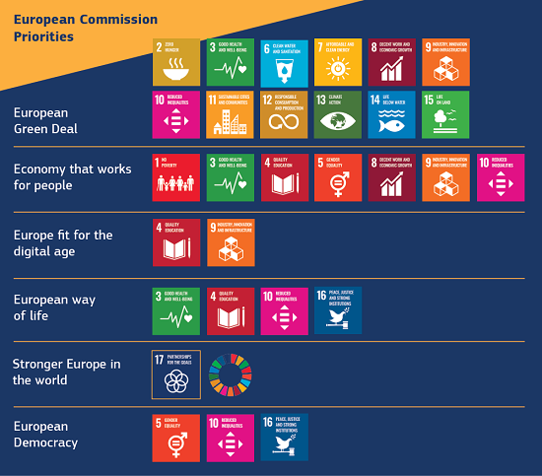

Slide 4
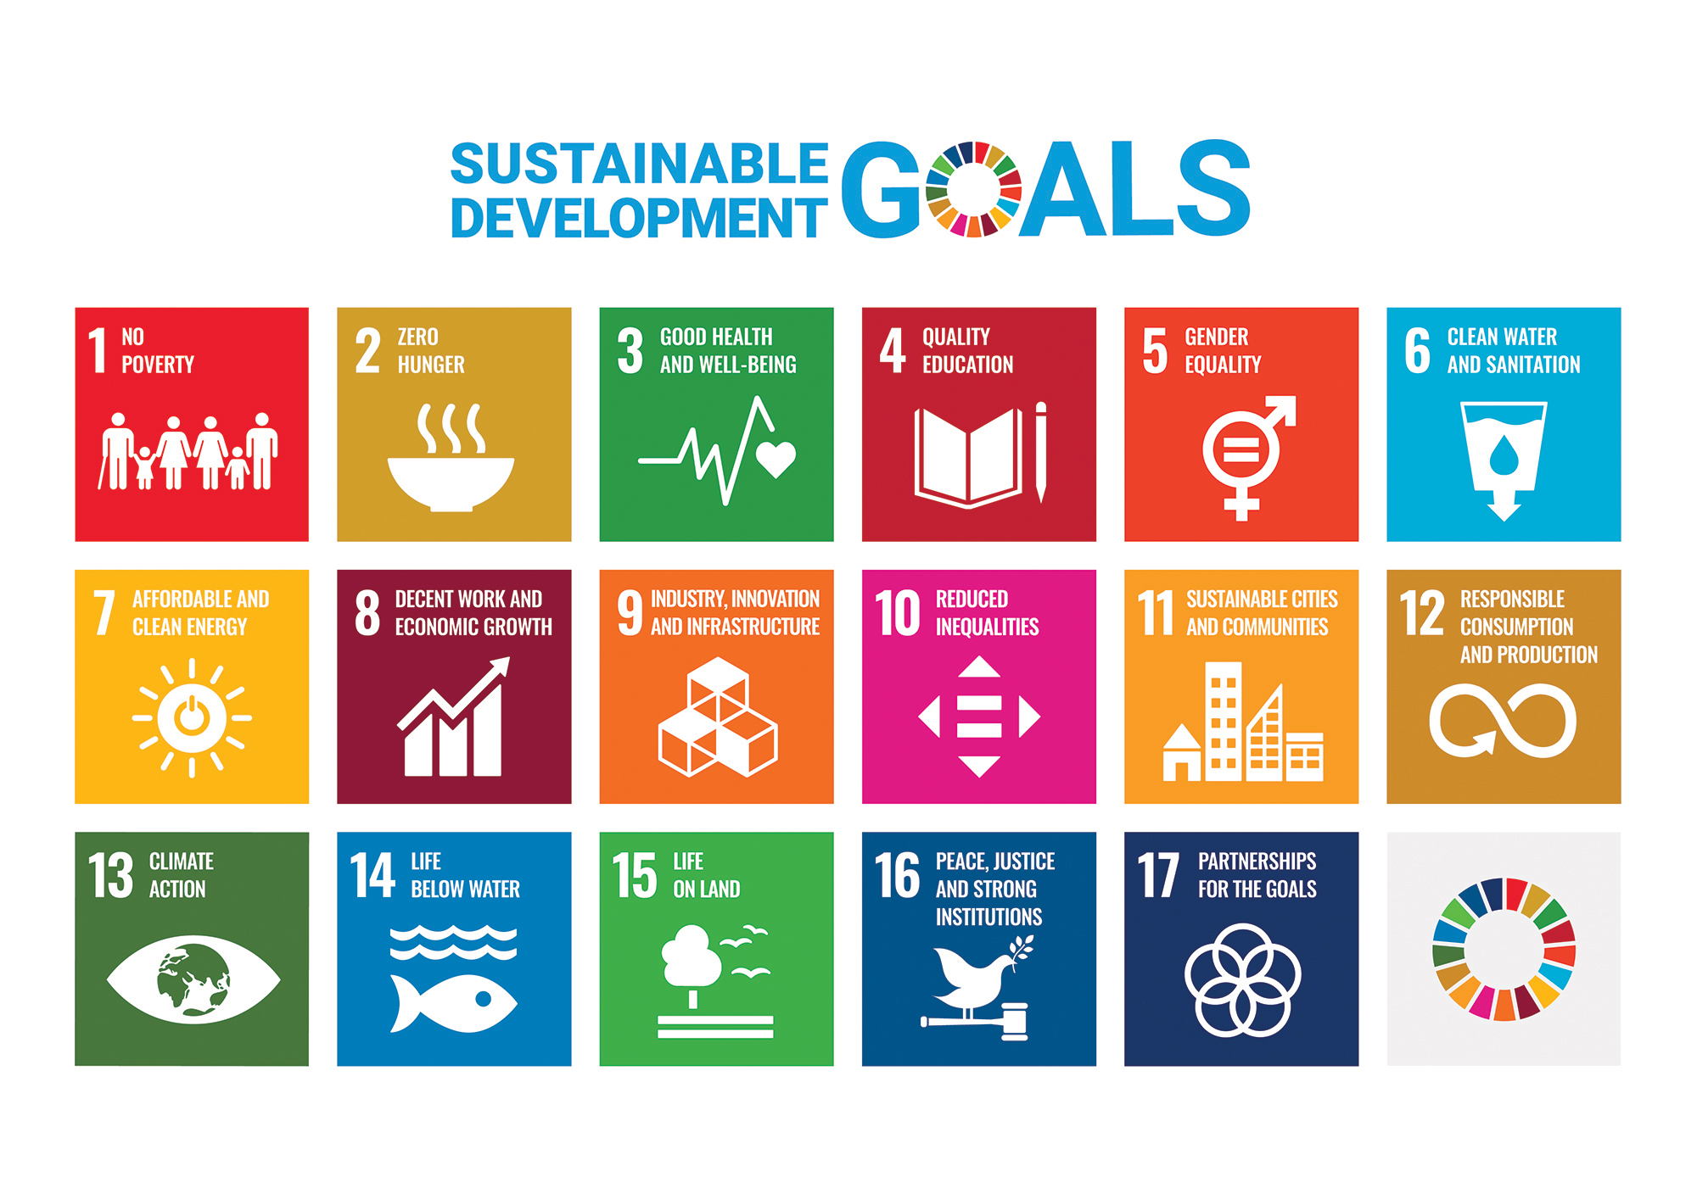
UN’S SUSTAINABLE DELOPMENT GOALS
Sustainable Development Goal 1: No poverty
Sustainable Development Goal 2: Zero hunger
Sustainable Development Goal 3: Good health and well-being
Sustainable Development Goal 4: Quality education
Sustainable Development Goal 5: Gender equality
Sustainable Development Goal 6: Clear water and sanitation
Sustainable Development Goal 7: Affordable and clean energy
Sustainable Development Goal 8: Decent work and economic growth
Sustainable Development Goal 9: Industry, innovation and infrastructure
Sustainable Development Goal 10: Reduced inequalities
Sustainable Development Goal 11: Sustainable cities and communities
Sustainable Development Goal 12: Responsible consumption and production
Sustainable Development Goal 13: Climate action
Sustainable Development Goal 14: Life below water
Sustainable Development Goal 15: Life on land
Sustainable Development Goal 16: Peace, justice and strong institutions
Sustainable Development Goal 17: Partnerships for the goals

Slide 5
INTEGRATION
Integration refers to the cohesive incorporation of sustainable development principles into various aspects of policymaking, ensuring that economic, social, and environmental considerations are harmonized and mutually reinforcing.
In the context of the European Commission's whole-of-government approach, integration involves mainstreaming the Sustainable Development Goals (SDGs) into all levels of government decision-making, including national, regional, and local authorities, as well as across different policy sectors.
Examples :-
The European Commission ensures that sustainability considerations are central to the development of new legislation, with specific provisions aimed at advancing the SDGs.
For instance, in environmental policy, directives and regulations may include targets and measures aligned with specific SDGs, such as promoting renewable energy (SDG 7) or protecting biodiversity (SDG 15).
Similarly, in social policy, initiatives may aim to reduce inequalities (SDG 10) or improve access to quality education (SDG 4) through targeted funding and support programs.
Integration is not limited to specific sectors but permeates all areas of legislation to ensure a comprehensive and coherent approach to sustainable development.

Slide 6
INTER GENRATIONAL EQUITY
The principle of intergenerational equity states that every generation holds the Earth in common with members of the present generation and with other generations, past and future. The principle articulates a concept of fairness among generations in the use and conservation of the environment and its natural resources (see also Conservation of Natural Resources; Environment, International Protection). The principle is the foundation of sustainable development.
The right to development must be fulfilled so as to equitably meet developmental and environmental needs of present and future generations (Rio Principle 3).
Integration into EU LAW:
TFEU Article 3(3): Promotion of sustainable development.
Environmental Legislation: Directives and regulations for conservation and sustainability.
Climate Change Policy: Commitment to reducing greenhouse gas emissions.

Slide 7
INTRA GENERATIONAL EQUITIES
Intragenerational equity is concerned with equity between people of the same generation and aims to assure justice among human beings that are alive today, as reflected in Rio Principle 6, mandating particular priority for the special situation and needs of developing countries, particularly the least developed and those most environmentally vulnerable.
The special situation and needs of developing countries, particularly the least developed and those most environmentally vulnerable, shall be given special priority. International actions in the field of environment and development should also address the interests and needs of all countries. (Rio Principle 6).
Integration into EU Law:
Cohesion Policy: Reduction of economic, social, and territorial disparities.
Environmental Justice: Legislation addressing environmental concerns and liabilities.

Slide 8
PRECAUTIONARY PRINCIPLE
The precautionary principle is an approach to risk management adopted by the European Union, outlined in Article 191 of the Treaty on the Functioning of the European Union (TFEU). It dictates that if there is a possibility that a policy or action may cause harm to the public or the environment, and if there is insufficient scientific consensus on the issue, then precautionary measures should be taken.
This principle emphasizes the importance of acting in the face of uncertainty to prevent potential harm, even in the absence of conclusive scientific evidence.
Developed by the case Law: “The Waddenzee Case”
Instances of the Precautionary Principle in EU Legislation:
The precautionary principle is integrated into various aspects of EU legislation, reflecting its significance in protecting public health and the environment.
One notable example is the regulatory framework for chemicals, including Regulation (EC) No 1907/2006, commonly known as REACH. REACH requires companies to assess and manage the risks associated with chemicals they produce or import, even in cases where scientific evidence of harm is inconclusive. This ensures that potentially hazardous substances are subject to precautionary measures to protect human health and the environment.
Another instance is the general regulation on food law, as outlined in Regulation (EC) No 178/2002. This regulation establishes principles and requirements for food safety and traceability within the EU, including provisions for applying the precautionary principle to address potential risks to public health associated with food consumption.

Slide 9
POLLUTER-PAYS PRINCIPLE
The polluter-pays principle is a fundamental concept in EU environmental policy, asserting that those responsible for environmental damage should pay to cover the costs incurred by society due to pollution.
It applies to various aspects, including prevention of pollution, remediation, liability (criminal, civil, and environmental), and the costs imposed on society by pollution that does occur.
This principle aims to internalize the external costs of pollution, ensuring that polluters are held accountable for the harm they cause to the environment and society.
Incorporation of the Principle in EU Legislation:
The polluter-pays principle is integrated into EU legislation across multiple sectors, reflecting its significance in environmental governance.
In waste management, for example, Directive 2008/98/EC mandates member states to establish systems for financing the costs of waste management, with polluters bearing financial responsibility.
Liability regimes for environmental damage, including criminal, civil, and environmental liability, are established under various EU directives, ensuring that polluters are legally accountable for their actions and the costs imposed on society.
Developed by a project led by the Institute for European Environmental Policy (IEEP) for DG Environment, this principle underscores the commitment of the European Union to environmental sustainability and responsible management of natural resources.

Slide 10
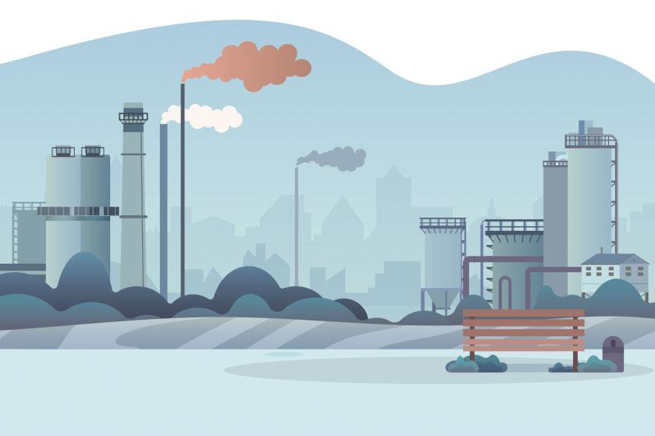
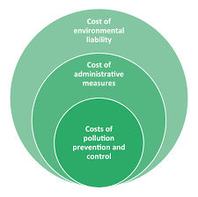
POLLUTER-PAYS PRINCIPLE

Slide 11
COOPERATION
Cooperation plays a vital role in advancing sustainable development goals, particularly in eradicating poverty, promoting economic growth, and preserving natural resources.
By collaborating with partner countries, civil society, and international organizations, the EU can leverage collective expertise, resources, and efforts to address complex global challenges effectively.
Examples:
The EU proposes legislation and policies aimed at promoting good governance, human development, and economic growth in partner countries.
EU institutions work together to provide funding and support initiatives that align with the United Nations' Sustainable Development Goals (SDGs).
Summaries of EU legislation on development and cooperation highlight efforts to address key aspects of sustainable development, including:
People: Ending poverty and hunger, ensuring dignity and equality.
Planet: Protecting future generations from environmental destruction and resource depletion.
Prosperity: Ensuring prosperous and fulfilling lives in harmony with nature.
Peace: Creating peaceful, just, and inclusive societies.
Partnership: Implementing development work through global partnerships.
The EU's cooperation efforts extend to 150 partner countries across Africa, Latin America and the Caribbean, Asia and the Pacific regions. In addition to financial aid, the EU engages in dialogues, research, and evaluation to ensure the effective use of aid and promote sustainable development outcomes.

Slide 12
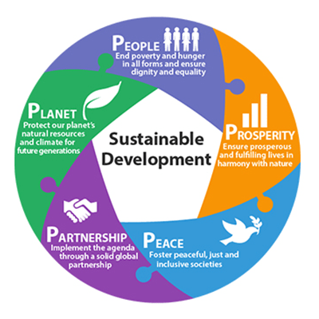
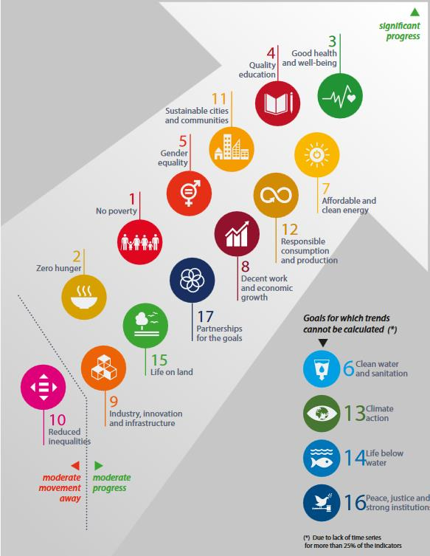
COOPERATION

Slide 13
SUSTAINABLE USE OF NATURAL RESOURCES
The unsustainable use of EU natural resources, including soil degradation and pollution, significantly contributes to the climate and biodiversity crises, costing lives and billions of euros.
Increasing droughts, wildfires, water scarcity, and flood risks tragically affect three-quarters of European countries, impacting citizens and increasing food prices.
How Does EU Legislation Promotes Sustainable Use of Natural Resources?
The European Commission proposes measures to ensure the long-term economic, social, health, and environmental benefits of sustainable natural resource use.
Proposed measures include a focus on soil resilience through a soil monitoring law, aiming to achieve healthy soils by 2050.
The proposed legislation establishes a clear definition of soil health, implements a solid monitoring framework, and mandates sustainable soil management as the norm.
Additionally, the EU promotes the use of new technologies, such as New Genomic Techniques (NGTs), to increase food system resilience, reduce chemical pesticide dependency, and cut greenhouse gas emissions.
Measures to improve plant and forest reproductive material aim to increase diversity, quality, and adaptation to climate change, ensuring stable yields and food security.
Efforts to reduce food and textile waste are also proposed, aiming to halve per capita global food waste and promote circularity in the textiles sector.

Slide 14
CASE STUDY
Water Framework Directive (WFD)
The Water Framework Directive (WFD) has been the main law for water protection in Europe since 2000.It focuses on ensuring good qualitative and quantitative health of water bodies, reducing pollution, and ensuring sufficient water for both wildlife and human needs.
Objective: The key objectives include protecting and restoring water bodies to achieve good status, both chemically and ecologically.
Law: The WFD is supported by daughter directives on groundwater and surface water quality and quantity. It mandates integrated water management and cooperation among neighboring countries through a river basin district approach.
Review: A Fitness Check concluded that the water legislation is broadly fit for purpose but requires improvements in various areas. A proposal to revise the lists of pollutants in surface water and groundwater has been adopted by the Commission.
Implementation: River Basin Management Plans are key tools for implementation, developed through extensive public consultation and valid for six-year periods. A Common Implementation Strategy (CIS) ensures harmonious implementation and addresses technical challenges through working groups and guidance documents.
This case study showcases how EU legislation, particularly the Water Framework Directive, integrates sustainable development principles by focusing on water protection, cooperation among Member States, and continuous improvement through review and revision processes.

Slide 16
CHALLENGES AND FUTURE DIRECTIONS
CHALLENGES:
Complex Interconnectedness: Achieving environmental and climate goals requires radical changes in production and consumption systems. However, these issues are intertwined with broader sustainability concerns, impacting social and economic dimensions. Holistic approaches to policy-making are essential.
Socio-Economic Considerations: Transitioning to sustainable practices can lead to socio-economic challenges, including unemployment and poverty. Addressing these dimensions ensures a socially just transition and avoids negative consequences.
Cultural Shifts and Behavioral Changes: Achieving sustainability requires changes in consumption patterns and behaviors. Shifting away from consumerism and short-termism may face resistance and requires strong advocacy and policy support.
Global Coordination: International cooperation is crucial for effective climate change mitigation. Strong agreements like the Paris Agreement are vital for global sustainability efforts.

Slide 17
CHALLENGES AND FUTURE DIRECTIONS
FUTURE DIRECTIONS
Rethinking Growth: Societies need to rethink the meaning of growth and progress for global sustainability, drawing inspiration from simplicity and social innovation.
Transforming Agriculture: Rethinking agriculture and food systems is crucial for enhancing resilience and sustainability.
Addressing Socio-Economic Impacts: Policy responses must address potential socio-economic disparities and ensure an inclusive transition to a climate-neutral economy.

Slide 18
CONCLUSION
The European Union's commitment to the 2030 Agenda and the Sustainable Development Goals (SDGs) is evident through various legislative initiatives and policy frameworks.
Sustainable development principles, such as the precautionary principle, the polluter-pays principle, and the integration of sustainability into legislation, are integral to EU policymaking.
Challenges such as economic growth, transitioning to a climate-neutral economy, and reimagining agriculture for sustainability underscore the ongoing efforts and complexities in implementing sustainable development in EU legislation.
Sustainable development is not just a goal but a necessity for the EU to address pressing environmental, social, and economic challenges.
EU legislation plays a crucial role in promoting sustainable development by integrating principles that prioritize environmental protection, social equity, and economic prosperity.
Upholding sustainable development in EU legislation ensures the well-being of current and future generations, fosters resilience to global challenges, and contributes to a more sustainable and prosperous Europe.

Slide 19
EXTRA READING MATERIAL
Sustainable development in the European Union – Monitoring report on progress towards the SDGs in an EU context – 2023 edition
https://ec.europa.eu/eurostat/en/web/products-statistical-reports/w/ks-05-23-188

