Slide 1
CCP-LAW
Curricula development on Climate Change Policy and Law
Subject title: CLIMATE CHANGE DISPUTE RESOLUTION
Instructor Name: Tran Anh Tuan
Project No of Reference: 618874-EPP-1-2020-1-VN-EPPKA2-CBHE-JP:
The European Commission's support for the production of this publication does not constitute an endorsement of the contents, which reflect the views only of the authors, and the Commission cannot be held responsible for any use which may be made of the information contained therein.

Slide 2
9.4. Communication exercises
Module 9. Practical applications and simulations
Case Study: Coastal Wind Farm Dispute
Background:
A proposed offshore wind farm project elicits strong opposition from the local fishing community concerned about impacts to their catches and livelihoods.
The wind energy company believes the project will benefit the area and help meet renewable energy goals.
Conflict escalates as both sides dig in.

Slide 3
9.4. Communication exercises
Module 9. Practical applications and simulations
Case Study: Coastal Wind Farm Dispute
Communication Exercise 1 - Active Listening Roleplay:
Participants take roles as the fishing representative and wind company liaison. The goal is to practice attentive dialogue.
They take turns sharing their perspective on the wind farm dispute for 2 minutes uninterrupted.
After one speaker finishes, the listener paraphrases back the core arguments made before responding, to demonstrate deep listening.
The exercise continues with the roles reversed. Observers provide feedback on the quality of listening demonstrated

Slide 4
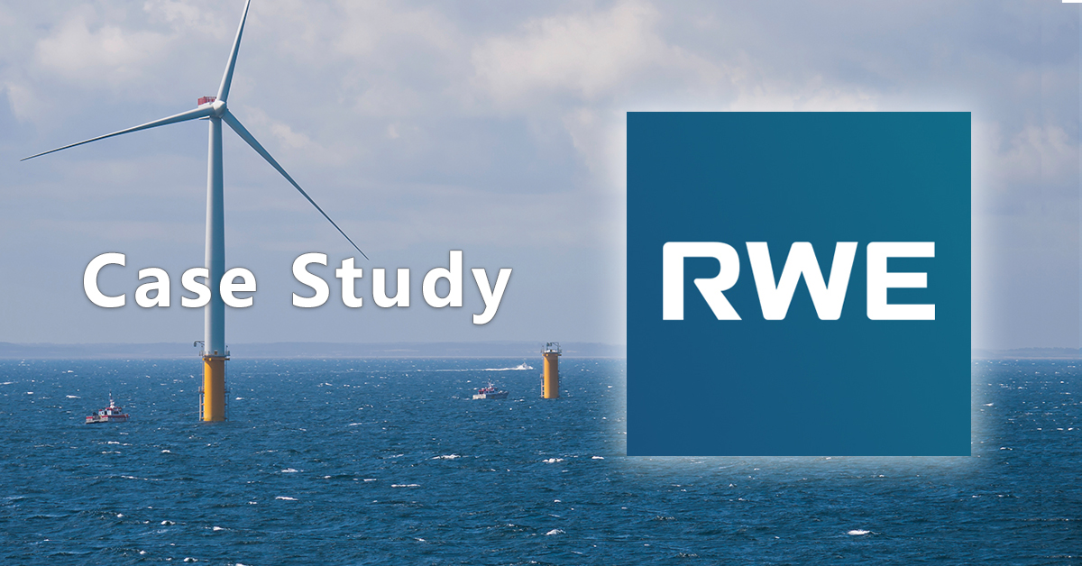
9.4. Communication exercises
Module 9. Practical applications and simulations
Case Study: Coastal Wind Farm Dispute
Communication Exercise 2 - Powerful Questioning Roleplay:
Participants roleplay a town hall meeting between the parties facilitated by a mediator.
The focus is crafting probing open-ended questions that reveal underlying interests and illuminate values.

Slide 5
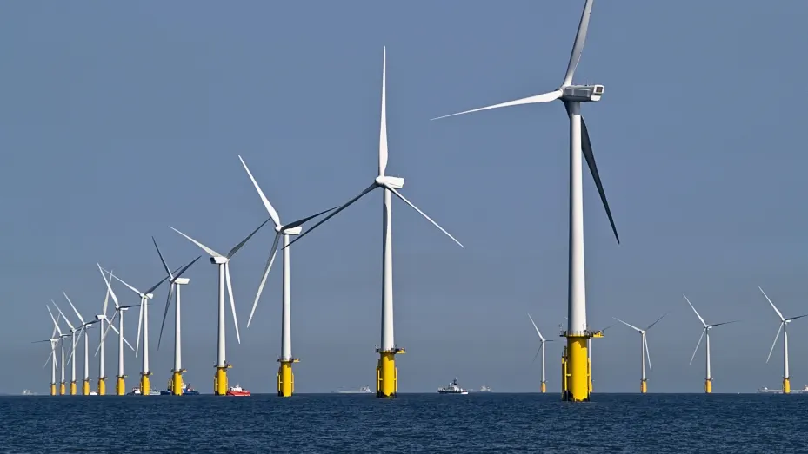
9.4. Communication exercises
Module 9. Practical applications and simulations
Case Study: Coastal Wind Farm Dispute
Communication Exercise 2 - Powerful Questioning Roleplay:
Examples are asking about desired alternatives, importance of location, bottom lines, and envisioned solutions.
The insightful questioning aims to uncover common ground and possibilities for mutually beneficial options.
Observers identify effective questions and reflect on shifts in the discussion.

Slide 6
9.4. Communication exercises
Module 9. Practical applications and simulations
Key takeaways:
Practicing core communication techniques like active listening and strategic questioning are key skills for constructively resolving climate disputes.
Applying these skills in roleplays builds competence and intuition before engaging in high-stakes negotiations.
Tailoring exercises to real-world climate contexts makes the learning immersive and relevant.

