Slide 1
CCP-LAW
Curricula development on Climate Change Policy and Law
Subject title: Climate Change Policy
Instructor Name: Dr. Rahul Nikam
Project No of Reference: 618874-EPP-1-2020-1-VN-EPPKA2-CBHE-JP:
The European Commission's support for the production of this publication does not constitute an endorsement of the contents, which reflect the views only of the authors, and the Commission cannot be held responsible for any use which may be made of the information contained therein.

Slide 2
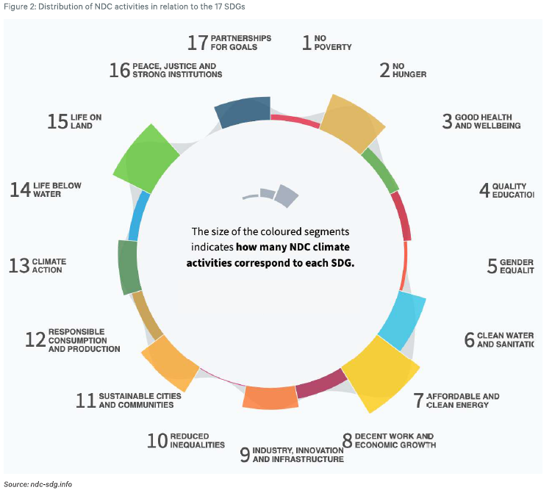
2030 Agenda through a climate lens – main findings for how climate action complements the SDGs & Discussion on NDCs & climate action plan

Slide 3
2030 Agenda through a climate lens – main findings for how climate action complements the SDGs & Discussion on NDCs & climate action plan
The top tier: SDGs with the strongest connections to NDC activities
Affordable and clean energy (SDG 7) links access to energy and energy efficiency measures to the key climate change objective to reduce greenhouse gas emissions.
Life on land (SDG 15) reflects the role of ecosystems, forest management, and land use in climate change mitigation and adaptation.
No hunger (SDG 2) makes clear that sustainable and climate-smart agriculture is seen as a key solution in the fight to limit the average temperature increase to below 2°C
Sustainable cities and communities (SDG 11) relates to climate activities focused on urban planning and public transport.

Slide 4
2030 Agenda through a climate lens – main findings for how climate action complements the SDGs & Discussion on NDCs & climate action plan
The top tier: SDGs with the strongest connections to NDC activities
Clean water and sanitation (SDG 6) relates to climate activities focusing on water efficiency and water ecosystem management.
Partnerships for goals (SDG 17) highlights the importance of providing financial support, technology transfer, and capacity building for those countries that need it the most - particularly the Least Developed Countries (LDCs) and the Small-Island Developing States (SIDS).
Strongest links to NDC activities: affordable and clean energy (SDG 7)

Slide 5
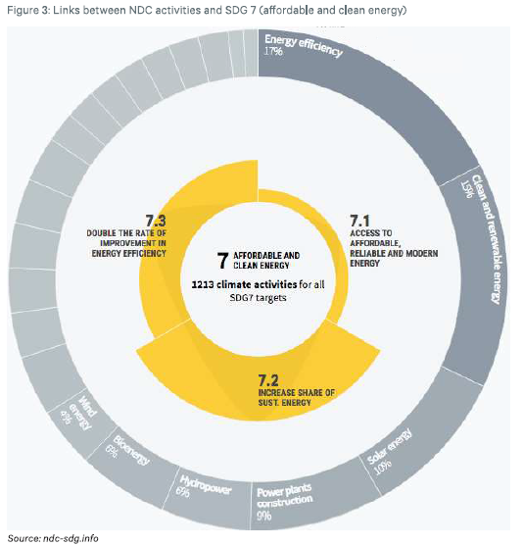
2030 Agenda through a climate lens – main findings for how climate action complements the SDGs & Discussion on NDCs & climate action plan

Slide 6
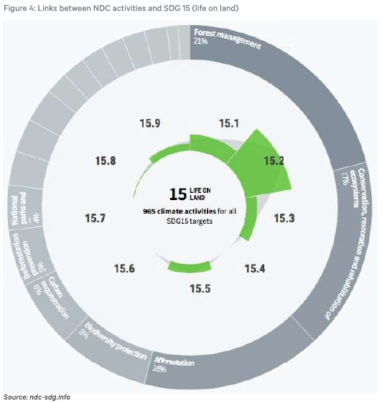
2030 Agenda through a climate lens – main findings for how climate action complements the SDGs & Discussion on NDCs & climate action plan

Slide 7
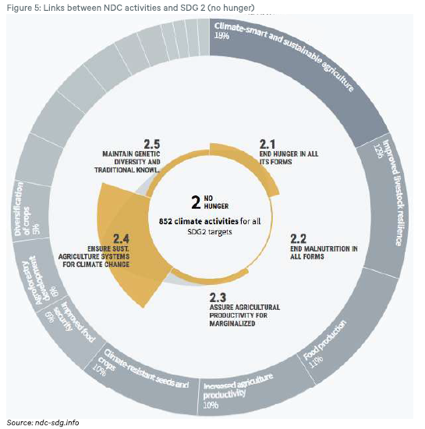
2030 Agenda through a climate lens – main findings for how climate action complements the SDGs & Discussion on NDCs & climate action plan

Slide 8
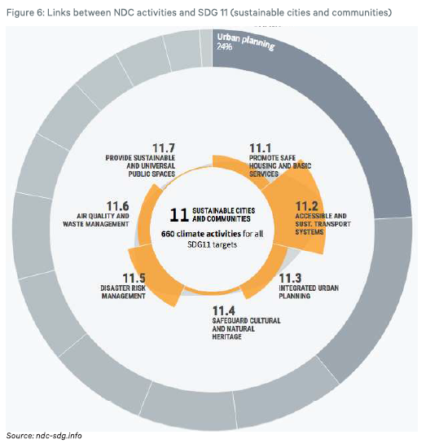
2030 Agenda through a climate lens – main findings for how climate action complements the SDGs & Discussion on NDCs & climate action plan

Slide 9
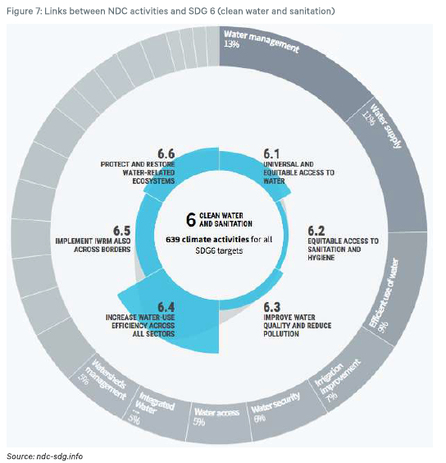
2030 Agenda through a climate lens – main findings for how climate action complements the SDGs & Discussion on NDCs & climate action plan

Slide 10
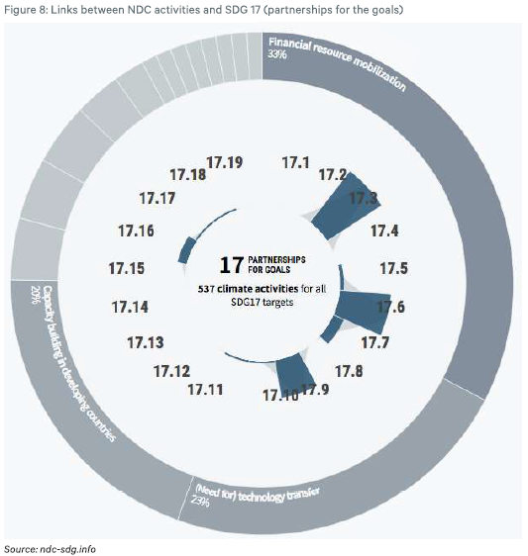
2030 Agenda through a climate lens – main findings for how climate action complements the SDGs & Discussion on NDCs & climate action plan

Slide 11
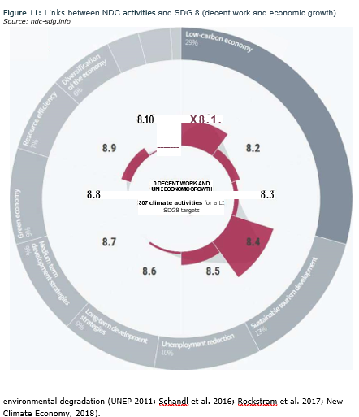
2030 Agenda through a climate lens – main findings for how climate action complements the SDGs & Discussion on NDCs & climate action plan

Slide 12
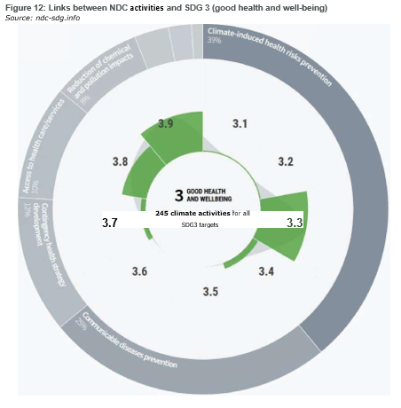
2030 Agenda through a climate lens – main findings for how climate action complements the SDGs & Discussion on NDCs & climate action plan

Slide 13
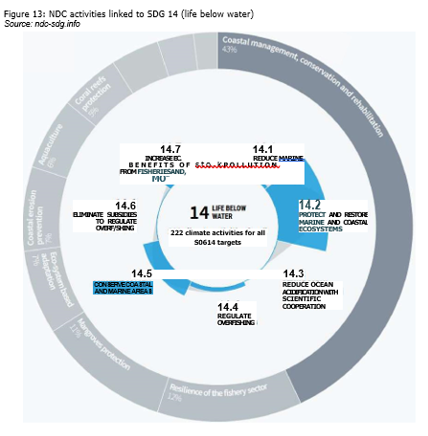
2030 Agenda through a climate lens – main findings for how climate action complements the SDGs & Discussion on NDCs & climate action plan

Slide 14
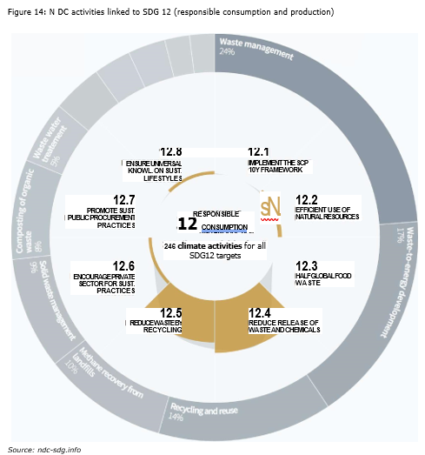
2030 Agenda through a climate lens – main findings for how climate action complements the SDGs & Discussion on NDCs & climate action plan

Slide 15
Further Reading
Connections between the Paris Agreement and the 2030 Agenda The case for policy coherence by Stockholm Environment Institute https://www.sei.org/wp-content/uploads/2019/08/connections-between-the-paris-agreement-and-the-2030-agenda.pdf

