Slide 1
CCP-LAW
Curricula development on Climate Change Policy and Law
Subject title: Climate Change Policy
Instructor Name: Dr. Rahul Nikam
Project No of Reference: 618874-EPP-1-2020-1-VN-EPPKA2-CBHE-JP:
The European Commission's support for the production of this publication does not constitute an endorsement of the contents, which reflect the views only of the authors, and the Commission cannot be held responsible for any use which may be made of the information contained therein.

Slide 2
International Trade and Climate Change
First, while climate change can have profound negative impacts on international trade, trade, and trade policies are essential elements of sound climate change adaptation strategies.
Second, although trade generates GHG emissions, trade and trade policies can foster the transition to a low-carbon economy by providing access to and spurring innovation in low-carbon technologies, disseminating best practices, and helping clean energy investments achieve the greatest reach at the lowest cost.
Third, improving the ambition and effectiveness of climate action requires greater international trade cooperation at the WTO.

Slide 3
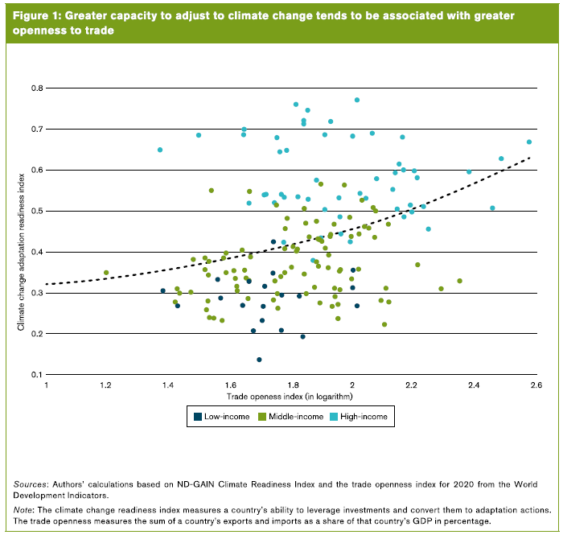
International Trade and Climate Change
Even though climate change can have profound negative impacts on international trade, trade and well-designed trade policies are essential elements of sound climate change adaptation strategies.

Slide 4
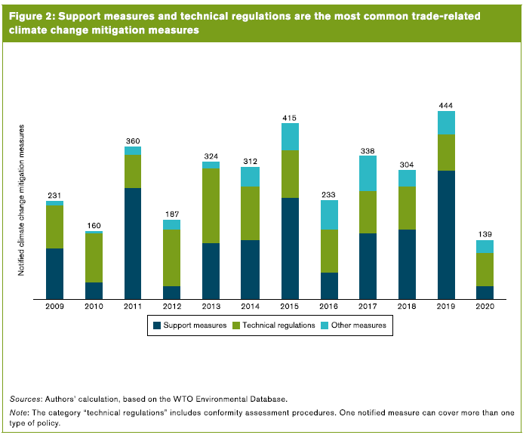
International Trade and Climate Change
Although trade generates GHG emissions, trade and trade policies can be part of the solutions to support a low-carbon transition

Slide 5
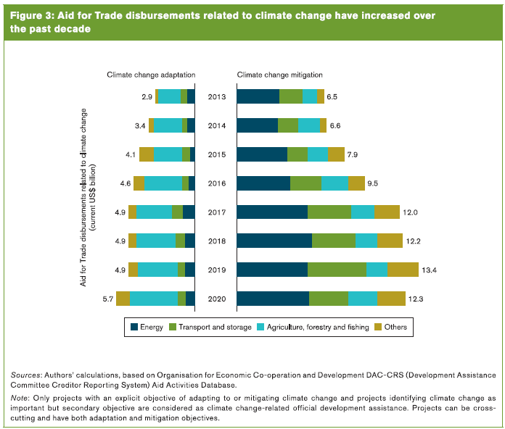
International Trade and Climate Change
Improving the ambition and effectiveness of climate change action requires greater international trade cooperation.

Slide 6
Further Reading
Trade and climate change https://www.wto.org/english/tratop_e/envir_e/climate_intro_e.htm
World Trade Report 2022 Climate change and international trade https://www.wto.org/english/res_e/publications_e/wtr22_e.htm

