Slide 1
CCP-LAW
Curricula development on Climate Change Policy and Law
Subject title: Climate Change Policy
Instructor Name: Dr. Rahul Nikam
Project No of Reference: 618874-EPP-1-2020-1-VN-EPPKA2-CBHE-JP:
The European Commission's support for the production of this publication does not constitute an endorsement of the contents, which reflect the views only of the authors, and the Commission cannot be held responsible for any use which may be made of the information contained therein.

Slide 2
Challenges and opportunities
Challenges
Adverse human health and environmental impacts usually take the form of interactions within complex systems influenced by multiple risk factors and causes.
Hazard assessment presents several challenges, in particular tensions between false positives and false negatives
Two main challenges for businesses. 1. amendments to legislation based on the precautionary principle may create costs and legal uncertainty for businesses and may therefore hinder their development or threaten their survival. 2. Furthermore, when companies see early warning signs that their products might present a hazard, they are faced with financial and ethical dilemmas.

Slide 3
Challenges and opportunities
Opportunities
OECD Report 2008 shows that the costs of inaction for society are sometimes substantial and, in certain cases, can weigh heavily on economies. Can reduce these costs even though it is not easy to estimate potential future costs in order to allow comparison with the cost of regulatory measures.
Can also serve to correct market failures that emerge when society has to pay for the external costs of adverse environmental and health effects caused by economic operators.
It may also help to avoid lengthy compensation proceedings which can drag on for decades
Applying the precautionary principle to environmental and health research can provide an opportunity to review strategies (to take account of societal information needs concerning poorly understood hazards), methodologies (in order to extend knowledge) and ways to communicate on risks (to facilitate judgments on the potential scale of possible environmental hazards).

Slide 4
Governance
1. Risks
1. Risk governance
According to the European Commission, it should ideally be based on four components:
Hazard identification;
Hazard characterization, which consists in determining the nature and severity of the adverse effects;
Appraisal of exposure, which consists in evaluating the exposure of the population or environment to the hazard;
Risk characterization, which consists in estimating the probability, frequency and severity of the known or potential adverse environmental or health effects liable to occur.
2. Risk Management
The International Risk Governance Council defines this as the design and implementation of the actions and remedies required to avoid, reduce, transfer or retain the risks. This also includes the generation, assessment, evaluation and selection of risk reduction options as well as their implementation and monitoring.
3. Risk Communication and Stakeholder Participation

Slide 5
Governance
Others have suggested alternative risk governance models.
Stirling advocates a model comprising five phases (screening, appraisal, evaluation, management and communication).
The IRGC suggests a four-step model embedded in a set of wider contexts (see Figure 3) as well as a 'concern assessment', defined as 'a systematic analysis of the associations and perceived consequences (benefits and risks) that stakeholders, individuals, groups or different cultures may associate with a hazard or cause of hazard'.

Slide 6
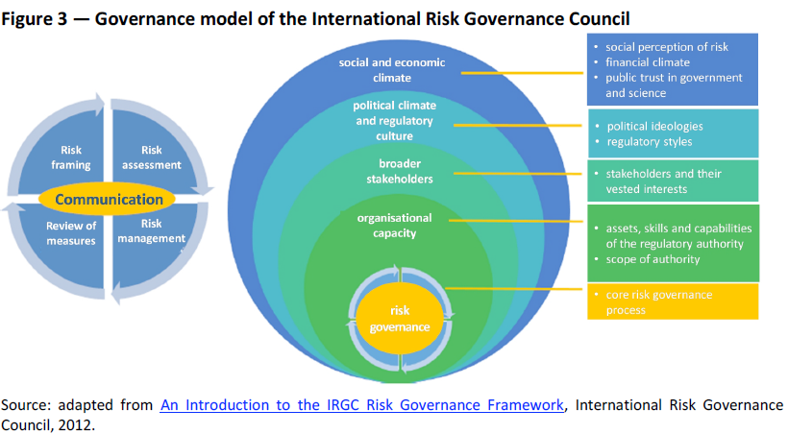
Governance- IRGC suggests a four-step model embedded in a set of wider contexts (see Figure 3)

Slide 7
Governance
2. Science-policy interface
There are several intersections between science and policy & Challenges arising at the intersection between science and policy include
• contributing scientific input to policy-making under conditions of complexity and uncertainty;
• striking the balance between curiosity-driven science (e.g., basic research) and issue driven science (e.g., development and innovation) and converting their results into policy-relevant knowledge; and
• reaffirming the role that scientific explanations play in helping to understand an issue and emphasising the inherent limitations of predictions
A report published by the SPIRAL project, funded under the 7th Framework Programme, studies nine examples of science-policy interfaces for biodiversity at national, European and international level. Lessons drawn from this study include:
• the balance to be struck between a formal approach and the need for adaptability;
• an open and transparent format complemented by a review process to ensure credibility;
• the persistent dominance of the linear model (one-way transfer of knowledge from science to policy), which hinders the development of more dynamic interfaces; and
• the need to address environmental issues through interdisciplinary interfaces involving a broad diversity of experts and transdisciplinary approaches that integrate various scientific disciplines.

Slide 8
A Way Forward
The definition is still under discussion and its status in international law is still in dispute.
The main focus of debate has now shifted to its scope of application since there are those who wish to limit it and those who wish to extend it.
Technological (and non-technological) innovations can be expected to play a central role in the transition to a decarbonised, sustainable and circular economy, as envisaged in EU policies and the vision set out in the 7th Environment Action Programme:
'In 2050, we live well, within the planet's ecological limits. Our prosperity and healthy
environment stem from an innovative, circular economy where nothing is wasted and
where natural resources are managed sustainably, and biodiversity is protected, valued
and restored in ways that enhance our society's resilience. Our low-carbon growth has
long been decoupled from resource use, setting the pace for a safe and sustainable
global society.’
The precautionary principle may be invoked to address the complexities and uncertainties inherent in such a transition.

Slide 9
A Way Forward
Furthermore, the question of adapting risk governance and science-policy interfaces in order to respond to these challenges could be raised if – as suggested by the European Environment Agency – The following four main approaches to environmental protection were more effectively taken on board in order to facilitate this transition.
Mitigate,
Adapt,
Avoid and
Restore the damage caused

Slide 10
Further Reading
The precautionary principle: Definitions, applications, and governance by Think Tank European Parliament https://www.europarl.europa.eu/thinktank/en/document/EPRS_IDA(2015)573876

