Slide 1
CCP-LAW
Curricula development on Climate Change Policy and Law
Subject title: Climate Change and Migration
Instructor Name: Dr. Shashikala Gurpur
Project No of Reference: 618874-EPP-1-2020-1-VN-EPPKA2-CBHE-JP:
The European Commission's support for the production of this publication does not constitute an endorsement of the contents, which reflect the views only of the authors, and the Commission cannot be held responsible for any use which may be made of the information contained therein.

Slide 2
TOPIC 2:Climate migration, development and social vulnerability
Total Allocated Hours: 34 hrs
Number of Sessions: 6

Slide 3
Climate, Capitalism, and Crisis
The interplay of climate change, economic systems, and social vulnerabilities has created a complex and pressing global challenge. This section explores the interconnections between these forces and the urgent need for transformative solutions.

Slide 4
Political Ecology and Epistemologies of Climate Change
Global Perspectives
Community Resilience
Interdisciplinary Insights
Climate change is a global issue that requires understanding diverse perspectives and knowledge systems across the world.
Local communities are at the frontlines of climate impacts and possess invaluable traditional ecological knowledge for adaptation.
Integrating political ecology, social science, and indigenous epistemologies offers critical insights into the power dynamics of climate change.

Slide 5
Impacts of Climate Migration on Development
Economic Disruption
Urbanization Challenges
Climate migration can disrupt local economies, straining resources and infrastructure. This can hinder economic development and increase unemployment in receiving regions.
Large influxes of climate migrants into urban areas can lead to overcrowding, housing shortages, and overwhelmed public services, making sustainable development more difficult.
Strains on Social Systems
Development Setbacks
Climate migration can increase social tensions and exacerbate inequalities, as vulnerable populations compete for scarce resources and public services in host communities.
Diverting resources to address the needs of climate migrants can divert funding and attention away from other critical development priorities, slowing overall progress.

Slide 6
Vulnerability and Climate Change
Disproportionate Impacts
Intersecting Inequalities
Compounding Crises
Adaptive Capacity
Climate change impacts are not evenly distributed across populations. Vulnerable groups such as the poor, elderly, and minorities often bear the brunt of natural disasters and environmental degradation.
Vulnerability to climate change is shaped by complex, intersecting factors like socioeconomic status, gender, race, and geographic location. Addressing these intersecting inequalities is crucial for building climate resilience.
Climate change can exacerbate existing challenges like food insecurity, conflict, and economic instability, creating a cascading effect that further heightens the vulnerability of marginalized groups.
Vulnerable populations often have limited resources and access to information, reducing their ability to adapt to the impacts of climate change. Strengthening adaptive capacity is key to fostering climate justice.

Slide 7
Challenges of climate migration for vulnerable populations
Economic Upheaval
Health Risks
Displacement from climate change can disrupt livelihoods, destroy assets, and leave vulnerable individuals without the means to rebuild their lives.
Refugees and displaced persons face increased exposure to disease, malnutrition, and mental health issues due to the stress and instability of migration.
Social Marginalization
Policy Gaps
Climate migrants, especially those from minority or impoverished backgrounds, can face discrimination, xenophobia, and exclusion in host communities.
Current legal and policy frameworks often fail to adequately protect the rights and needs of climate-displaced populations, leading to gaps in support.

Slide 8
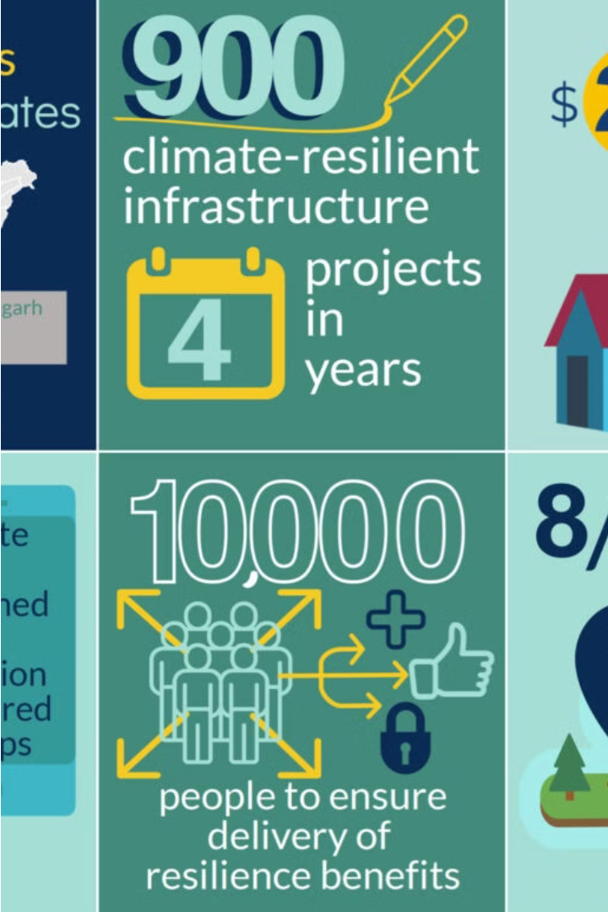
Climate Resilience
Building climate resilience is crucial for communities facing the impacts of climate change. This involves developing infrastructure, policies, and systems that can withstand and adapt to environmental stresses.
Resilience strategies may include sustainable urban planning, early warning systems, disaster preparedness, and nature-based solutions like mangrove restoration. These approaches help protect vulnerable populations and promote long-term sustainability.

Slide 9
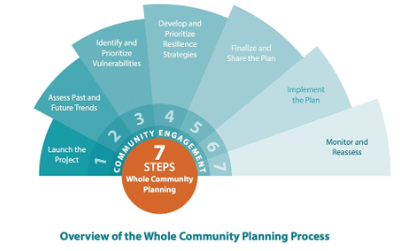
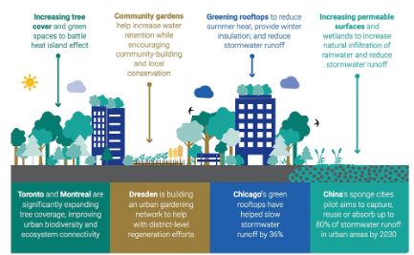
Strategies for sustainable climate migration
Strategic Planning
Community Engagement
Sustainable Livelihoods
Develop comprehensive plans that integrate climate projections, disaster risk reduction, and long-term livelihood opportunities for communities vulnerable to climate impacts.
Empower local stakeholders to lead adaptation efforts, ensuring strategies align with community needs and traditional knowledge.
Foster climate-resilient livelihoods, such as climate-smart agriculture, that enhance food security and economic opportunities for those displaced by climate change.

Slide 10
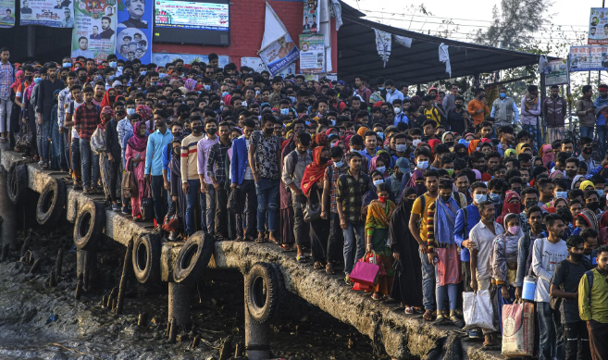
Case studies of climate migration and development
Climate migration is a complex issue with varying impacts on development. Case studies from regions like the Sahel, Bangladesh, and the Pacific islands highlight how climate-induced displacement disrupts livelihoods, strains resources, and exacerbates social vulnerabilities. Adapting development approaches to address these challenges is critical for sustainable outcomes.

Slide 11
Climate migration – Spotlight on least developed countries
Many of the world's least developed countries (LDCs) are on the frontlines of climate change, facing severe impacts like rising sea levels, drought, and extreme weather. This threatens the livelihoods and security of vulnerable populations, driving climate-induced migration.
LDCs often lack the resources and infrastructure to support and integrate climate migrants, exacerbating development challenges. Addressing this crisis requires coordinated global action to support climate adaptation and resilience in the world's most vulnerable nations.

Slide 12
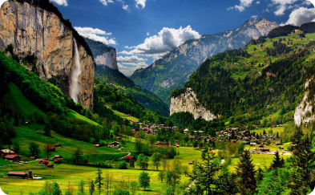
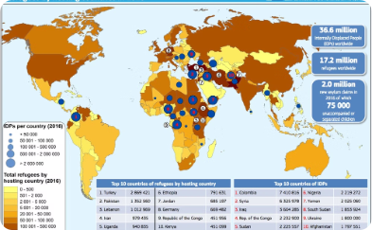
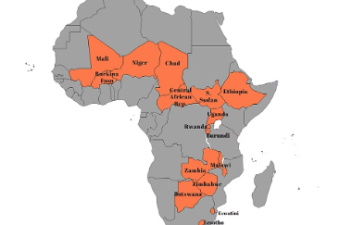
Climate migration – Spotlight on landlocked countries
Unique Challenges
Limited Resources
Sustainable Solutions
Landlocked countries face unique challenges in dealing with climate migration, such as limited access to the sea, reliance on neighboring countries for trade, and lack of infrastructure to support large influxes of displaced populations.
Many landlocked developing countries have limited resources and capacity to provide for the needs of climate migrants, exacerbating social tensions and straining already overburdened public services.
Addressing climate migration in landlocked countries requires innovative, collaborative solutions that enhance regional integration, improve infrastructure, and build climate resilience to support both host communities and displaced populations.

