Slide 1
CCP-LAW
Curricula development on Climate Change Policy and Law
Subject title: Climate Change Ethics
Instructor Name: Dr. Albert Ruda
Project No of Reference: 618874-EPP-1-2020-1-VN-EPPKA2-CBHE-JP:
The European Commission's support for the production of this publication does not constitute an endorsement of the contents, which reflect the views only of the authors, and the Commission cannot be held responsible for any use which may be made of the information contained therein.

Slide 2
Overview
Global ongoing environmental destruction
Different approaches
Anthropocentrism
Ecocentrism
Ethics and Environmental Ethics
Ecocide
- What is ecocide
- Reference texts
“Grub first, then ethics” (Bertold Brecht)
Ethics vs efficiency

Slide 3
The Environmental Crisis
Climate change
Loss in biodiversity
Habitats decline
Widespread pollution
Overpopulation
Affluent overconsumption
Too much faith in technology?

Slide 4
Environmental Ethics
What is the environment?
- There is no universally accepted definition of the environment.
- Should it include natural as well as cultural elements? See Lugano Convention.
What is environmental ethics (EE)?
What kind of problems does EE face?
What is nature?
- Complexity of habitats
- Interconnectedness of natural resources.
Independent vs dependent moral status
Shades of green (different conceptions or schools of thought within environmental ethics)
The last man (should the last man protect the natural environment?)

Slide 5
Ethics in General
What is Ethics
- General ethical conceptions have an influence on environmental ethics
Realism vs relativism
- Are there universally accepted ethical values? Are there absolute values at all?
Is vs Ought (The naturalistic fallacy)
- On the attemps to derive an ethics from naturalistic observation
Religious vs Secular Ethics
Humanism
Cornucopians
Economism
Modernism

Slide 6
Schools of Ethics
Deontologism (Rights) – Immanuel Kant
Categorical imperative
“Act only according to that maxim whereby you can at the same time will that it should become a universal law.”
Consequentialism (Effects) – Jeremy Bentham, JS Mill
Utilitarianism
Please note there are many different schools of thought within utilitatianism irself!
Virtue Ethics (Virtues) – Aristotle
Green virtue ethics (GVE)

Slide 7
Value Issues
Individualism vs holism
Instrumental value vs intrinsic value
Inherent value
Objective vs subjective value
Anthropocentrism vs ecocentrism
Anthropocentrism:
Human chauvinism
Speciecism
Resourcism
Managerial environmentalism
Ecocentrism:
Zoocentrism
Biocentrism
Ecocentric misanthropy?

Slide 8
The Limitations of Human-Centredness
Things exist for use (usefulness)
Can a human-centred ethic be an adequate environmental ethic?
Constituents of well-being
- What are they?
Weighing goods lost and gained
Willingness to pay (WTP)
Contingent Valuation Method (CVM)
Cost Benefits Analysis (CBA)

Slide 9
Light Green Ethics
Anthropocentrism
Shallow ethics
Techno-optimism
Ecosystem services
Social ecology
NGO environmentalism
Lifeboat ethics

Slide 10
Suggested Activity
Please read the following paper:
Garrett Hardin, The Tragedy of the Commons, Science 1968, vol. 162, no. 3859, p. 1243-1248
Available under:
https://www.jstor.org/stable/1724745
https://www.econlib.org/library/Enc/TragedyoftheCommons.html
Discuss.

Slide 11
Mid Green Ethics
2 formulations:
Greater Value Assumption: natural gods have an intrinsic value
Biocentrism: all living beings have an intrinsic value (moral extensionism: animals)
Animal Liberation (Peter Singer, 1977)
Sentience (ability to suffer)
Speciecism
Criticism: human chauvinism replaced with sentient chauvinism

Slide 12
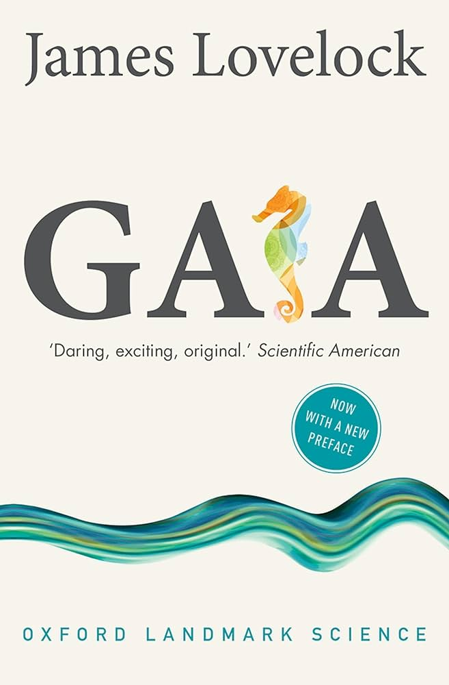
Dark Green Ethics
Ecocentrism (Earth-centred)
- Holistic perspective (human and non-human)
- Nature-as-value
Land Ethic (Aldo Leopold): A Sand County Almanac (1949)
- ‘Think like a mountain’
Gaia Theory (James Lovelock)
Deep Ecology (Arne Naess)

Slide 13
The problem of cooperation
Games theory
Prisoner’s dilemma
Cooperators’ dilemma
Self-interest, prudence and rationality
Free-riding

Slide 14
Environmental Virtues
Character virtues and intellectual virtues
Some environmental virtues
- Related to sensual pleasures
- Related to emotions
- Wonder
- Scientific enquiry

Slide 15
What Entities Have Independent Moral Status?
Independent moral status
Extension
Respect for nature
Capacity to feel pleasure or suffer

Slide 16
Proposed activity with students
Look for the instances where a legislature or a court has acknowledged the rights of nature.
1. What kind of resources are protected this way?
2. Where are they located?
3. Do you think this acknowledgment has actually improved the resource protection?
4. Are you in favour or against of this strategy? Why?

