Slide 1
CCP-LAW
Curricula development on Climate Change Policy and Law
Subject title: Climate Change Policy
Instructor Name: Dr. Rahul Nikam
Project No of Reference: 618874-EPP-1-2020-1-VN-EPPKA2-CBHE-JP:
The European Commission's support for the production of this publication does not constitute an endorsement of the contents, which reflect the views only of the authors, and the Commission cannot be held responsible for any use which may be made of the information contained therein.

Slide 2
Climate Technologies
What are climate technologies?
Technologies that we use to address climate change are known as climate technologies.
Climate technologies that help us reduce GHGs include renewable energies such as wind energy, solar power and hydropower.
To adapt to the adverse effects of climate change, we use climate technologies such as drought-resistant crops, early warning systems and sea walls.
There are also ‘soft’ climate technologies, such as energy-efficient practices or training for using equipment.

Slide 3
Climate Technologies
What is technology transfer to support climate action?
Developing and transferring technologies to support national action on climate change has been an essential element from the beginning of the UNFCCC process.
The Paris Agreement speaks of the vision of fully realizing technology development and transfer for both improving resilience to climate change and reducing GHG emissions.
It establishes a technology framework to provide overarching guidance to the Technology Mechanism.

Slide 4
Climate Technologies
What are the key institutions and mechanisms?
Technology Mechanism
In 2010, the COP established the Technology Mechanism to accelerate and enhance climate technology development and transfer.
It consists of two complementary bodies that work together, – the Technology Executive Committee (TEC) and the Climate Technology Centre and Network (CTCN)
The mechanism also serves the Paris Agreement.
The Joint Work Programme of the Technology Mechanism (2023–2027) is composed of the joint activities and common areas of work of the Technology Executive Committee (TEC) and the Climate Technology Centre and Network (CTCN), the rolling workplan of the TEC and the Programme of Work of the CTCN.

Slide 5
Climate Technologies
What are the key institutions and mechanisms?
Technology Mechanism
In 2023, the Technology Mechanism launched its Initiative on Artificial Intelligence for Climate Action (#AI4ClimateAction) to explore the role of AI as a powerful technological tool for advancing and scaling up transformative climate solutions for mitigation and adaptation action in developing countries with a focus on LDCs and SIDS.
Technology Executive Committee
The TEC is the Technology Mechanism’s policy arm and analyses policy issues and provides recommendations to support countries in enhancing climate technology efforts.

Slide 6
Climate Technologies
What are the key institutions and mechanisms?
The Climate Technology Centre and Network (CTCN)
The CTCN is the mechanism’s implementation arm and it supports countries to enhance the implementation of climate technology projects and programmes.
It has three core services: providing technical assistance to developing countries; creating access to knowledge on climate technologies; and fostering collaboration among climate technology stakeholders.
The CTCN is hosted by the United Nations Environment Programme, in collaboration with the United Nations Industrial Development Organization, and is supported by 11 partner institutions with expertise in climate technologies.
The Centre facilitates a network of national, regional, sectoral and international technology centres, networks, organizations and private sector entities. More than 150 Parties have submitted their national designated entities (NDEs) for climate technology and transfer, which are also part of the network.

Slide 7
Climate Technologies
What are the key institutions and mechanisms?
Technology Framework
Article 10, paragraph 4, of the Paris Agreement established the Technology Framework.
The framework provides overarching guidance to the work of the Technology Mechanism in promoting and facilitating enhanced action on technology development and transfer to support the implementation of the Agreement in pursuit of the long-term vision of technology development and transfer referred to in Article 10, paragraph 1.
Technology needs assessments
Understanding climate technology needs is the starting point for effective action to reduce greenhouse gas emissions and adapt to the adverse impacts of climate change.
To determine their climate technology priorities, developing countries undertake technology needs assessments (TNAs).

Slide 8
Climate Technologies
What are the key institutions and mechanisms?
Technology needs assessments
A TNA supports national sustainable development, builds national capacity, and facilitates the implementation of prioritized climate technologies.
Since 2001, more than 85 developing countries have undertaken TNAs to identify their technology needs for mitigation and adaptation.
Since 2010, as part of their TNAs, developing countries have also developed technology action plans (TAPs), which are concrete action plans for the implementation of their prioritized technology needs.”

Slide 9
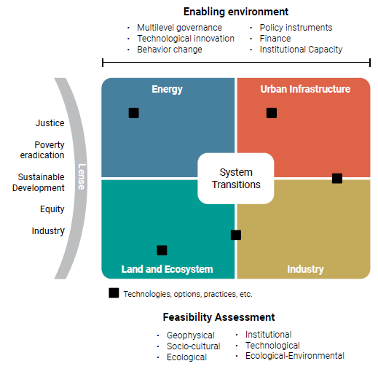
Climate Technologies- System Transitions
System transitions To achieve system transitions, technology development, and transfer is one of the indispensable enabling conditions. It is hence essential to understand better the processes that shape technology development and transfer in general, and thereby to understand the factors that lead to successful outcomes as well as barriers that hinder such outcomes. An enabling environment for enhanced technology development and transfer consists of resources and conditions that are generated by different structures and institutions. In addition to focusing on enabling environments, this report also focuses on feasibility. ‘Feasibility’ indicates how likely it is that a mitigation or adaptation technology is implemented, based on how many barriers and enablers are in place. The feasibility for a technology, and enabling conditions for the same, are interlinked, such that feasibility increases when enabling conditions are strengthened.

Slide 10
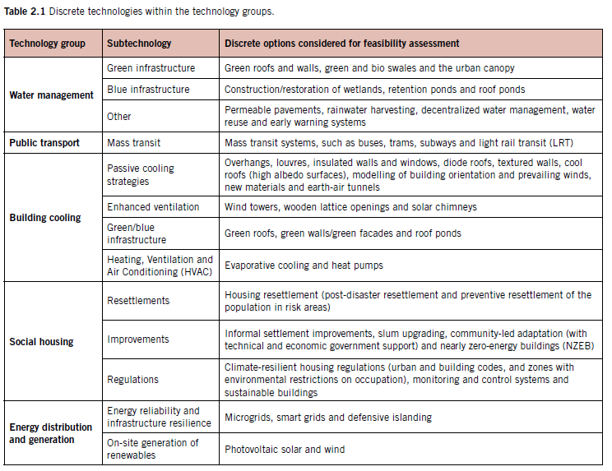
Climate Technologies

Slide 11
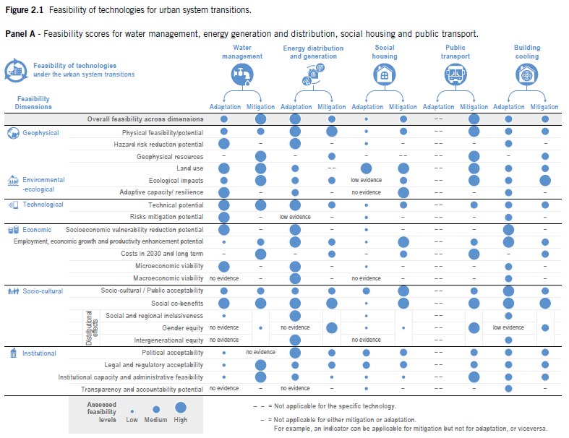
Climate Technologies

Slide 12
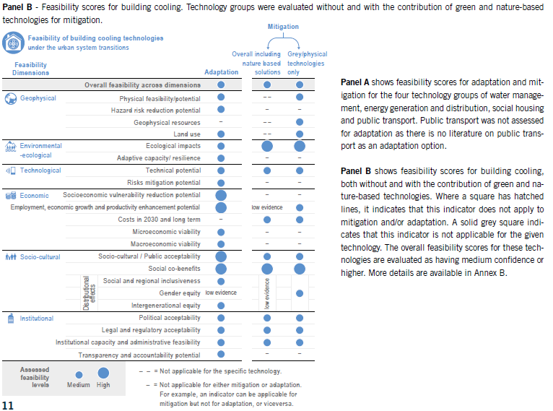
Climate Technologies

Slide 13
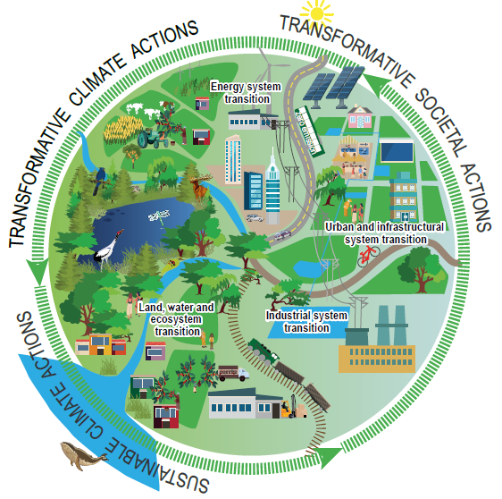
Climate Technologies-SYNERGIES AND TRADE-OFFS OF URBAN SYSTEM TECHNOLOGIES EVALUATED THROUGH A SYSTEM TRANSITION FRAMEWORK

Slide 14
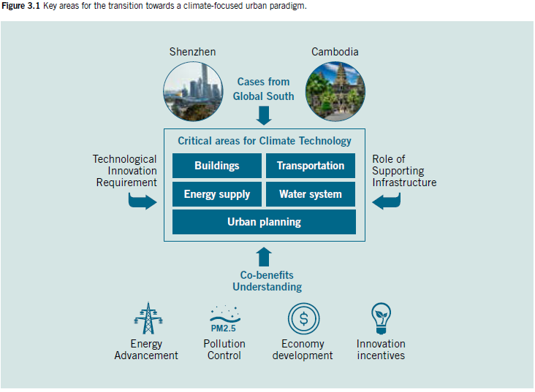
Climate Technologies

Slide 15
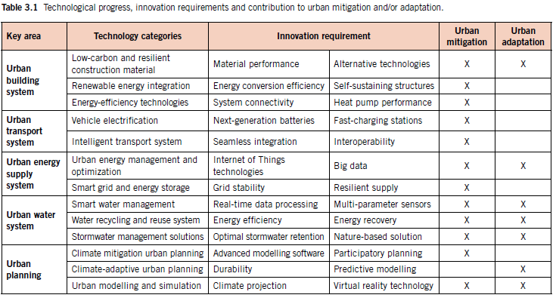
Climate Technologies

Slide 16
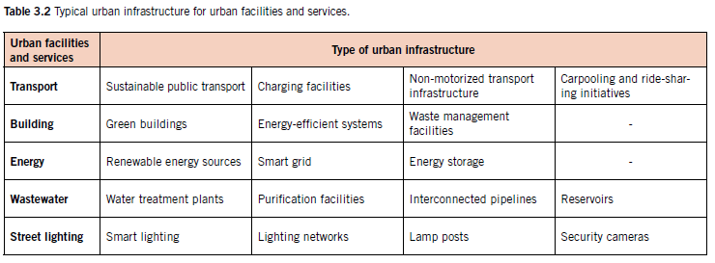
Climate Technologies

Slide 17
Further reading
The Climate Technology Progress Report 2023- Speed and Scale for Urban Systems Transformation
https://www.ctc-n.org/resources/climate-technology-progress-report-2023-speed-and-scale-urban-systems-transformation
United Nation Climate Change
https://unfccc.int/topics/what-is-technology-development-and-transfer

