Slide 1
CCP-LAW
Curricula development on Climate Change Policy and Law
Subject title: Climate Change Policy
Instructor Name: Dr. Rahul Nikam
Project No of Reference: 618874-EPP-1-2020-1-VN-EPPKA2-CBHE-JP:
The European Commission's support for the production of this publication does not constitute an endorsement of the contents, which reflect the views only of the authors, and the Commission cannot be held responsible for any use which may be made of the information contained therein.

Slide 2
Inter-relationships between adaptation and mitigation, damages avoided, and climate policy portfolio
1 Trade-offs and synergies in global-scale analysis
Analysts working on global-scale climate analyses remain apart in their formulation of the inter-relationships between adaptation and mitigation. Some consider them as substitutes and seek the optimal policy mix, while others emphasise the diversity of impacts (with little scope for adaptation in some sectors) and the asymmetry of social actors who need to mitigate versus those who need to adapt.
Cost-effectiveness analyses (CEAs) depict a rather remote relationship between adaptation and mitigation. They implicitly assume that some sort of a global climate change target can be agreed upon that would keep all climate-change impacts at the level that can be managed via adaptation or taken as 'acceptable losses' . Or, cost-effectiveness analyses consider a range of hypothetical targets, but remain silent on the appropriateness of these targets. Global CEAs have proliferated since the publication of the TAR.

Slide 3
Inter-relationships between adaptation and mitigation, damages avoided, and climate policy portfolio
The competition of adaptation measures, mitigation measures and non-climate policies for a finite budget has not been studied in much detail.
2 Consideration of costs and damages avoided and/or benefits gained
Various approaches have been taken since the TAR to estimate the size of climate change damages that can be avoided by emissions reduction. Among the global integrated assessments reviewed in the previous sub-section, cost-effectiveness models (by far the most widely used decision analysis framework) do not include impacts, hence they cannot measure avoided damages either. In contrast, CBAs of greenhouse-gas emissions reduction necessarily estimate the avoided damages of climate change but rarely report them. Economic assessments of marginal damage costs (e.g., the incremental impact of an additional tonne of carbon emissions) provide a means of comparing damages avoided with marginal abatement costs. Such studies typically cover a range of sectors and report damage functions and estimates for scenarios of climate change, and increasingly reference scenarios of socio-economic vulnerability.

Slide 4
Inter-relationships between adaptation and mitigation, damages avoided, and climate policy portfolio
Tol and Yohe (2006), using the integrated assessment model, Climate Framework for Uncertainty, Negotiation and Distribution (FUND), conclude that the most serious impacts of climate change can be avoided at an 850 ppm CO2-equivalent stabilisation target for greenhouse-gas concentrations, and that incrementally avoided damages get smaller and smaller as one moves to more stringent stabilisation targets.
3 Inter-relationships within regions and sectors
Considering the details of specific adaptation and mitigation activities at the level of regions and sectors shows that adaptation and mitigation can have a positive and negative influence on each other's effectiveness.
Land-use and land-cover changes involve diverse and complex inter-relationships between adaptation and mitigationCarbon sequestration in agricultural soils offers another positive link from mitigation to adaptation

Slide 5
Inter-relationships between adaptation and mitigation, damages avoided, and climate policy portfolio
Carbon sequestration in agricultural soils offers another positive link from mitigation to adaptation.
Afforestation and reforestation have been advocated for decades as important mitigation options. Recent studies reveal a more differentiated picture.
Bioenergy crops are receiving increasing attention as a mitigation option. Most studies, however, focus on technology options, costs and competitiveness in energy markets and do not consider the implications for adaptation.
Another possible conflict between adaptation and mitigation might arise over water resources. One obvious mitigation option is to shift to energy sources with low greenhouse-gas emissions

Slide 6
Inter-relationships between adaptation and mitigation, damages avoided, and climate policy portfolio

Slide 7
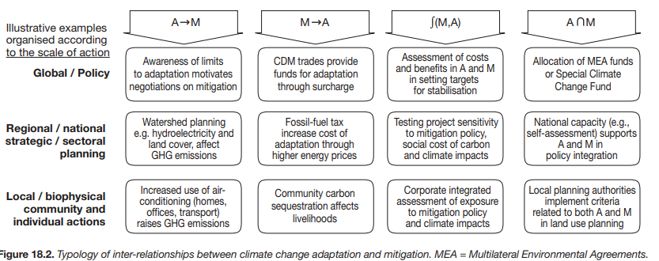
Inter-relationships between adaptation and mitigation, damages avoided, and climate policy portfolio

Slide 8
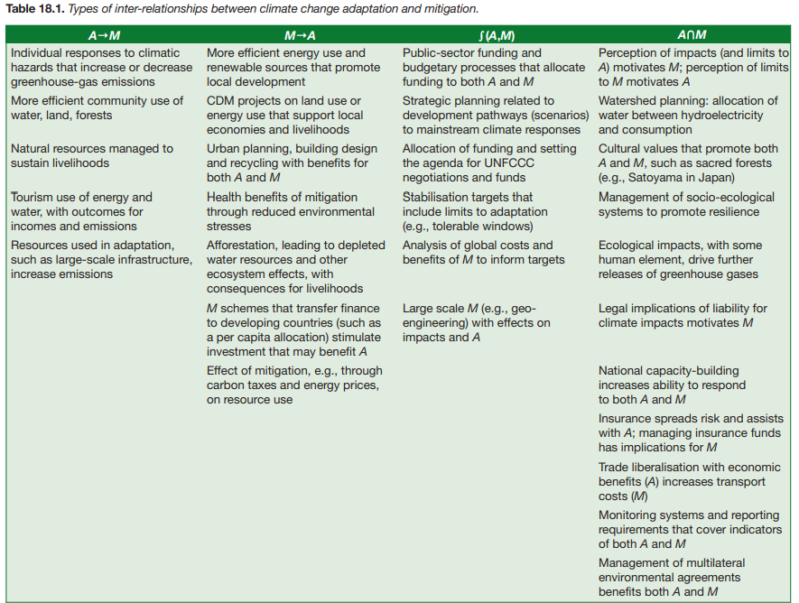
Inter-relationships between adaptation and mitigation, damages avoided, and climate policy portfolio

Slide 9
Further Reading
Inter-relationships between adaptation and mitigation https://www.ipcc.ch/site/assets/uploads/2018/02/ar4-wg2-chapter18-1.pdf

