Slide 1
CCP-LAW
Curricula development on Climate Change Policy and Law
Subject title: Climate Justice
Instructor Name: Dr. Shashikala Gurpur, Dr. Sujata Arya
Project No of Reference: 618874-EPP-1-2020-1-VN-EPPKA2-CBHE-JP:
The European Commission's support for the production of this publication does not constitute an endorsement of the contents, which reflect the views only of the authors, and the Commission cannot be held responsible for any use which may be made of the information contained therein.

Slide 2
Climate Justice
This module: Climate Justice has been divided into 4 sub-sections:
Concept and Perspectives Approaches to Climate Justice . Principle of Climate Justice Climate change and Human Rights Climate change and trade Climate change and armed conflict 2. Mitigation and Adaptation International approach Comparative approach: European Union, Asia Climate Change Litigation: International judicial institutions 4. Alternative Dispute Settlement Mechanisms for Climate Justice

Slide 3
Introduction to Climate Justice
Concept of Climate Justice
People of color, indigenous communities, and global South nations face disproportionate ecological, economic, and health impacts from climate disruption.
Climate change is often seen as a natural process, ignoring its link to specific human activities.
Climate justice acknowledges that fighting climate change is intertwined with racial and economic justice.
It views climate injustice as a core element of climate disruption that must be addressed to reverse its effects.

Slide 4
History of Climate Justice
Concept of Climate Justice
Climate Justice Summit aims to "build alliances across states and borders" against climate change and in favor of
sustainable development. In 2000, at the same time as the Sixth Conference of the Parties (COP 6), the first Climate
Justice Summit took place in The Hague.
Subsequently, international environmental groups met in August–September 2002 for the Earth Summit in Johannesburg, South Africa.
The Durban Group for Climate Justice was formed at an international meeting in Durban, South Africa. In 2004,
representatives from NGOs and people’s movements discussed realistic policies for addressing climate change.
During COP 13 in Bali in 2007, a number of NGOs exited the Climate Action Network to from a new movement called Climate Justice Now! with a significantly more system- critical orientation.

Slide 5
History of Climate Justice
Concept of Climate Justice
Today however climate justice encompasses a very large ensemble of positions.
It has become a central discursive element for a wide variety of actors whose social and political visions are different, sometimes distant and even conflicting.
Mary , Robinson’s Climate Justice Foundation, 350.org, TckTckTck, Caritas, Pan African Alliance for Climate Justice, The Durban Climate Justice group, Climate Justice Now! Time for Climate Justice Movement: all these actors and organizations operate in thediscursive field of climate change.

Slide 6
History of Climate Justice
Concept of Climate Justice
The 15th Conference of the Parties to the UNFCCC, held in Copenhagen in 2009, was a crucial turning point for the climate regime and the discourse of climate justice. Dubbed “ Hopenhagen” by a UN global marketing campaign, climate justice assumed a significant role.
Climate Justice’s core element is grounded on the sharp asymmetry existing between those who done the least to cause global warming- poor people in poor countries and the high emitting countries which have benefitted from such emissions and are best placed to finance mitigation of, and adaptation to, climate changes.
In 2010, the World People's Conference on Climate Change and the Rights of Mother Earth took place in Tiquipaya, Bolivia. The conference published a "People's Agreement“ calling for greater climate justice. In December 2018, the People's Demands for Climate Justice were signed by 292,000 individuals and 366 organisations.

Slide 7
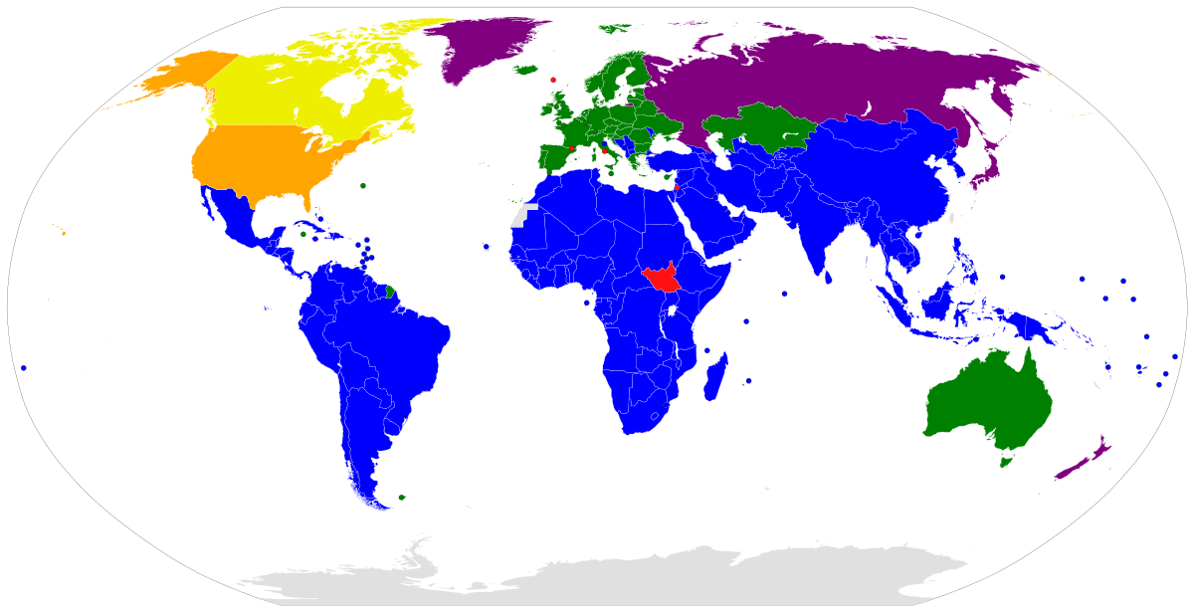
Legislative International History of Climate Justice
Concept of Climate Justice
1. Conference in Japan in 1997.
The Kyoto Protocol
2. The Paris Climate Agreement in 2015.
3. European Green Deal in 2019.

Slide 8
Principles related to Climate Justice
Concept of Climate Justice
1. Equity in distributing the burdens and sharing the benefits of climate change in communities and among nations;
2. Social and political processes that recognize currently or previously marginalized groups as rightful participants in the governance and management of climate change;
3. Freedom of peoples to make choices that maximize their capabilities to survive now and in the future;
4. Rebuilding damaged historical relationships between parties, correcting past wrongs against humanity, and restoring the Earth.

Slide 9
Development of the modern international protection: international perspective
Perspective of Climate Justice
Protecting individuals
1948: Universal Declaration of Human Rights (UDHR)
1966: Covenant on Civil and Political Rights (CCRR) - classic rights
1966: Covenant on Economic, Social and Cultural Rights (CESCR)
1966: Convention on the Elimination of All Forms of Racial Discrimination
1979: Convention on the Elimination of All Forms of Discrimination against women
1989: Convention on the Rights of the Child
Protecting the environment
1972: the Declaration of the United Nations Conference on the Human Environment
1992: the Rio Declaration on Environment and Development
2000: Millennium Development Goals
2002: Johannesburg Declaration on Sustainable Development

