Slide 1
CCP-LAW
Curricula development on Climate Change Policy and Law
Subject title: CLIMATE CHANGE DISPUTE RESOLUTION
Instructor Name: Tran Anh Tuan
Project No of Reference: 618874-EPP-1-2020-1-VN-EPPKA2-CBHE-JP:
The European Commission's support for the production of this publication does not constitute an endorsement of the contents, which reflect the views only of the authors, and the Commission cannot be held responsible for any use which may be made of the information contained therein.

Slide 2
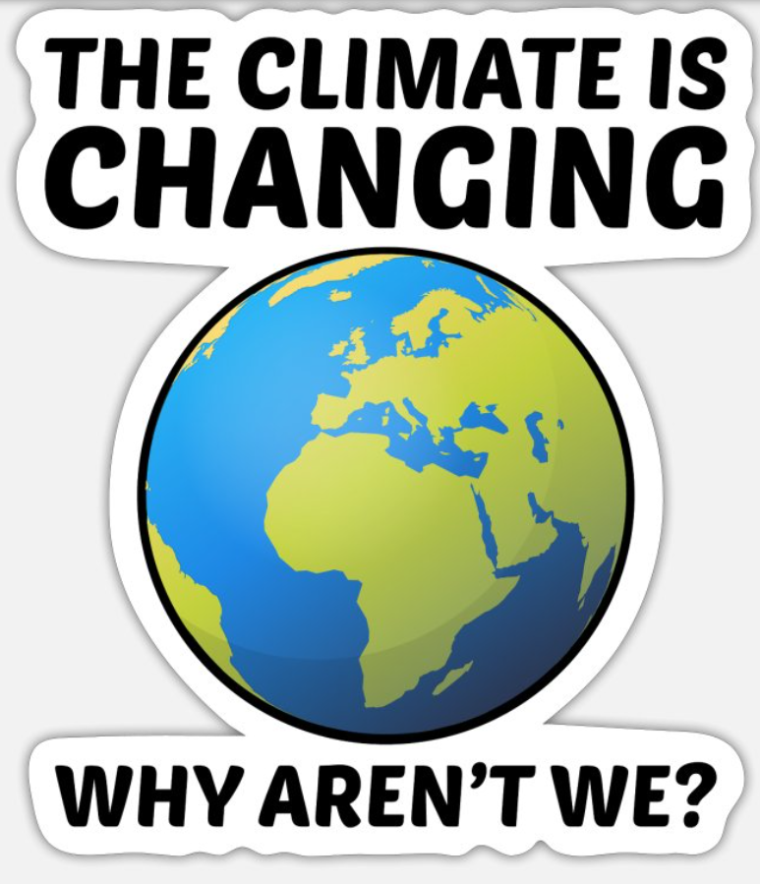
2.1. The principle of common but differentiated responsibilities
2. JUSTICE AND EQUITY IN CLIMATE DISPUTE RESOLUTION
What is Common But Differentiated Responsibilities (CBDR)?
The principle was formalized in the 1992 United Nations Framework Convention on Climate Change (UNFCCC)
A central principle in addressing global challenges, particularly environmental issues.
Emphasizes shared responsibility for a healthy planet while recognizing different levels of responsibility.

Slide 3
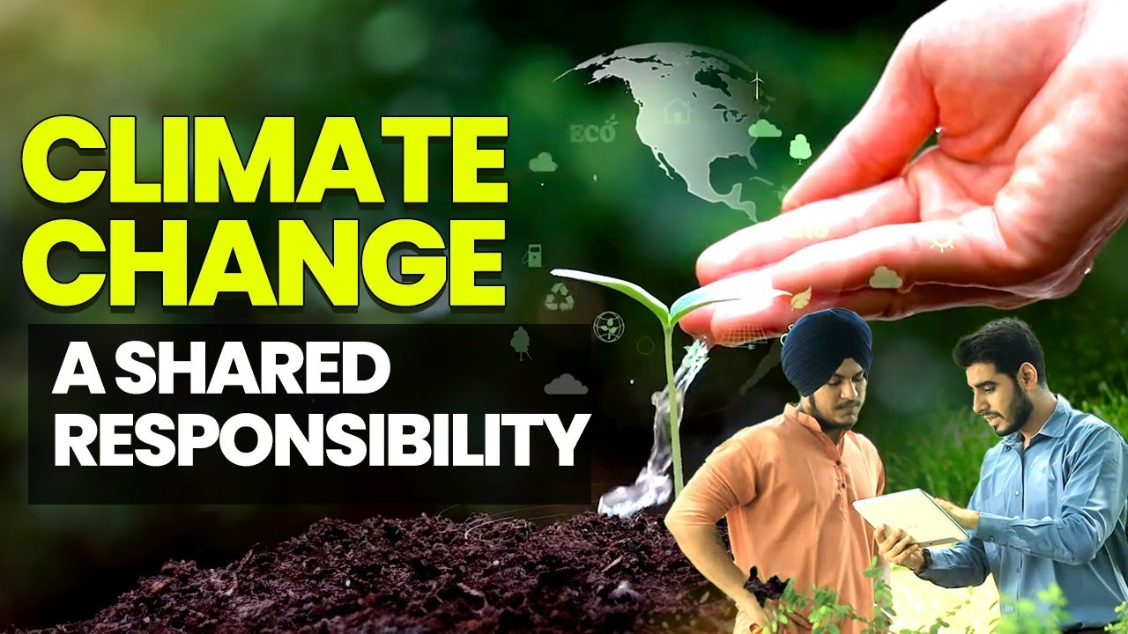
2.1. The principle of common but differentiated responsibilities
2. JUSTICE AND EQUITY IN CLIMATE DISPUTE RESOLUTION
Shared Responsibility
All countries share responsibility for protecting the environment.
Our shared dependence on a healthy planet necessitates this responsibility.
Environmental problems like climate change have global consequences.

Slide 4
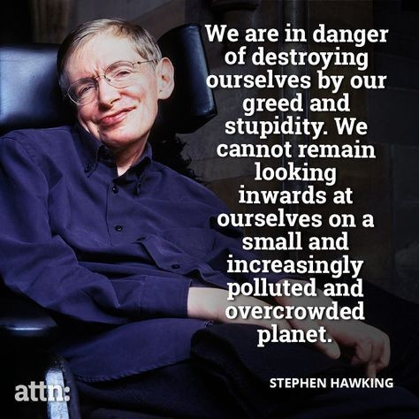
2.1. The principle of common but differentiated responsibilities
2. JUSTICE AND EQUITY IN CLIMATE DISPUTE RESOLUTION
Levels of Responsibility
While all share responsibility, the level may differ based on historical and current factors.
Developed countries have historically contributed more to environmental challenges.
Developing countries often face resource and technological constraints.

Slide 5
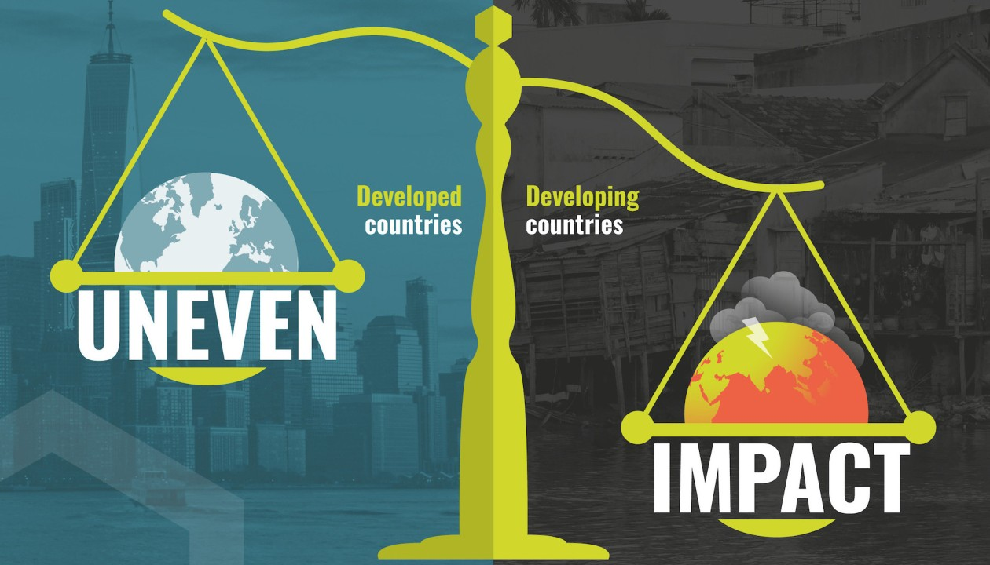
2.1. The principle of common but differentiated responsibilities
2. JUSTICE AND EQUITY IN CLIMATE DISPUTE RESOLUTION
Developing Countries' Responsibilities
Adopt sustainable development practices within their capacity.
Participate in global efforts to address environmental challenges.
Work towards increasing their capabilities to address environmental issues.

Slide 6
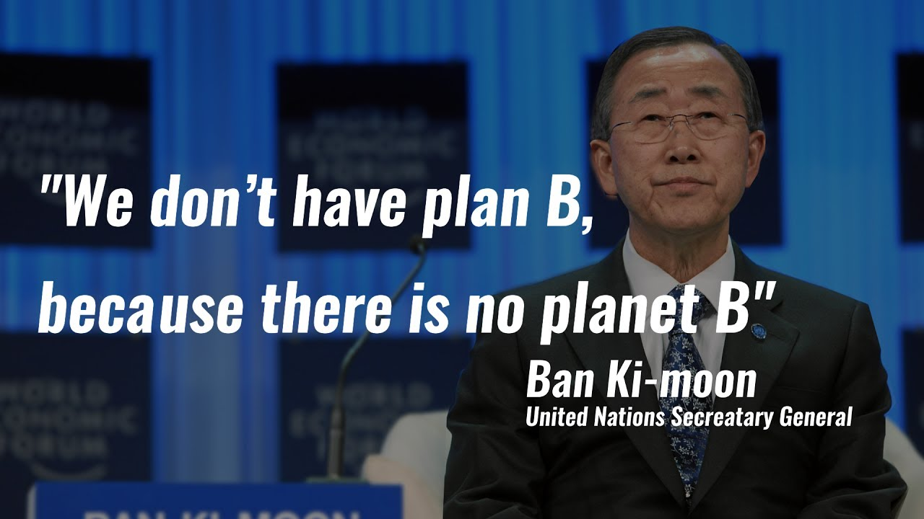
2.1. The principle of common but differentiated responsibilities
2. JUSTICE AND EQUITY IN CLIMATE DISPUTE RESOLUTION
Developed Countries' Responsibilities
Take stronger mitigation actions (e.g., reducing emissions).
Provide financial and technological support to developing countries.
Invest in clean energy technologies and sustainable development practices.

Slide 7
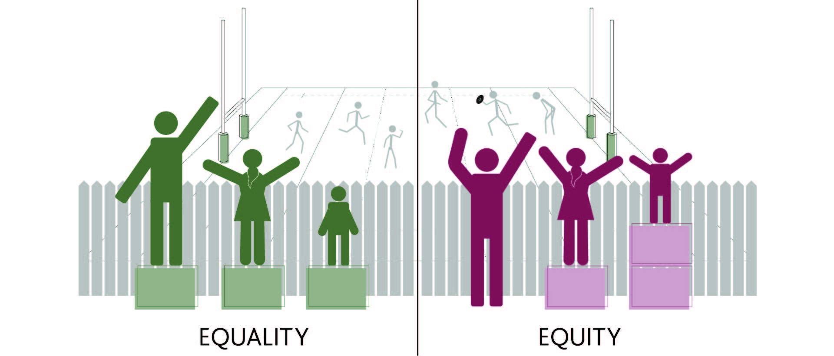
2.1. The principle of common but differentiated responsibilities
2. JUSTICE AND EQUITY IN CLIMATE DISPUTE RESOLUTION
Collaboration in Action
Developed and developing countries collaborate based on differentiated responsibilities.
Developed countries offer financial and technological support to empower developing countries.
Joint efforts contribute to a sustainable future for all.
Equity and Fairness
CBDR promotes international cooperation and equity in addressing global challenges.
All countries are encouraged to contribute their best efforts to achieve a sustainable future.

Slide 8
2.2. Climate compensation
2. JUSTICE AND EQUITY IN CLIMATE DISPUTE RESOLUTION
Some key points
Involves compensating countries disproportionately affected by climate change, despite minimal contribution to the issue.
Rooted in the "polluter pays principle," holding major emitters like the US and Europe accountable for their historical greenhouse gas emissions.
Suggestions for direct bilateral compensation payments linked to emissions and financial capacity.

Slide 9
2.2. Climate compensation
2. JUSTICE AND EQUITY IN CLIMATE DISPUTE RESOLUTION
Some key points
Proposed mechanisms include a UN Climate Compensation Fund funded by major emitters, aiding vulnerable nations in recovery and resilience building.
Reparations may include financial aid, technology transfer for adaptation, and emission reductions, with debt cancellation to support climate actions in developing nations.

Slide 10
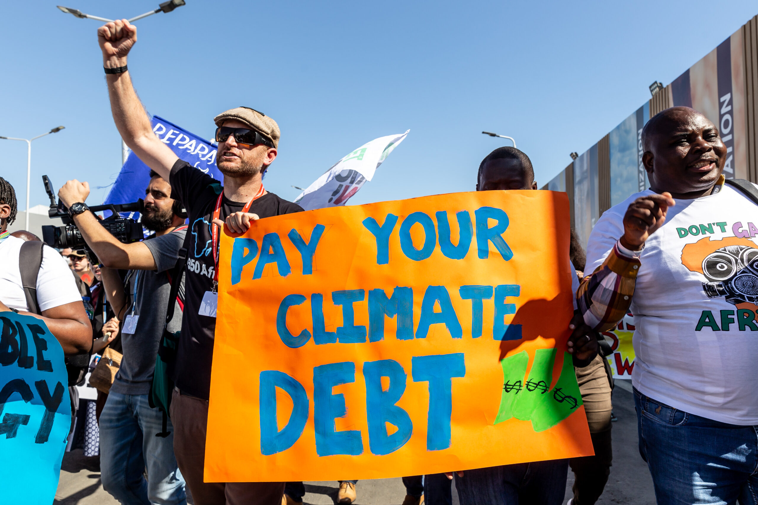
2.2. Climate compensation
2. JUSTICE AND EQUITY IN CLIMATE DISPUTE RESOLUTION
Arguments for:
Justice: Developed nations, responsible for most emissions, should bear the burden of compensating those suffering the most severe consequences.
Equity: Addresses the historical imbalance where developed nations benefited from polluting while developing nations bear the brunt of the impact.
Effectiveness: Directing resources to vulnerable communities helps them adapt, rebuild, and become more resilient to future climate impacts.

Slide 11
2.2. Climate compensation
2. JUSTICE AND EQUITY IN CLIMATE DISPUTE RESOLUTION
Arguments against:
Complexity: Identifying historical responsibility and calculating fair compensation is incredibly difficult.
Cost: The scale of financial resources needed could be immense, creating a burden on developed nations.
Implementation: Determining how to distribute funds and ensure they reach those most in need presents logistical challenges.

Slide 12
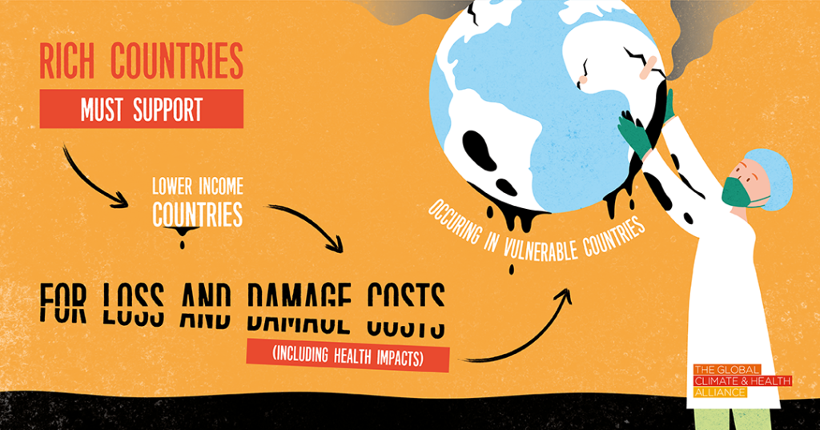
2.2. Climate compensation
2. JUSTICE AND EQUITY IN CLIMATE DISPUTE RESOLUTION
Current status:
The concept is gaining traction, with discussions at international climate negotiations.
In 2023, the UN established a committee for "loss and damage" finance paving the way for reparations.
Some countries have already implemented forms of compensation, but a global framework is still missing.

Slide 13
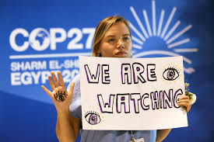
2.3. Addressing loss and damage from climate change impacts
2. JUSTICE AND EQUITY IN CLIMATE DISPUTE RESOLUTION
Environmental Justice Considerations
Recognition of Responsibility: Developed nations, as major historical emitters, bear a greater responsibility for causing climate-related loss and damage. This underscores the "polluter pays principle."
Equitable Compensation: A key issue is determining fair and equitable compensation mechanisms to assist vulnerable nations in coping with loss and damage they did little to cause.

Slide 14
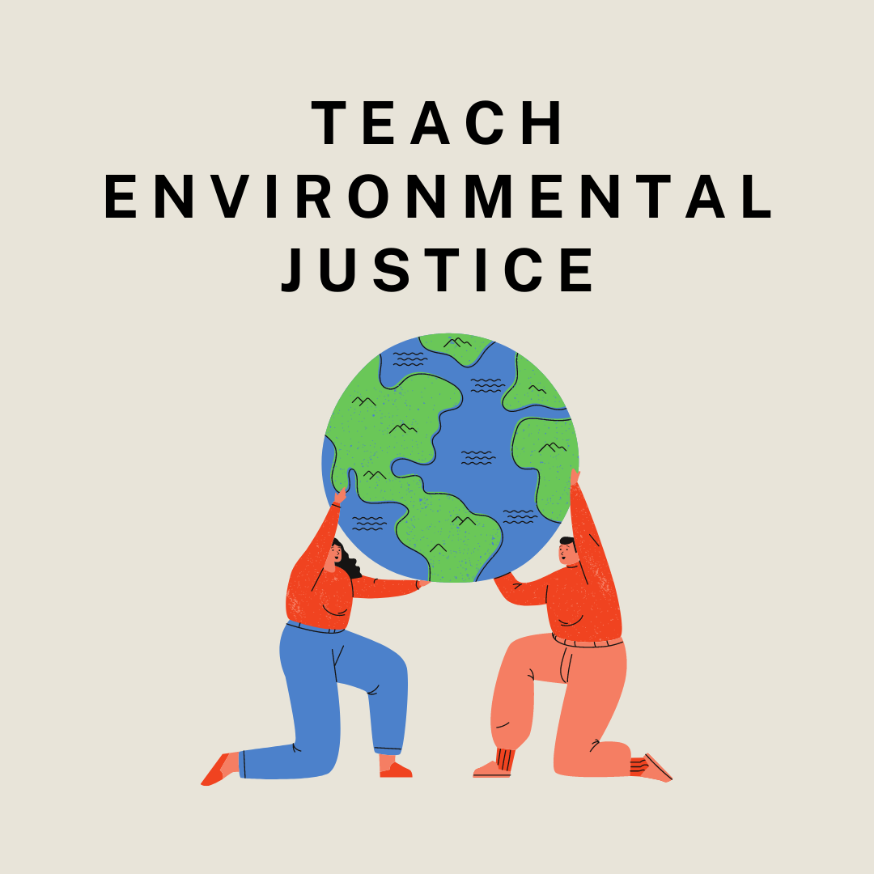
2.3. Addressing loss and damage from climate change impacts
2. JUSTICE AND EQUITY IN CLIMATE DISPUTE RESOLUTION
Environmental Justice Considerations:
Prioritizing the Most Vulnerable: Climate dispute resolution must center the needs of the most climate-vulnerable communities, often marginalized and lacking resources to fully address the impacts.
Beyond Financial Aid: Environmental justice demands addressing loss and damage holistically. It includes technological support for adaptation, capacity building for climate resilience, and addressing non-economic losses.

Slide 15
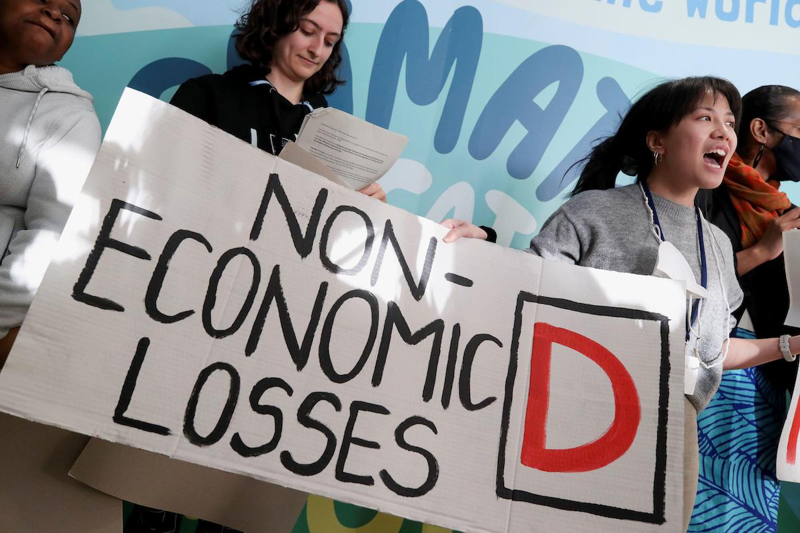
2.3. Addressing loss and damage from climate change impacts
2. JUSTICE AND EQUITY IN CLIMATE DISPUTE RESOLUTION
Types of Loss and Damage:
Economic Loss: Climate change can damage infrastructure, disrupt livelihoods, and lead to economic losses, particularly in sectors like agriculture and tourism.
Non-Economic Loss: Loss of land, cultural heritage, and traditional ways of life can have devastating social and cultural impacts, particularly for indigenous communities and those with deep connections to their environment.

Slide 16
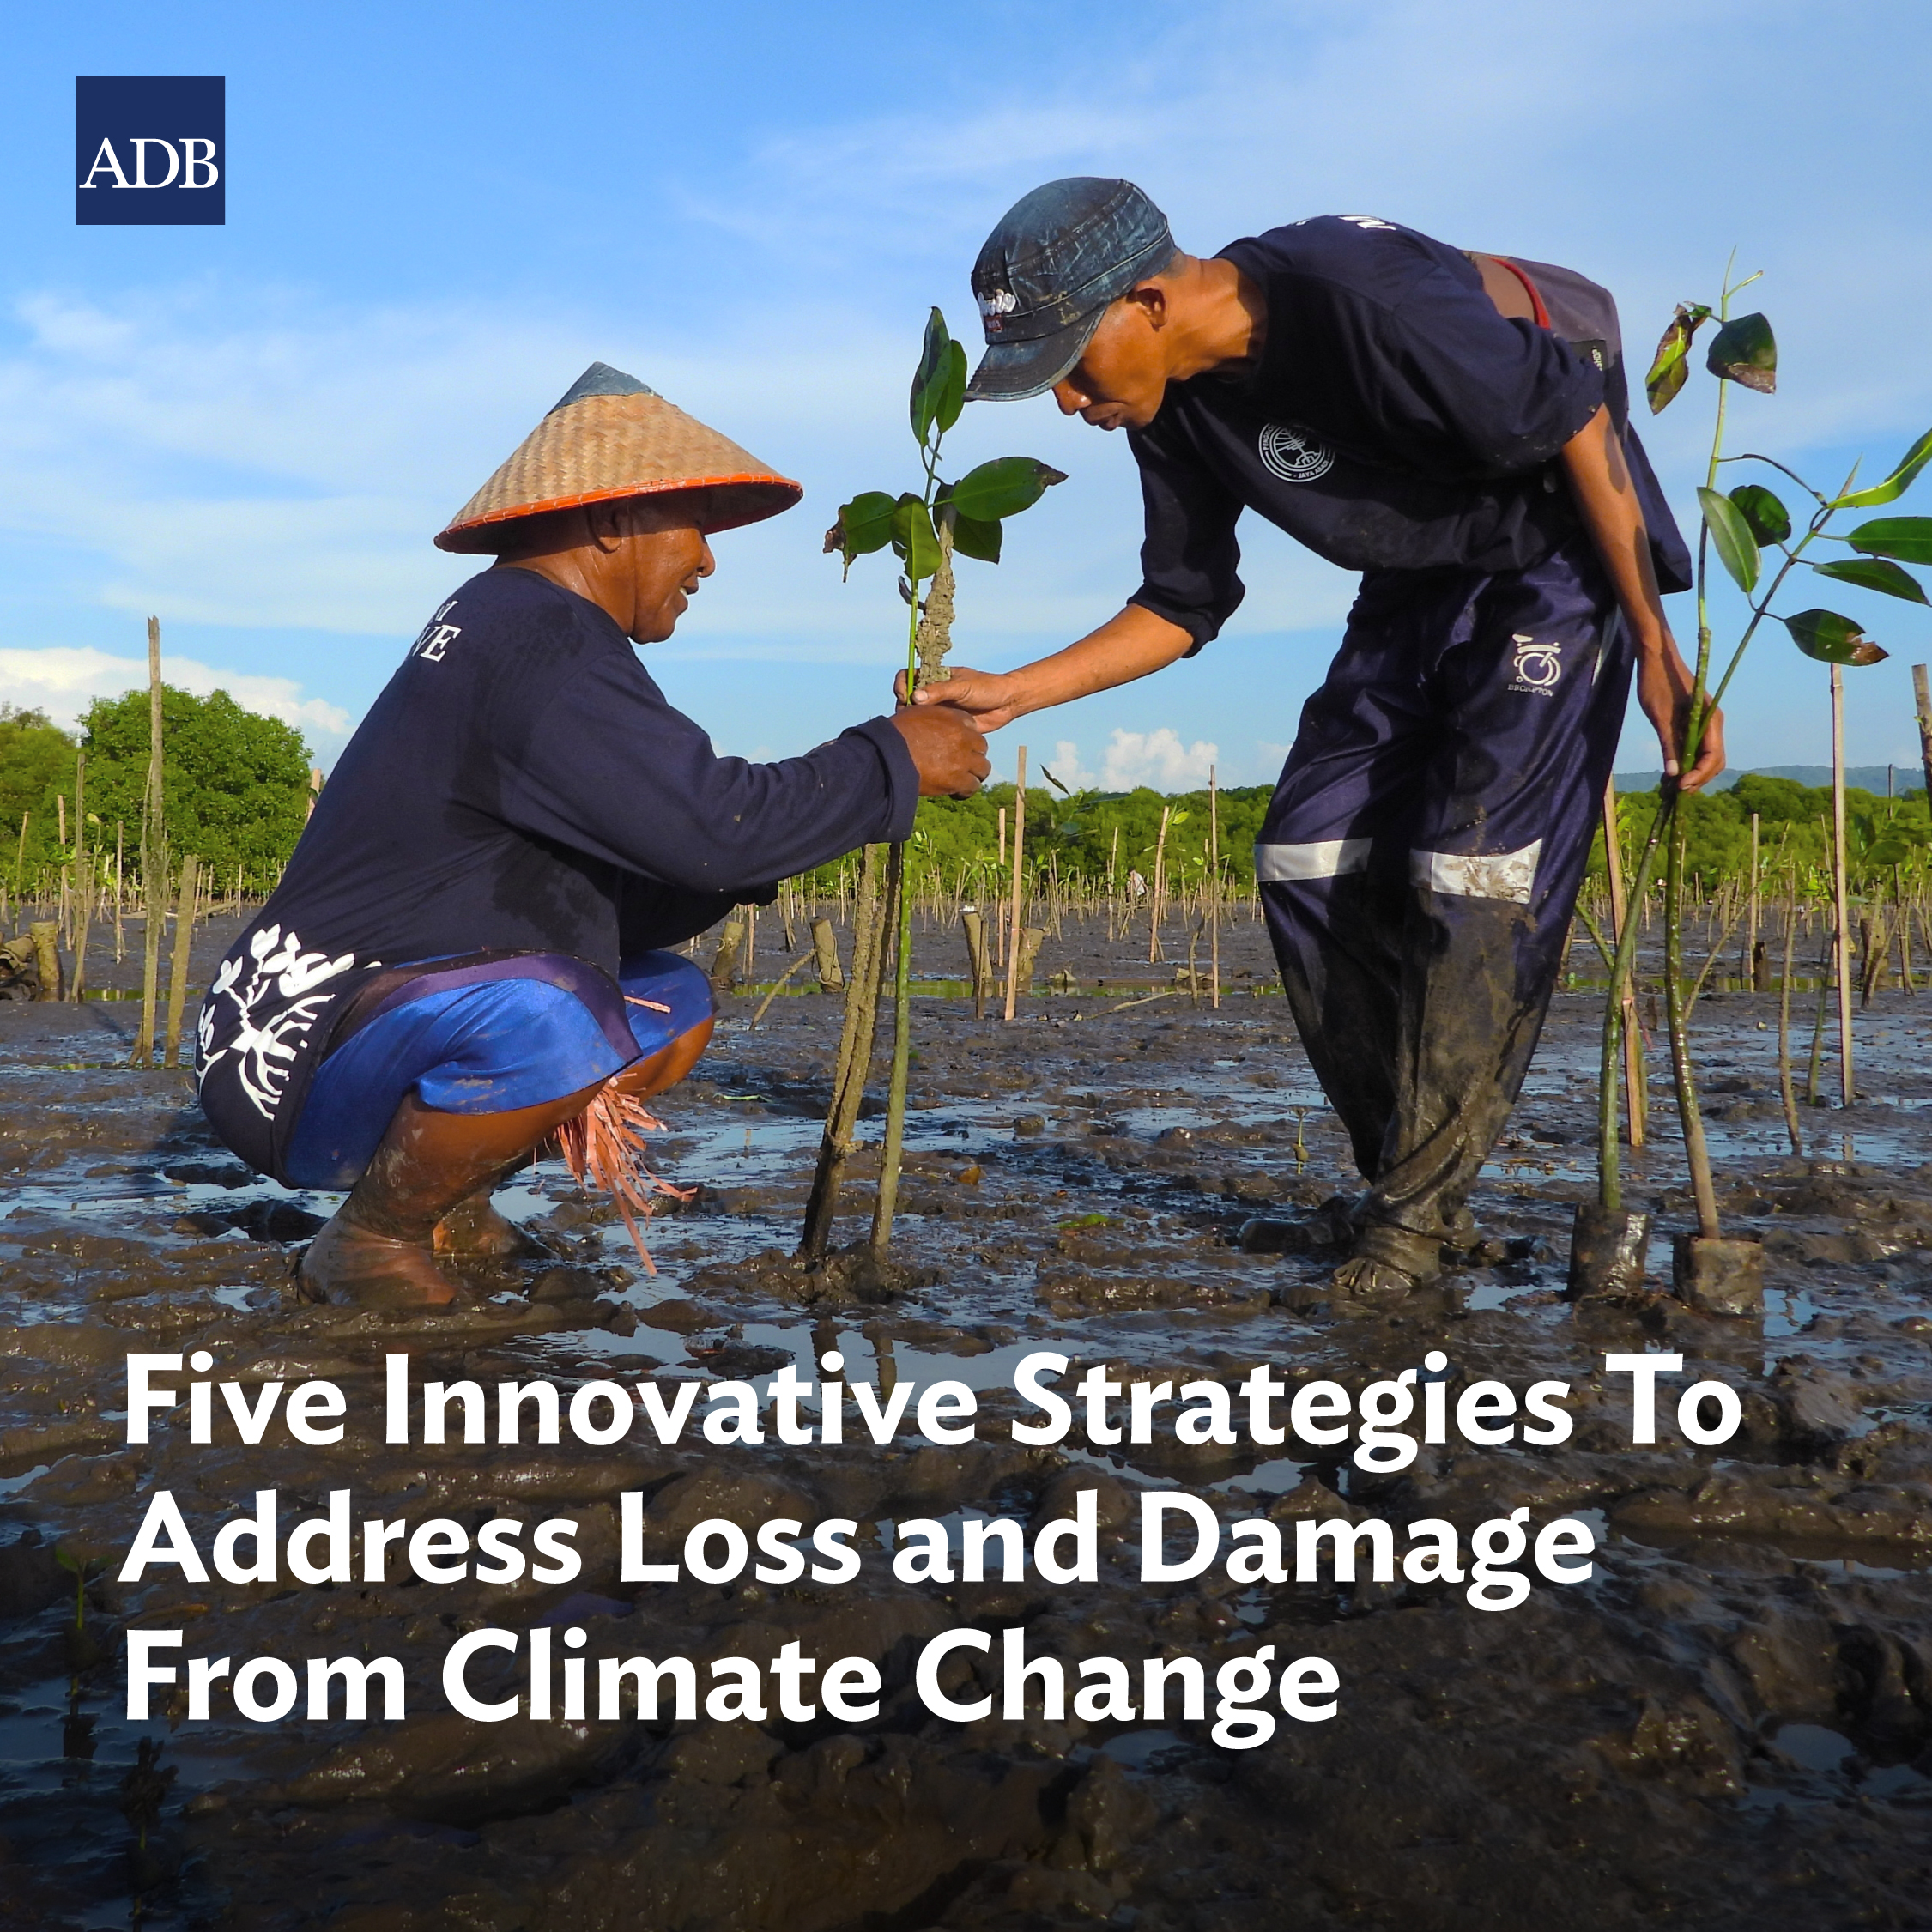
2.3. Addressing loss and damage from climate change impacts
2. JUSTICE AND EQUITY IN CLIMATE DISPUTE RESOLUTION
Addressing Loss and Damage:
Financial Support: Developed countries should provide financial assistance to help vulnerable communities cope with the loss and damage they experience. This could include funding for adaptation measures, disaster relief, and loss compensation.
Capacity Building: Building the capacity of vulnerable communities to adapt to climate change is essential. This includes providing training, resources, and technology to help them manage risks and build resilience.

Slide 17
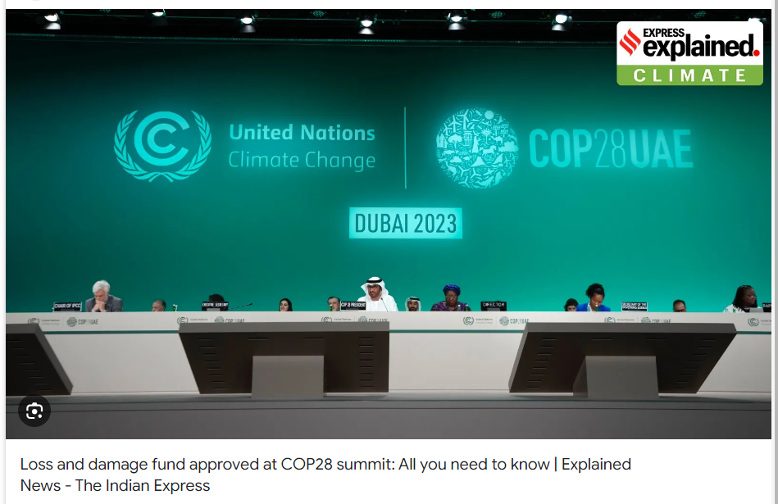
2.3. Addressing loss and damage from climate change impacts
2. JUSTICE AND EQUITY IN CLIMATE DISPUTE RESOLUTION
Addressing Loss and Damage:
Establishing a dedicated Loss and Damage funding mechanism: This will create a reliable source of finance specifically for addressing loss and damage.
Participatory frameworks: Include affected communities in decision-making surrounding loss and damage, ensuring their voices are heard.
Innovative compensation schemes: Explore mechanisms beyond traditional aid, such as levies on fossil fuel industries or debt-for-climate swaps.

Slide 18
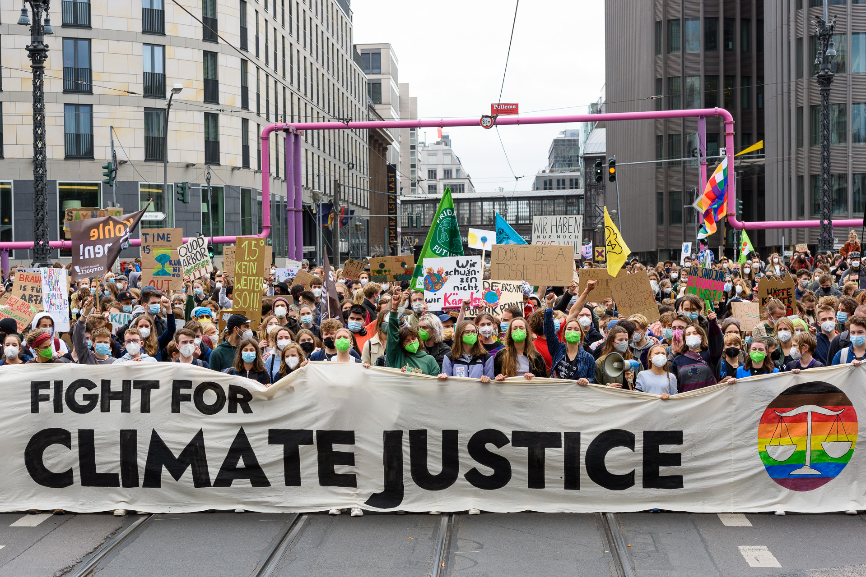
2.4. Ethical and social considerations in climate dispute resolution
2. JUSTICE AND EQUITY IN CLIMATE DISPUTE RESOLUTION
Ethical and Social Dimensions of Climate Disputes:
Climate Injustice: Climate change amplifies existing inequalities. Wealthy nations with high emissions often have greater resources to adapt, while poorer countries with minimal contributions suffer the worst impacts.
Intergenerational Equity: Today's decisions regarding emissions and mitigation profoundly impact future generations. Dispute resolution must consider the rights and well-being of those yet to be born.

Slide 19
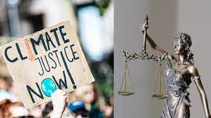
2.4. Ethical and social considerations in climate dispute resolution
2. JUSTICE AND EQUITY IN CLIMATE DISPUTE RESOLUTION
Ethical and Social Dimensions of Climate Disputes:
Distributive Justice: How should the costs and burdens of climate action be distributed fairly? Should high emitters bear more responsibility? Should the most vulnerable receive more support?
Procedural Justice: Ensuring marginalized communities and developing nations have a voice in international climate negotiations and dispute resolution mechanisms is crucial for procedural fairness and just outcomes.

Slide 20
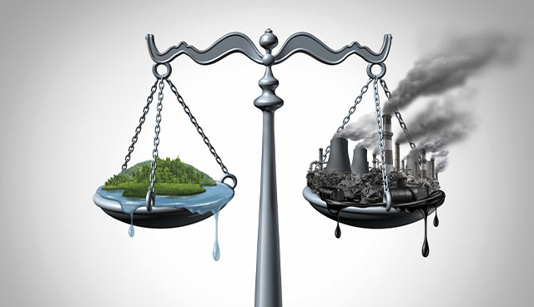
2.4. Ethical and social considerations in climate dispute resolution
2. JUSTICE AND EQUITY IN CLIMATE DISPUTE RESOLUTION
Key Ethical and Social Considerations:
Recognition of Differential Impacts and Responsibilities: Acknowledging that climate change has disproportionate impacts and that historical emitters have a greater responsibility is the foundation for ethical dispute resolution.
Equity-Based Decision Making: Prioritizing the needs of the most vulnerable – nations, communities, and individuals – must be central to decision-making processes to address historical and ongoing climate injustices.

Slide 21
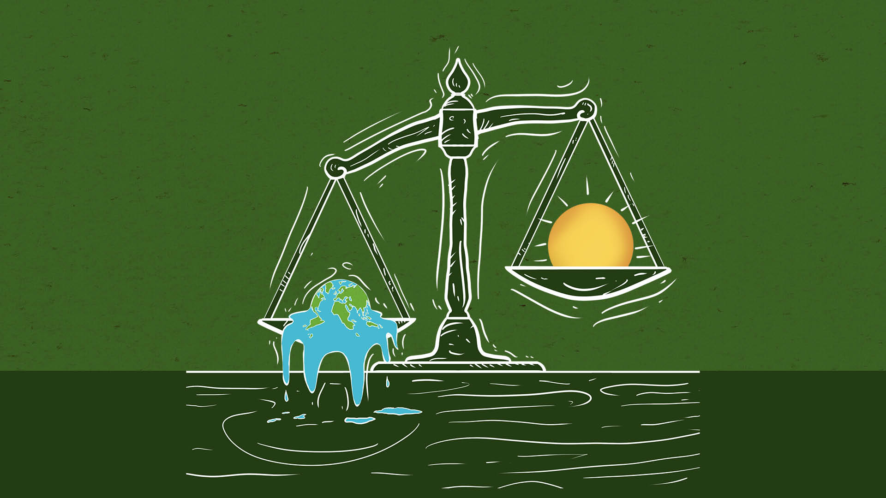
2.4. Ethical and social considerations in climate dispute resolution
2. JUSTICE AND EQUITY IN CLIMATE DISPUTE RESOLUTION
Key Ethical and Social Considerations:
Fair Burden Sharing: Determining how the costs of climate mitigation, adaptation, and loss & damage should be shared requires ethical considerations of fairness within and across generations.
Compensation and Reparations: There's an ethical argument for developed nations, as major historical emitters, to compensate or provide reparations to nations facing the most severe impacts of climate change.

Slide 22
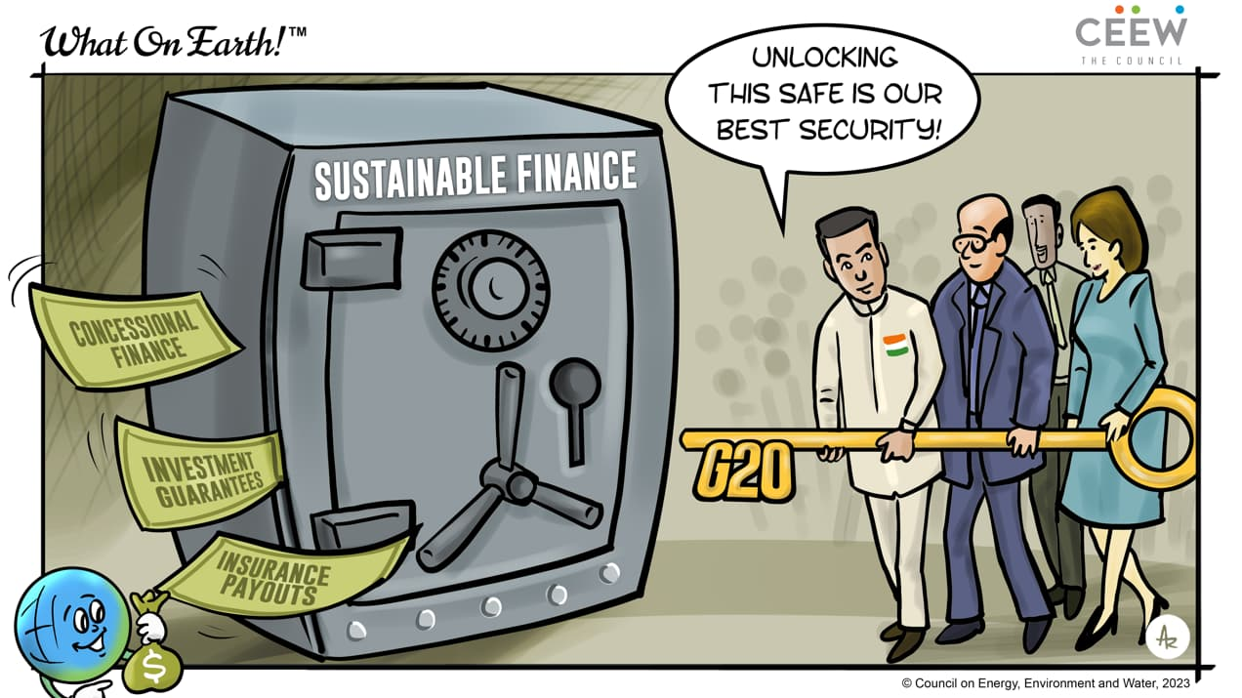
2.4. Ethical and social considerations in climate dispute resolution
2. JUSTICE AND EQUITY IN CLIMATE DISPUTE RESOLUTION
The Imperative for Just Climate Solutions
Ethical and social factors are critical in resolving climate disputes to form a fair and balanced response to the climate crisis, even with existing challenges.
Neglecting fairness in climate change deepens existing problems, hindering solutions and global unity.
Prioritizing the vulnerable, honoring past contributions, and sharing decision-making can ensure a just response to climate change.

Slide 23
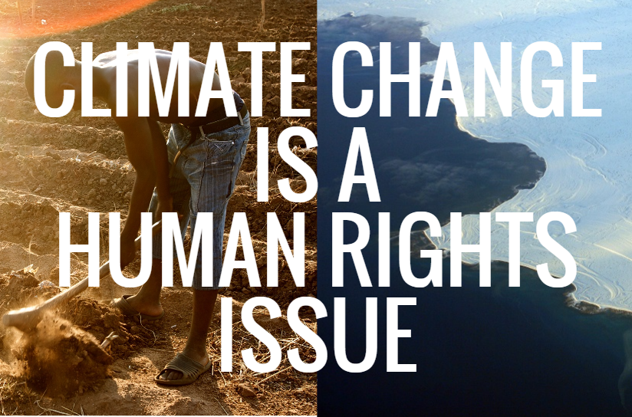
2.5. Climate justice and human rights
2. JUSTICE AND EQUITY IN CLIMATE DISPUTE RESOLUTION
Climate justice and human rights are fundamental concepts when considering justice and equity in climate dispute resolution.
Climate Justice:
Equity and Fairness: Climate change disproportionately harms developing nations and marginalized communities despite contributing minimally to the problem. Dispute resolution should consider the historical responsibility of major polluters and ensure solutions address this imbalance.

Slide 24
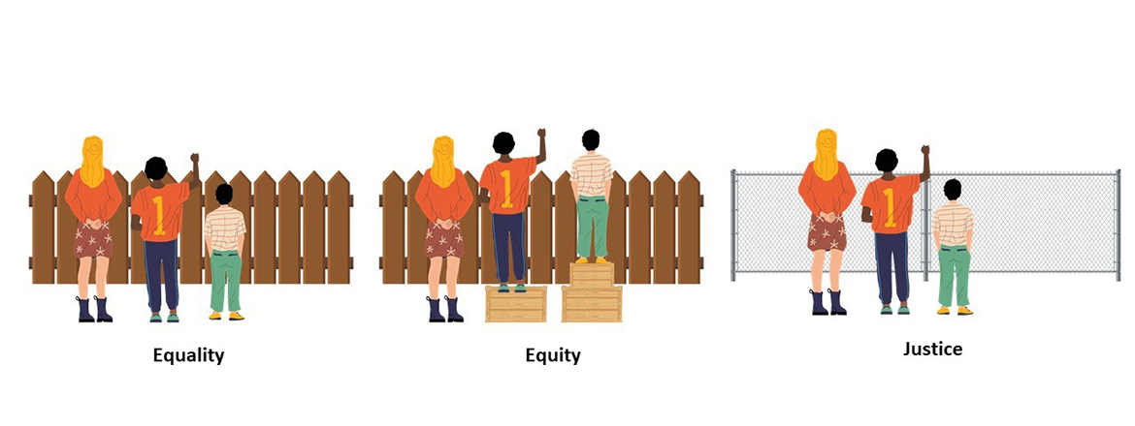
2.5. Climate justice and human rights
2. JUSTICE AND EQUITY IN CLIMATE DISPUTE RESOLUTION
Climate Justice:
Right to a Healthy Environment: Everyone has the right to a healthy environment. Climate disputes should consider how proposed solutions protect this right and minimize harm to vulnerable populations.
Intergenerational Equity: Decisions made today impact future generations. Dispute resolution should consider the long-term consequences of actions and ensure a sustainable future for all.

Slide 25
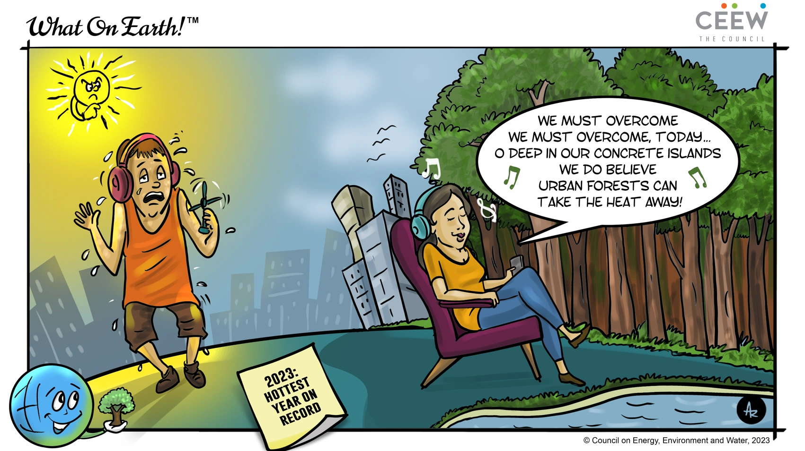
2.5. Climate justice and human rights
2. JUSTICE AND EQUITY IN CLIMATE DISPUTE RESOLUTION
Human Rights:
Right to Life, Health, and Food: Climate change threatens these fundamental rights. Dispute resolution should prioritize solutions that protect these rights and ensure access to resources for adaptation.
Right to Remedy: Those harmed by climate change have the right to seek compensation and hold polluters accountable. Dispute resolution mechanisms should provide avenues for redress.

Slide 26
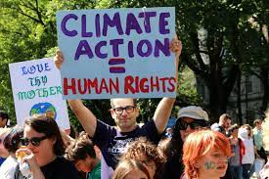
2.5. Climate justice and human rights
2. JUSTICE AND EQUITY IN CLIMATE DISPUTE RESOLUTION
Human Rights:
Right to Information and Participation: Communities affected by climate change projects have the right to be informed and participate in decision-making. Dispute resolution processes should be transparent and inclusive.

Slide 27
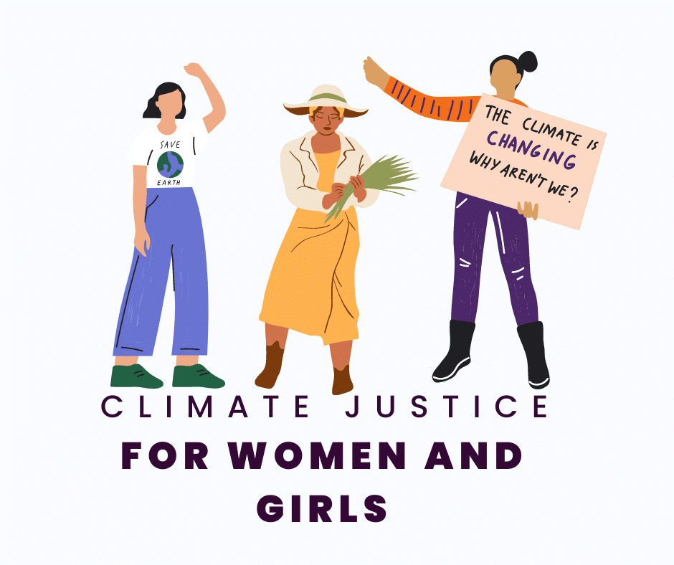
2.5. Climate justice and human rights
2. JUSTICE AND EQUITY IN CLIMATE DISPUTE RESOLUTION
Integrating climate justice and human rights into climate dispute resolution can help achieve:
Fair and equitable outcomes: Solutions should address historical responsibility and prioritize the needs of the most vulnerable.
Protection of human rights: Decisions should uphold fundamental human rights threatened by climate change.
Sustainable solutions: Dispute resolution should promote long-term solutions that build resilience and ensure a just future for all.

Slide 28
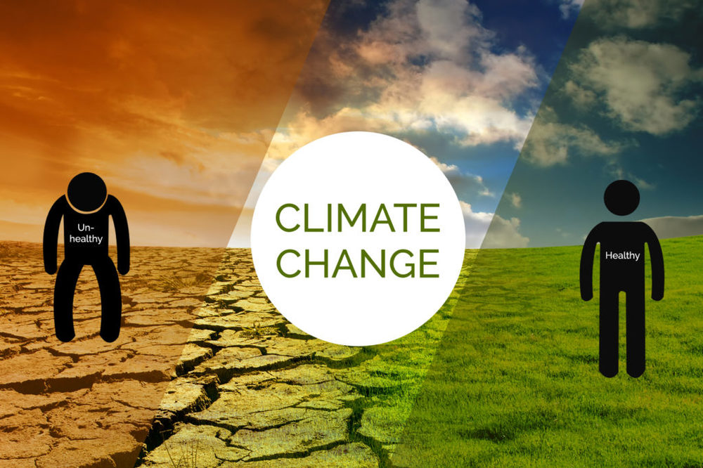
2.5. Climate justice and human rights
2. JUSTICE AND EQUITY IN CLIMATE DISPUTE RESOLUTION
Key Considerations
Equity over equality: Ensure solutions prioritize those most vulnerable and historically marginalized, not just equal distribution across affected populations.
Right to a healthy environment: Recognize the right to a clean, healthy, and sustainable environment as fundamental to human well-being and climate action.

Slide 29
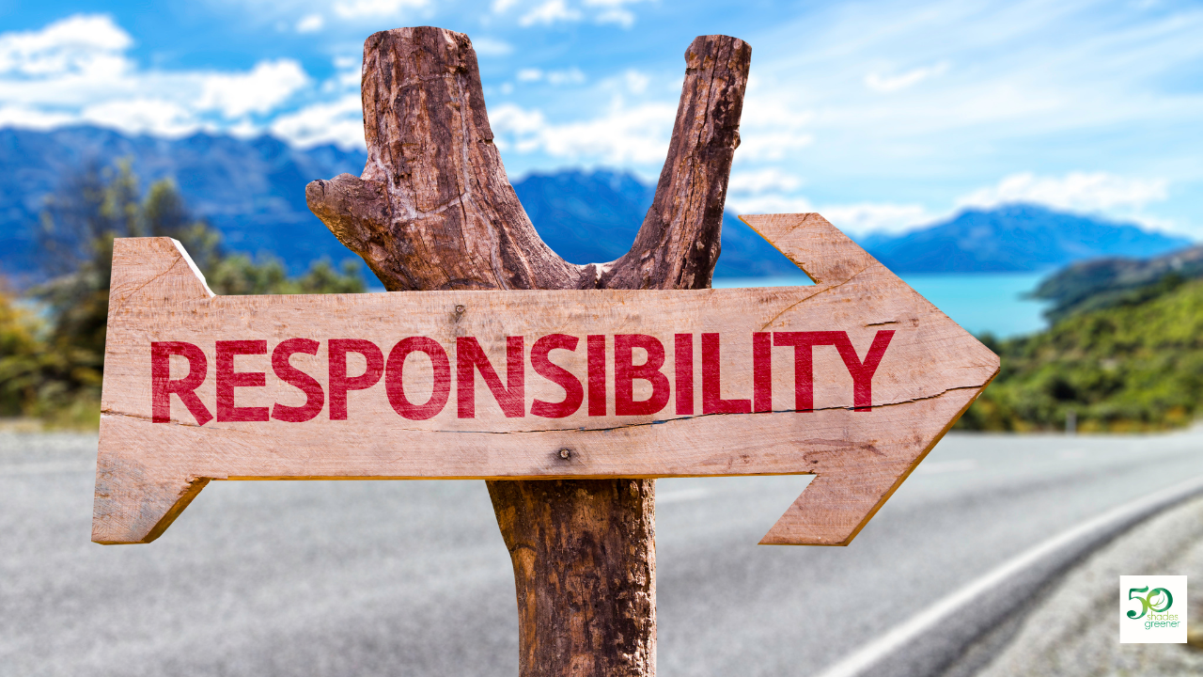
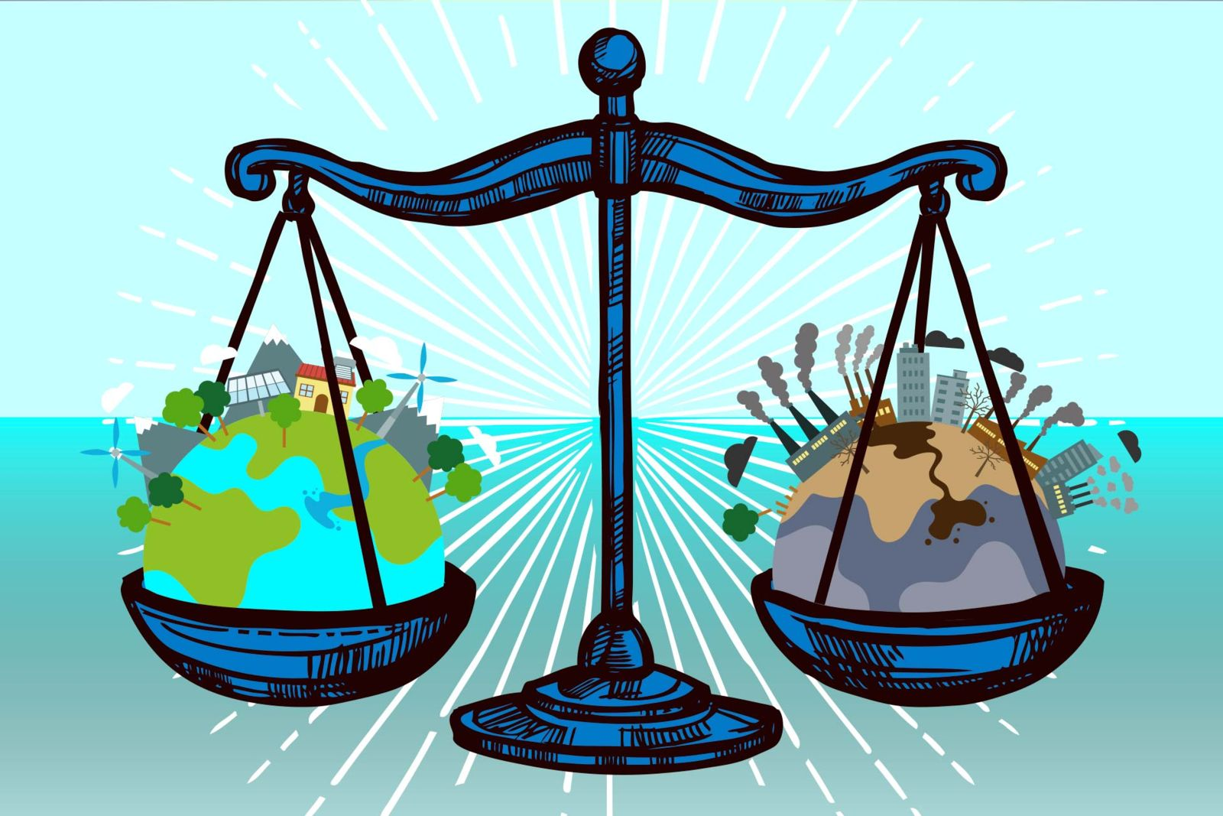
2.5. Climate justice and human rights
2. JUSTICE AND EQUITY IN CLIMATE DISPUTE RESOLUTION
Key Considerations
Participation and inclusion: Empower communities, particularly those most affected, to participate in decision-making and hold governments and corporations accountable.
Addressing historical responsibility: Recognize the disproportionate historical responsibility of developed nations for emissions and ensure they contribute fairly to adaptation and compensation efforts.
Gender equality and social justice: Integrate gender considerations and address social inequalities that exacerbate vulnerability to climate change.

Slide 30
2.5. Climate justice and human rights
2. JUSTICE AND EQUITY IN CLIMATE DISPUTE RESOLUTION
Moving forward
Integrating human rights principles into climate policies and actions is crucial for achieving a just and sustainable future.
Holding governments and corporations accountable for upholding human rights in the context of climate change is essential.
Supporting and empowering communities on the frontlines of climate injustice is vital for effective solutions.

