Slide 1
CCP-LAW
Curricula development on Climate Change Policy and Law
Subject title: Introduction to the EU Emissions Trading Scheme
Instructor Name: PROF ABHINAV SHRIVASTAVA AND PROF RAJ VARMA
Project No of Reference: 618874-EPP-1-2020-1-VN-EPPKA2-CBHE-JP:
The European Commission's support for the production of this publication does not constitute an endorsement of the contents, which reflect the views only of the authors, and the Commission cannot be held responsible for any use which may be made of the information contained therein.

Slide 2
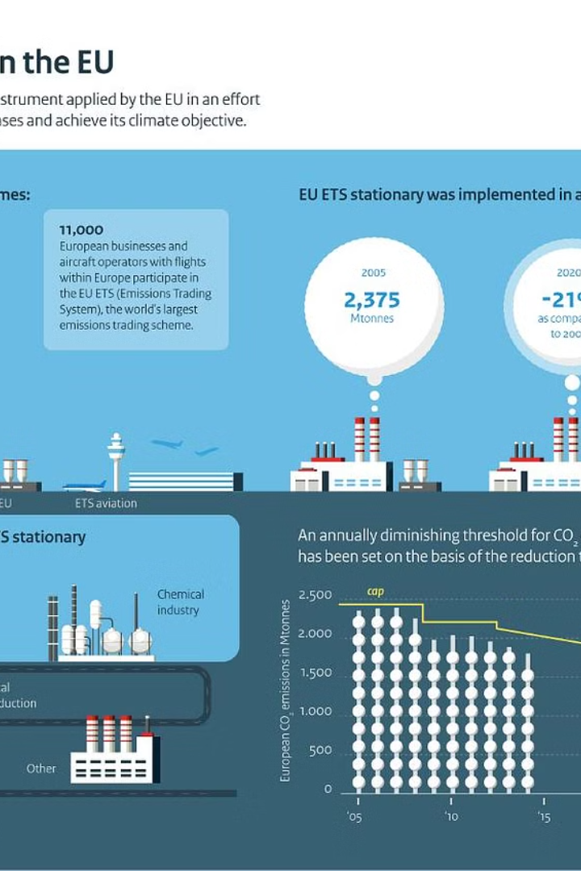
INTRODUCTION
The European Union Emissions Trading Scheme (EU ETS) is the world's largest carbon market, aimed at reducing greenhouse gas emissions from industrial sectors across Europe. It is a cornerstone of the EU's policy to combat climate change and a key tool for transitioning to a low-carbon economy.

Slide 3
PHASE I( 2005-2007): PILOT PHASE
1. ESTABLISHMENT: The EU Emissions Trading Scheme (EU ETS) was launched in 2005 as a pilot phase to lay the groundwork for a comprehensive carbon trading system.
2. COVERAGE: During this initial phase, the EU ETS covered only CO2 emissions from power generation and selected energy-intensive industries across 15 member states.
3. LESSONS LEARNED: This pilot phase allowed policymakers to test the system, address design flaws, and gather valuable data to improve the EU ETS in subsequent phases.

Slide 4
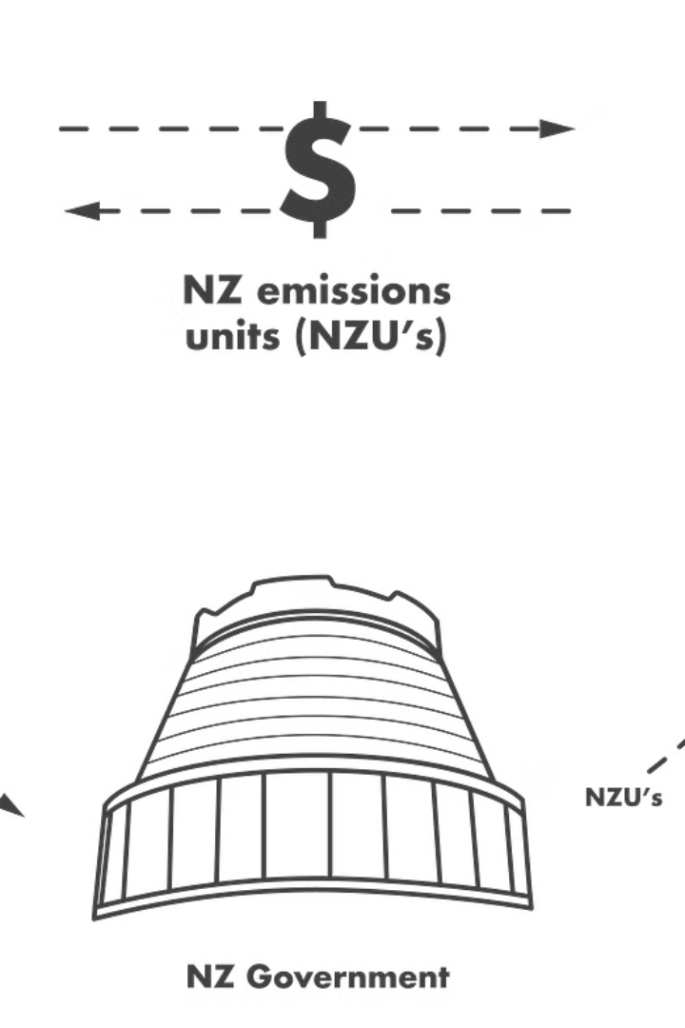
OBJECTIVES AND DESIGN OF PHASE I
The primary objectives of the EU Emissions Trading Scheme's (EU ETS) Phase I were to establish a functional carbon market, gain experience with emissions trading, and lay the groundwork for future phases. The design focused on setting up the necessary infrastructure, allocating emissions allowances to participating sectors, and developing the monitoring and reporting framework.
Phase I was a pilot phase, running from 2005-2007, and covered only CO2 emissions from the power and industrial sectors. The allowances were largely allocated for free to the participating facilities based on their historical emissions data

Slide 5
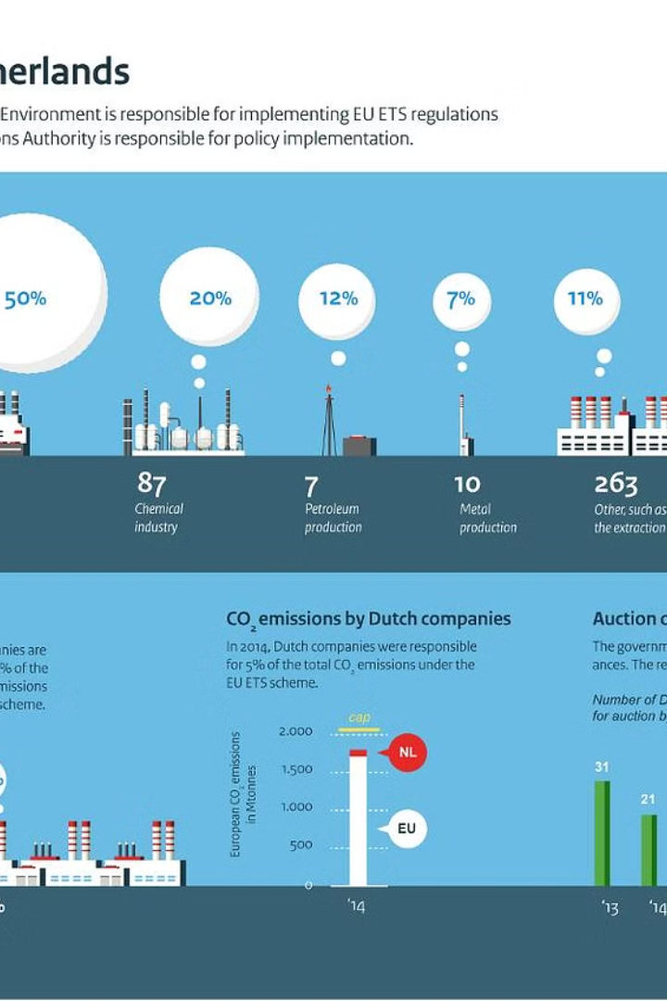
Challenges and Lessons Learned from Phase I
Overallocation of emissions allowances led to a price collapse, highlighting the need for more rigorous allocation and monitoring.
Lack of harmonized monitoring, reporting, and verification (MRV) processes across member states caused inconsistencies and reduced data reliability
The exclusion of certain sectors, like aviation, limited the overall emissions coverage and impact of the scheme

Slide 6
Phase II (2008-2012): Kyoto commitment period
1. EXPANDING SCOPE: Phase II of the EU ETS expanded the system to include more sectors and gases, aiming to cover a larger portion of Europe's carbon emissions.
2. STRICTER TARGETS: During this period, the EU committed to meeting its Kyoto Protocol targets, requiring deeper emissions cuts from participating countries and companies.
3. ALLOCATION IMPROVEMENTS: Lessons from Phase I led to improved allocation of emissions allowances, with more auctioning and fewer free allocations to industries.

Slide 7
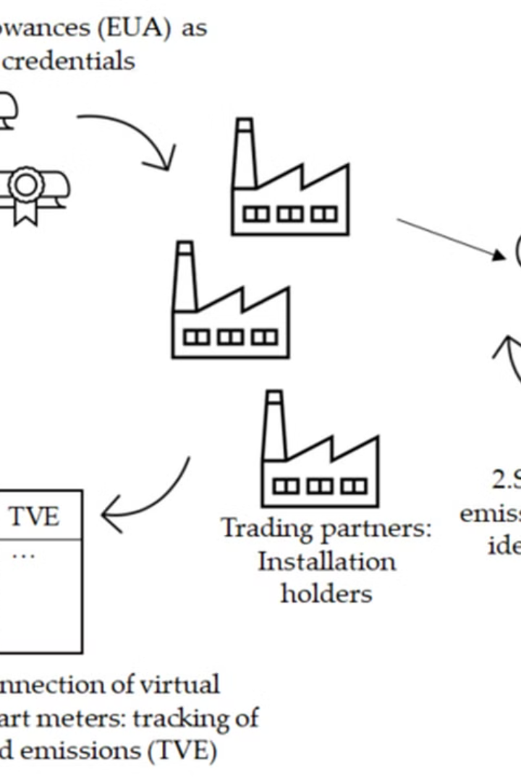
Expansion and improvements in Phase II
Phase II of the EU Emissions Trading Scheme (2008-2012) saw significant expansions and improvements compared to the pilot phase. The scope of the system was expanded to include new sectors and greenhouse gases.
Allocation of emissions allowances was further harmonized across member states, and the use of international credits from the Kyoto Protocol's flexible mechanisms was allowed.

Slide 8
Achievements and Limitations of Phase II
1) ACHIEVEMENTS: During Phase II, the EU ETS saw a significant expansion as it was linked to the Kyoto Protocol, allowing international emissions trading. This helped drive emissions reductions across Europe and incentivized investment in clean technologies.
2) INCREASED PARTICIPATION: The scheme was expanded to include more sectors and countries, strengthening its impact and reach. This broader coverage increased the overall volume of emissions being regulated under the system.
3) TIGHTNING CAPS: The emissions caps were reduced compared to Phase I, driving greater emissions cuts. This demonstrated the system's ability to be adjusted over time to meet more ambitious climate goals.
4) LIMITATIONS; Despite the progress, Phase II faced challenges such as high price volatility, windfall profits for some companies, and concerns about the effectiveness of offsets used for compliance.

Slide 9
Phase III (2013-2020): Structural Reform
EXPANDED SCOPE: Phase III expanded the EU ETS to include more sectors, such as aviation, and more greenhouse gases beyond just carbon dioxide
CENTRALISED BENCHMARKING: A centralized benchmarking system was introduced to set emissions caps for each industry based on the most efficient technologies.
AUCTIONING ALLOWANCES: In Phase III, a greater proportion of emissions allowances were auctioned off rather than freely allocated, increasing the market-based nature of the system.

Slide 10
Key changes in Phase III
1) EXPANDED SCOPE: Phase III expanded the EU ETS to cover more sectors, including aviation, and increased the number of participating countries.
2) CENTRALISED ALLOCATION: The allocation of emissions allowances became more centralized, with the European Commission taking a greater role in the process
3) INCREASED AUCTIONING: The proportion of allowances auctioned increased significantly, rather than being freely allocated, to strengthen the carbon price signal.
4) EMMISSION REDUCTION TARGET: The overall emissions reduction target for the EU ETS was increased to 21% below 2005 levels by 2020.

Slide 11
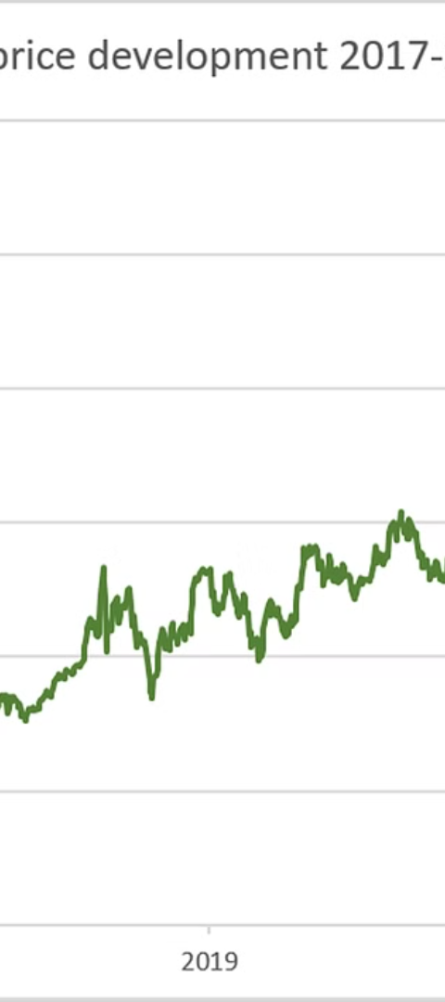
Impact of the Reforms on the EU ETS
1) STRENGTHENED CARBON PRICE: The reforms have led to a significant increase in the price of carbon allowances, providing stronger incentives for emissions reductions.
2) REDUCED OVERSUPPLY: Measures like backloading and the introduction of the Market Stability Reserve have addressed the surplus of allowances, improving the functioning of the system.
3) EXPANDED SCOPE: The inclusion of additional sectors and greenhouse gases has broadened the reach and impact of the EU ETS, covering a larger share of emissions.

Slide 12
Phase IV (2021-2030): Strengthening the system
1. The EU has set more ambitious greenhouse gas emissions reduction targets of at least 55% by 2030 compared to 1990 levels, up from
2. Phase IV will expand the EU ETS to include new sectors like the maritime industry and potentially road transport and buildings, further broadening its scope.
3. Improved monitoring, reporting, and verification (MRV) requirements will enhance the transparency and integrity of the system, ensuring accurate emissions data.

Slide 13
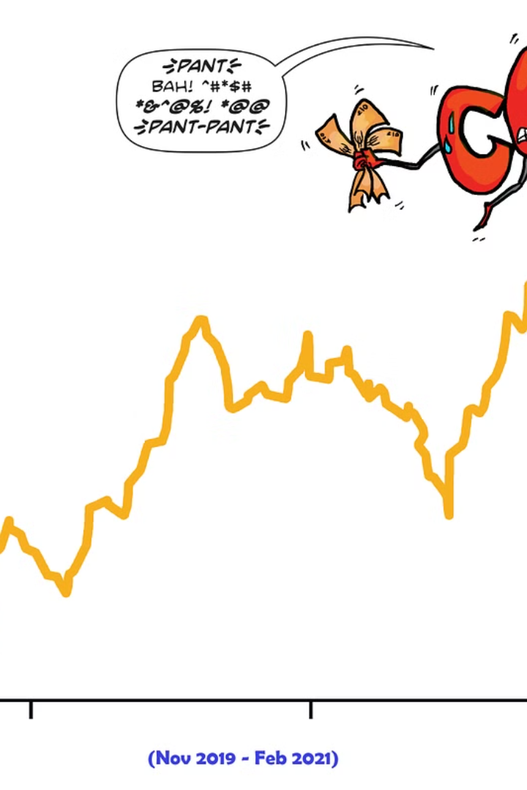
Proposed changes and targets for Phase IV
For Phase IV of the EU Emissions Trading Scheme (2021-2030), policymakers have proposed several key changes to strengthen the system and drive deeper emissions cuts. These include a steeper annual emissions reduction factor, expanded coverage of sectors, and higher carbon prices to incentivize low-carbon investments.
The proposed targets for Phase IV are to reduce EU-wide emissions by at least 55% below 1990 levels by 2030, up from the previous 40% target. This more ambitious goal aligns with the EU's updated climate commitments under the Paris Agreement.

Slide 14
Role of the EU ETS in Achieving Climate Goals
The EU Emissions Trading System (EU ETS) is a critical component in the European Union's strategy to combat climate change and reduce greenhouse gas emissions. As the world's largest carbon market, the EU ETS serves as a powerful economic tool to incentivize industries to transition towards more sustainable practices and technologies.
By setting a cap on the total amount of allowed emissions and introducing a market-based mechanism for trading emission allowances, the EU ETS has driven significant reductions in carbon dioxide (CO2) emissions across key sectors, including power generation, manufacturing, and aviation. This market-based approach has proven effective in driving cost-effective emissions cuts and promoting investment in clean energy solutions.
As the EU works towards its ambitious goal of reducing net greenhouse gas emissions by at least 55% by 2030, the EU ETS will continue to play a vital role in helping industries and member states achieve their climate targets. Through ongoing reforms and adjustments, the system aims to strengthen its impact and ensure that the EU remains on track to meet its long-term climate objectives.

Slide 15
Monitoring, Reporting, and Verification (MRV) in the EU ETS
MONITORING: Companies must closely monitor their greenhouse gas emissions and collect detailed data on their activities, energy usage, and emission sources.
REPORTING: Verified emission reports must be submitted annually, providing transparent and accurate information on a company's emissions and compliance
VERIFICATION: An independent third-party verifies the reported emissions data to ensure reliability and integrity of the EU ETS system.

Slide 16
Future outlook and potential developments
As the EU Emissions Trading Scheme continues to evolve, there are exciting possibilities on the horizon. Policymakers are exploring new ways to strengthen the system and drive deeper emissions reductions.

