Slide 1
CCP-LAW
Curricula development on Climate Change Policy and Law
Renewable energy and climate change
Instructor Name: …
Project No of Reference: 618874-EPP-1-2020-1-VN-EPPKA2-CBHE-JP:
The European Commission's support for the production of this publication does not constitute an endorsement of the contents, which reflects the views only of the authors, and the Commission cannot be held responsible for any use which may be made of the information contained therein.

Slide 2
Content​
Overview of renewable energy sources and their role in mitigating climate change.
Legal framework to promote renewable energies and their efficiency.
Research the case of successful implementation of renewable energy projects.

Slide 3
Overview of renewable energy
1. Overview of renewable energy sources and their role in mitigating climate change
Renewable energy is energy exploited from natural sources that can regenerate in a short period of time and does not cause resource depletion.

Slide 4
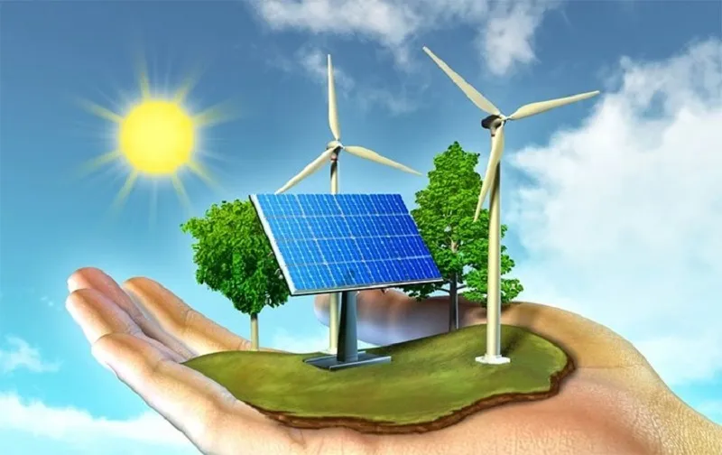
Overview of renewable energy sources
1. Overview of renewable energy sources and their role in mitigating climate change
Popular renewable energy sources include:
Solar energy: Uses sunlight to generate electricity or heat.
Wind energy: Using wind power to operate wind turbines, generating electricity.
Hydroelectric energy: Using water power to rotate turbines and generate electricity.
Biomass energy: Using organic materials (trees, biological waste) to produce energy.
Geothermal energy: Uses heat from underground to produce electricity or heat.
Tidal and wave energy: Uses the movement of ocean water to generate electricity.

Slide 5
Solar
1. Overview of renewable energy sources and their role in mitigating climate change
Solar energy uses sunlight to generate electricity or heat. This technology includes solar panels and solar thermal systems. This is a clean, endless source of energy and does not pollute the environment.

Slide 6
Wind energy
1. Overview of renewable energy sources and their role in mitigating climate change
Wind energy uses wind power to operate wind turbines. When wind blows through the blades, the turbine rotates and produces electricity. This is a clean energy source that does not emit greenhouse gases.

Slide 7
Water energy (Hydropower)
1. Overview of renewable energy sources and their role in mitigating climate change
Hydroelectric energy is produced by using water power to turn turbines and generate electricity. Hydroelectric dams store water and control its flow to generate electricity. This is a stable energy source and has the ability to store energy.

Slide 8
Biomass energy
1. Overview of renewable energy sources and their role in mitigating climate change
Biomass energy uses organic materials such as trees and biological waste to produce electricity or heat. This process may include combustion, gasification or fermentation. This is a renewable energy source and helps reduce waste.

Slide 9
Geothermal energy
1. Overview of renewable energy sources and their role in mitigating climate change
Geothermal energy uses heat from underground to produce electricity or heat. Geothermal systems exploit steam or hot water from underground to spin turbines to generate electricity or provide heat. This is a stable source of energy and has little impact on the environment.

Slide 10
The role of renewable energy in mitigating climate change
Climate change is happening on our planet for many different reasons, of which the important reason is due to human production and business activities that exploit and process many types of minerals and gases to turn them into energy sources that are used in large quantities, frequently and commonly in human life.
The exploitation of resources derived from fossils such as coal, crude oil, etc. can lead to deforestation, loss of vegetation, and biodiversity, thereby reducing the ability to regulate climate, reducing the ability to carbon absorption, increasing the possibility of ozone layer depletion, and leading to the greenhouse effect.
The process of exploiting and producing energy from fossil minerals also releases many wastes that deplete the ozone layer, causing a greenhouse effect in the environment, increasing the possibility of climate change.

Slide 11
The role of renewable energy in mitigating climate change
Exploiting, producing, and using renewable energy will overcome the negative effects on the environment, causing climate change, of re-exploiting, producing, and using energy of fossil origin, such as: Reduce deforestation and loss of vegetation, thereby increasing the ability to absorb greenhouse gases and gases that cause ozone layer depletion.
Exploiting, producing, and using renewable energy reduces (possibly zero) emissions of substances that deplete the ozone layer and greenhouse gases, thereby minimizing climate change.
Exploiting, producing and using renewable energy also creates a new trend and new awareness of climate change response, thereby contributing to reducing climate change.

Slide 12
2. Legal framework to promote renewable energies and their efficiency
2.1. Legal framework
The issue of renewable energy development regulated in the Constitution of each country, as an indispensable content to protect the environment, and ensure the right to live in a fresh environment of people.
The issue of renewable energy must be regulated in the Environmental Protection Law or in a law on green economy.
Renewable energy must be a content in national, regional, sectoral and local strategies on responding to climate change.
Renewable energy must also be regulated in detail in legal documents, such as Government Decree, guiding Circulars of Ministries, etc.

Slide 13
2. Legal framework to promote renewable energies and their efficiency
2.1. Legal framework
The State must have policies, strategies, and overall plans to promote renewable energy in each period, in accordance with the international treaties that the State has signed and participated in, as well as in line with the socio-economic conditions of each country.
There are support mechanisms in many aspects to promote renewable energy. This mechanism includes: exemption and reduction of some taxes; preferential loans with low interest rates, preferential technical infrastructure, preferential land rental support, etc. for renewable energy projects.

Slide 14
2. Legal framework to promote renewable energies and their efficiency
2.1. Legal framework
Specifying the contents of State management in the field of renewable energy, clearly defining the tasks and powers of state agencies in the process of managing activities in the field of renewable energy,and promoting develop renewable energy.
Objective: Promote renewable energy development and bring economic benefits.
Conditions: Meets general market conditions and specific requirements for carbon credit trading.
Important factors:
- Carbon emission quota.
- Rights and obligations of the buyer and seller.
- State intervention into market operations.

Slide 15
2. Legal framework to promote renewable energies and their efficiency
2.1. Legal framework
Regulations on supervision, inspection, examination, handling of violations, resolution of disputes, complaints and denunciations in the field of renewable energy to ensure the effectiveness of law enforcement on promotion recycled energy.
Objective: Ensure the effectiveness of the law on renewable energy.
Specifically:
Monitor activities.
Periodical inspection and testing.
Handling violations.
- Resolve disputes, complaints and denunciations.

Slide 16
2. Legal framework to promote renewable energies and their efficiency
2.1. Legal Framework
Regulations on information assurance mechanism in renewable energy promotion activities
Objective: Ensure effective control and promote the exploitation and use of renewable energy.
Specified:
Providing information between State agencies.
Providing information between businesses and state agencies.
- Disclose information to the community.

Slide 17
2. Legal framework to promote renewable energies and their efficiency
2.1. Legal framework
Regulations on international cooperation activities in the field of renewable energy, with specific contents on international cooperation such as: information exchange, financial support, technological support, training human resources, developing policies to promote renewable energy, etc. These contents must be assigned to agencies and organizations with sufficient authority and conditions to implement.
Objective: Promote renewable energy through international cooperation.
Specific content:
- Information exchange.
- Financial support.
- Technology support.
- Human resource training.
- Develop policies to promote renewable energy.

Slide 18
2. Legal framework to promote renewable energies and their efficiency
2.2. The efficiencies
Create a legal basis for more effective exploitation, production and use of renewable energy
Adjust human behavior towards promoting renewable energy development.
Contribute to raising community awareness on promoting renewable energy.
Promote international cooperation mechanisms between countries in promoting renewable energy development.

Slide 19
2. Legal framework to promote renewable energies and their efficiency
2.2. The efficiencies
Forming and developing many projects and facilities to exploit, produce and use renewable energy in many countries around the world
Create a positive trend in renewable energy development, significantly reduce greenhouse gas emissions and substances that deplete the ozone layer.
Create an increasingly effective international cooperation mechanism to promote renewable energy.
Handle and prevent violations of the law in promoting renewable energy .

Slide 20
Wind power projects
3. Cases of successful implementation of renewable energy projects
Bac Lieu wind power project, Huong Linh 1 wind power project, Huong Linh 2 wind power project, Dam Nai wind power project, etc.

Slide 21
Hydroelectric power projects
3 Cases of successful implementation of renewable energy projects
Hydroelectric power projects in Vietnam such as : Hoa Binh Hydropower Plant, Son La Hydropower Plant, Lai Chau Hydropower Plant, etc.

Slide 22
3. Cases of successful implementation of renewable energy projects
Conclusion:
Renewable energy projects play an important role in the country's economic development process, ensuring energy security, contributing to environmental protection, and reducing emissions of greenhouse gases and degrading substances of ozone layer, limiting the impacts leading to climate change in Vietnam and globally.
The development of renewable energy projects requires the joint efforts of many entities and requires timely and appropriate incentive and support mechanisms from the State.
In the context of countries, especially developing countries, to promote the development of renewable energy to cope with climate change, international cooperation plays a very important role.

