Slide 1
CCP-LAW
Curricula development on Climate Change Policy and Law
Subject title: Intersection of climate change and international human rights issues
Instructor Name: Dr. Shashikala Gurpur, Dr. Sujata Arya
Project No of Reference: 618874-EPP-1-2020-1-VN-EPPKA2-CBHE-JP:
The European Commission's support for the production of this publication does not constitute an endorsement of the contents, which reflect the views only of the authors, and the Commission cannot be held responsible for any use which may be made of the information contained therein.

Slide 2
Climate Change and Human Rights
We all are the children of anthropocene, whether we fall into the categories of the privileged, the suffering, the curious, the angry, the optimistic, the alarmed, the fatalistic , the ignorant and/or the complacent.
The anthropocene is the most common accepted name today for the geological era that we are living in.
Climate change impacts, directly and indirectly, an array of internationally guaranteed human rights. States (duty-bearers) have an affirmative obligation to take effective measures to prevent and redress these climate impacts, and therefore, to mitigate climate change, and to ensure that all human beings (rights-holders) have the necessary capacity to adapt to the climate crisis.. OHCHR’s Key Messages on Human Rights and Climate Change highlight the essential obligations and responsibilities of States and other duty-bearers (including businesses) and their implications for climate change-related agreements, policies, and actions. In order to foster policy coherence and help ensure that climate change mitigation and adaptation efforts are adequate, sufficiently ambitious, non-discriminatory and otherwise compliant with human rights obligations, the following considerations should be reflected in all climate action, including agreements to be negotiated at the 21st Conference of the Parties to the United Nations Framework Convention on Climate Change.

Slide 3
Climate Change and Human Rights
Perspectives of Climate Justice
Human rights are fundamental rights and freedoms inherent to all human beings, regardless of nationality, ethnicity, religion, gender, or other characteristics. These rights are enshrined in international human rights instruments such as the Universal Declaration of Human Rights (UDHR) and encompass civil, political, economic, social, and cultural rights. Examples of human rights include the right to life, liberty, and security of person; the right to freedom of speech and expression; the right to education; the right to work and fair wages; and the right to a standard of living adequate for health and well-being. Human rights provide the moral and legal foundation for dignity, equality, and justice, serving as a cornerstone of democratic societies and international cooperation.

Slide 4
Importance to understand Relation between Climate Change and Human Rights
Perspectives of Climate Justice
Recognition of Inherent Linkages: Understanding the relationship between climate change and human rights is imperative as it acknowledges the inherent linkages between environmental degradation and social justice issues.
Disproportionate Impact on Vulnerable Communities: Climate change exacerbates existing inequalities, disproportionately affecting marginalized and disadvantaged communities who often lack resources and infrastructure to adapt.
Threat to Fundamental Human Rights: The consequences of climate change pose a significant threat to fundamental human rights, including the right to life, health, food, water, housing, and self-determination.
Holistic and Equitable Solutions: Recognizing this relationship facilitates the development of holistic and equitable solutions that address both environmental sustainability and social justice concerns simultaneously.
.

Slide 5
Importance to understand Relation between Climate Change and Human Rights
Perspectives of Climate Justice
Inclusive Decision-making Processes: Integrating human rights considerations into climate action strategies ensures inclusive decision-making processes that prioritize the needs and rights of all individuals, particularly those most affected by climate change.
Responsive Policy Frameworks: By understanding the interplay between climate change and human rights, policymakers can craft responsive policy frameworks that mitigate vulnerabilities and enhance resilience in communities.
Promotion of Environmental Justice: Understanding the relationship underscores the importance of promoting environmental justice and ensuring that responses to climate change uphold principles of fairness, equity, and inclusivity.
Long-term Sustainability: Addressing both climate change and human rights in tandem is essential for building a more resilient, equitable, and sustainable future for present and future generations. It fosters a holistic approach to sustainable development that integrates environmental, social, and economic dimensions

Slide 6
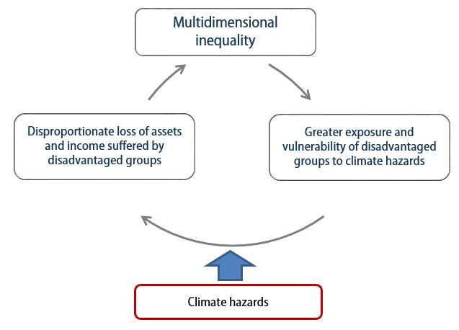
Inequality and climate change vicious cycle
Perspective of Climate Justice
Climate Change and Social Inequality S. Nazrul Islam and John Winkel (2017) DESA Working Paper No. 152

Slide 7
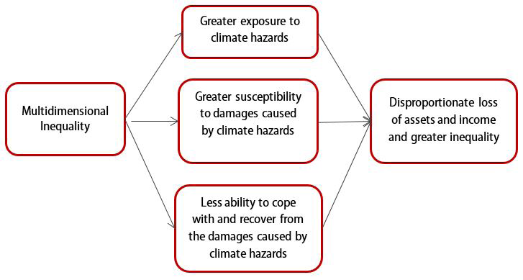
The effects of inequality on disadvantaged groups
Perspective of Climate Justice
Climate Change and Social Inequality S. Nazrul Islam and John Winkel (2017) DESA Working Paper No. 152

Slide 8
Why integrate human rights in climate change-related actions?
Human rights are universal legal guarantees that protect individuals, groups and peoples against actions and omissions that interfere with their fundamental freedoms and entitlements. Human rights law obliges governments (principally) and other duty-bearers to respect, promote, protect and fulfil all human rights.
It is now beyond dispute that climate change caused by human activity has negative impacts on the full enjoyment of human rights. Climate change has profound impacts on a wide variety of human rights, including the rights to life, self-determination, development, food, health, water and sanitation and housing. Simply put, climate change is a human rights problem and the human rights framework must be part of the solution. The Fifth Assessment Report (AR5) by the Intergovernmental Panel on Climate Change (IPCC) unequivocally states that “human influence on the climate system is clear, and recent anthropogenic emissions of green-house gases are the highest in history.” It notes that “recent climate changes have had widespread impacts on human and natural systems.” Former High Commissioner for Human Rights, Mary Robinson, now President of the Mary Robinson Foundation – Climate Justice, described climate change as “probably the greatest human rights challenge of the 21st century”

Slide 9
How can human rights be integrated in climate-change related actions?
Human rights can be integrated in climate-change related actions by applying a rights-based approach to policy and development as called for by the Declaration on the Right to Development and agreed to in the UN Common Understanding of a Human Rights-Based approach to Development Cooperation.. A rights-based approach analyses obligations, inequalities and vulnerabilities, and seeks to redress discriminatory practices and unjust distributions of power. It anchors plans, policies and programmes in a system of rights, and corresponding obligations established by international law. The essential attributes of a human rights-based approach are the following:
As policies and programmes are formulated, the main objective should be to fulfil human rights.
The rights-holders and their entitlements must be identified as well as the corresponding duty-bearers and their obligations in order to find ways for strengthening the capacities of rights-holders to make their claims and of duty-bearers to meet their obligations.
Principles and standards derived from international human rights law – especially the Universal Declaration of Human Rights and the core universal human rights treaties, should guide all policies and programming in all phases of the process.

Slide 10
The European Court of Human Rights (ECHR/ECtHR/Strasbourg Court)
The ECHR was first established in 1959, in Strasbourg, France, under the Council of Europe.
It’s purpose is to interpret the European Convention on Human Rights – which ensures certain basic rights to the citizens of signatory States – adjudicate complaints regarding violations of the Convention, and enforce observance of the Convention by States.
Jurisdiction – The Court has jurisdiction over inter-State complaints, as well complaints from individuals against States. It may also issue advisory opinions. Cases cannot be taken up suo motu.

Slide 11
The European Court of Human Rights (ECHR/ECtHR/Strasbourg Court)
ases adjourned until Grand Chamber hearings for ongoing cases:
Uricchiov v. Italy and 31 Other States (2021):
Two young adults have contended that greenhouse gas emissions from 33 member States of the European Union have caused global warming and extreme weather events, affecting their life and mental health.
Main Convention Articles: Art. 2 – right to life; Art. 8 – right to respect for private and family life; Art. 13 – right to effective remedy; Art. 14 – non-discrimination.
Mullner v. Austria (2021):
The applicant suffers from a medical condition that makes him wheelchair-bound if temperatures exceed 30 degrees Celsius (temperature-sensitive multiple sclerosis and Uhthoff’s Syndrome). The contention here is that Austria has not created a legislative and administrative framework adequate for meeting the Paris Agreement’s goals, or even the national targets for reduction in emissions.
Main Convention Articles: Art. 2 – right to life; Art. 6 – right to fair trial; Art. 8 – right to respect for private and family life; Art. 13 – effective remedy.

Slide 12
The European Court of Human Rights (ECHR/ECtHR/Strasbourg Court)
Soubeste v. Austria and 11 Other States (2022):
The applicants (young adults) contended that the 1994 Energy Charter Treaty, ratified by the 12 respondent States, protects the fossil fuel industry from regulatory changes, and inhibits the implementation of immediate measures against climate change. This has led to severe meteorological events, directly linked to climate change, which have adverse effects that violate their right to life, right to non-discrimination, right against inhuman and degrading treatment, and right to respect for private and family life.
Main Convention Articles: Art. 2 – right to life; Art. 3 – inhumane treatment prohibition; Art. 8 – right to respect for private and family life; Art. 14 – non-discrimination.
Engels v. Germany (2022):
The applicants (nine teenagers and young adults) have claimed that the amended version of the German Climate Protection Act is insufficient to meet the greenhouse gas emissions target necessary for the achievement of the Paris Agreement’s goals. The inadequacy of the Act is violative of their right to life, and right to respect for privacy and home life.
Main Convention Articles: Art. 2 – right to life; Art. 8 – right to respect for private and family life.

Slide 13
Cases Pending before the Grand Chambera
Verein KlimaSeniorinnen Schweiz v. Switzerland (2022)
The KlimaSeniorinnen is a group of older women – average age 73 – who contend that older women are particularly vulnerable to climate change, and more likely to die during heatwaves. The claim is that the Swiss government has failed in its positive obligation to protect human life, and private and family life.
The petition was first brought to Switzerland’s domestic courts. The government argued that older women were not the only group affected, and despite the reality of climate change, it could not be directly linked to their health. It further stated that Switzerland’s climate policies were sufficient for its goals.
However, the Climate Action Tracker has deemed Switzerland’s policies to be insufficient.
The KlimaSeniorinnen are asking for Switzerland to cut its emissions by above 60% below 1990 levels by 2030.
Main Convention Articles: Art. 2 – right to life; Art. 6 – right to fair trial; Art. 8 – right to respect for private and family life; Art. 13 – right to an effective remedy.

Slide 14
Cases Pending before the Grand Chambera
Careme v. France (2022)
Damien Careme first filed an application with the Council of State for cancellation of the French government’s decision to not take additional measures for reducing greenhouse gas emissions by 40% by 2030. He filed the petition as resident, and mayor, of Grande-Synthe – a municipality considered to be at high risk for climate change impact, especially flooding.
The Council of State admitted the application, with the Grande-Synthe municipality, and others, as petitioner, and directed the government to take additional measures by 31st March, 2022.
However, Careme’s stance as an applicant was rejected as the Court found his claim limited to being an individual with a home in an area at risk for flooding.
In the application filed with the ECtHR, Careme contends that he is an interested party in the case as his Convention rights have been violated by climate risk caused by inadequate government action.
Main Convention Articles: Art. 2 – right to life, and Art. 8 – right to respect for private and family life.

Slide 15
Ecocide
Global momentum is growing for a collective meaningful effort to be made to tackle the increasing urgency of the climate emergency
Calls for “ecocide” to be recognised as an international crime are being given serious consideration.
The term, which refers to the mass damage and destruction of ecosystems, is not a new one.
It was first used in 1970, when professor Arthur w. Galston coined the term to describe the effects of the use of agent orange by the US in Vietnam.
Galston proposed an international agreement to ban ecocide at the time.
It was subsequently considered for inclusion as an additional crime in early drafts of what became the Rome Statute of the International Criminal Court (ICC), alongside the international crimes prosecuted at the Nuremburg trials (War Crimes, Genocide, Crimes Against Humanity), but was ultimately excluded.

Slide 16
Human Rights Threatened by Climate Change
Right to life: Increased frequency of extreme weather events (floods, hurricanes).
Right to health: Spread of diseases, air quality degradation, heat waves.
Right to food and water: Agricultural disruptions, water scarcity, famine risks.

Slide 17
Vulnerable Populations and Inequality
Indigenous peoples, women, and children: Greater exposure to climate risks.
Displacement and migration: Climate refugees and forced relocation.
Economic inequality: Poor communities face greater obstacles to adapting and recovering.
Social justice concerns: Unequal access to resources and decision-making processes.

Slide 18
Legal Frameworks and Global Action
Paris Agreement: Recognizes the need to respect human rights in climate action.
United Nations Human Rights Council: Advocating for climate justice.
Need for stronger international legal frameworks: Ensuring human rights protection in climate mitigation and adaptation efforts.
Future Outlook: Integrating human rights into national climate policies for equitable outcomes.

