Slide 1
CCP-LAW
Curricula development on Climate Change Policy and Law
Subject title: Climate Change and Migration
Instructor Name: Dr. Shashikala Gurpur
Project No of Reference: 618874-EPP-1-2020-1-VN-EPPKA2-CBHE-JP:
The European Commission's support for the production of this publication does not constitute an endorsement of the contents, which reflect the views only of the authors, and the Commission cannot be held responsible for any use which may be made of the information contained therein.

Slide 2
TOPIC 4:The legal dimensions of climate migrants
Total Allocated Hours: 32 hrs
Number of Sessions: 6

Slide 3
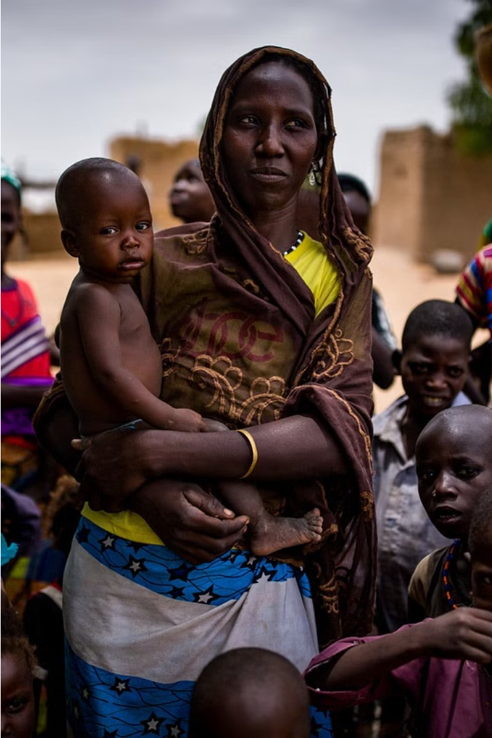
The Legal Status of Climate Migrants
As global temperatures rise and extreme weather events become more common, millions of people are being forced to flee their homes due to the impacts of climate change. However, the legal status of these "climate migrants" remains largely unresolved.

Slide 4
Defining climate migrants
Displaced by Climate Change
Seeking Refuge
Crossing Borders
Lack of Legal Status
These climate-induced migrants often seek refuge in other regions or countries, creating complex legal and humanitarian challenges for the international community.
Unlike traditional refugees who flee political persecution, climate migrants may cross international borders in search of a safer, more habitable environment for themselves and their families.
Climate migrants are individuals or groups who are forced to leave their homes due to the impacts of climate change, such as rising sea levels, droughts, wildfires, and other natural disasters.
Currently, climate migrants lack a clear legal status under international law, leaving them vulnerable and without access to the same protections and support as recognized refugees.

Slide 5
International Laws and Treaties
1
United Nations Framework Convention on Climate Change (UNFCCC)
2
Guiding Principles on Internal Displacement
Developed in 1998, these principles recognize the rights and needs of those displaced within their own countries, including by environmental causes.
This landmark treaty, adopted in 1992, provides a framework for international cooperation on climate change, but does not directly address the issue of climate migration.
3
Nansen Initiative on Disaster-Induced Cross-Border Displacement
This non-binding initiative, launched in 2012, aims to build consensus on how to protect and assist people displaced across borders by natural disasters, including those related to climate change.

Slide 6
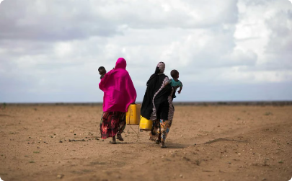
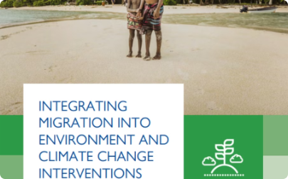
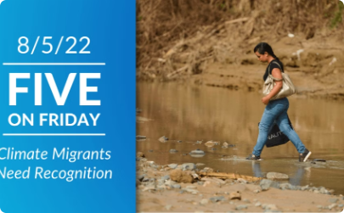
Regional and National Policies
National Immigration Policies
Regional Cooperation
Local Community Integration
Regional bodies such as the European Union and African Union are establishing frameworks for coordinating the management of climate migration across borders, sharing resources and best practices.
Grassroots initiatives in receiving communities are crucial, providing climate migrants with housing, job training, language classes, and other support services to facilitate their integration.
Many countries are developing policies to address the influx of climate migrants, including visa programs, temporary protection status, and resettlement initiatives tailored to their unique circumstances.

Slide 7
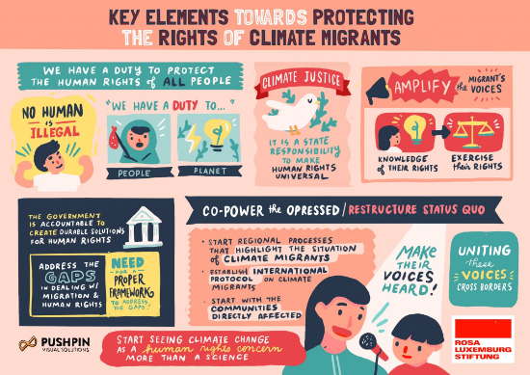
International Human Rights Law and Protection of Climate Migrants
International human rights law provides a framework for protecting the rights of climate migrants. This includes the right to life, freedom of movement, and access to basic resources like food, water, and housing. Climate migrants are particularly vulnerable and must be protected from human rights abuses.
The UN Guiding Principles on Internal Displacement and the Kampala Convention outline the obligations of states to protect and assist internally displaced persons, including those displaced by climate change. These principles emphasize the need for non-discrimination, access to services, and durable solutions.

Slide 8
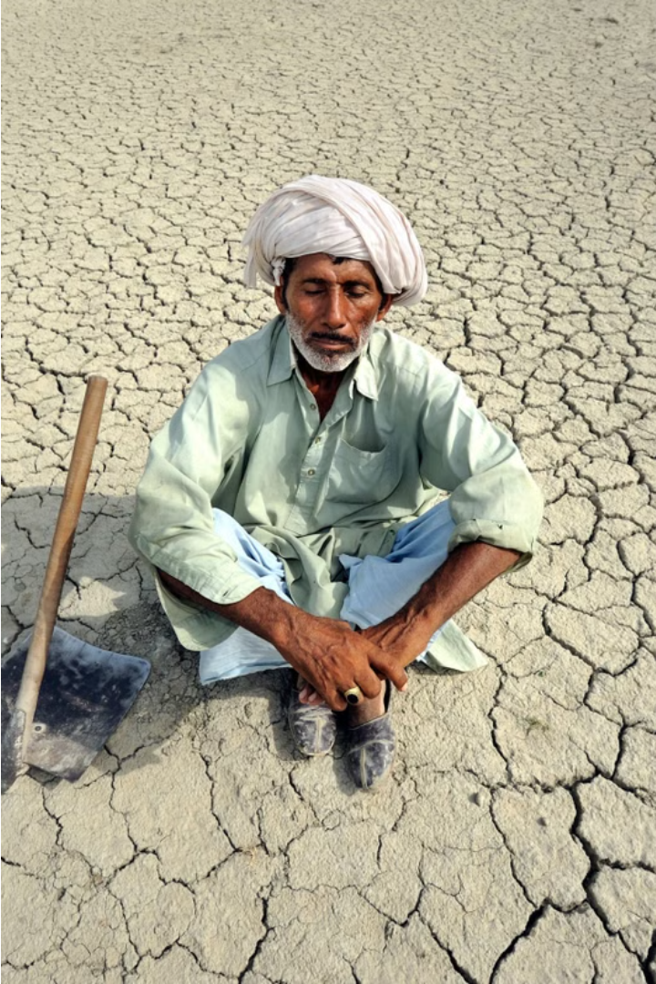
International Refugee Law and Protection of Climate Migrants
International refugee law currently does not recognize climate-induced displacement as a basis for refugee status. This legal gap leaves climate migrants vulnerable and without the protections afforded to traditional political refugees. Efforts are underway to expand the legal framework to better address the needs of those displaced by environmental factors.

Slide 9
International Convention on the Protection of the Rights of All Migrant Workers and Members of Their Families and Protection of Climate Change Induced Migration
Migrant Workers
Climate Migration
Legal Protections
The Convention addresses the rights of migrant workers and their families, including those displaced by climate change impacts.
The Convention can be applied to protect the rights of people displaced by climate-related events such as sea level rise, droughts, and extreme weather.
The Convention outlines fundamental human rights and legal safeguards for migrant workers, which can also apply to climate migrants.

Slide 10
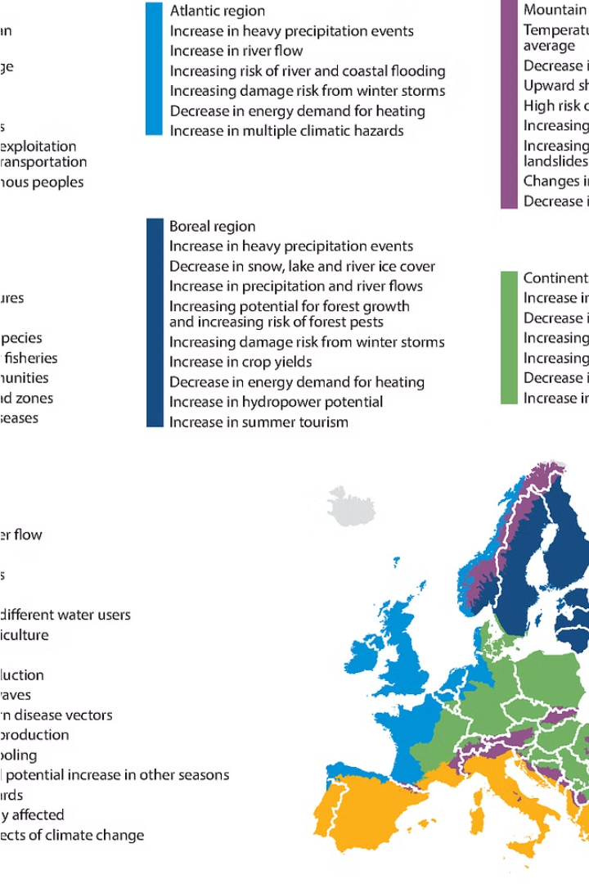
European Union and Protection of Climate Migrants
The European Union has taken steps to address the growing issue of climate migration. EU policies focus on humanitarian aid, resettlement programs, and supporting developing countries affected by climate change.
The EU's 2021 New Pact on Migration and Asylum acknowledges the role of climate change as a driver of displacement and calls for greater coordination on climate-related migration.

Slide 11
Organization of African Unity and Protection of Climate Migration
The Organization of African Unity (OAU), established in 1963, played a crucial role in addressing the challenges of climate-induced migration on the African continent. The OAU recognized the unique vulnerabilities of African nations to the impacts of climate change and sought to develop regional policies and frameworks to protect the rights of climate migrants.
Through its various resolutions and declarations, the OAU advocated for the inclusion of climate migration as a key consideration in its development and humanitarian agendas. This laid the foundation for the African Union's (AU) more recent efforts to address the legal and policy gaps surrounding the protection of climate migrants in Africa.

Slide 12
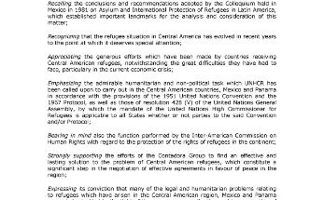
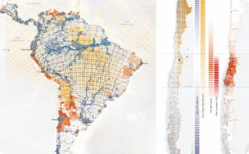
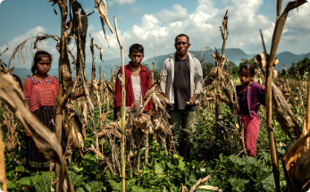
Cartagena Declaration and Protection of Climate Migration
Cartagena Declaration
Protection in Latin America
UN Recognition
The UN has recognized the Cartagena Declaration as an innovative regional instrument for protecting the rights of climate migrants, and encourages its application beyond Latin America.
The 1984 Cartagena Declaration on Refugees expanded the definition of refugees to include those displaced by events seriously disturbing public order, which has been interpreted to include climate-related disasters.
The Cartagena Declaration has been incorporated into the national laws of several Latin American countries, providing a regional framework for protecting climate migrants and those displaced by environmental factors.

