Slide 1
CCP-LAW
Curricula development on Climate Change Policy and Law
Subject title: Overview on the governance of marine areas beyond national jurisdiction, particularly the Arctic and Southern oceans and the contribution of the EU to the implementation of international instruments relating to the marine environment
Instructor Name: PROF ABHINAV SHRIVASTAVA AND PROF RAJ VARMA
Project No of Reference: 618874-EPP-1-2020-1-VN-EPPKA2-CBHE-JP:
The European Commission's support for the production of this publication does not constitute an endorsement of the contents, which reflect the views only of the authors, and the Commission cannot be held responsible for any use which may be made of the information contained therein.

Slide 2
INTRODUCTION
Marine Areas Beyond National Jurisdiction (ABNJ), commonly called the high seas, are those areas of ocean for which no one nation has sole responsibility for management. In all, these make up 40 percent of the surface of our planet, comprising 64 percent of the surface of the oceans and nearly 95 percent of its volume.
Urgent action is crucial to improve ABNJ fisheries management and protect associated ecosystems to mitigate adverse impacts on marine biodiversity, socio-economic welfare, and food security. Despite being acknowledged as the world's last "global commons," ABNJ ecosystems encounter formidable challenges due to their remote location and vulnerability to human activities like shipping, marine pollution, deep-sea fishing, and mining, further compounded by inadequate legal frameworks and governance mechanisms.
Importance of international cooperation for governance:
The governance of marine areas beyond national jurisdiction, particularly in the Arctic and Southern Oceans, necessitates robust international cooperation to address complex environmental challenges. Collaboration among nations is paramount to ensure effective management strategies, conservation efforts, and sustainable use of resources in these critical regions. As these areas are considered global commons, concerted efforts through international cooperation are essential to safeguard marine biodiversity and ecosystem health for present and future generations.

Slide 3
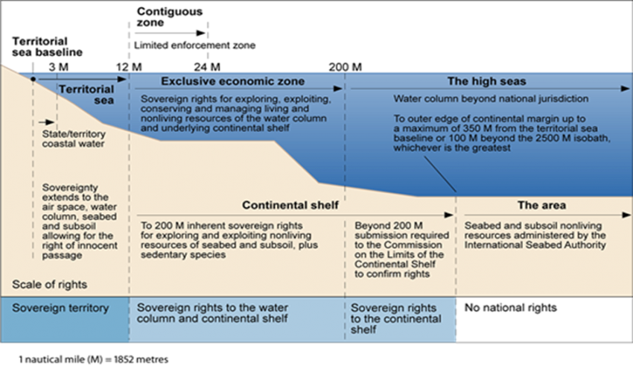

Slide 4
KEY CHALLENGES IN THE ARCTIC AND SOURTHERN OCEAN
Impact of climate change on marine ecosystems:
Understanding the threats and challenges to ecosystems due to climate change is critical as its impacts become more pronounced and are likely to intensify over the coming decades. Climate change exacerbates physiological stress on organisms and ecosystems, interacts with other anthropogenic stressors, and necessitates adaptive ecosystem research and management strategies to address uncertainties and mitigate ecosystem degradation. Long-term monitoring plays a vital role in detecting and understanding shifts in ecosystems, providing essential insights into vulnerability, and informing mitigation efforts amid dynamic environmental changes.
Loss of sea ice in the Arctic and its consequences:
The loss of sea ice in the Arctic, driven by climate change, leads to significant consequences such as amplified warming through reduced albedo effect and disruption of ecosystems, wildlife habitats, and coastal communities, highlighting the urgent need for climate action and adaptation measures.
Vulnerability of Southern Ocean ecosystems to warming and ocean acidification:
Southern Ocean ecosystems are highly vulnerable to warming and ocean acidification due to their sensitivity to climate change impacts. These changes threaten marine biodiversity, disrupt food webs, and jeopardize the stability of ecosystems in this region, underscoring the urgent need for mitigation and conservation efforts.

Slide 5
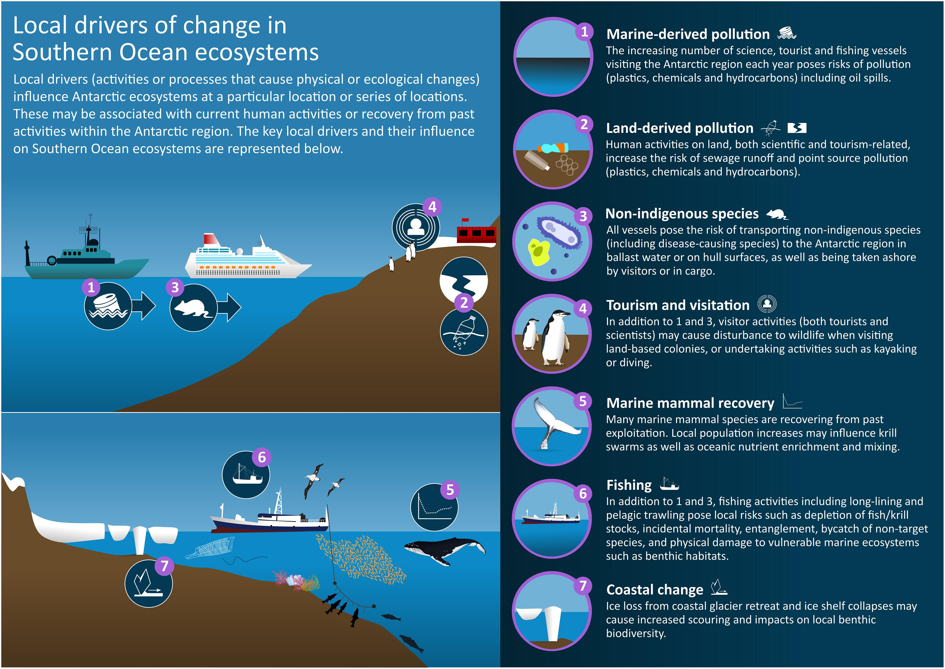
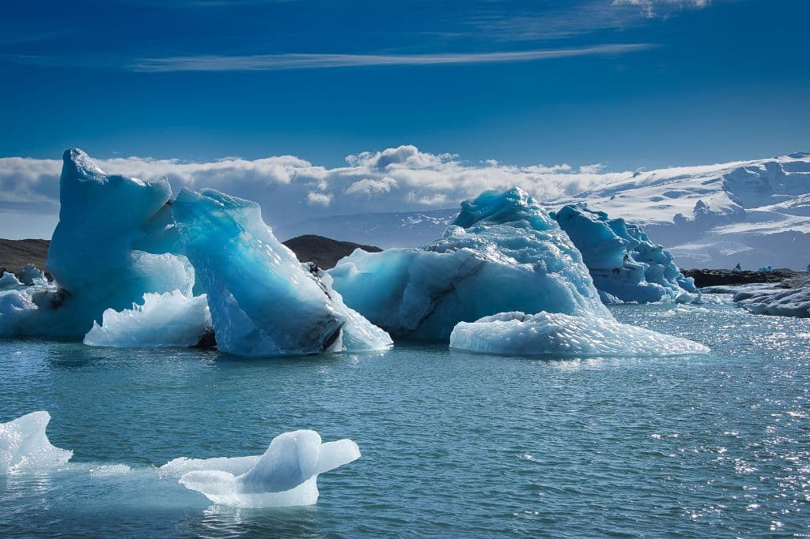

Slide 6
Governance Frameworks for Marine Areas Beyond National Jurisdiction
Governance frameworks for marine areas beyond national jurisdiction rely on international instruments and agreements such as the United Nations Convention on the Law of the Sea (UNCLOS) and the Convention on Biological Diversity (CBD). These agreements provide legal frameworks for the management, conservation, and sustainable use of marine resources, facilitating cooperation among nations to address challenges in areas beyond national jurisdiction effectively.
- Need for comprehensive governance frameworks to address conservation and sustainable use- There is a pressing need for comprehensive governance frameworks to address conservation and sustainable use of marine resources in areas beyond national jurisdiction. These frameworks are essential to ensure effective management, protect biodiversity, and promote the equitable and sustainable utilization of shared oceanic resources.

Slide 7
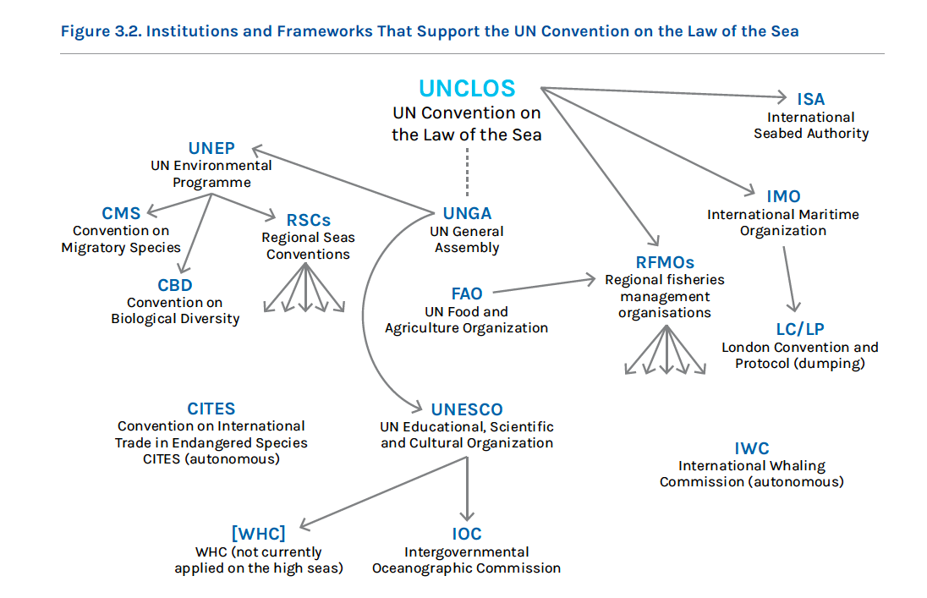

Slide 8
ROLE OF EU IN MARINE ENVIRONMENTAL GOVERNANCE
The European Union (EU) demonstrates a strong commitment to environmental protection through its legislative framework and policy initiatives. As a regional leader, the EU implements measures to promote sustainable practices, mitigate pollution, and conserve marine biodiversity, contributing to global efforts for marine environmental governance.
EU policies and initiatives addressing marine conservation and climate change- EU policies and initiatives addressing marine conservation and climate change include the European Green Deal, the EU Biodiversity Strategy for 2030, and the EU Maritime Strategy, which aim to promote sustainable ocean management, combat marine pollution, protect marine ecosystems, and mitigate the impacts of climate change on marine environments. These initiatives prioritize the implementation of conservation measures, the transition to a circular economy, and the reduction of greenhouse gas emissions to ensure the long-term health and resilience of marine ecosystems in the face of climate change.
The European Union's leadership is crucial in global efforts for marine governance due to its significant economic influence, extensive coastline, and commitment to sustainable practices. By setting high environmental standards, promoting cooperation among member states, and advocating for multilateral agreements, the EU plays a pivotal role in shaping international policies and initiatives aimed at conserving marine biodiversity, combating pollution, and addressing the impacts of climate change on marine ecosystems. Through its proactive stance and collaborative approach, the EU helps drive progress towards achieving global targets for ocean conservation and sustainable development.

Slide 9
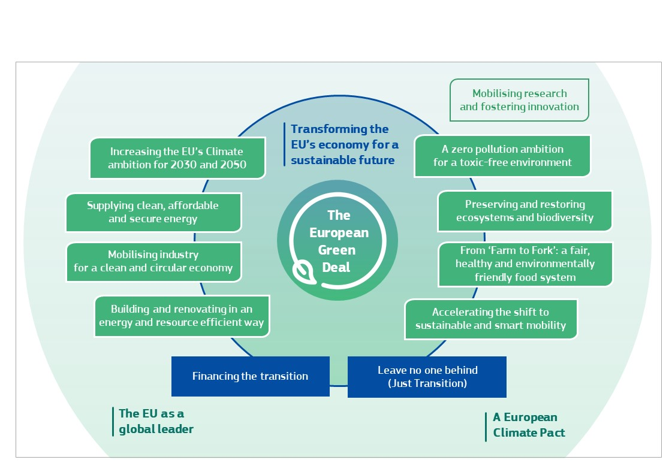

Slide 10
EU INITIATIVES IN ARCTIC AND SOUTHERN OCEANS
The European Union funds various projects and initiatives in the Arctic and Southern Oceans aimed at enhancing scientific research, promoting sustainable practices, and addressing environmental challenges. These initiatives focus on monitoring climate change impacts, conserving biodiversity, and fostering international cooperation to ensure the long-term health and resilience of marine ecosystems in these critical regions.
The European Union actively collaborates with regional organizations and stakeholders in the Arctic and Southern Oceans to address common challenges and promote sustainable management practices. By fostering partnerships and dialogue, the EU contributes to coordinated efforts for ecosystem conservation, climate change adaptation, and the protection of marine resources in these sensitive environments.
Examples of successful partnerships and outcomes in marine governance include collaborative projects between the European Union and regional organizations like the Arctic Council and the Commission for the Conservation of Antarctic Marine Living Resources (CCAMLR). These partnerships have led to the establishment of marine protected areas, the adoption of sustainable fishing practices, and the implementation of measures to mitigate the impacts of climate change, demonstrating the effectiveness of international cooperation in addressing marine conservation challenges.

Slide 11
FUTURE DIRECTIONS
Advancing Collaborative Governance: Strengthen international cooperation and partnerships among nations and regional organizations to develop comprehensive governance frameworks for sustainable management of marine areas beyond national jurisdiction in the Arctic and Southern Oceans.
Integrating Indigenous Knowledge: Recognize and integrate indigenous knowledge systems into decision-making processes to enhance inclusivity and effectiveness in marine governance, ensuring the preservation of traditional practices and the protection of indigenous rights.

Slide 12
QUESTIONS
Q. How do governance structures differ for marine areas beyond national jurisdiction compared to those within national boundaries?
Q. What are the key environmental challenges facing the Arctic and Southern oceans, and how are they being addressed internationally?
Q. How does the EU contribute to the governance and conservation of marine areas beyond national jurisdiction, particularly in the Arctic and Southern oceans?
Q. How can cooperation and collaboration between countries be strengthened to better manage and protect marine areas beyond national jurisdiction?
Q. What are the implications of climate change on the marine environment in these regions, and how is international governance responding to these challenges?

Slide 13
CONCLUSION
The governance of Marine Areas Beyond National Jurisdiction (ABNJ) in regions like the Arctic and Southern Oceans demands urgent and concerted action from the international community. With these vast expanses comprising a significant portion of our planet's surface, it's imperative to recognize them as global commons and implement robust governance frameworks to address the myriad challenges they face. The environmental challenges in these regions, including the impacts of climate change, loss of sea ice, and vulnerability of ecosystems to warming and acidification, underscore the critical need for proactive measures. Through international cooperation and adherence to agreements like UNCLOS and CBD, nations can work together to ensure the sustainable management, conservation, and equitable use of marine resources in ABNJ areas. The European Union emerges as a key player in this endeavor, demonstrating its commitment to environmental protection through legislative frameworks and proactive policies. With initiatives like the European Green Deal and EU Biodiversity Strategy for 2030, the EU leads by example in promoting sustainable practices, combating pollution, and addressing the impacts of climate change on marine ecosystems. Furthermore, the EU's engagement in the Arctic and Southern Oceans through funding projects, collaborating with regional organizations, and fostering partnerships showcases its dedication to addressing common challenges and promoting sustainable management practices.
Looking ahead, advancing collaborative governance and integrating indigenous knowledge systems will be crucial steps in ensuring the effective and inclusive management of marine areas beyond national jurisdiction. By strengthening international cooperation and recognizing the valuable insights of indigenous communities, we can strive towards a future where these vital ecosystems are preserved for generations to come, safeguarding biodiversity, food security, and socio-economic welfare on a global scale.

