Slide 1
CCP-LAW
Curricula development on Climate Change Policy and Law
Module 9: Climate Change and Sustainable development
Subject title: How sustainability can be implemented from a practical perspective? Deforestation prevention strategies
Instructor Name:
Project No of Reference: 618874-EPP-1-2020-1-VN-EPPKA2-CBHE-JP:
The European Commission's support for the production of this publication does not constitute an endorsement of the contents, which reflect the views only of the authors, and the Commission cannot be held responsible for any use which may be made of the information contained therein.

Slide 2
Content
Content
Forests and climate change
Brief to global forest policy, goals and targets
International Forest Regime
Focusing on national strategies for preventing
deforestation
https://pixabay.com/images/search/forest/

Slide 3
Forests and climate change
Why are forests critical to fighting the climate crisis
Forests cover nearly a third of the Earth's land surface, equivalent to the combined areas of Brazil, Canada, China, and the United States
Forest loss and damage is the cause of around 10% of global warming. There's simply no way we can fight the climate crisis if we don't stop deforestation. According to the FAO, agricultural expansion—cropland and livestock grazing—drove almost
90% of global deforestation in the period 2000–2018 (FAO, 2022)
Healthy forests play a crucial role in mitigating climate change by acting as carbon storage, absorbing billions of metric tonnes of CO2 annually remove greenhouse gases (GHG) from the atmosphere and help us avoid the worst impacts of the climate crisis
According to findings from the Intergovernmental Panel on Climate Change (IPCC), the agriculture, forestry, and other land use (AFOLU) sector can provide up to 30 percent of the GHG emissions reductions needed to limit global warming to 2°C, at a relatively low cost
Forests also serve as vital shields against extreme weather conditions, such as storms and floods and are essential in supplying drinking water to nearly half of the world’s largest cities
Notes:
FAO. 2020. Global Forest Resources Assessment 2020 – Key findings. Rome. https://doi.org/10.4060/ca8753en
2022 Intergovernmental Panel on Climate Change : Climate Change 2022 Mitigation of Climate Change Working Group III Contribution to the Sixth Assessment Report of the Intergovernmental Panel on Climate Change
https://www.unep.org/topics/forests/why-do-forests-matter

Slide 4
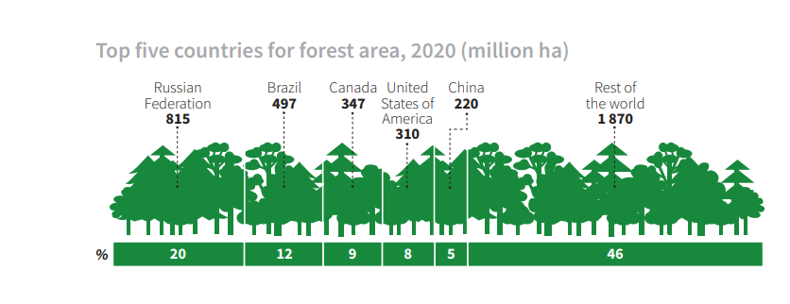
Forests and climate change
Why are forests critical to fighting the climate crisis
Source: FAO. 2020. Global Forest Resources Assessment 2020 – Key findings. Rome. https://doi.org/10.4060/ca8753en
Notes:
FAO. 2020. Global Forest Resources Assessment 2020 – Key findings. Rome. https://doi.org/10.4060/ca8753en
2022 Intergovernmental Panel on Climate Change : Climate Change 2022 Mitigation of Climate Change Working Group III Contribution to the Sixth Assessment Report of the Intergovernmental Panel on Climate Change
https://www.unep.org/topics/forests/why-do-forests-matter

Slide 5
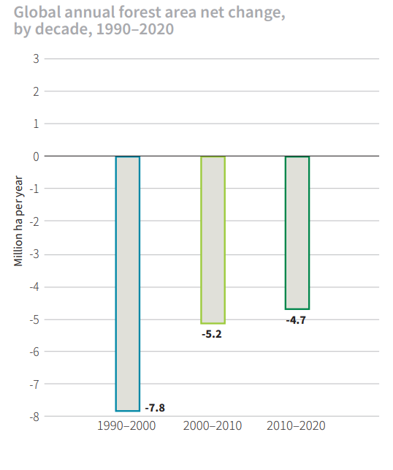
Forests and climate change
Challenges
Forest cover decline: Forest cover continues to decline due to land-use changes toward agriculture, unsustainable forest management, urbanization, mining, and wildfires with climate change playing an overarching and negatively impacting role. Deforestation, contributes to about 25% of global greenhouse gas emissions when combined with agriculture and other land use changes.
The rate of net forest loss declined from 7.8 million ha
per year in the decade 1990–2000 to 5.2 million ha per
year in 2000–2010 and 4.7 million ha
per year in 2010–2020. The rate of decline
of net forest loss slowed in the most
recent decade due to a reduction in the
rate of forest expansion
(Source: FAO. 2020. Global Forest Resources Assessment
2020 – Key findings. Rome. https://doi.org/10.4060/ca8753en
Africa had the largest annual rate of net forest loss in 2010–2020,
Followed by South America. Asia had the highest net gain of
forest area in 2010-2020 followed by Oceania and Europe.
The world has lost 178 million ha of forest since 1990, which is an area about the size of Libya.
Notes:
Keenan, R. J. (2015). Climate change impacts and adaptation in forest management: a review. Ann. For. Sci 72, 145–167. doi: 10.1007/s13595-014-0446-5
FAO. 2020. Global Forest Resources Assessment 2020 – Key findings. Rome. https://doi.org/10.4060/ca8753en
https://www.forestdeclaration.org/resources/forest-finance-theme-3-assessment#div_block-64-171
https://climatepromise.undp.org/news-and-stories/forests-can-help-us-limit-climate-change-here-how

Slide 6
Forests and climate change
Challenges
Insufficient funding: Financial support for forest-based climate solutions is woefully insufficient. Currently, domestic and international mitigation finance for forests averages USD 2.3 billion per year—less than one percent of the necessary total.
Unclear land tenure and rights: as an example, Governments often claim ownership of vast forested areas, while Indigenous communities hold traditional or customary rights. This unclear situations may lead to illegal logging and deforestation as there is no clear authority on who is responsible to safeguard these lands.
Global demand for comodoties: As demand for food and other resources continues to grow, forests are often cleared to make way for new fields and plantations. Goods such as soy, palm oil, beef, and timber are essential components in global supply chains where the demand for cheap and abundant products has driven the expansion of their production, often at the expense of forests
40% of global deforestation is commodity-driven.
Notes:
Keenan, R. J. (2015). Climate change impacts and adaptation in forest management: a review. Ann. For. Sci 72, 145–167. doi: 10.1007/s13595-014-0446-5
https://www.forestdeclaration.org/resources/forest-finance-theme-3-assessment#div_block-64-171
https://climatepromise.undp.org/news-and-stories/forests-can-help-us-limit-climate-change-here-how

Slide 7
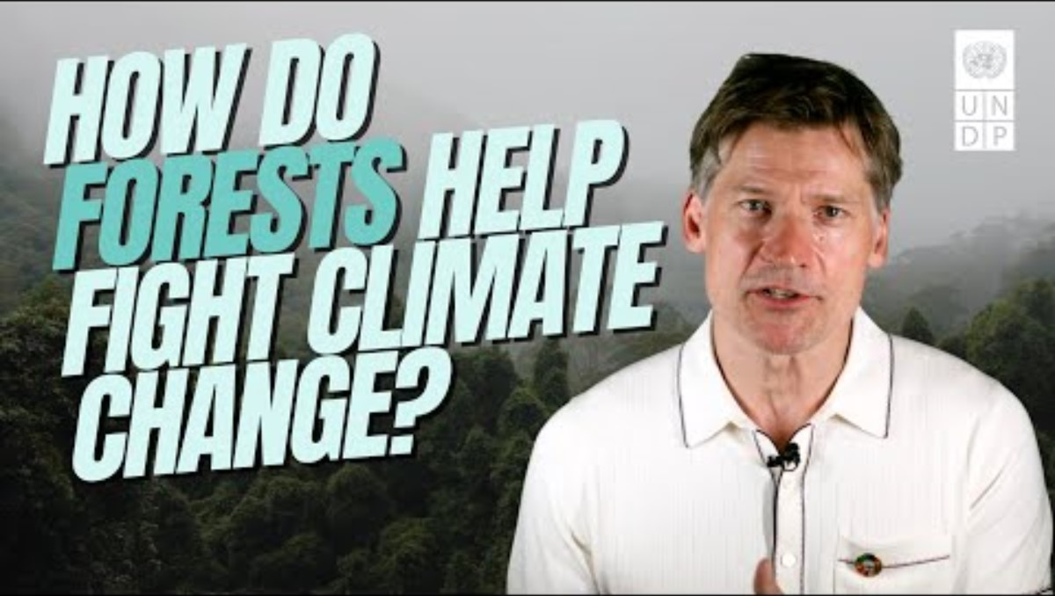
Forests and climate change
UNDP Video: How Do Forests Help Fight Climate Change
https://youtu.be/-bTfc13xZy8

Slide 8
Global forest policy, goals and targets
The United Nations Strategic Plan for Forests 2017–2030 provides a global framework for action to manage
All types of forests and
All trees outside forest
The UNSPF was adopted by the UN Economic and Social Council on 20 April 2017, and was subsequently adopted by the UN General Assembly on 27 April 2017. It serves as a reference for the forest-related work of the UN system and for fostering enhanced coherence, collaboration and synergies among UN bodies and partners
Vision
a world where all types of forests and trees outside forests are sustainably managed, contribute to sustainable development and provide economic, social, environmental and cultural benefits for present and future generations
Notes:
https://www.un.org/esa/forests/wp-content/uploads/2019/04/Global-Forest-Goals-booklet-Apr-2019.pdf/ GLOBAL FOREST GOALS AND TARGETS OF THE UN STRATEGIC PLAN FOR FORESTS 2030

Slide 9
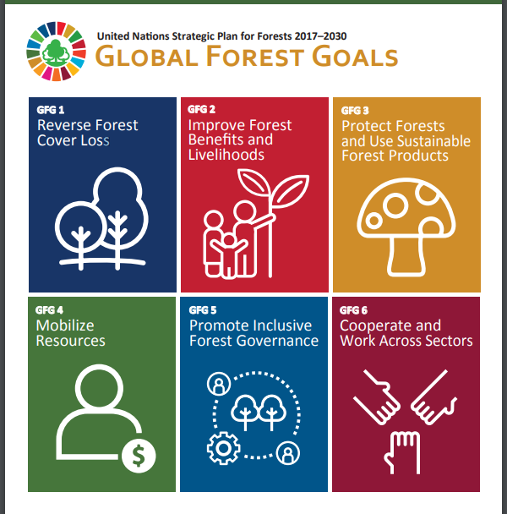
Global forest policy, goals and targets
Six Global Forest Goals and 26 associated targets
Reverse Forest Cover Loss
Improve Forest Benefits and Livelihoods
Protect Forests and use sustainable forest products
Mobilize Resources
Promote inclusive Forest Governance
Cooperation and Work across sectors
Goals are Voluntary and Universal
Aim: to support the objectives of the SDG, Paris Agreement, the Aichi Biodiversity targets and other international related instruments and commitments
Notes:
https://www.un.org/esa/forests/wp-content/uploads/2019/04/Global-Forest-Goals-booklet-Apr-2019.pdf/ GLOBAL FOREST GOALS AND TARGETS OF THE UN STRATEGIC PLAN FOR FORESTS 2030

Slide 10
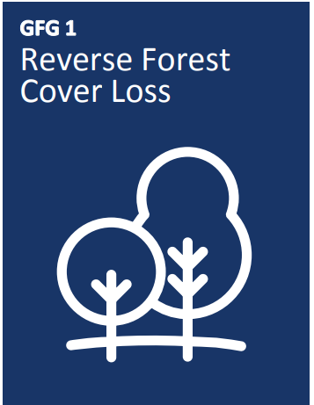
Global forest policy, goals and targets
Reverse Forest Cover Loss
Reverse the loss of forest cover worldwide through SFM, including protection, restoration, afforestation and reforestation, and increase efforts to prevent forest degradation and contribute to the global effort of addressing climate change.
1.1 Forest area is increased by 3% worldwide.
1.2 The world’s forest carbon stocks are maintained or enhanced.
1.3 By 2020, promote the implementation of sustainable management of
all types of forests, halt deforestation, restore degraded forests and
substantially increase afforestation and reforestation globally.
1.4 The resilience and adaptive capacity of all types of forests to
natural disasters and the impacts of climate change is significantly
strengthened worldwide

Slide 11
Global forest policy, goals and targets
Enhance forest benefits and livelihoods
Enhance forest-based economic, social and environmental benefits, including by improving the livelihoods of forest dependent people.
2.1 Extreme poverty for all forest dependent people is eradicated.
2.2 Increase the access of small-scale forest enterprises, in particular
in developing countries, to financial services, including affordable credit,
and their integration into value chains and markets.
2.3 The contribution of forests and trees to food security is significantly
increased. 2.4 The contribution of forest industry, other forest-based
enterprises and forest ecosystem services to social, economic and
environmental development, among others, is significantly increased.
2.5 The contribution of all types of forests to biodiversity conservation
and climate change mitigation and adaptation is enhanced, taking into
account the mandates and ongoing work of relevant conventions and
instruments.

Slide 12
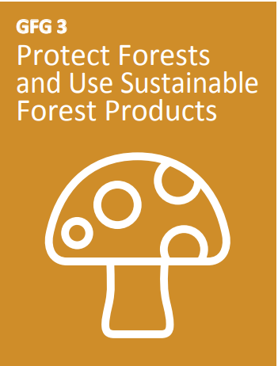
Global forest policy, goals and targets
Protect Forests and Use Sustainable Forest Products
Increase significantly the area of protected forests worldwide and other areas of sustainably managed forests, as well as the proportion of forest products from sustainably managed forests.
3.1 The area of forests worldwide designated as protected areas or
conserved through other effective area-based conservation measures
is significantly increased.
3.2 The area of forests under long-term forest management plans is
significantly increased.
3.3 The proportion of forest products from sustainably managed forests is
significantly increased.

Slide 13
Global forest policy, goals and targets
Mobilize Resources
Mobilize significantly increased, new and additional financial resources
from all sources for the implementation of SFM and strengthen scientific
and technical cooperation and partnerships.
4.1 Mobilize significant resources from all sources and at all levels to finance
sustainable forest management and provide
adequate incentives to developing countries to advance such management,
including for conservation and reforestation.
4.2 Forest-related financing from all sources at all levels, including public
(national, bilateral, multilateral and triangular), private and philanthropic financing
is significantly increased.
4.3 North-South, South-South, North-North and triangular cooperation and public
private partnerships on science, technology and innovation in the forest sector are
Significantly enhanced and increased.
4.4 The number of countries which have developed and implemented forest financing
strategies and have access to financing from all sources is significantly increased.
4.5 The collection, availability and accessibility of forest-related information is improved through, for example, multi-disciplinary scientific assessments.

Slide 14
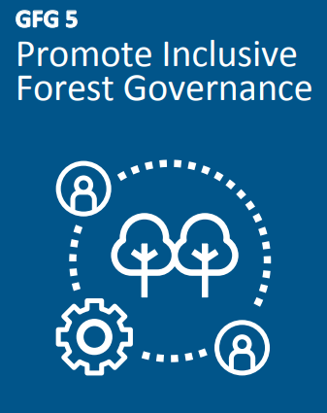
Global forest policy, goals and targets
Promote Inclusive Forest Governance
Promote governance frameworks to implement SFM, including through the UN
Forest Instrument, and enhance the contribution of forests to the 2030 Agenda.
5.1 Number of countries which have integrated forests into their national
Sustainable development plans and/or poverty reduction strategies is significantly
increased.
5.2 Forest law enforcement and governance are enhanced, including through
Significantly strengthening national and subnational forest authorities, and illegal
logging and associated Trade is significantly reduced worldwide.
5.3 National and subnational forest-related policies and programs are
coherent, coordinated and complementary across ministries, departments and
authorities, consistent with national laws, and engage relevant stakeholders
,local communities and indigenous peoples, fully recognizing the UN Declaration
on the Rights of Indigenous Peoples.
5.4 Forest-related issues and the forest sector
are fully integrated into decision making processes of land use planning and development.

Slide 15
Global forest policy, goals and targets
Cooperate and Work Across Sectors
Enhance cooperation, coordination, coherence and synergies on forest-related
issues at all levels, including within the UN System and across CPF member
organizations, as well as across sectors and relevant stakeholders.
6.1 Forest-related programmes within the UN system are coherent and
complementary and integrate the Global Forest Goals and targets where
appropriate.
6.2 Forest-related programs across CPF member organizations are coherent
and complementary and together encompass the multiple contributions of forests
and the forest sector to the 2030 Agenda for Sustainable Development.
6.3 Cross-sectoral coordination and cooperation to promote SFM and halt
deforestation and forest degradation is significantly enhanced at all levels.
6.4 A greater common understanding of the concept of SFM is achieved and an
associated set of indicators is identified.
6.5 The input and involvement of major groups and other relevant stakeholders in the implementation of the UNSPF and in the work of work of the Forum, including intersessional work, is strengthened.

Slide 16
Global forest policy, goals and targets
Implementation framework
The United Nations strategic plan for forests, 2017-2030 (UNSPF) provides a reference actions by all actors, at all levels, to achieve its global forest goals and targets
Key actors:
UNFF and its Secretariat,
The UN Forum on Forests (UNFF) is a functional commission of the UN Economic and Social Council (ECOSOC) with universal membership. The Forum is composed of all Member States of the United Nations and Member States of specialized agencies. The Forum is responsible for follow-up and review of the implementation of the Strategic Plan
Member States – voluntary national contributions and voluntary national reports
MS are invited to consider strengthening regional and subregional forest policy development, dialogue and coordination to advance the strategic plan.
National Reports: provide the main source of information for the Forum to assess progress towards the achievement of the Global Forest Goals and targets
Vietnam NR
National Contributions: include national actions and targets related to other international forest-related commitments and goals, i.e the 2030 Agenda for SDG, the Aichi Biodiversity Targets and actions to address climate change under the Paris Agreement under the United Nations Framework Convention on Climate Change.
Regional and subregional organizations
The United Nations regional economic commissions and the FAO regional forestry commissions, and other regional and subregional bodies and processes provide a crucial bridge between international policies and national actions and are important partners in efforts to implement the strategic plan and achieve its global forest goals and targets

Slide 17
Global forest policy, goals and targets
Video:
United Nations : Department of Economic and Social Affairs Forests
: Forest-based solutions to improve people’s lives
http://www.un.org/esa/forests/

Slide 18
International Forest Regime
International Forest Regime
The Foundational Period: before 1990: first forest-related international agreements were adopted;
The Fragmentation Period: from 1990 until 2011. Forests entered the UN environmental agenda, gained recognition as a stand-alone topic, forest-specific soft law was adopted, the UNFF was established.
The Pre-Constitutional Period: from 2011 until present: Negotiations on the Legally Binding Agreement (LBA) on Forests in Europe take place. Registered parties in the process include the Russian Federation, 14 observer states ( including Brazil, Canada, USA and China) and 45 observer organizations (including FAO, International Tropical Timber
Organization (ITTO), International Union for Nature Conservation (IUCN), International Union of Forest Research Organizations (IUFRO), United Nations Development Program (UNDP), United Nations Environment Program (UNEP) and UNFF).

Slide 19
International Forest Regime
International Forest Regime
The Foundational Period: before 1990: first forest-related international agreements were adopted.
The Fragmentation Period: from 1990 until 2011. Forests entered the UN environmental agenda, gained recognition as a stand-alone topic, forest-specific soft law was adopted, the UNFF was established.
The Pre-Constitutional Period: from 2011 until present: Negotiations on the Legally Binding Agreement (LBA) on Forests in Europe take place. Registered parties in the process include the Russian Federation, 14 observer states ( including Brazil, Canada, USA and China) and 45 observer organizations (including FAO, International Tropical Timber
Organization (ITTO), International Union for Nature Conservation (IUCN), International Union of Forest Research Organizations (IUFRO), United Nations Development Program (UNDP), United Nations Environment Program (UNEP) and UNFF).

Slide 20
International Forest Regime
Legally binding forest-related instruments
The International Tropical Timber Agreement (ITTA) Adopted: 1 January 1994, Geneva Entry into force: 1 January 1997: Is an agreement to provide an effective framework for cooperation between tropical timber producers and consumers and to encourage the development of national policies aimed at sustainable utilization and conservation of tropical forests and their genetic resources. The International Tropical Timber Organization was established under this agreement, which first opened for signature on 18 November 1983, then Entered into force on 1 April 1985. There were subsequent treaties, with an increasing number of signatories, in 1994 (ITTA2) and 2006 (ITTA3).
Fifty eight parties signed up to the 1983 agreement: Australia, Austria, Belgium, Bolivia, Brazil, Burma, Cameroon, Canada, People's Republic of China, Colombia, Democratic Republic of the Congo, Republic of the Congo, Ivory Coast, Denmark, Ecuador, Egypt, European Union, Fiji, Finland, France, Gabon, Germany, Ghana, Greece, Guyana, Honduras, India, Indonesia, Ireland, Italy, Japan, South Korea, Liberia, Luxembourg, Malaysia, Nepal, Netherlands, New Zealand, Norway, Panama, Papua New Guinea, Peru, Philippines, Portugal, Russia, Spain, Sweden, Switzerland, Thailand, Togo, Trinidad and Tobago, United Kingdom, United States, Venezuela
Sixty-two parties ultimately ratified the 1994 agreement: Australia, Austria, Belgium, Bolivia, Brazil, Burma, Cambodia, Cameroon, Canada, Central African Republic, People's Republic of China, Colombia, Democratic Republic of the Congo, Republic of the Congo, Ivory Coast, Denmark, Ecuador, Egypt, European Union, Fiji, Finland, France, Gabon, Germany, Ghana, Greece, Guatemala, Guyana, Honduras, India, Indonesia, Ireland, Italy, Japan, South Korea, Liberia, Luxembourg, Malaysia, Mexico, Nepal, Netherlands, New Zealand, Nigeria, Norway, Panama, Papua New Guinea, Peru, Philippines, Poland, Portugal, Spain, Suriname, Sweden, Switzerland, Thailand, Togo, Trinidad and Tobago, United Kingdom, United States, Uruguay, Vanuatu, Venezuela
As of October 2018, there are 74 parties to ITTA3. Nigeria and Paraguay have signed the agreement but have not ratified it. Canada ratified the agreement in 2009 but has since denounced it.

Slide 21
International Forest Regime
The Convention on Biological Diversity (CBD): Adopted: 5 June 1992, Rio de Janeiro by 188 Member States. CBD does not directly address forests but its objective is defined as ‘the conservation of biological diversity, the sustainable use of its components and the fair and equitable sharing of the benefits arising out of the utilization of genetic resources’ (Article 1), which is obviously relevant to forests.
Cartagena Protocol on Biosafety to the Convention on Biological Diversity: Adopted: 20 January 2000, Montreal
Entry into force: 11 September 2003
United Nations Framework Convention on Climate Change (UNFCCC) Adopted: 9 May 1992. Entry into force: 21 March 1994 (annexes adopted in 1997 and 2001). Number of parties: 188. he UNFCCC’s objective is to achieve ‘stabilization of greenhouse gas concentrations in the atmosphere…within a time-frame sufficient to allow ecosystems to adapt naturally to climate change, [and] to ensure that food production is not threatened’(Article 2). Hence, this Convention can be directly related to the role of forests.
The Marrakech Accord (signed at Conference of the Parties 7 in November 2001) acknowledged four major roles of forests in climate change: 1) As a source of carbon dioxide when destroyed or degraded; 2) As a sensitive indicator of a changing climate; 3) As a source of biofuels to replace fossil fuels; 4) As a carbon sink, when managed sustainably

Slide 22
International Forest Regime
The United Nations Convention to Combat Desertification (UNCCD) Adopted: 17 June 1994, Paris
Entry into force: 26 December 1996 aims at addressing desertification, land degradation, and drought (DLDD) through sustainable land management practices. As, on the one hand, deforestation and forest degradation are among the main causes of desertification and drought; and, on the other hand, forests can help to stabilize soils, mitigating against desertification and drought, the Convention has consequently recognized a connection between desertification, deforestation and forest degradation.
Other international legally binding conventions:
Convention on International Trade in Endangered Species of Wild Fauna and Flora (CITES)
Convention on Wetlands of International Importance especially as Waterfowl Habitat (Ramsar Convention)

Slide 23
International Forest Regime
REDD+ under the Paris Agreement (adopted by 196 Parties at COP 21 in Paris, on 12 December 2015 and entered into force on 4 November 2016). Developing countries can use REDD+ to reduce emissions from deforestation and forest degradation, and foster conservation, sustainable management of forests, and enhancement of forest carbon stocks.
REDD stands for: ‘Reducing emissions from deforestation and forest degradation in developing countries. The ‘+’ stands for additional forest-related activities that protect the climate, namely sustainable management of forests and the conservation and enhancement of forest carbon stocks.
REDD+ is enshrined in Article 5 of the Paris Agreement as the method to stop deforestation by 2030 using Article 6 to finance government action.
REDD+ is divided into three phases:
1) Developing national strategies or action plans, policies and measures, and other capacity building activities.
2) Implementing national policies and measures, and national strategies or action plans.
3) Results-based payments following the verification of emission reductions.

Slide 24
International Forest Regime
Non-Legally Binding Instruments, Agreements and Processes
1. United Nations Forum on Forests (UNFF): Comprising all member states of the United Nations and specialized agencies, the UNFF convenes annually to advance the implementation of forest-related agreements. Its primary objectives include facilitating sustainable forest management, promoting a shared understanding among stakeholders, and fostering ongoing policy development and dialogue among Governments, international organizations, and major groups as outlined in Agenda 21.
2. Collaborative Partnership on Forests (CPF): Designed to bolster the efforts of the United Nations Forum on Forests and its member countries, the CPF issues annual progress reports. This dynamic partnership consists of 16 international organizations, institutions, and secretariats with extensive forest-focused programs. The CPF envisions a future where all forest types and landscapes are sustainably managed by 2030, recognizing their diverse values and unlocking their full potential in alignment with the Global Forest Goals, the Sustainable Development Goals, and other pertinent global commitments.
3. Food and Agricultural Organization of the United Nations National Forest Programme: Operating through its Forestry Programme, the FAO strives for transformative impacts benefiting forests and forest-dependent communities while contributing to the 2030 Agenda for Sustainable Development and the Sustainable Development Goals. Managing over 230 projects in 82 countries, with a project budget exceeding USD 246 million (as of 2019), the Forestry Programme is guided by the Committee on Forestry (COFO) and six regional forestry commissions in its technical forestry endeavors.
Notes:
https://www.fao.org/collaborative-partnership-on-forests/en
https://www.fao.org/forests/en/

Slide 25
International Forest Regime
FAO’s work in forestry is clustered around the following priorities:
Halting deforestation and forest degradation
Forest restoration, reforestation and afforestation
Conservation and sustainable use of forests to enhance forest-based livelihoods
Improving forest-related data and information and capacities
4.The World Bank and G-8 have initiated the Forest Law Enforcement and Governance (FLEG) process among producer and consumer nations to combat illegal logging in Asia and Africa (World Bank, 2005). It is too early to assess the effectiveness of these initiatives on conserving forests stocks.
5.2030 Agenda for Sustainable Development. Sustainable Development Goal 15 specifically calls on countries to “protect, restore and promote sustainable use of terrestrial ecosystems, sustainably manage forests, combat desertification, and halt and reverse land degradation and halt biodiversity loss”
by 2030 (UN, 2015).
Notes:
https://www.fao.org/collaborative-partnership-on-forests/en
https://www.fao.org/forests/en/

Slide 26
National Strategies for preventing deforestation
Defining Deforestation:
The Food and Agriculture Organization of the United Nations (FAO) defines deforestation as the “change of land cover with depletion of tree crown cover to less than 10 percent. Changes within the forest class (e.g. from closed to open forest) which negatively affect the stand or site and, in particular, lower the production capacity, are termed forest degradation” (FAO 2000).
The Kyoto Protocol, defines deforestation as “the direct human-induced conversion of forested land to non forested land
Drivers of deforestration:
Proximate causes (direct drivers) are human activities that directly affect the environment
Underlying (indirect) drivers are fundamental forces that underpin the proximate causes of deforestation. Considered as a complex of social, political, economic, technological, and cultural variables (Geist & Lambin, 2001)
Is one of the contributing factors to Climate Change
Notes:
https://www.fao.org/collaborative-partnership-on-forests/en
https://www.fao.org/forests/en/

Slide 27
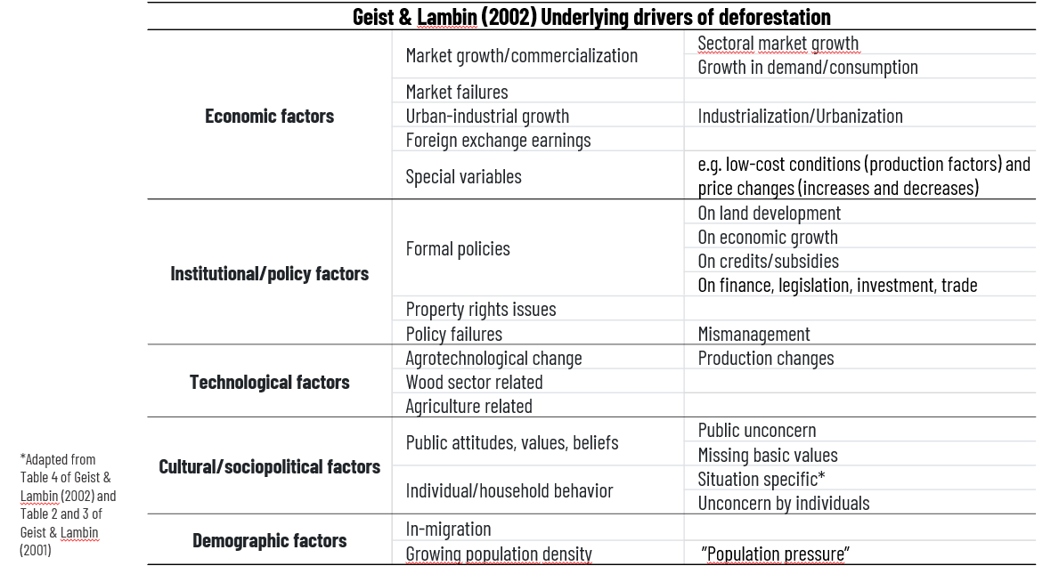
National Strategies for preventing deforestation
Notes:
https://www.fao.org/collaborative-partnership-on-forests/en
https://www.fao.org/forests/en/

Slide 28
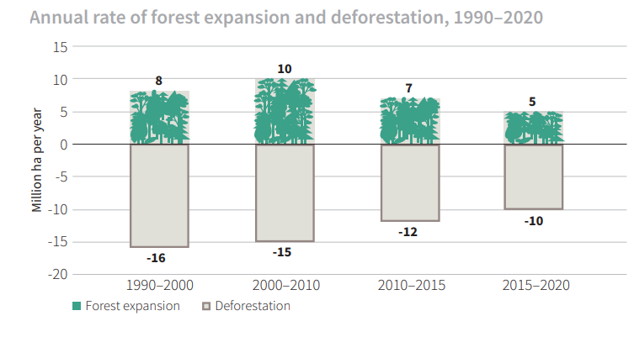
National Strategies for preventing deforestation
Deforestation continues, but at a lower rate
An estimated 420 million ha of forest has been lost
worldwide through deforestation since 1990, but the
rate of forest loss has declined substantially.
In the most recent five-year period (2015–2020), the
Annual rate of deforestation was estimated at 10 million ha,
down from 12 million ha in 2010–2015.
Source: FAO. 2020. Global Forest Resources Assessment
2020 – Key findings. Rome. https://doi.org/10.4060/ca8753en
Notes:
https://www.fao.org/collaborative-partnership-on-forests/en
https://www.fao.org/forests/en/

Slide 29
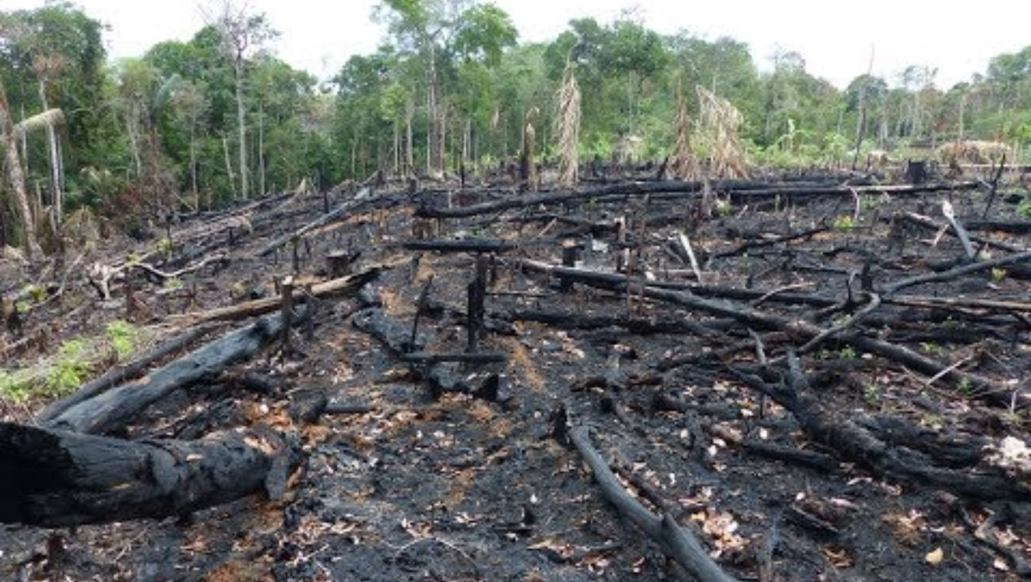
National Strategies for preventing deforestation
Deforestation: Facts, Causes & Effects
LiveScience
https://youtu.be/aS_lRabpgqw?t=9
Notes:
https://www.fao.org/collaborative-partnership-on-forests/en
https://www.fao.org/forests/en/

Slide 30
National Strategies for preventing deforestation
Key measures for preventing and reducing deforestation
The institutional framework of each country responds to its economic, social-political and environmental
situation and, therefore, arrangements vary considerably country by country
Land tenure. Governments that own land have direct responsibility for forest management, including some control over the rate of deforestation and degradation on that land. Effective governance of tenure is critical to achieving sustainable land use, including sustainable forest management and forest conservation, as insecure tenure rights can discourage long-term investment in sustainable land-use practices (Finnegan, 2016)
See also Voluntary Guidelines on the Responsible Governance of Tenure produced by FAO which provide guidelines
on how countries can reform and strengthen land tenure systems and secure the rights of local communities, Indigenous Peoples, and smallholders.
Payments for ecosystem services. PES refer to payments made to farmers or landowners for specific land management practices that provide ecological benefits. PES is a market-based mechanism similar to a subsidy that incentivizes landowners and managers to conserve natural resources. The scheme typically involves forest owners or farmers who receive payments for managing and protecting their resources to support forest and watershed conservation, biodiversity preservation, or carbon sequestration. This protection can include practices such as tree replanting, maintaining existing trees, or adopting alternative agricultural methods (International Institute for Environment and Development, 2023; Jack et al., 2008).
Notes:
https://www.fao.org/collaborative-partnership-on-forests/en
https://www.fao.org/forests/en/
Measures to Enhance Forest Conservation and Reduce Deforestation: Viewpoints and Lessons from Producing Countries February 2024: Written by Florencia Sarmiento, Cristina Larrea, Andreas Oeschger, and Rashmi Jose

Slide 31
National Strategies for preventing deforestation
Protected areas (PAs): Protected areas, whether strict or multiple-use, are consistently associated with lower rates of deforestation across the tropics (Busch and Ferretti-Gallon, 2017). Designating protected areas in threatened forests is a direct way that governments can curtail deforestation
Indigenous affairs: Recognizing and protecting the territorial rights of indigenous peoples and other traditional communities is a direct way for governments to curtail deforestation. Research shows significantly less deforestation in indigenous lands. Indigenous lands account for one-fifth of the Brazilian Amazon.
Incorporating deforestation concerns into road and transport policies : Development of new roads increases deforestation in many different ways, for example, by opening new areas of forests and by increasing the profitability of agriculture through eased transport. For this reason, analyzing the implications of road construction for forest cover should be an essential component of any transport policy.
Increasing the political status of forest conservation and sustainable management. The successful
implementation of policies to reduce deforestation rates largely depends on the robustness, strength and presence of the forest institutional structure (Grainger et al. 1993; Kaimowitz et al. 1998; Kaimowitz and Angelsen 1998; Geist and Lambin 2001). National forest institutions have the aim to monitor the state of forests as well as compliance with regulation, promote the expansion of environmentally responsible forest industries and support applied forestry research. Increasing the political status implies that forest institutions need to employ well-trained staff and receive enough funding to undertake their responsibilities
Notes:
https://www.fao.org/collaborative-partnership-on-forests/en
https://www.fao.org/forests/en/

Slide 32
National Strategies for preventing deforestation
Mandatory due diligence regulations are seen as a way to address environmental and social issues in global supply chains, including deforestation, human rights abuses, and labour violations that affect communities and ecosystems around the world. In 2017, France adopted a law requiring companies to establish and implement a vigilance plan to identify and prevent human rights abuses and environmental harm in their operations and supply chains, including
deforestation. In June 2021, Germany adopted a similar law that requires companies to conduct due diligence on
their supply chains to prevent and address human rights abuses, environmental harm (including deforestation),
and corruption; it entered into force in January 2023.
Agricultural permits. Agriculture is the leading driver of deforestation across much of the tropics (Curtis et al., 2018). Control over the issuing of licenses for agriculture in forest areas is a direct way that governments can accelerate or curtail deforestation.
Policies to increase and capture forest rent: Policies can influence forest rent in similar ways to agricultural
rent, e.g., through taxes and marketing arrangements that affect the prices of timber and other forest products, or by promoting new technologies
Mining permits. Mining is a significant driver of deforestation. As with agriculture, control over the issuing of licenses to mine in forest areas is a direct way that governments can accelerate or curtail deforestation
Notes:
https://www.fao.org/collaborative-partnership-on-forests/en
https://www.fao.org/forests/en/

Slide 33
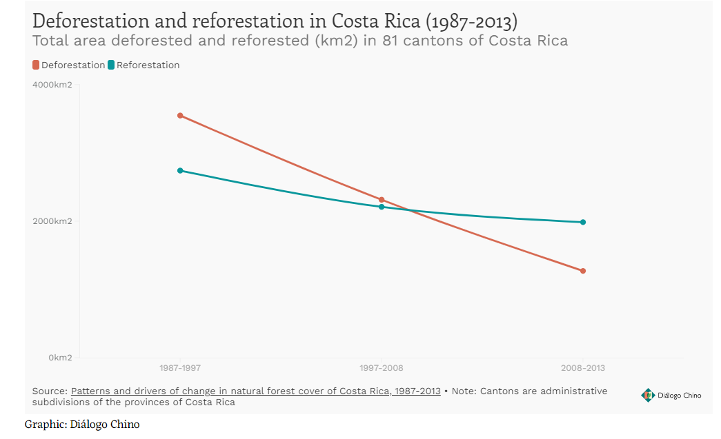
National Strategies for preventing deforestation
Case study:
Costa Rica:
In the 70’s and 80’s Costa Rica had the highest deforestation rate in all Latin America. Almost half of all the forest in Costa Rica was cut down to make room for economic purposes
According to the State of the World's Forests 2016, the country achieved a 54% increase in its forest area thanks to a large national effort, becoming a global example of reforestation success just over 20 years after deforestation peaked.
Notes:
https://www.worldbank.org/en/news/feature/2022/11/16/costa-rica-s-forest-conservation-pays-off

Slide 34
Regional perspective for preventing deforestation
Key Governmental Actions:
Political will, environmental passion and tourism that has enabled the country to become a pioneer in reforestation.
1) Strict regulatory framework: Costa Rica enacted a comprehensive Forestry Law that imposed strict regulations on logging and land use. This legislation aimed to protect the remaining forests and promote sustainable forestry practices.
2) Consolidation of the protected areas system of the country. Slow and constant increment of the number and area of the protected areas of different types and final stabilization at the current levels of 26.1% of the national territory. Government proceeded with enforcement of the tenure rights by the State in the protected areas so that the 26.1% under this condition can be considered under true protection.
3) Payments for Environmental Services Program (PES): The Costa Rican PES system is executed through the Fondo Nacional de Financiamiento Forestal (FONAFIFO) and makes direct cash transfers to private landowners for five or 10-year contracts for different activities of forest protection, reforestation, sustainable forest management and agroforestry. The Program protects primary forest, allows secondary forest to flourish, and promotes forest plantations to meet industrial demands for lumber and other wood products. From 1997 to 2019, it had benefited 18,000 families including 2,788 women, 6,888 men, 19 indigenous communities (303 projects), and 8,712 family associations.
4) Strengthening Accounting and Confidence in REDD+ Carbon Credits: Costa Rica received its first payment from the World Bank’s Forest Carbon Partnership Facility (FCPF) of $16.4 million for reducing carbon emissions from deforestation and forest degradation (commonly referred to as REDD+).
5) Education and Awareness: Extensive education campaigns helped raise awareness about the importance of forests and biodiversity. Communities became more involved in conservation efforts.
Notes:
Costa Rica Case Study Prepared for FAO as part of the State of the World’s Forests 2016 (SOFO) Written by Ronnie de Camino Velozo, Roger Villalobos and Jean Pierre Morales
https://unfccc.int/climate-action/momentum-for-change/financing-for-climate-friendly-investment/payments-for-environmental-services-program

Slide 35
National Strategies for preventing deforestation
Hurdles Faced
Agricultural Pressures
Poverty and Livelihood
Illegal Logging
Costa Rica’s Current Standing in Global Biodiversity Conservation
Biodiversity Hotspot
Ecotourism Hub
Global Rankings
Global Impact
Notes:
Agricultural Pressures: Agricultural expansion posed a significant threat to forests. The demand for land for crops and cattle ranching led to deforestation in some areas.
Poverty and Livelihoods: Many communities depended on logging and land clearance for their livelihoods. Balancing conservation with poverty alleviation was a complex challenge.
Illegal Logging: Despite regulations, illegal logging remained a concern. Enforcing forest protection laws requires vigilance and resources.

Slide 36
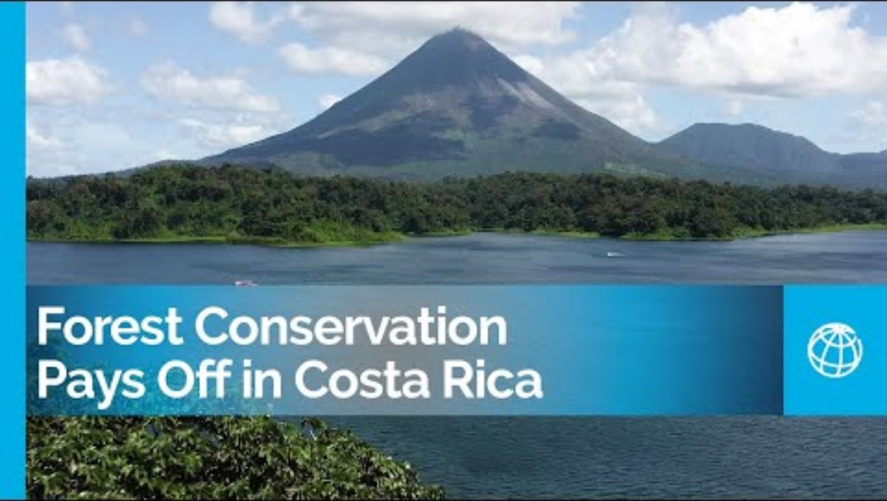
National Strategies for preventing deforestation
Video: https://youtu.be/HafKimQZzt8
Notes:
Agricultural Pressures: Agricultural expansion posed a significant threat to forests. The demand for land for crops and cattle ranching led to deforestation in some areas.
Poverty and Livelihoods: Many communities depended on logging and land clearance for their livelihoods. Balancing conservation with poverty alleviation was a complex challenge.
Illegal Logging: Despite regulations, illegal logging remained a concern. Enforcing forest protection laws requires vigilance and resources.

