Slide 1
CCP-LAW
Curricula development on Climate Change Policy and Law
Subject title: CLIMATE CHANGE DISPUTE LITIGATION
Instructor Name: Nguyễn Thị Hồng Trinh
Project No of Reference: 618874-EPP-1-2020-1-VN-EPPKA2-CBHE-JP:
The European Commission's support for the production of this publication does not constitute an endorsement of the contents, which reflect the views only of the authors, and the Commission cannot be held responsible for any use which may be made of the information contained therein.

Slide 2
1.1. Legal Frameworks & Instruments
1. OVERVIEW OF GLOBAL CLIMATE CHANGE LITIGATION
1) International Climate Change Agreements and Conventions
UNFCCC and its agreements, such as Kyoto Protocol establish international commitments and mechanisms for addressing climate change.
These agreements set targets for fighting climate change and provide a framework for international cooperation and accountability.

Slide 3
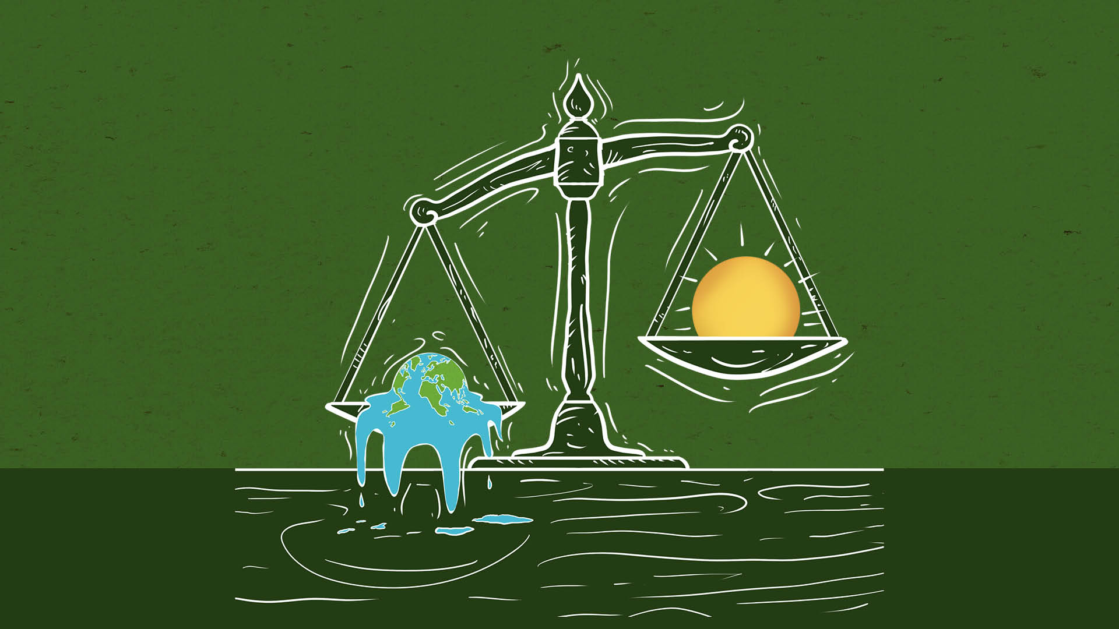
1.1. Legal Frameworks & Instruments
1. OVERVIEW OF GLOBAL CLIMATE CHANGE LITIGATION
2) National and Regional Climate Change Laws and Policies
Many countries have enacted domestic laws and policies to address climate change, such as emissions trading schemes, renewable energy policies, and energy efficiency regulations.
Regional initiatives, such as the European Union's Emissions Trading System, provide legal frameworks for coordinated actions among member states.

Slide 4
1.1. Legal Frameworks & Instruments
1. OVERVIEW OF GLOBAL CLIMATE CHANGE LITIGATION
3) Environmental and Human Rights Legislation
Existing environmental laws, such as those related to air pollution and protection of natural resources, can be invoked in climate change cases.
Human rights laws and principles, including the right to a healthy environment, have been used in climate change litigation to hold governments and corporations accountable for their actions or inactions.

Slide 5
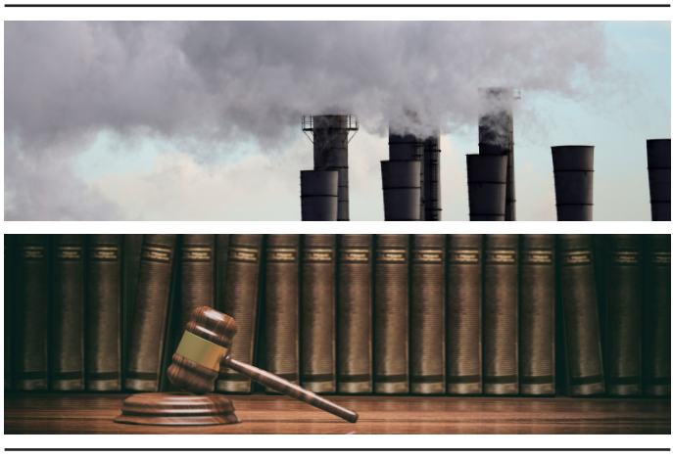
1.1. Legal Frameworks & Instruments
1. OVERVIEW OF GLOBAL CLIMATE CHANGE LITIGATION
4) Tort Law and Civil Liability
Tort law principles, such as negligence and nuisance, have been applied in climate change lawsuits against corporations or governments for their contribution to climate change impacts.
Civil liability claims seek compensation for damages or injunctive relief to prevent further harm.

Slide 6
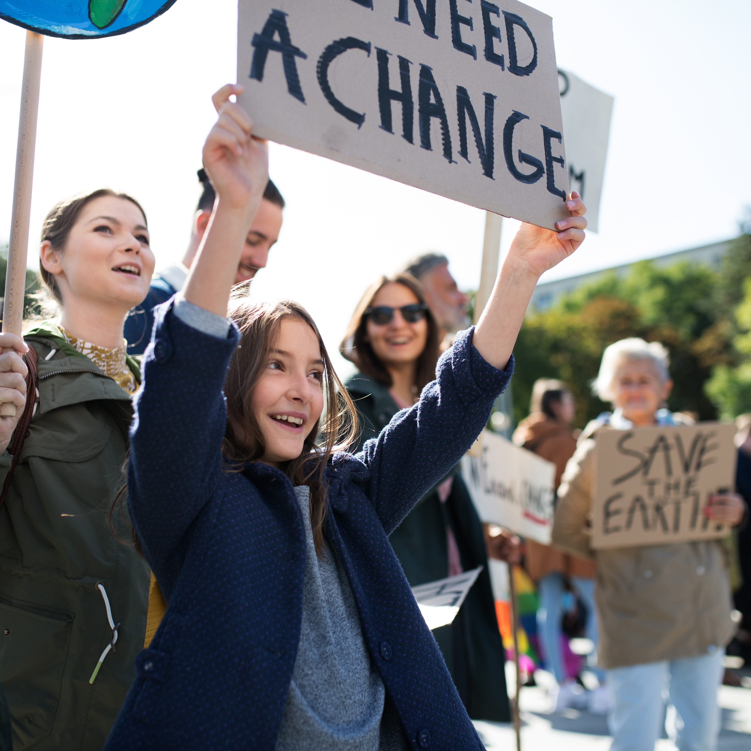
1.1. Legal Frameworks & Instruments
1. OVERVIEW OF GLOBAL CLIMATE CHANGE LITIGATION
5) Administrative and Judicial Review Mechanisms
Administrative law procedures and judicial review processes allow individuals and organizations to challenge government decisions or actions related to climate change policies and regulations..
These mechanisms can be used to scrutinize the adequacy of climate change mitigation and adaptation measures or to address failures to address climate change risks.

Slide 7
1.1. Legal Frameworks & Instruments
1. OVERVIEW OF GLOBAL CLIMATE CHANGE LITIGATION
6) Corporate Disclosure and Reporting Requirements
Regulatory frameworks for corporate disclosure and reporting on climate change risks, greenhouse gas emissions, and environmental impacts have been implemented in several jurisdictions.
These requirements aim to enhance transparency and accountability, enabling shareholders and stakeholders to assess companies' climate-related risks and strategies.

Slide 8
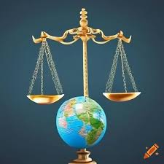
1.2. International Treaties (e.g., Paris Agreement)
1. OVERVIEW OF GLOBAL CLIMATE CHANGE LITIGATION
International Treaties and Global Climate Change Litigation
The Critical Role of the Paris Agreement
Global Temperature Goals:
Nationally Determined Contributions (NDCs)
Legally Binding Accountability Framework

Slide 9
1.2. International Treaties (e.g., Paris Agreement)
1. OVERVIEW OF GLOBAL CLIMATE CHANGE LITIGATION
Introduction to International Climate Treaties
Overview of key international climate treaties pre-Paris Agreement.
The unique role of international agreements in combating global warming.

Slide 10
1.2. International Treaties (e.g., Paris Agreement)
1. OVERVIEW OF GLOBAL CLIMATE CHANGE LITIGATION
The Paris Agreement Explained
Adoption in 2015 as a landmark in global climate efforts.
The agreement's core aim: limiting global warming to well below 2, preferably to 1.5 degrees Celsius.

Slide 11
1.2. International Treaties (e.g., Paris Agreement)
1. OVERVIEW OF GLOBAL CLIMATE CHANGE LITIGATION
Nationally Determined Contributions (NDCs)
Explanation of NDCs and their importance.
.How NDCs enhance transparency and accountability in climate action.

Slide 12
1.2. International Treaties (e.g., Paris Agreement)
1. OVERVIEW OF GLOBAL CLIMATE CHANGE LITIGATION
Legal Mechanisms of the Paris Agreement
Compliance mechanism and its facilitative nature.
Role of the global stocktake in enhancing accountability.

Slide 13
1.2. International Treaties (e.g., Paris Agreement)
1. OVERVIEW OF GLOBAL CLIMATE CHANGE LITIGATION
The Paris Agreement and National Laws
How the Paris Agreement influences national climate policies and legislation.
Examples of countries incorporating NDCs into national law.

Slide 14
1.3. National and regional regulations and policies
1. OVERVIEW OF GLOBAL CLIMATE CHANGE LITIGATION
National and Regional Regulations in Climate Litigation
The Backbone of Legal Climate Action
National Regulations as Foundations for Climate Litigation
Regional Policies and Global Climate Goals Alignment

Slide 15
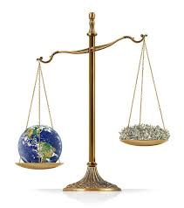
1.3. National and regional regulations and policies
1. OVERVIEW OF GLOBAL CLIMATE CHANGE LITIGATION
The Importance of National Regulations
National laws as direct responses to international agreements like the Paris Agreement.
Role in setting enforceable standards and targets for emission reductions.

Slide 16
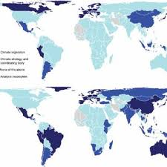
1.3. National and regional regulations and policies
1. OVERVIEW OF GLOBAL CLIMATE CHANGE LITIGATION
Regional Climate Policies: A Closer Look
Overview of how regions like the EU, North America, and Asia implement unique climate policies.
The impact of regional agreements and collaborations on climate action.

Slide 17
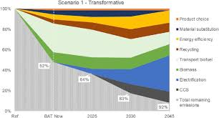
1.3. National and regional regulations and policies
1. OVERVIEW OF GLOBAL CLIMATE CHANGE LITIGATION
Case Studies: Success Stories
Brief examples of successful national/regional policies driving down emissions.
The role of litigation in enforcing these policies.

Slide 18
1.3. National and regional regulations and policies
1. OVERVIEW OF GLOBAL CLIMATE CHANGE LITIGATION
Legal Frameworks and Climate Litigation
How national and regional legal frameworks serve as the basis for climate lawsuits.
Examples of litigation used to enforce policy compliance.

