Slide 1
CCP-LAW
Curricula development on Climate Change Policy and Law
Subject title: CLIMATE CHANGE DISPUTE RESOLUTION
Instructor Name: Tran Anh Tuan
Project No of Reference: 618874-EPP-1-2020-1-VN-EPPKA2-CBHE-JP:
The European Commission's support for the production of this publication does not constitute an endorsement of the contents, which reflect the views only of the authors, and the Commission cannot be held responsible for any use which may be made of the information contained therein.

Slide 2
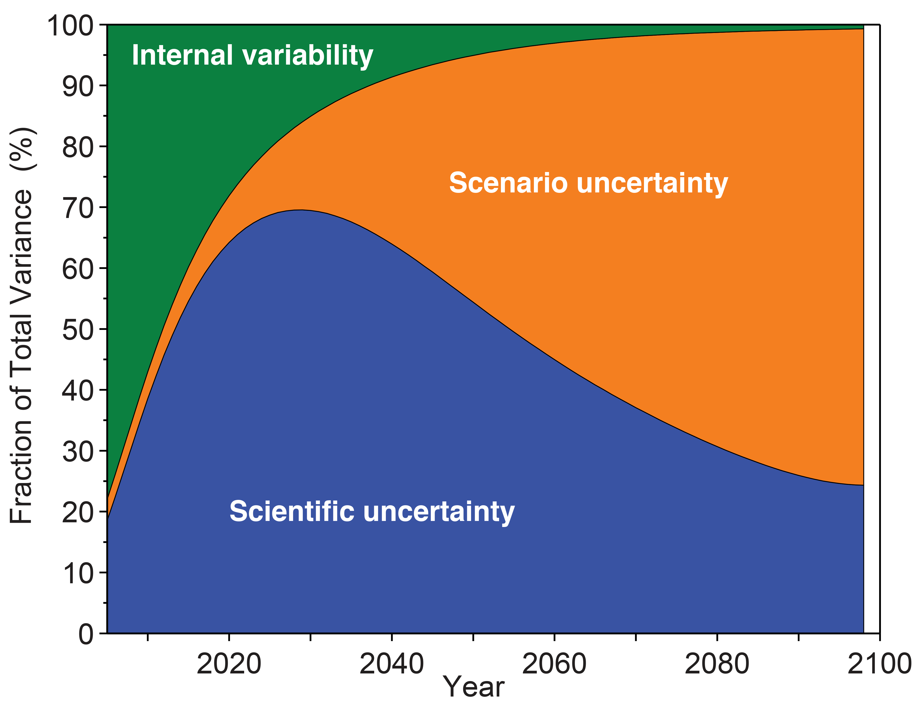
7.1. Scientific uncertainty and interpretation
Module 7. Challenges in resolving climate change disputes
Individual assignment on the subtopics 7.1

Slide 3
7.2. Ambiguity and complexity of agreements
Module 7. Challenges in resolving climate change disputes
Roots of Ambiguity and Complexity
Balancing Diverse Interests: International climate agreements must accommodate nations' diverse economies, emissions histories, and climate vulnerabilities, balancing these leads to wording that may be ambiguous.
Scientific and Technical Jargon: Climate science's complexity and varied concepts make it challenging to encapsulate in universally clear, legally binding language, risking diverse interpretations.

Slide 4
7.2. Ambiguity and complexity of agreements
Module 7. Challenges in resolving climate change disputes
Roots of Ambiguity and Complexity
Intentional Vagueness: Ambiguity in agreements can be strategic, allowing nations to agree or retain flexibility, yet it may also lead to debates about the true intent.
Evolving Science and Solutions: As knowledge of climate change and mitigation evolves, agreements need to adapt, though frequent updates can complicate and introduce loopholes or inconsistencies.

Slide 5
7.2. Ambiguity and complexity of agreements
Module 7. Challenges in resolving climate change disputes
How These Impacts Dispute Resolution
Disagreements on Obligations: Vague wording about what actions a nation must take ("best efforts", "as appropriate") leads to debates about whether parties are meeting their commitments. Lack of quantifiable targets complicates assessment.
Differing Timelines: Phrases like "as soon as possible" or "long-term goals" can be interpreted differently, leading to disputes over when targets should be achieved and what constitutes reasonable progress.

Slide 6
7.2. Ambiguity and complexity of agreements
Module 7. Challenges in resolving climate change disputes
How These Impacts Dispute Resolution
Conflicting Priorities: Agreements often enshrine competing goals, like economic development versus stringent emission cuts. This leaves governments justifying actions based on their interpretation of which goals hold priority, fueling disputes.
Shifting the Burden: Ambiguity allows room for nations to creatively interpret agreements to shift the burden of action onto others, arguing their efforts are sufficient compared to the 'real' intent of the agreement.

Slide 7
7.2. Ambiguity and complexity of agreements
Module 7. Challenges in resolving climate change disputes
Examples
Paris Agreement's NDCs: (NDCs) are the heart of the Paris Agreement, but lack standardization. Countries decide the format and targets, leading to debates on whether collective goals are being met and who needs to step up ambition.
Kyoto Protocol's Flexibility Mechanisms: Mechanisms like carbon trading were intended to provide cost-effective pathways to reduce emissions. However, complexity in verification and fears of loopholes created disputes over their true effectiveness.

Slide 8
7.2. Ambiguity and complexity of agreements
Module 7. Challenges in resolving climate change disputes
Addressing the challenges:
Clear and precise language: Using clear and concise language in agreements, avoiding ambiguity, and defining key terms are crucial for minimizing room for misinterpretation.
Regular reviews and updates: Regularly reviewing and updating agreements to reflect evolving scientific knowledge, technological advancements, and changing geopolitical contexts can help address ambiguities and ensure their continued relevance.

Slide 9
7.2. Ambiguity and complexity of agreements
Module 7. Challenges in resolving climate change disputes
Addressing the challenges:
Transparency and inclusivity: Engaging stakeholders in the drafting process, promoting transparency, and ensuring inclusivity can help build consensus and reduce ambiguity from the outset.
Dispute resolution mechanisms: Establishing effective dispute resolution mechanisms within agreements, such as conciliation or arbitration, can provide avenues for resolving conflicts arising from ambiguity in a timely and efficient manner.

Slide 10
7.2. Ambiguity and complexity of agreements
Module 7. Challenges in resolving climate change disputes
Key takeaways:
Ambiguity in agreements may appease negotiators in the short term, but it spawns future headaches.
Dispute resolution becomes a game of interpretation rather than action.
Climate action urgently needs greater clarity and precision in the agreements that govern it.

Slide 11
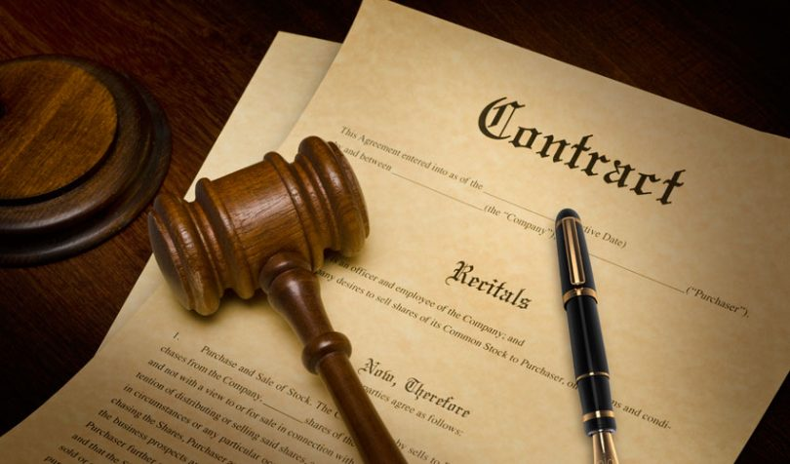
7.3. Enforcement and compliance
Module 7. Challenges in resolving climate change disputes
Roadblocks to Enforcement
Lack of Legally Binding Provisions:
Many international agreements, like the Paris Agreement, rely on voluntary commitments rather than legally binding obligations.
This weakens their enforceability and allows nations to interpret and implement them at their own pace, potentially jeopardizing collective efforts.

Slide 12
7.3. Enforcement and compliance
Module 7. Challenges in resolving climate change disputes
Roadblocks to Enforcement
Sovereignty Concerns: National sovereignty is a sensitive topic. Enforcing measures perceived as infringing on a nation's sovereign right to manage its resources or priorities can trigger resistance and impede cooperation.
Limited enforcement mechanisms: Existing international mechanisms for enforcing environmental agreements are often weak and lack authority to impose sanctions on non-complying states.

Slide 13
7.3. Enforcement and compliance
Module 7. Challenges in resolving climate change disputes
Consequences of Non-Compliance:
Eroded Trust and Cooperation: When parties fail to comply with agreements, it undermines trust and discourages others from upholding their commitments.
Unequal Burden and Ineffectiveness: If some nations comply while others do not, the burden of climate change falls disproportionately on the former
Loss of Credibility and Legitimacy: Frequent non-compliance weakens the effectiveness of international agreements and complicates the collective response to climate change.

Slide 14
7.3. Enforcement and compliance
Module 7. Challenges in resolving climate change disputes
Examples:
Differing National Ambitions: The Paris Agreement allows nations to set their own NDCs for emissions reductions. However, some NDCs lack ambition or clarity, raising concerns about their effectiveness and potential for non-compliance.
Challenges in Implementing the Kyoto Protocol: The Kyoto Protocol had stricter binding targets and penalties for non-compliance. However, enforcement was hindered by complex procedures and the withdrawal of major emitters.

Slide 15
7.3. Enforcement and compliance
Module 7. Challenges in resolving climate change disputes
Prospects for Improvement:
Strengthening existing mechanisms: Enhancing international environmental law authority and effectiveness may involve creating stronger enforcement and clear consequences for non-compliance.
Building trust and partnerships: Fostering trust and cooperation through open dialogue, transparency in reporting, and promoting global partnerships can incentivize nations to comply with agreements out of a sense of shared responsibility and collective benefit.

Slide 16
7.3. Enforcement and compliance
Module 7. Challenges in resolving climate change disputes
Prospects for Improvement:
Promoting transparency and accountability: Establishing robust and transparent monitoring, reporting, and verification (MRV) systems can shed light on compliance gaps and hold nations accountable for their actions, while also encouraging positive competition and peer pressure towards collective goals.

Slide 17
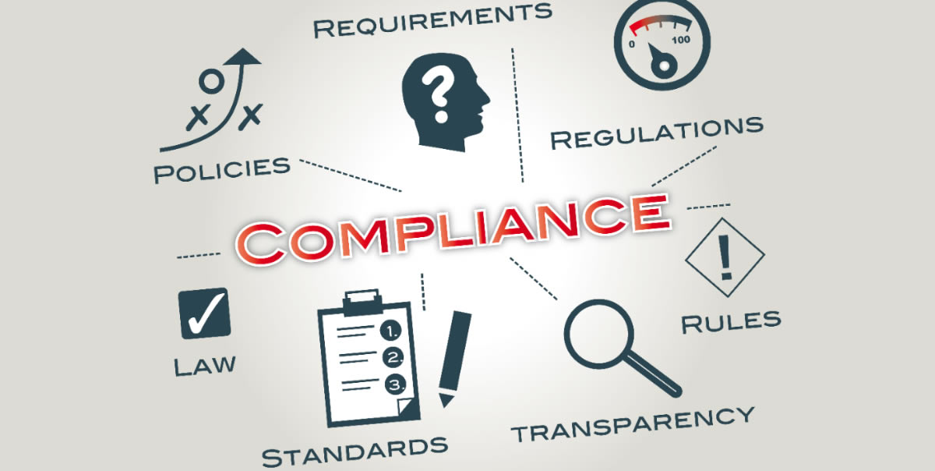
7.3. Enforcement and compliance
Module 7. Challenges in resolving climate change disputes
Key takeaways:
Effectively resolving climate change disputes hinges largely on the ability to enforce agreements and ensure compliance from all parties involved.
Ensuring effective enforcement and compliance with climate change agreements remains a complex challenge. Yet, it is crucial for achieving the collective action needed to address this global problem.
Exploring solutions that combine legal frameworks, trust-building strategies, and domestic accountability mechanisms can help pave the way for a more robust and enforceable global response to climate change.

Slide 18
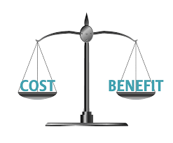
7.4. Economic implications and power dynamics
Module 7. Challenges in resolving climate change disputes
Research aspects of the sub-topic 7.4 and share notes via Zalo Group or Google Doc

Slide 19
7.5. Differing national interests and lack of trust
Module 7. Challenges in resolving climate change disputes
Clashing Priorities and Self-Interest
Economic Development vs. Climate Action: Developing countries may see strict climate measures as hindering economic growth and poverty reduction, while developed countries might endorse bold changes yet hesitate if economic competitiveness is at risk.
Resource Competition: Climate change aggravates conflicts over vital resources like water or the right to use carbon-heavy fuels, often leading nations to prioritize self-interest, which can undermine collective efforts.

Slide 20
7.5. Differing national interests and lack of trust
Module 7. Challenges in resolving climate change disputes
Clashing Priorities and Self-Interest
Historical Responsibility vs. Current Needs: Developed nations bear historical responsibility for the bulk of greenhouse gas emissions. However, rapidly developing nations are now major emitters, leading to arguments about who should shoulder the greater burden of mitigation costs and restrictions.
How Self-Interest Fuels Mistrust
Fear of Exploitation: Nations may fear that agreements will be used to their disadvantage, either economically or politically, hindering commitment and fueling suspicions

Slide 21
7.5. Differing national interests and lack of trust
Module 7. Challenges in resolving climate change disputes
How Self-Interest Fuels Mistrust
Inconsistent Actions: When countries backtrack on pledges or prioritize national interests over agreed-upon targets, it erodes trust and weakens the foundation for future cooperation and dispute resolution.
The "Free Rider" Problem: Nations may be tempted to benefit from collective climate action without taking on proportionate responsibility, expecting others to do the heavy lifting. This breeds resentment and makes agreements less effective.

Slide 22
7.5. Differing national interests and lack of trust
Module 7. Challenges in resolving climate change disputes
Impacts on Dispute Resolution
Negotiation Stalemates: Mistrust hinders good faith negotiations, leading to watered-down agreements or a lack of progress altogether.
Impasse on Implementation: Even with agreements in place, lack of trust prevents nations from believing others will deliver, hindering coordinated action and making dispute resolution more likely.
Shifting Blame: Nations may use disputes to deflect responsibility and focus on the perceived failings of others, rather than seeking collaborative solutions.

Slide 23
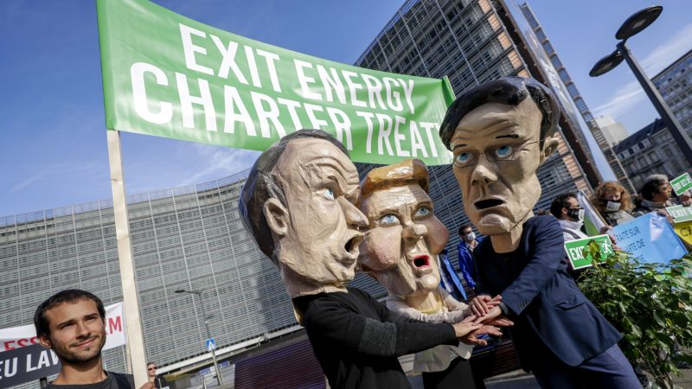
7.5. Differing national interests and lack of trust
Module 7. Challenges in resolving climate change disputes
Examples
Withdrawal from International Agreements: Exits like the US temporarily withdrawing from the Paris Agreement are often a symptom of prioritizing perceived national interests over international cooperation, and deeply erode trust.
Disputes over Technology Transfer: Developed nations may be protective of intellectual property related to clean technology, whereas developing nations demand access for rapid transition. Lack of trust hinders mutually agreeable solutions.

Slide 24
7.5. Differing national interests and lack of trust
Module 7. Challenges in resolving climate change disputes
Ways to Address the Challenge
Building Trust through Transparency: Clear reporting, open dialogue, and demonstrating commitment through actions are vital to rebuilding trust amongst parties.
Emphasis on Equity and Fairness: Agreements must acknowledge historical responsibility and differing capabilities, while finding just ways to distribute the burdens of climate action.

Slide 25
7.5. Differing national interests and lack of trust
Module 7. Challenges in resolving climate change disputes
Ways to Address the Challenge
Benefits-Focused Approach: Highlighting the economic and social co-benefits of climate action (e.g., green jobs, improved public health) can align national interests with global needs.
International Support Mechanisms: Financial aid, technology transfer, and capacity-building initiatives offered in good faith can foster trust and collaboration, especially with vulnerable nations.

Slide 26
7.5. Differing national interests and lack of trust
Module 7. Challenges in resolving climate change disputes
Key takeaways:
Differing national interests and the lack of trust they can foster form a significant barrier when it comes to resolving climate change disputes.
Climate change is a global problem demanding cooperation, but self-preservation instincts often drive nations apart.
Building trust is a slow process, but essential. Without it, dispute resolution becomes an adversarial exercise rather than a collaborative path towards solutions.

