Slide 1
CCP-LAW
Curricula development on Climate Change Policy and Law
Module: Environmental Risk Prevention and Management
Topic: Participatory Engagement, Inclusivity and Communication
Instructor Name:
Project No of Reference: 618874-EPP-1-2020-1-VN-EPPKA2-CBHE-JP:
The European Commission's support for the production of this publication does not constitute an endorsement of the contents, which reflect the views only of the authors, and the Commission cannot be held responsible for any use which may be made of the information contained therein.

Slide 2
Aims of the Session
Explore
Explore the mitigation and management strategies being used by countries which are at risk from environmental hazards.
Consider
Consider to what extent they are in line with international frameworks on environmental risks
Acknowledge
Acknowledge how participatory approaches by researchers and consultants can be used to encourage greater inclusivity of marginalised groups.
Identify
Identify any long-term residual risk facing nations and how they can prepare for those.

Slide 3
Recap on Disaster Management Model

Slide 4
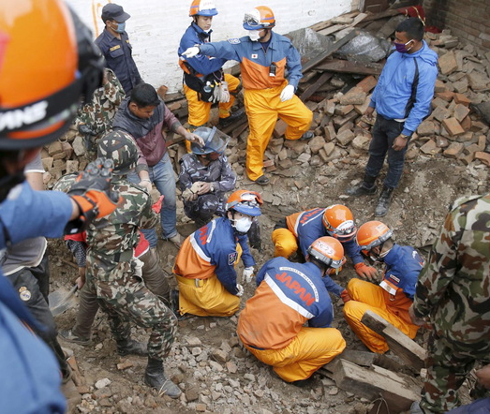
Disaster response
“The Response Phase is the actual implementation of the disaster plan. Disaster response is the organisation of activities used to respond to the event and its aftermath”
(Herrman 2007)

Slide 5
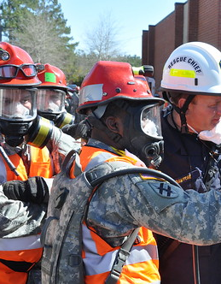
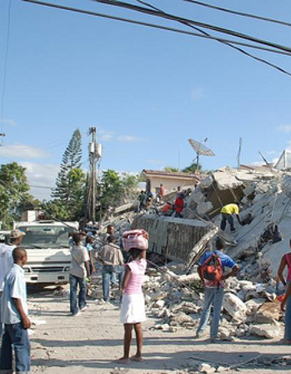
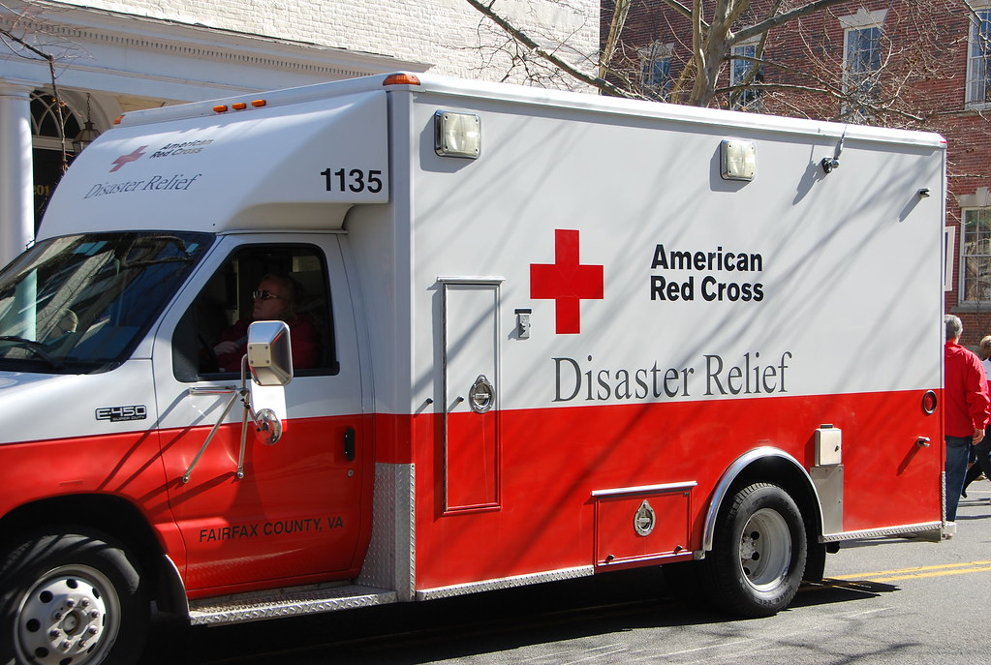
Disaster Response
The focus in the response phase is on meeting the basic needs of the people until more permanent and sustainable solutions can be found.
The social, economic and political consequences of disasters are frequently complex.

Slide 6
Challenges with a Disaster relief
Who monitors disaster relief? Where does it come from?
Is there an agenda with it?
Is everything that is being given in disasters always being received by the countries and communities in need?
Are certain items/donations more welcome than others?
Communication in terms of what is needed.
Where is the money going? Who is keeping track of it?

Slide 7
Defining Disaster Risk Management
“The systematic process of using administrative
decisions, organisation, operational skills and
capacities to implement policies, strategies and
coping capacities of the society and communities
to lessen the impacts of natural hazards and related
environmental and technological disasters. This
comprises all forms of activities, including structural
and non-structural measures to avoid (prevention) or
to limit (mitigation and preparedness) adverse effects
of hazards”
(UNEP 2008:6).

Slide 8
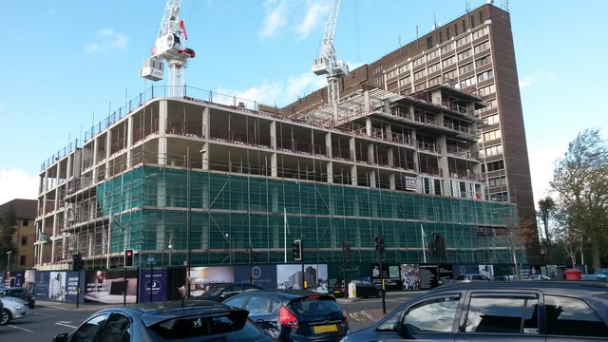
Recovery
Recovery in the context of disaster response, is a process that results in people’s lives returning to normal in a way that they will be more resilient to future disasters.
The extent to which people can recover after a disaster depends on the situation beforehand and how robust or resilient their resources are to withstand the effects of the disaster. For some, recovery will be relatively quick; for others it may take years.

Slide 9
What is a community action plan?
Community led action planning is a tried and tested way of setting out a vision for a community with an accompanying set of actions to be delivered over time. It is a participatory tool aimed at not only developing that plan, but, in the process, building the capacity of the residents of a community so that there is the skills, confidence, resources and resilience to implement that plan with minimal external support. It is not meant to articulate what a community is like, but to stimulate change and action. The action plan will be set out in response to the needs, challenges and gaps in a community and the implementation plan will be rooted in the assets of a community.

Slide 10
Community Disaster Plans
What do we need to include in a disaster plan?
Who needs to be included?
What questions do we need to ask to identify people's needs, skills and knowledge?
How do we ensure inclusivity in the process?
How is the information presented and disseminated?

Slide 11
Hazard Prone Community Example from Swift River Community, Jamaica.

Slide 12
Hazard Prone Community Example from Swift River Community.

Slide 13
Hazard Prone Community Example from Lime
Hall Community

Slide 14
Participatory Research as an approach to understanding and addressing environmental challenges

Slide 15
DEFINTION
Participatory Action Research (PAR) is a process through which people investigate meaningful social topics, participate in research to understand the root causes of problems that directly impact them, and then take action to influence policies through the dissemination of their findings to policymakers and stakeholders
(Powers and Allaman 2013:1)

Slide 16
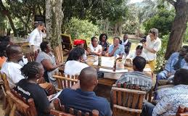
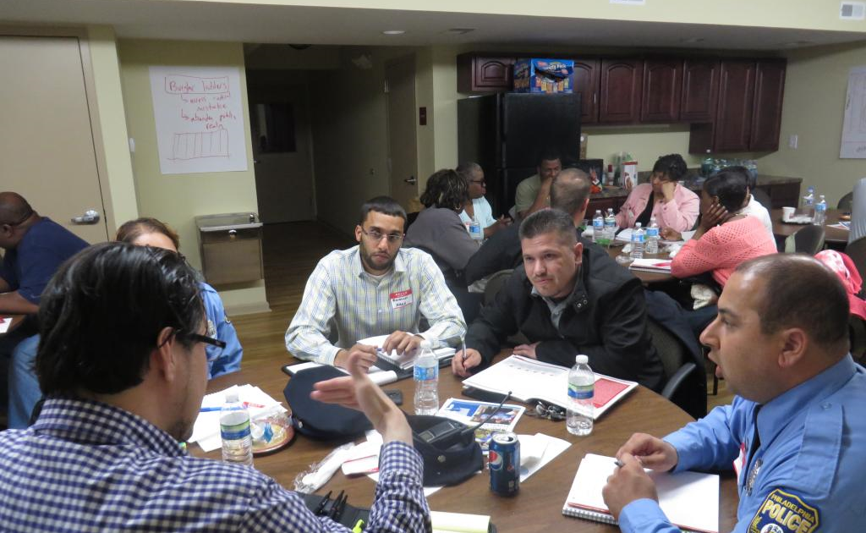
Definition
Participatory action research creates a Disruption in the traditional, hierarchical power relations
Benefits of the research felt directly by the community
Collaborative process of research, education and action

Slide 17
PARTICIPATORY ACTION RESEARCH
Challenges the idea that knowledge resides in the academy
Recognises the plurality of knowledge(s)
Counter-hegemonic knowledge production
Recognises that those who have been most oppressed or excluded are best placed to reveal aspects of their oppression
Action research been used as an approach since the 1940’s

Slide 18
PAR – first wave
Paulo Freire 1960s and 1970s
1970s PAR especially in Africa, India and Latin America
Tanzania – Marja-Liisa Swantz – first to use term ‘participatory research’
Rajesh Tandon – similar approach – ‘community based research’ in India
Columbia ‘participatory action research’ – emancipatory and promote social change

Slide 19
PAR – second wave
1980s – community development and international development
Rural appraisal approaches – alternatives to surveys
Designed to help people become involved in own development
1990s – PAR – minority world institutions
Blended with critical social science

Slide 20
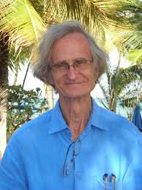
Other forms of participatory research
Rapid Rural Appraisal
A much quicker process where researchers are often more extractive when gathering their research
Offsetting biases
A reversal of learning
Useful when time is tight, and results are needed quickly.
Participatory Rural Appraisal
Participants can lead, co-lead the research and help direct in a particular direction
Offsetting biases
A reversal of learning
Self-critical awareness and responsibility taken by researcher
Findings shared with participants
Notes:
The photo is of Robert Chambers who coined the term

Slide 21
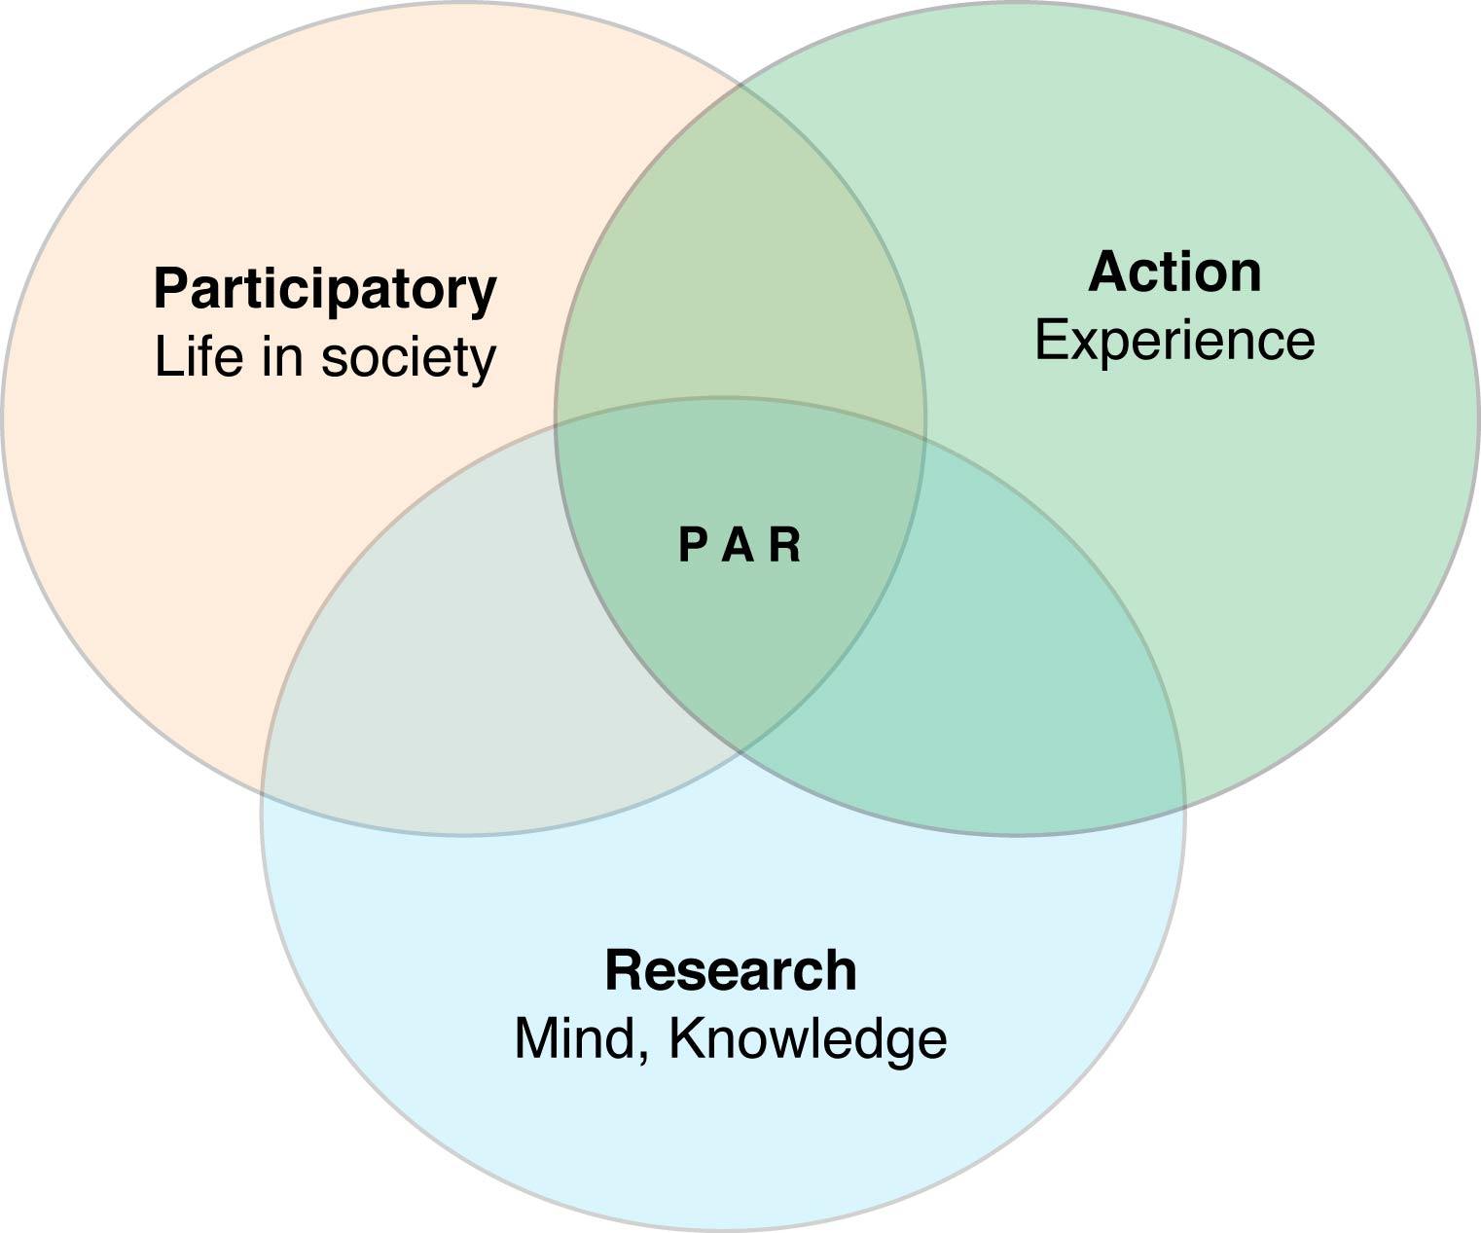

Slide 22
Spatiality and PAR
If we think of PAR as a spatial practice – regardless of where it takes place ‘invited’ or ‘popular’[‘under a shady tree or in a community centre’]
Socio-spatial arena governed by the discourses and practices of participation
Can provide ‘safe places’ for marginalised groups – can speak freely, criticise wider society etc.

Slide 23
Spatiality and PAR
PAR can aid empowerment through creation of participatory spaces
Establishment of ground rules
Associational modes of interaction
Facilitation of minority voices
Negotiation and persuasion rather than domination
‘normal’ power relations will remain outside and can curtail empowering relations
For example, fear of speaking out – consequences
Situated practice

Slide 24
Country Focus – Online Forum/Flip Chart Paper in Class (1.5 hours)
Look at the country case study folders.
Identify the challenges facing your own country regarding a changing climate.
What are those climatic challenges?
What are the wider impacts?
How well equipped is your country and locality for mitigating against and managing such a risk?
What other social, economic, political or cultural challenges is your nation facing that could both limit or enhance its resilience to environmental risk?
What approaches/actions have/are being taken currently to address or prepare for environmental risk?
What further recommendations are needed to deal with the environmental risks associated with anthropogenic climate change?
Can you design a community action plan towards dealing with this?

Slide 25
Residual Risk
Residual risk is the disaster risk that remains even when effective disaster risk reduction measures are in place, and for which emergency response and recovery capacities must be maintained. The presence of residual risk implies a continuing need to develop and support effective capacities for emergency services, preparedness, response and recovery, together with socioeconomic policies such as safety nets and risk transfer mechanisms, as part of a holistic approach.
(Community Resilience can assist with this)

Slide 26
Creative Destruction
This is the view that communities and nations have an opportunity for long term change and to essentially “build back better” after a disaster event (see. Skidmore and Toya 2002).
Communications, technology and infrastructure can be completely rebuilt to reduce the risk of disaster in future.
This is essentially a very positive viewpoint.
Does anyone agree?

Slide 27
Conclusion
Communication, community engagement and inclusivity are vital for the survival, protection and recovery of a community living in an environmentally hazardous location.
A community action plan is an effective way of being able to identify the strengths and weaknesses of community members, alongside available resources, knowledge, and evacuation plans during extreme events.
The creation of a community action plan should be undertaken in a way that is inclusive, participatory and fosters a sense of social capital and community resilience. One approach to do this is through participatory action research or appraisals.
These can be especially effective in rural communities or nations in the Global South. They can also make up for any inaction or mistrust within national or local governments.

Slide 28
Additional Reading
Almeida, P., González, L. R., Flores, E. O., Curry, V., & Padilla, A. (2023). The building blocks of community participation in local climate meetings. Npj Climate Action, 2(1). https://doi.org/10.1038/s44168-023-00071-4
IFRC. (2018). Case Studies: Red Cross Red Crescent Disaster Risk Reduction in Action – What Works at Local Level. www.ifrc.org
Institute of Development Studies. (2024). Participatory Methods. Https://Www.Participatorymethods.Org/Page/about-Participatory-Methods.
Restrepo-Mieth, A., Perry, J., Garnick, J., & Weisberg, M. (2023). Community-based participatory climate action. In Global Sustainability (Vol. 6). Cambridge University Press. https://doi.org/10.1017/sus.2023.12

