Slide 1
CCP-LAW
Curricula development on Climate Change Policy and Law
Module 9: Climate Change and Sustainable development
Subject Actionable practices in corporate sustainability
Instructor Name:
Project No of Reference: 618874-EPP-1-2020-1-VN-EPPKA2-CBHE-JP:
The European Commission's support for the production of this publication does not constitute an endorsement of the contents, which reflect the views only of the authors, and the Commission cannot be held responsible for any use which may be made of the information contained therein.

Slide 2
Content
Content
Introduction to Measurement and Reporting in Corporate Sustainability
Key Performance Indicators (KPIs) for Sustainability
Sustainability Reporting Frameworks and Standards
Create a corporate sustainability report
Case studies in Sustainability Reporting

Slide 3
Measurement and Reporting in Corporate Sustainability
Definitions
Corporate sustainability performance measurement encompasses evaluating social, environmental, and economic dimensions at the corporate level. Measurement involves the identification and quantification of key performance indicators (KPIs) related to sustainability aspects such as carbon emissions, energy consumption, water usage, waste generation, employee diversity, community engagement, and ethical business practices.
Sustainability reporting, entails the dissemination of measurement results and other relevant sustainability information to internal and external stakeholders. Sustainability reports provide stakeholders with insights into the organization's sustainability strategy, goals, initiatives, and performance outcomes.
Defined by Gray et al.: Sustainability reporting is “the process of communicating the social and environmental effects of organizations’ economic actions to particular interest groups within society and to society at large”
Sustainability reporting is part of a legitimization process signaling corporate responsiveness to stakeholder needs
Effective measurement and reporting are essential components of corporate sustainability management, as they enable organizations to:
Assess and understand their environmental, social, and economic impacts
Monitor progress towards sustainability goals and targets
Identify areas for improvement and resource optimization
Enhance transparency, accountability, and trust with stakeholders
Demonstrate commitment to sustainable business practices and corporate citizenship
Notes:
Sukitsch M, Engert S, Baumgartner RJ. The Implementation of Corporate Sustainability in the European Automotive Industry: An Analysis of Sustainability Reports. Sustainability. 2015; 7(9):11504-11531. https://doi.org/10.3390/su70911504

Slide 4
Measurement and Reporting in Corporate Sustainability
Purpose
Corporate sustainability reporting serves several purposes:
Transparency: It allows stakeholders to access information about a company's sustainability performance, goals, and progress.
Accountability: Reporting holds companies accountable for their environmental and social impacts and encourages responsible business practices.
Decision-making: It provides stakeholders with data to make informed decisions regarding investment, purchasing, and engagement with the company.
Continuous Improvement: Reporting encourages companies to set targets, measure progress, and continuously improve their sustainability performance
Internal Management and Decision Making: Sustainability reporting provides valuable information to internal stakeholders, including executives, managers, and employees, about the company's environmental, social, and governance (ESG) performance.
Notes:
Sukitsch M, Engert S, Baumgartner RJ. The Implementation of Corporate Sustainability in the European Automotive Industry: An Analysis of Sustainability Reports. Sustainability. 2015; 7(9):11504-11531. https://doi.org/10.3390/su70911504

Slide 5
Measurement and Reporting in Corporate Sustainability
Sustainability reporting drivers:
Firm size, media visibility, and ownership structure are significant drivers of sustainability reporting
Profitability, capital structure, firm age or board composition as an indicator of corporate governance do not show a clear tendency (Dienes et al. (2016)
Other drivers:
Regulatory Compliance: Governments worldwide are enacting regulations that mandate or encourage companies to disclose their sustainability performance. In EU the Corporate Sustainability Reporting Directive (CSRD), replacing the EU’s Non-Financial Reporting Directive (NFRD) covers all relevant environmental, social and governance (ESG) elements, and aims to increase investments in truly sustainable activities across the European Union. Users of non-financial information, mainly investors and civil society organizations, are now demanding more and better information from companies about their social and environmental performance and impacts.
Investor Interest: Institutional investors are integrating ESG factors into their investment decisions, recognizing the potential impact of sustainability performance on financial returns and risk management. organizations that voluntarily integrate environmental and social policies in their business model represent a fundamentally distinct type of the modern corporation, characterized by a governance structure that in addition to financial performance, accounts for the environmental and social impact of the company,
Stakeholder Pressure: Investors, consumers, employees, and communities increasingly expect companies to operate sustainably and transparently.
The interrelated challenges associated with sustainability reporting underscore the importance of addressing these issues to enhance transparency and accountability in businesses (Gurvitš-Suits & Инна, 2022).
The KPMG survey on firms’ sustainability reporting shows that in 1993, 12% of the top 100 companies in 52 countries engaged in sustainability reporting, and in 2020, it increased to 80%
Notes:
Dienes, D., Sassen, R., & Fischer, J. (2016). What are the drivers of sustainability reporting? a systematic review. Sustainability Accounting, Management and Policy Journal, 7(2), 154-189. https://doi.org/10.1108/sampj-08-2014-0050
https://finance.ec.europa.eu/publications/commission-guidelines-non-financial-reporting_en
Clarkson, M. B. E., et al. (2019). The Impact of Stakeholder Pressure on CSR Disclosure. Journal of Business Ethics, 165(3), 391-411.
Eccles, R. G., & Serafeim, G. (2013). The Impact of Corporate Sustainability on Organizational Processes and Performance. Management Science, 59(5), 1055–1077.

Slide 6
Measurement and Reporting in Corporate Sustainability
Regulatory compliance in the EU:
The Corporate Sustainability Reporting Directive (CSRD) entered into force on 5 January 2023. It modernizes and strengthens the rules concerning the social and environmental information that companies have to report. A broader set of large companies, as well as listed SMEs, will now be required to report on sustainability. In particular the Directive covers:
all listed companies with over 500 employees on EU-regulated markets; and
all large companies that fulfil two of these three criteria:
over 250 employees;
€40 million net revenue; and
≥ €20 million on the balance sheet.
In addition global non-EU firms with a net turnover of €150 million and at least one significant subsidiary or branch in the EU are obliged to report on their ESG impacts, as defined in the CSRD.
The first companies will have to apply the new rules for the first time in the 2024 financial year, for reports published in 2025.
Companies subject to the CSRD will have to report according to European Sustainability Reporting Standards (ESRS). The standards are developed in a draft form by the EFRAG, previously known as the European Financial Reporting Advisory Group, an independent body bringing together various different stakeholders.
The first set of ESRS was published in the Official Journal on 22 December 2023 under the form of a delegated regulation. These standards apply to companies under the scope of the CSRD regardless of which sector they operate it. They are tailored to EU policies, while building on and contributing to international standardization initiatives.
The CSRD also requires assurance on the sustainability information that companies report and will provide for the digital taxonomy of sustainability information.
Notes:
https://www2.deloitte.com/gr/en/pages/risk/articles/the-corporate-sustainability-reporting-directive---latest-insigh.html

Slide 7
Measurement and Reporting in Corporate Sustainability
Reporting Challenges
Data Collection and Verification: Gathering reliable data on sustainability metrics can be challenging due to the lack of standardized measurement methodologies and inconsistent reporting practices across industries. Ensuring data accuracy and consistency is crucial for credibility.
Scope and Materiality:
Determining which sustainability issues are most relevant (material) to a company's operations and stakeholders can be subjective and influenced by various factors. Balancing the breadth of coverage with the depth of analysis is essential.
Integration into Business Strategy:
Integrating sustainability goals and metrics into overall business strategy poses challenges, as it requires alignment with core business objectives and may involve trade-offs between short-term financial performance and long-term sustainability outcomes.
Stakeholder Engagement:
Engaging stakeholders effectively in the measurement and reporting process can be challenging due to differing interests, priorities, and levels of influence. Ensuring inclusivity and transparency is essential for credibility and legitimacy.
Standardization and Harmonization:
Lack of standardized frameworks and reporting guidelines for sustainability measurement and reporting can lead to inconsistency and comparability issues across companies and sectors.

Slide 8
Measurement and Reporting in Corporate Sustainability
Reporting Trends based on KPMG 2022 survey: Big shifts, small steps
Sustainability reporting is steadily advancing, with a shift towards adopting standardized frameworks based on stakeholder materiality assessments. Currently, an impressive 96 percent of the world’s top 250 companies engage in sustainability reporting, a figure expected to rise with the introduction of new regulations governing non-financial reporting.
There's a notable increase in reporting on climate-related risks and carbon reduction targets, aligning with the recommendations of the Task Force on Climate-related Financial Disclosures (TCFD). While nearly three-quarters of companies disclose their carbon targets, approximately 20 percent fail to reference any external target, such as those related to limiting global warming to 1.5 degrees Celsius.
The significance of biodiversity risk is gaining traction, particularly in light of international efforts to combat biodiversity loss. Despite this growing awareness, fewer than half of companies recognize biodiversity loss as a business risk. Nevertheless, most sectors, including those traditionally viewed as low risk, acknowledge this issue. The launch of frameworks like the Taskforce on Nature-related Financial Disclosures (TNFD) and Corporate Sustainability Reporting Directive (CSRD) is expected to drive further reporting in this area.
Reporting on the United Nations Sustainable Development Goals (SDGs) is widespread, although there's a tendency to prioritize quantity over quality. While the majority of companies report on the SDGs, only 10 percent report against all 17 goals. Notably, three SDGs—Decent Work and Economic Growth (SDG 8), Responsible Consumption and Production (SDG 12), and Climate Action (SDG 13)—are the most commonly addressed by companies.
In terms of risk reporting, climate-related risks lead the way, with an increasing number of companies acknowledging climate change as a threat to their business since 2017. However, less than half of companies report on social and governance risks. Moreover, descriptions of these risks tend to be narrative-driven and often lack quantification of their financial impact on companies or society.
Notes:
https://assets.kpmg.com/content/dam/kpmg/xx/pdf/2022/10/ssr-executive-summary-small-steps-big-shifts.pdf

Slide 9
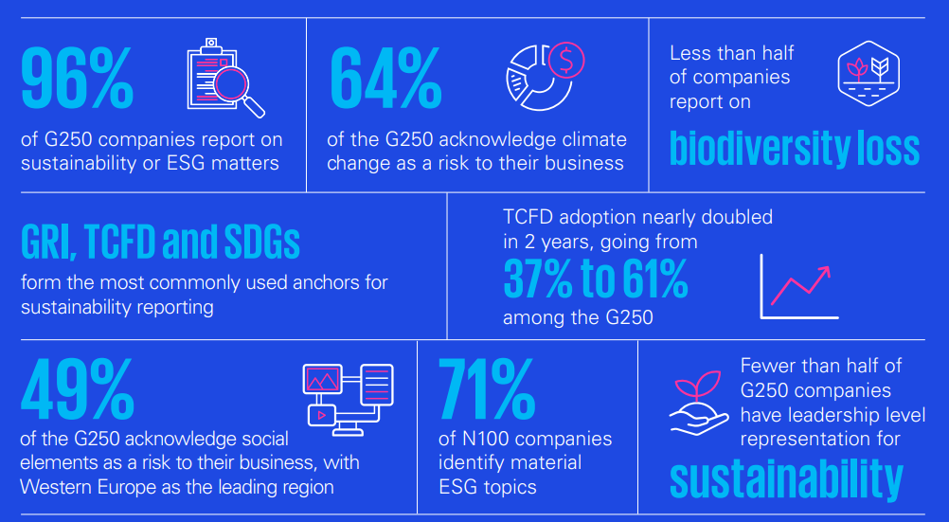
Measurement and Reporting in Corporate Sustainability
Source KPMG 2022 survey: Big shifts, small steps
Notes:
https://assets.kpmg.com/content/dam/kpmg/xx/pdf/2022/10/ssr-executive-summary-small-steps-big-shifts.pdf

Slide 10
Key Performance Indicators
KPIs are measurable indicators that offer insights into how well an organization is achieving its strategic objectives
KPIs are used to assess the success of an organization or a specific activity such as projects, programmes,
products, or other activities.
In the context of sustainability reporting, KPIs play a vital role in measuring critical objectives necessary for business sustainability
When selecting KPIs for CSR reporting, there is no one-size-fits-all approach as different companies may have different CSR priorities, goals, stakeholders and contexts.
Certain criteria can help companies choose relevant and meaningful KPIs. Example
Alignment with the company’s strategic goals
Materiality: Focus on issues that have significant impact on stakeholders, including environmental, social, and governance (ESG) aspects.
Measurability: Choose KPIs that can be accurately and reliably measured using available data sources and measurement methodologies
Comparability over time and with peers; KPIs shall allow for benchmarking and comparison against industry peers, sector averages, best practices, and relevant standards.
Clarity in language, formats and visuals.
Notes:
Abdullah, A. S. B., Zulkifli, N. F. B., Zamri, N. F. B., Harun, N. W. B., & Abidin, N. Z. Z. (2022). The benefits of having key performance indicators (kpi) in public sector. International Journal of Academic Research in Accounting, Finance and Management Sciences, 12(3). https://doi.org/10.6007/ijarafms/v12-i3/15064

Slide 11
Key Performance Indicators
Some key performance indicators (KPIs) commonly used in sustainability reporting
Environmental KPIs
Greenhouse Gas (GHG) Emissions: Measure GHG emissions per unit of output or revenue.
Energy Consumption Reduction: Track the reduction in energy consumption over time through efficiency measures
Water Use Efficiency: Measure water consumption per unit of output or revenue and track reductions.
Waste Reduction: Monitor the amount of waste generated per unit of output and track waste reduction efforts.
Social KPIs:
Employee Diversity and Inclusion: Measure workforce diversity in terms of gender, ethnicity, age, and other demographic factors.
Employee Health and Safety: Track workplace injury rates, occupational health measures, and employee wellness programs.
Labor Practices and Supply Chain: Monitor compliance with labor standards, human rights policies, and supplier engagement initiatives.
Community Engagement: Report on philanthropic activities, community investments, and partnerships with local organizations.
Governance KPIs:
Board Diversity: Measure the diversity of the board of directors in terms of gender, ethnicity, skills, and experience.
Ethics and Compliance: Track the number of ethics violations, whistleblower reports, and measures to promote ethical behavior.
Corporate Governance Structure: Assess the independence and effectiveness of the board, executive compensation policies, and shareholder engagement practices.
Risk Management: Monitor the identification and mitigation of ESG risks, including climate-related risks, supply chain disruptions, and regulatory compliance.
Notes:
Hristov I, Chirico A. The Role of Sustainability Key Performance Indicators (KPIs) in Implementing Sustainable Strategies. Sustainability. 2019; 11(20):5742. https://doi.org/10.3390/su11205742

Slide 12
Sustainability Reporting Frameworks and Standards
Frameworks and Standards: They provide structured approaches for reporting on a wide range of sustainability issues, helping organizations align with best practices, meet stakeholder expectations, and drive continuous improvement.
Global Reporting Initiative (GRI): Is one of the most widely used sustainability reporting frameworks globally. GRI (claims over 10,000 GRI framework reporters across 100 countries -GRI, 2021), offering a comprehensive set of guidelines and indicators for organizations to report on their economic, environmental, and social performance transparently and systematically.
More than two-thirds of the world’s largest 250 companies by revenue listed on the Fortune 500 have used the GRI framework. The GRI framework has sought guidance from the Global Sustainability Standards Board, that have set GRI standards for sustainability reporting (Threlfall et al., 2020).
GRI also emphasizes stakeholder engagement, materiality assessment, and the use of reporting principles such as. accuracy, balance, clarity, comparability, completeness, sustainability context, timeliness and verifiability
The GRI sustainability reporting uses three series of GRI sustainability reporting standards
Universal
Sector and
Topic to transparently show how firms have contributed (or aim to do so) toward sustainable development.
Three reasons firms adopt the GRI reporting framework (Alonso-Almeida et al. (2013):
to build relationships with stakeholders,
to avoid stakeholder pressure for not reporting about sustainability and
to show that firms are doing the right things to attract investors.
Notes:
Abeysekera, I. (2022). A framework for sustainability reporting. Sustainability Accounting, Management and Policy Journal, 13(6), 1386-1409. https://doi.org/10.1108/sampj-08-2021-0316
Alonso-Almeida, M.D.M., Llach, J. and Marimon, F. (2013), “A closer look at the ’global reporting
initiative’ sustainability reporting as a tool to implement environmental and social policies: a
worldwide sector analysis”, Corporate Social Responsibility and Environmental Management, Vol. 21 No. 6, pp. 318-335, doi: 10.1002/csr.1318

Slide 13
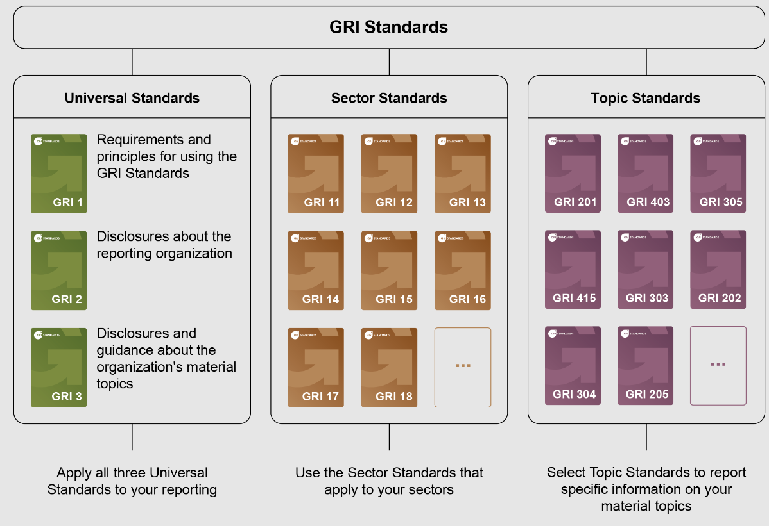
Sustainability Reporting Frameworks and Standards
Source:https://www.globalreporting.org/how-to-use-the-gri-standards/gri-standards-english-language/

Slide 14
Sustainability Reporting Frameworks and Standards
Sustainability reporting with the GRI Standards

Slide 15
Sustainability Reporting Frameworks and Standards
Frameworks and Standards:
Sustainability Accounting Standards Board (SASB): Provides industry-specific standards for disclosing financially material sustainability information to investors. SASB standards focus on the intersection between sustainability issues and financial performance, helping companies identify and report on ESG factors that are most relevant to their industry. SASB standards cover a wide range of industries and are designed to facilitate comparability and decision-making for investors (see https://sasb.ifrs.org/)
Task Force on Climate-related Financial Disclosures (TCFD):The Task Force on Climate-related Financial Disclosures (TCFD) provides recommendations for disclosing climate-related risks and opportunities in mainstream financial filings. TCFD recommendations focus on four thematic areas: governance, strategy, risk management, and metrics and targets. By integrating climate-related information into financial reporting, TCFD aims to help investors, lenders, and insurers better understand and assess climate-related risks and opportunities. (https://www.fsb-tcfd.org/)
European Sustainability Reporting Standards (ESRS): Companies subject to the CSRD will have to report according to European Sustainability Reporting Standards (ESRS). The standards are developed in a draft form by the EFRAG, previously known as the European Financial Reporting Advisory Group, an independent body bringing together various different stakeholders.
ESRSs require companies to provide information on:
their governance and strategy to address material sustainability topics;
the impacts, risks and opportunities arising from those topics; and
quantitative metrics and targets.
Notes:
https://kpmg.com/xx/en/home/insights/2022/05/european-sustainability-reporting-standards-eu-esrs.html

Slide 16
Create a corporate sustainability report
1.Define the purpose and objectives of the sustainability report, aligning them with the organization's sustainability strategy and goals.
2. Identify the most material ESG issues that are relevant to the organization and its stakeholders. Materiality assessments help prioritize the disclosure of significant sustainability impacts.
3. Collect relevant data on environmental performance (e.g., energy consumption, emissions), social performance (e.g., diversity, labor practices), and governance practices (e.g., board structure, ethics).
4. Choose a recognized sustainability reporting framework such as the Global Reporting Initiative (GRI) or the Sustainability Accounting Standards Board (SASB) standards to guide the reporting process.
5. Involve internal and external stakeholders in the reporting process to gather diverse perspectives and ensure the report addresses their information needs.
6. Establish sustainability targets and key performance indicators (KPIs) to measure progress towards sustainability goals and track performance over time.
7 Develop the sustainability report following the selected framework's guidelines, including sections on strategy, governance, performance, and future goals.
8Conduct internal reviews and verification processes to ensure the accuracy and reliability of the data and information presented in the report.
9.Publish the sustainability report through appropriate channels, such as the company website, and communicate key findings to stakeholders, investors, employees, and the public.
10.Continuously monitor the organization's sustainability performance, gather feedback on the report, and use insights to improve future reporting and sustainability practices.

Slide 17
Case studies in Sustainability Reporting
Examples of sustainability reporting
Novo Nordisk's Integrated Reporting (see: https://www.novonordisk.com/investors/esg.html)
Novo Nordisk, a global healthcare company, has adopted an integrated reporting approach that combines financial and non-financial information in a single report. The company regularly solicits feedback from stakeholders on its reporting practices and uses insights to enhance transparency, relevance, and accessibility of its sustainability disclosures. Novo Nordisk's integrated reporting reflects its commitment to continuous improvement and stakeholder engagement.
Unilever's Sustainable Living Plan outlines the company's sustainability strategy and commitments, including goals to reduce environmental impact, enhance social welfare, and improve governance. The plan includes transparent reporting on progress against targets, challenges faced, and lessons learned
Dow Chemical conducted a comprehensive materiality assessment to identify the most significant ESG issues for its business. The assessment involved engaging with internal and external stakeholders to prioritize issues such as climate change, water scarcity, and product safety. Dow Chemical uses the results to inform its sustainability strategy and reporting priorities.

