Slide 1
CCP-LAW
Curricula development on Climate Change Policy and Law
Subject title: Climate Change Policy
Instructor Name: Dr. Rahul Nikam
Project No of Reference: 618874-EPP-1-2020-1-VN-EPPKA2-CBHE-JP:
The European Commission's support for the production of this publication does not constitute an endorsement of the contents, which reflect the views only of the authors, and the Commission cannot be held responsible for any use which may be made of the information contained therein.

Slide 2
Introductory -The Risks and Perils of Climate Change from a Policy Perspective
Improved disclosure of climate-related risks and opportunities will provide investors, lenders, insurance underwriters, and other stakeholders with the metrics and information needed to undertake robust and consistent analyses of the potential financial impacts of climate change.
There is a need for a standardized framework to promote alignment across existing regimes and G20 jurisdictions and to provide a common framework for climate-related financial disclosures.
An important element of such a framework is the consistent categorization of climate-related risks and opportunities. As a result, the Task Force defined categories for climate-related risks and climate-related opportunities.

Slide 3
1. Climate-Related Risks
Climate-Related Risks, Opportunities, and Financial Impacts
2. Climate-Related Opportunities
3. Financial Impacts

Slide 4
Climate Policy Assessment Tool
Stabilizing the global climate requires rapid cuts in greenhouse gas (GHG) emissions this decade
However, the world is not yet on track to ‘net zero’: major gaps in climate mitigation ambition and implementation persist
Policy reforms are urgently needed across all countries to narrow climate mitigation ambition and implementation gaps.
What is holding back policymakers from implementing needed policies?
New tools are required to assist policymakers in designing, assessing, and implementing reforms to accelerate a ‘just transition’.
The IMF-World Bank (WB) Climate Policy Assessment Tool (CPAT) is a spreadsheet-based ‘model of models’. It allows for the rapid estimation of effects of mitigation policies for over 200 countries

Slide 5
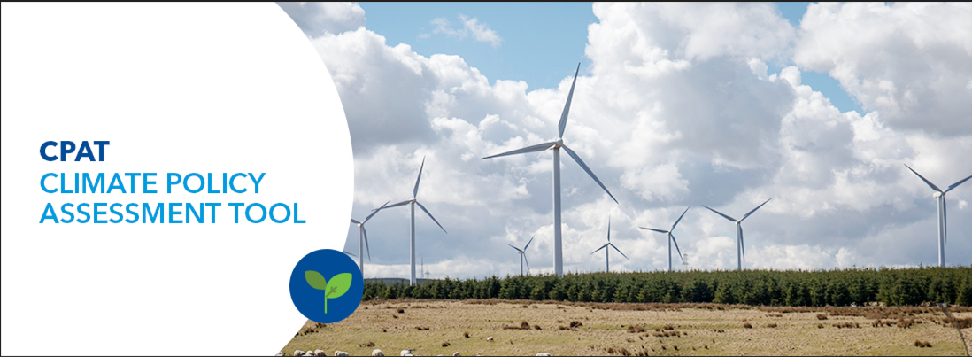
Mitigation Module
Various Modules
Distribution Module
Air Pollution Module
Transport Module

Slide 6
Further Reading
Final Report -Recommendations of the Task Force on Climate-related Financial Disclosures
https://assets.bbhub.io/company/sites/60/2021/10/FINAL-2017-TCFD-Report.pdf

