Slide 1
CCP-LAW
Curricula development on Climate Change Policy and Law
Subject title: Climate Change Policy
Instructor Name: Dr. Rahul Nikam
Project No of Reference: 618874-EPP-1-2020-1-VN-EPPKA2-CBHE-JP:
The European Commission's support for the production of this publication does not constitute an endorsement of the contents, which reflect the views only of the authors, and the Commission cannot be held responsible for any use which may be made of the information contained therein.

Slide 2
Processes and Institutions Complementary to the Paris Agreement
Clubs, R&D, and Climate Finance: Incentives for Ambitious GHG Emission Reductions
Climate clubs, namely subgroups of countries implementing more ambitious and effective climate policies than others, may be the only practical approach to address the lack of incentives to reduce GHG emissions on the part of most if not all, countries.
In climate clubs, incentives to undertake ambitious GHG emission reduction efforts may come from adapting R&D & financial policies that provide benefits exclusively to club members. As they provide innovation to reduce the costs of a unit of abated carbon & financial or insurance schemes to reduce the costs of investing in mitigation. These cost reductions can be designed to favor club members only.

Slide 3
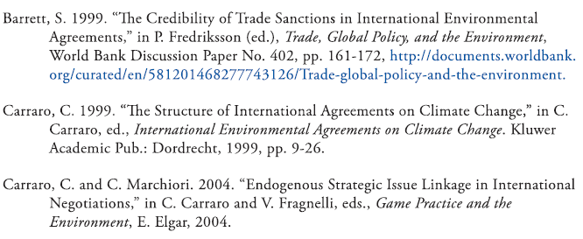
Further Reading

Slide 4
Processes and Institutions Complementary to the Paris Agreement
The Paris Agreement: We Can Do (and Have Done) Better
This assessment & review framework is unlikely to create strong incentives for countries to reduce their emissions relative to the levels that would have resulted without the Agreement.
The Montreal Protocol creates very different incentives and has been more successful than any of the climate agreements in reducing greenhouse gas emissions.
Montreal’s success is due to its approach, which asks countries to coordinate their behavior.
In addition to amending Montreal to phase down HFCs, negotiators should pursue other opportunities for coordination, including agreements on technical standards for airplanes and ocean shipping and process standards for the manufacture of aluminum.

Slide 5
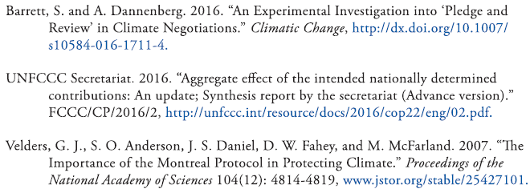
Further Reading

Slide 6
Processes and Institutions Complementary to the Paris Agreement
Bilateral and Mini-multilateral Agreements after Paris
Bilateral & mini-multilateral agreements can and should be developed to complement and catalyze the UNFCCC process because that process is insufficient and too slow.
Where shared interests exist, agreements among smaller, like-minded sets of countries can be negotiated and implemented more quickly, achieve greater ambition, initiate a virtuous cycle for other countries, and generate momentum in global climate policy.
Each new agreement must represent a measurable, additional improvement on the commitments in participating countries’ INDCs.

Slide 7
Processes and Institutions Complementary to the Paris Agreement
Networks and Coordination in Global Climate Governance
The UNFCCC is now accompanied by many other initiatives by non-state actors, businesses, cities, and others.
Coordinating across these initiatives can increase ambition and catalyze action to meet the Paris Agreement goals.
Social networks matter to climate governance, by building trust and spreading ideas across various initiatives.
Understanding networks of actors in climate governance can help identify ways to improve coordination and thus raise ambition.

Slide 8
Further Reading

Slide 9
Financing Mitigation and Adaptation in the Paris Regime
The Future of the Financial Mechanism: Analysis and Proposals
The decentralized and complex nature of the climate finance regime poses challenges but also has advantages that can be enhanced with modest reforms.
Setting uniform standards across climate finance institutions, especially the GEF, GCF, and AF could dramatically reduce the transaction costs of accessing funds and would facilitate information sharing and analysis.
More active coordination across financing mechanisms would promote a more sensible division of labor and sharing of best practices.
The financial mechanism should be a major focus of the global stocktake called for in the Paris Agreement.

Slide 10
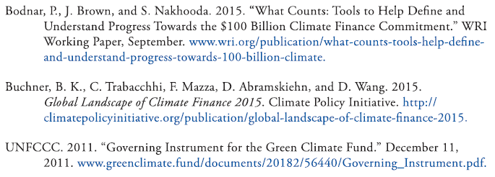
Further Reading

Slide 11
Financing Mitigation and Adaptation in the Paris Regime
Funding Climate Adaptation
Private finance should be attracted to some climate adaptation investments.
This will require mitigation of country-specific risks, allowing private investors to focus on commercial risks.
Investment deals can be structured to reduce or eliminate country-specific risks by involving appropriate third parties.

Slide 12
Financing Mitigation and Adaptation in the Paris Regime
Investing in Climate Adaptation
Climate adaption investments face large uncertainties, moral-hazard threats, potential opportunity costs, and major equity concerns.
Allocating international funds targeted towards adaptation will require major political trade-offs between the interests of developing countries and donors.
Inconsistence of strict additionality requirements will result in underinvestment. Instead, investments that provide adaptation benefits and help meet infrastructure, development, and social needs should be encouraged.

Slide 13
Financing Mitigation and Adaptation in the Paris Regime
Forests, Finance, and the Paris Agreement
Art. 5 of the Paris Agreement calls for the protection and enhancement of carbon sinks, including forests.
These actions require economic invention because forests are often cleared for higher returns.
Carbon markets were once the primary means proposed to create incentives, but their use has met resistance. The Paris Agreement and separate international aviation policies may create conditions for market-based finance, but will likely be complemented by other means and sources of finance.
Research can inform decisions on how to structure transactions to achieve cost-effective reductions at the national and local levels.

Slide 14
Further Reading

