Slide 1
CCP-LAW
Curricula development on Climate Change Policy and Law
Subject title: Climate Change Policy
Instructor Name: Dr. Rahul Nikam
Project No of Reference: 618874-EPP-1-2020-1-VN-EPPKA2-CBHE-JP:
The European Commission's support for the production of this publication does not constitute an endorsement of the contents, which reflect the views only of the authors, and the Commission cannot be held responsible for any use which may be made of the information contained therein.

Slide 2
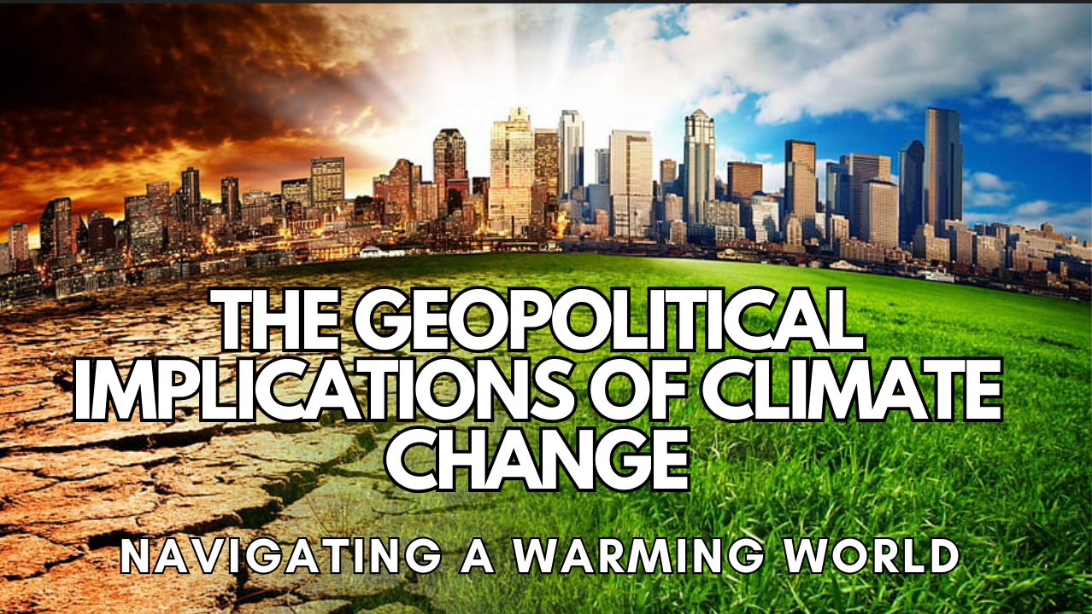
Introduction-Geopolitics of Climate Change
Climate Superpowers, Equity & the Future of Democracy, New Modes of Multilateralism
Climate Change & Financial Stability
The Geopolitics of Decarbonization, Migration & Displacement
Geoengineering: Intervention in the Earth System

Slide 3
Setting the Scene
2007 has also been the year when climate change was raised to the top of the agenda of mainstream politics, on national and on global levels.
The issue has also been debated in the Security Council of the United Nations(UNSC) as well as in the smaller circle of the G8.
The latest reports of the United Nations Intergovernmental Panel on Climate Change, (IPCC), have now reached a state of unprecedented accuracy and certainty in their conclusions that the climate of the planet is changing.
What now remains is further perfection of knowledge and political action.
This uncertainty and lack of clarity, or indeed lack of an analytical framework with which clarity could be produced, is particularly pronounced in the interface between climate change and international security.

Slide 4
Setting the Scene
Aims to provide a framework for understanding and further researching and debating the security impacts of climate change, as well as describing the current state of research, in order to provide a map of possible consequences and to discuss the specifically political dynamics of security in relation to climate change.
Specifically, the report addresses the following research questions:
Will climate change have a significant impact on world politics and affect global security politics?
Will climate change have a significant impact on politics in regions of the world and affect regional security politics? If so which regions are likely to be affected?
Will climate change have a significant impact on politics within states and affect their internal and external security politics?

Slide 5
The Theoretical Framework of the Study
It combines a number of theoretical perspectives in order to provide a comprehensive understanding of the interlinkage between climate change and international politics / international security.
For a disciplinary point of view the study is grounded in International Relations (IR) theory but it makes no claim to exclusively be based on one school rather than another, e.g. it does not take sides in the long-standing debates on the relative merits of Realism as opposed to liberalism but rather includes factors that two camps tend to emphasise.
It also considers trade and economy as highly important factors in determining whether the relations between states of a certain region will be bellicose or not.
Within the theoretical repertoire of IR theory, the study seeks to cover as broad a spectrum as possible in order to avoid the respective biases of the different traditions.

Slide 6
The Theoretical Framework of the Study
In the study, this is done within a larger sociological framework that focuses on the generation of social action, again a highly Weberian trait that was reinforced and explicitly outlined in the works of Talcott Parsons.
The one aspect of the study that breaks with the Weberian-Parsonian heritage of the study is the use of Niklas Luhmanns Modern Systems Theory (MST) to conceptualise the bridge between natural systems, such as the climate system and social systems, such as the international political system.
Luhmanns sociology departs from the classical sociological heritage in many ways, most notably for the peripheral part that agency plays in it. This study does not use MST to conceptualise phenomena on the level of action which avoids inconsistencies.
Consequently, these combinations of the three main orientations within IR theory as well as the two principal strands in contemporary sociology, sociology of action and MST, have been chosen and designed to avoid biases and the partiality that any single one perspective would have entailed.

Slide 7
Further Reading
21st Century Diplomacy: Foreign Policy is Climate Policy Full Report https://www.wilsoncenter.org/publication/21st-century-diplomacy-foreign-policy-climate-policy-full-report

