Slide 1
CCP-LAW
Curricula development on Climate Change Policy and Law
Subject title: Climate Change Policy
Instructor Name: Dr. Rahul Nikam
Project No of Reference: 618874-EPP-1-2020-1-VN-EPPKA2-CBHE-JP:
The European Commission's support for the production of this publication does not constitute an endorsement of the contents, which reflect the views only of the authors, and the Commission cannot be held responsible for any use which may be made of the information contained therein.

Slide 2
Negotiations and Resolving Conflicts: An Overview
In a successful negotiation, everyone wins. The objective should be agreement, not victory.
Every desire that demands satisfaction and every need to be met is at least potentially an occasion for
negotiation; whenever people exchange ideas to change relationships, whenever they confer for agreement, they are negotiating.

Slide 3
Negotiations and Resolving Conflicts: An Overview
Potential Positive Outcomes of Conflict
Can motivate us to try harder to "win"
Can increase commitment, enhance group Loyalty
Increased clarity about the problem
Can lead to innovative breakthroughs and new approaches
Conflict can clarify underlying problems, facilitate change
Can focus attention on basic issues and lead to solution
Increased energy level; making visible key values
Involvement in conflict can sharpen our approaches to bargaining, influencing, competing
Potential Negative Outcomes of Conflict
Can lead to anger, avoidance, sniping, shouting, frustration, fear of failure, sense of personal inadequacy
Withholding of critical information
Lower productivity from wasteful conflict
Careers can be sidetracked; relationships ruined
Disrupted patterns of work
Consume a huge amount of time-loss of productivity

Slide 4
Negotiations and Resolving Conflicts: An Overview
Major Causes of Conflict
Opposing interests (or what we think are opposing interests) are at the core of most conflicts. In a modern complex society, we confront these situations many times a day. The modern organization adds a whole new group of potential causes of conflict that are already present:
competition over scarce resources, time
ambiguity over responsibility and authority:
differences in perceptions, work styles, attitudes, communication problems, individual differences
increasing interdependence as boundaries between individuals and groups become increasingly blurred
reward systems: we work in situations with complex and often contradictory incentive systems
differentiation: division of labor which is the basis for any organization causes people and groups to see
situations differently and have different goals
equity vs. equality: continuous tension exists between equity (the belief that we should be rewarded relative to our relative contributions) and equality (a belief that everyone should receive the same or similar outcomes).

Slide 5
Negotiations and Resolving Conflicts: An Overview
The Five Modes of Responding to Conflict
It is useful to categorize the various responses we have to conflict in terms of two dimensions:
1. how important or unimportant it is to satisfy our needs and
2. how important or unimportant it is to satisfy the other person's needs.
Answering these questions results in the following five modes of conflict resolution. None is these is “right“ or “wrong”. There are situations where any would be appropriate. For example, if we are cut off from driving to work, we may decide "avoidance" is the best option. Other times "avoidance" may be a poor alternative. Similarly, collaboration may be appropriate sometimes but not at other times.

Slide 6
Negotiations and Resolving Conflicts: An Overview
Competition: Distributive (win-lose) bargaining
Satisfying your needs is important; satisfying the other's needs isn't important to you
Collaboration: Integrative (win-win)
Satisfying both your needs and the other's needs is important
Compromising:
Satisfying both your needs and the others is moderately important
Avoiding:
You are indifferent about satisfying either your needs or the other's needs: no action is likely
Accommodating:
Simply yield (it doesn't matter to you and it matters to the other person)

Slide 7
Negotiations and Resolving Conflicts: An Overview
We will focus on the two most problematic types: Collaborative (integrative) and Competitive (Distributive).
We will focus on the two most problematic types: Collaborative (integrative) and Competitive (Distributive).
The key to successful negotiation is to shift the situation to a "win-win" even if it looks like a "win-lose" situation. Almost all negotiations have at least some elements of win-win. Successful negotiations often depend on finding the win-win aspects in any situation. Only shift to a win-lose mode if all else fails.

Slide 8
Negotiations and Resolving Conflicts: An Overview
Reducing Conflict that Already Exists
Organizations also take steps to reduce conflict. The following list suggests some of these ways:
Physical separation
Hierarchy (the boss decides)
Bureaucratic approaches (rules, procedures)
Integrators and third-party intervention
Negotiation
Rotating members
Interdependent tasks and superordinate goals ("We are all in this together...")
Intergroup and interpersonal training

Slide 9
Negotiations and Resolving Conflicts: An Overview
Rational vs. the Emotional Components of Negotiation
All negotiations involve two levels: a rational decision-making (substantive) process and a psychological (emotional) process.
In most cases, the failure of two people to reach the "optimal" resolution or best alternative stems from intangible factors such as:
Psychological Factors that will affect negotiations
How comfortable each feels about conflict
How each perceives or misperceives the other
The assumptions each makes about the other and the problem
The attitudes and expectations about the other
The decisions each makes about trust, about how important "winning" is, how important it is to avoid
Conflict, how much one likes or dislikes the other; how important it is to "not look foolish."

Slide 10
Negotiations and Resolving Conflicts: An Overview

Slide 11
Negotiations and Resolving Conflicts: An Overview
The Two Most Important Kinds of Bargaining: Distributive (win-lose) vs. Integrative (win-win)
All bargaining situations can be divided into two categories:
Distributive (also called competitive, zero sum, win-lose or claiming value).
In this kind of bargaining, one side "wins" and one side "loses."
There are fixed resources to be divided so that the more one gets, the less the other gets.
One person's interests oppose the others. In many "buying" situations, the more the other person gets of your money, the less you have left.
The dominant concern in this type of bargaining is usually maximizing one's own interests.
Dominant strategies in this mode include manipulation, forcing, and withholding information.
This version is also called "claiming value" since the goal in this type of situation is to increase your own value and decrease your opponent’s.
Integrative (collaborative, win-win or creating value).
In this kind of bargaining, there is a variable amount of resources to be divided and both sides can "win."
The dominant concern here is to maximize joint outcomes.
Dominant strategies in this mode include cooperation, sharing information, and mutual problem solving.
This type is also called "creating value" since the goal here is to have both sides leave the negotiating feeling they had greater value than before.

Slide 12
Negotiations and Resolving Conflicts: An Overview
Integrative or Win-Win Bargaining: The Critical Points
• Plan and have a concrete strategy: Be clear on what is important to you
• Separate people from the problem
• Emphasize win-win solutions:
• Focus on interests, not positions
• Create Options for Mutual Gain: Generate a variety of possibilities before deciding what to do
• Aim for an outcome be based on some objective standard
• Consider the other party's situation:
• Know your BATNA (Best Alternative to a Negotiated Alternative)
• Pay a lot of attention to the flow of negotiation
• Take the Intangibles into account
• Use Active Listening Skills

Slide 13
Negotiations and Resolving Conflicts: An Overview
Planning for the Negotiation
It is helpful to have a min-max strategy. Have a "walk-away" position. When entering a negotiation or
conflict resolution, make sure you have already thought about answers to these questions: Planning for the
negotiation: The min-max approach
1. What is the minimum I can accept to resolve the conflict?
2. What is the maximum I can ask for without appearing outrageous;
3. What is the maximum I can give away?
4. What is the least I can offer without appearing outrageous?
5. Try to predict the answers the other person will have to these questions
Separate people from the problem
Address problems, not personalities: Avoid the tendency to attack your opponent personally; Maintain a rational, goal oriented frame of mind
Emphasize win-win solutions:
Even in what appears to be win-lose situations, there are often win-win solutions; look for an integrative solution; create additional alternatives, such as low cost concessions that might have high value to the other person; frame options in terms of the other person's interests; look for alternatives that allow your opponent to declare victory.

Slide 14
Negotiations and Resolving Conflicts: An Overview
Find underlying interests
A key to success is finding the "integrative" issues--often they can be found in underlying interests. A key part in finding common interests is the problem identification. It is important to define the problem in a way that is mutually acceptable to both sides. This involves depersonalizing the problem so as not to raise the defensiveness of the other person.
Use an Objective Standard
Try to have the result be based on some objective standard. Make your negotiated decision based on principles and results, not emotions or pressure; try to find objective criteria that both parties can use to evaluate alternatives; don't succumb to emotional please, assertiveness, or stub-borness.
Try to understand the other person: Know his/her situation
Know Your Best Alternative

Slide 15
Negotiations and Resolving Conflicts: An Overview
Negotiation is a sequence of events
A negotiation usually involves a number of steps including the exchange of proposals and counter proposals.
Such an approach suggests the importance of perception-conflict is in the eye of the beholder.
Next, once aware of the conflict, both parties experience emotional reactions to it and think about it in various ways. Then based on the thoughts and emotions that arise in the process of conflict resolution, we formulate specific intentions about the strategies we will use in the negotiation.
These may be quite general (eg. plan to use a cooperative approach) or quite specific (eg. use a specific negotiating tactic).

Slide 16
Negotiations and Resolving Conflicts: An Overview
Other Elements that affect negotiation
Intangibles are often the key factors in many negotiations. Some of these intangibles are:
Personalities;
Your own personality and style;
Physical space;
Past interaction;
Time pressure;
Subjective utilities;
Understand the Context for the Conflict
What are the important personal and organizational consequences of the conflict? What are possible
future consequences?
What behavior patterns characterize the conflict
What are the substantive issues? Are the issues biased by each side's perceptions and feelings?
What are the underlying or background factors that have lead to the situation and the related feelings, perceptions, and behaviors?

Slide 17
Negotiations and Resolving Conflicts: An Overview
Be an active Listener:
Don't: Talk at the other side, focus on the past, blame the other person. Do: Be an "active listener.
Is it ethical to "lie or bluff" in negotiations?
To summarize the most important keys to successful conflict resolution:
• bargain over interests, not predetermined positions
• de-personalize the problem (separate the person from the problem)
• separate the problem definition from the search for solutions
• try to generate alternative solutions; try to use objective criteria as much as possible
• reflect on your negotiations; learn from your successes and mistakes

Slide 18
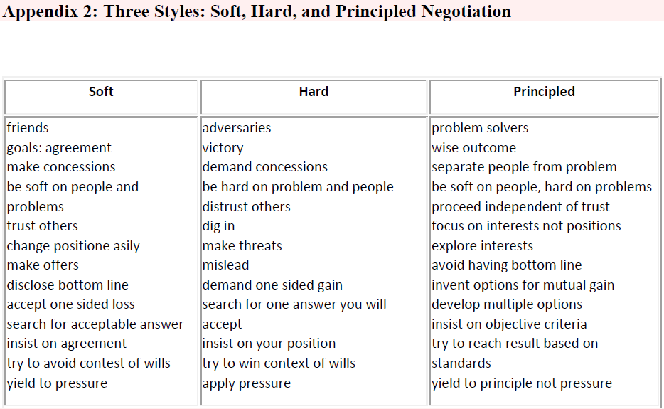
Negotiations and Resolving Conflicts: An Overview

Slide 19
Further Reading
Negotiations and Resolving Conflicts: An Overview
https://www.europarc.org/communication-skills/pdf/Negotiation%20Skills.pdf

