Slide 1
CCP-LAW
Curricula development on Climate Change Policy and Law
Module: Environmental Risk Prevention and Management
Topic: Case Studies in Managing Environmental Risk with a focus on Displacement – Environmental Hazards, Pollution and Biodiversity Loss
Instructor Name:
Project No of Reference: 618874-EPP-1-2020-1-VN-EPPKA2-CBHE-JP:
The European Commission's support for the production of this publication does not constitute an endorsement of the contents, which reflect the views only of the authors, and the Commission cannot be held responsible for any use which may be made of the information contained therein.

Slide 2
Aims of the Session
Critically discussing the impact of anthropogenic activity in exacerbating and accelerating environmental hazards, pollution and biodiversity loss.
Consider how these environmental challenges are exacerbated by and managed in the context of case studies relating to displacement, industrialisation and migration.

Slide 3
Urbanisation Context
In 1950, approximately one-third of the planet's 2.5 million people lived in cities.
Today, over 8 million people do.
By 2050, when the global population is expected to reach nine billion, an estimated two-thirds of all people will live in cities.

Slide 4
Context (ii)
Population growth, lifestyle choices, industrialisation and environmental change has led to an increase in urbanisation.
Urban areas provide a wide range of opportunities and dense professional and social networks.
Pull factors for younger people
80% of economic output originates in cities
Success stories such as Singapore and Dubai
Cosmopolitan cities such as New York or London
Urbanisation is not without its challenges though!

Slide 5
Future Predictions
By 2050, 600 million people will live in the world’s 25 largest cities
None of these are in Europe
Karachi (Pakistan), Dhaka (Bangladesh), Shenzen- China, [Delhi, Beijing, Guangzhou, Shanghai, Manila, Mumbai, Istanbul and Cairo].
By 2100 Lagos, Nigeria will be the world’s largest city, showing how quickly Africa is catching up

Slide 6
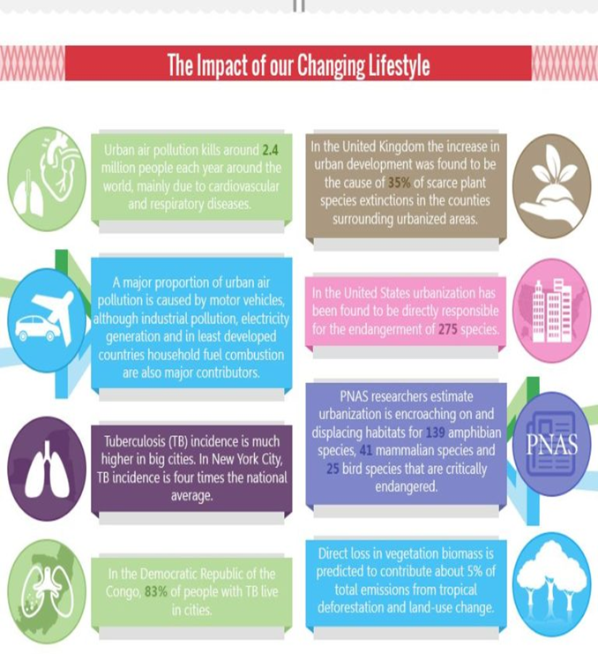

Slide 7
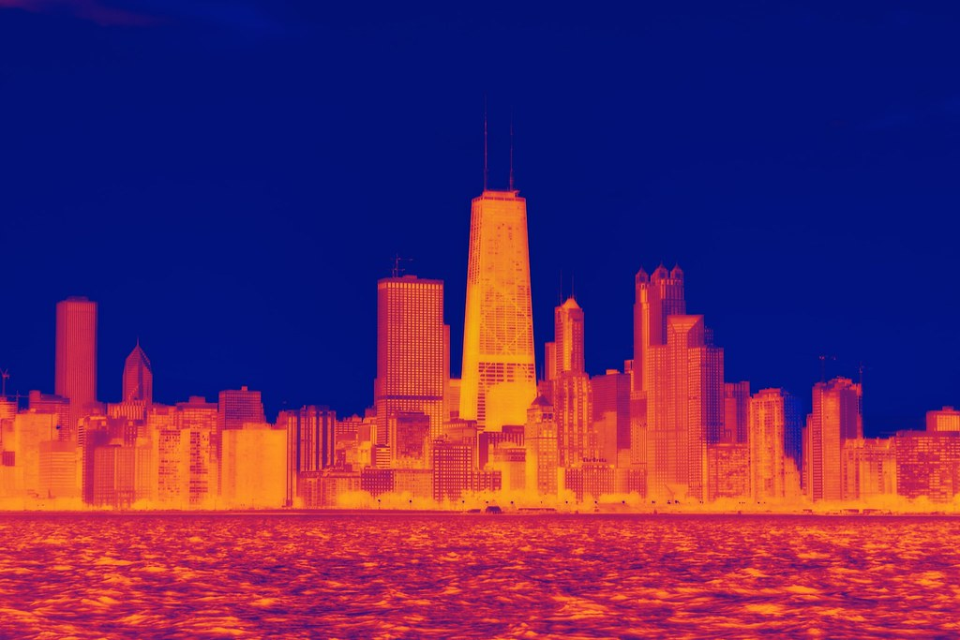
Defining Urban Heat Islands
The term stemmed from the analogy of an urban heat island as a ‘warm island’ in a ‘cool sea’ of the surrounding natural environment.
Currently, large cities in the world suffer from the urban heat island effect (i.e. the temperatures in downtown areas are significantly higher than in the suburbs) and the problem is becoming increasingly serious. The term stemmed from the analogy of an urban heat island as a ‘warm island’ in a ‘cool sea’ of the surrounding natural environment. Heat island brings adverse effects on the urban environment in various aspects, such as an increase of energy demand for cooling, which leads to more air pollutants and greenhouse gas emissions, lowered groundwater quality, and endangerment of urban biodiversity and human health.
Urban heat island is a combined effect of human activities and local meteorological conditions during urbanization. The causes of urban heat island effect include the characteristics of urban ground surface, greenhouse gas emissions, concentration of heat sources, and air pollution.
Heat islands exist because the land surface in towns and cities, which is made of materials like Tarmac and stone, absorbs and stores heat. That, coupled with concentrated energy use and less ventilation than in rural areas, creates a heating effect.

Slide 9
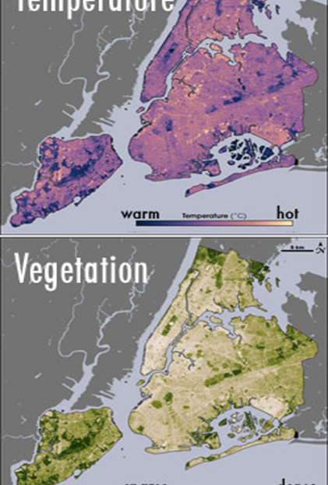
Urban Heat Islands
•Tall buildings and narrow streets can heat air trapped between them and reduce air flow.
•Waste heat from vehicles, factories, and air conditioners may add warmth to their surroundings, further exacerbating the heat island effect.
•Displacing trees and vegetation minimizes the natural cooling effects of shading and evaporation of water from soil and leaves (evapotranspiration)..
•The release of heat from the burning of fossil fuels can also raise urban temperatures. Manhattan releases four times more energy from burning fossil fuels than the amount of energy that comes into the urban area from the Sun.
•The haze of air pollution that hangs over many cities can act as a miniature greenhouse layer, preventing outgoing thermal radiation (heat) from escaping from urban areas.

Slide 10
How is city pollution effecting the environment?
Heat Waves from rapid urbanisation have been witnessed globally. A graph by the EPA show the changing temperatures in the USA’s mainland states.
This has an impact on crop cultivation, food production and food security. It additionally can be responsible for global temperature rises (i.e.: sea level rise) along with health implications for vulnerable and marginalised people such as the elderly, the poor, people in ill health and ethnic minorities.

Slide 11
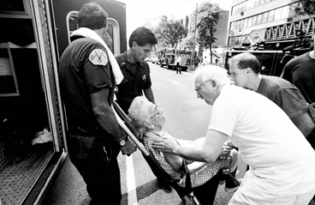
Heat Waves
The Deadly Chicago Heat Wave Is As Relevant to Racial Justice Today As It Was 25 Years Ago (nrdc.org)
•Temperatures soared to 43 degrees Celsius in Chicago in July 1995.
•There were 739 heat related deaths as a result, primarily among the elderly community, the poor and people of colour.
•The direct affect was the urban heat island of Chicago, but can you think of any other reasons why the death toll was as high?
Read Laaidi (2012) which looks at urban heat islands on Paris’ and Chicago heatwaves.
Read Thompson et. Al (2023) on the most at-risk locations for heatwaves.

Slide 12
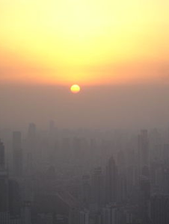
Smog
Photochemical smog is a type of smog produced when ultraviolet light from the sun reacts with nitrogen oxides in the atmosphere. It is visible as a brown haze.
Industrial smog typically exists in urban areas where factories burn fossil fuels such as coal, which creates smoke and sulphur dioxide that mix with fog droplets to create a thick blanket of haze close to the ground.

Slide 13
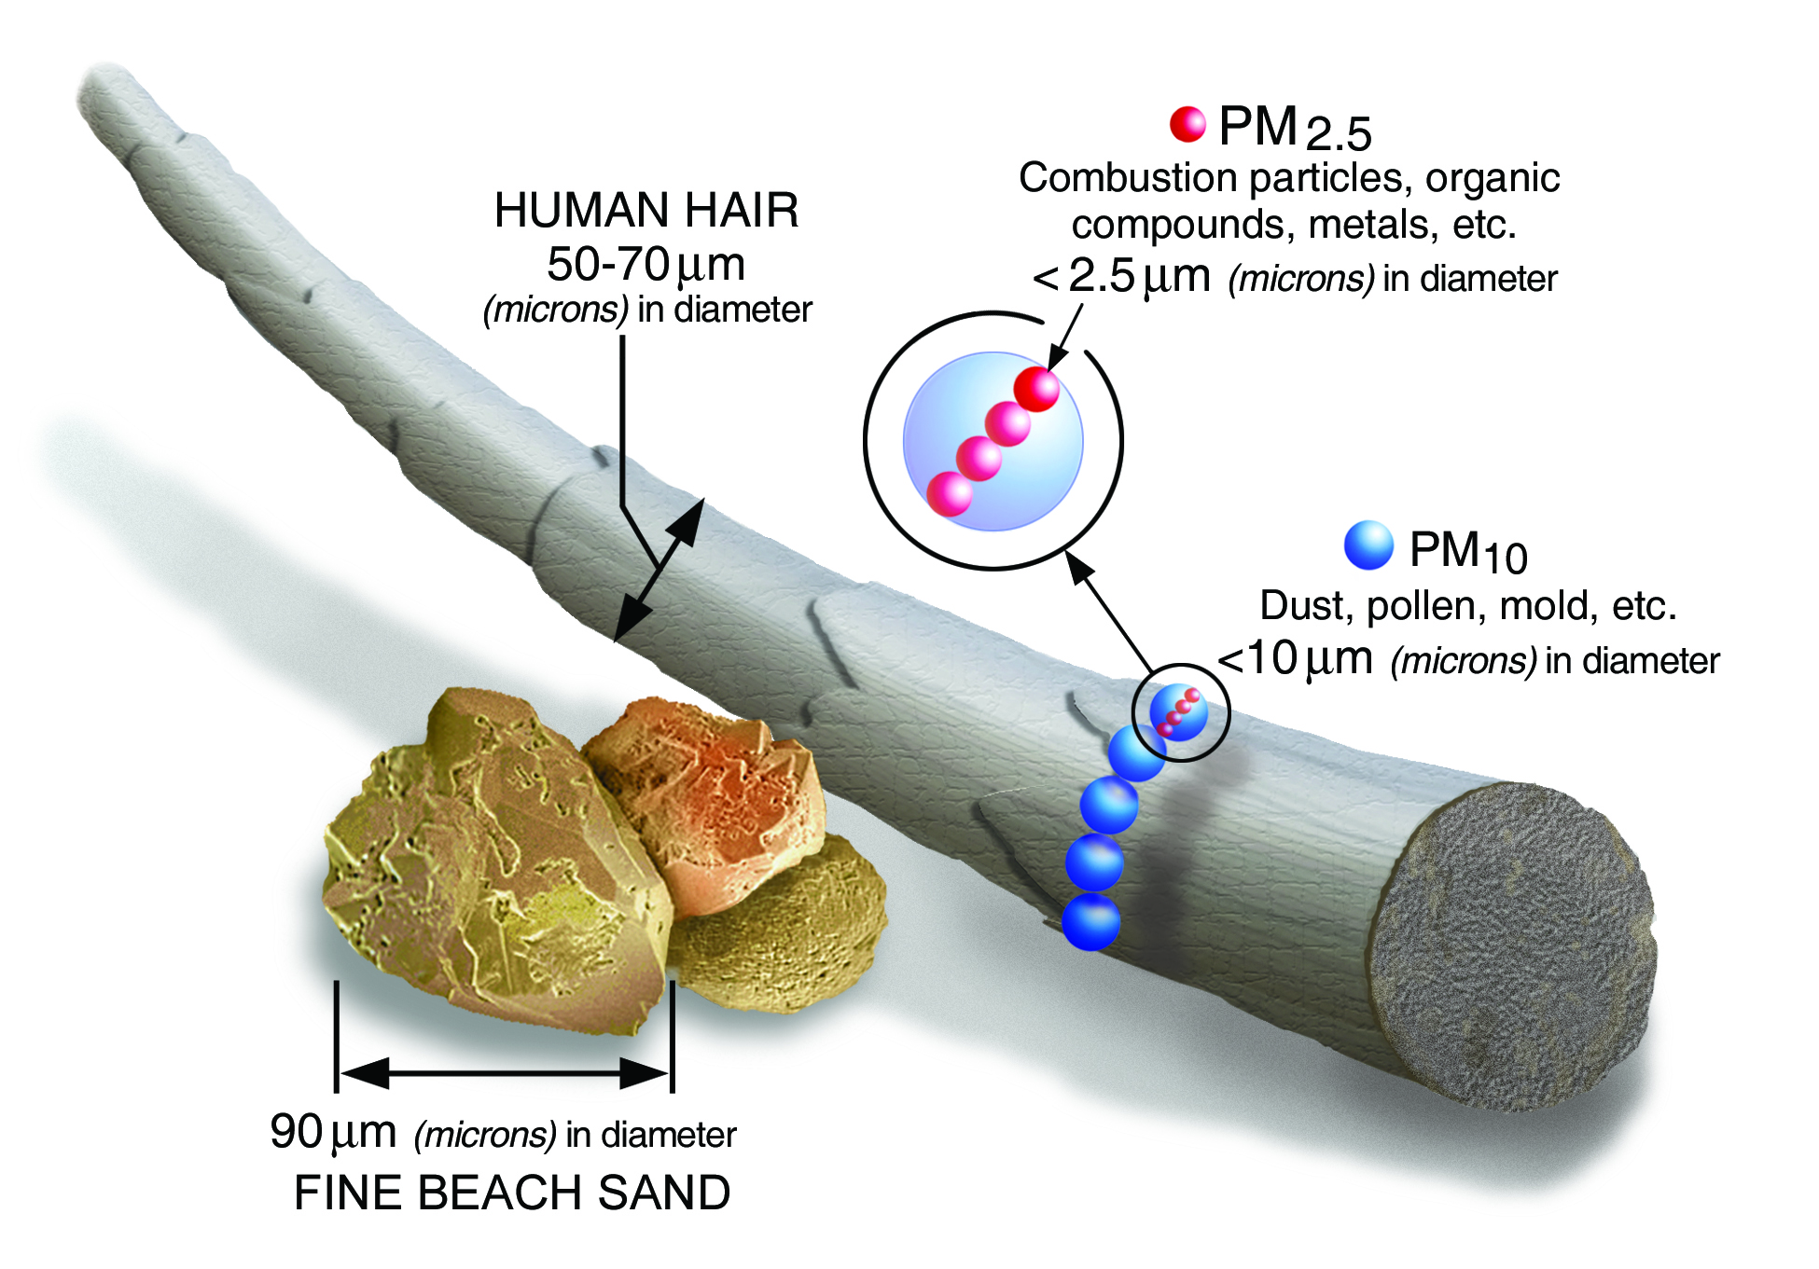

Slide 14
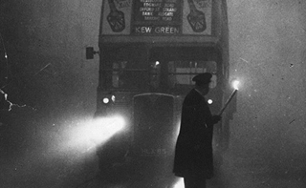
London Smog 1952
•The impact that emissions from coal burning factories in London on creating pollution in the city.
•There was a period of cold weather in London, combined with an anticyclone and windless conditions, coupled with pollution collecting in the streets and forming a thick layer of smog across the city.
•The crisis influenced a great rethink of the dangers of air pollution, with environmental legislation like the City of London (Various Powers) act of 1954 and the Clean Air Acts of 1956 and 1968 being established.

Slide 15
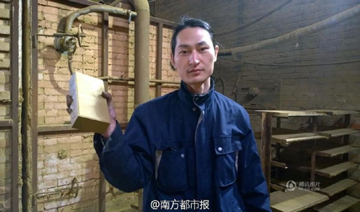
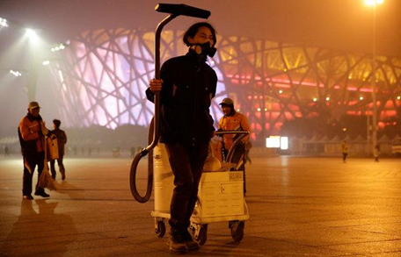
Solutions: Smog Bricks and Smoke-stack Subsidies
Smog in some of China’s largest cities has reached such a dangerous level that medical professionals have suggested that it is responsible for 4000 deaths per year. Wang Rhenzeng, a Chinese artist has decided to demonstrate the scale of this by creating ‘smog bricks’ from the fumes that he sucks up within his vacuum cleaner.
See: https://www.theguardian.com/world/2015/dec/01/chinese-vacuum-cleaner-artist-turning-beijings-smog-into-bricks
At a national level, the Chinese Government have also been addressing PM2.5 by undertaking upgrades to coal-fired stations. Since 2004, the Chinese Government have offered subsidies to retrofit smokestacks in coal fire powered stations with filters to remove sulphur dioxide, a molecule that reacts with other compounds in the atmosphere to form PM2.5 particles.
(Dyani Lewis for Nature)

Slide 16
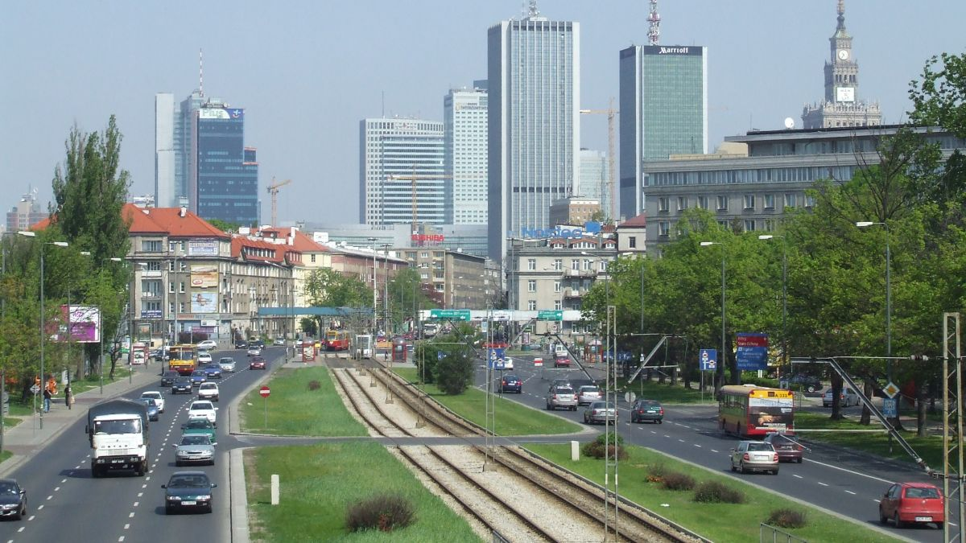
Framing Resilient, Inclusive and Sustainable Cities
“We share a vision of cities for all, referring to the equal use and enjoyment of cities and human settlements, seeking to promote inclusivity and ensure that all inhabitants, of present and future generations, without discrimination of any kind, are able to inhabit and produce just, safe, healthy, accessible, affordable, resilient and sustainable cities and human settlements to foster prosperity and quality of life for all.”
New Urban Agenda Habitat III, 2016s
Quito, Ecuador

Slide 17
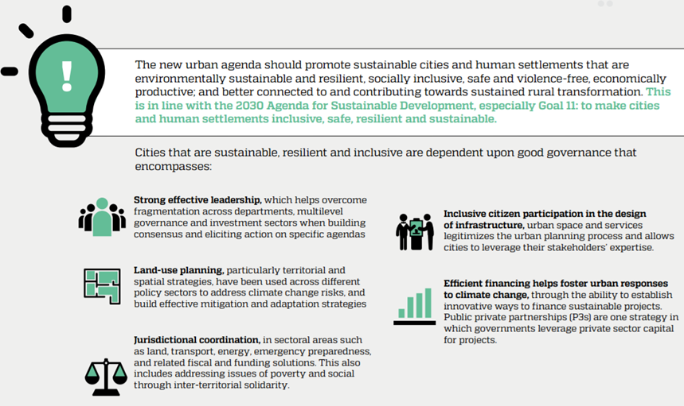

Slide 18
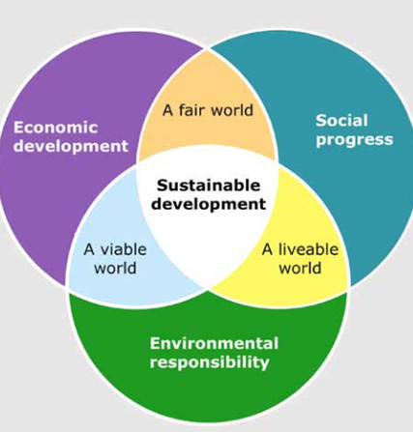
Sustainable Cities
“Sustainability can be taken to be development that meets the needs of the present without compromising the ability of future generations to meet their own needs. Important in this is achieving a desirable state of sustainably, preventing the destruction of the conditions that support a city, and allowing a balance between development and the environment.”
There are many aspects of sustainability including:
•Environmental sustainability
•Economic sustainability
•Social sustainability
Do not confuse sustainability with self-sufficiency. This can be very difficult to achieve in a new global age of trade and consumption.

Slide 19
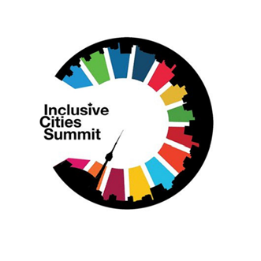
Inclusive Cities
An inclusive city can be perceived as one in which everyone is enabled and empowered to fully participate in all aspects of society including in all social, economic and political opportunities.
To ensure inclusivity, there are three main dimensions: Spatial inclusion – i.e. access to land, housing and infrastructure.
Social inclusion – i.e. ensure people’s rights and participation in society.
Economic inclusion – i.e. ensuring equitable access to opportunities for all.
Strong governance systems are required to drive real change and address inequality in cities. The systems must view sustainability and inclusivity within cities as inextricably linked – i.e. if a city is not inclusive it cannot be sustainable.

Slide 20
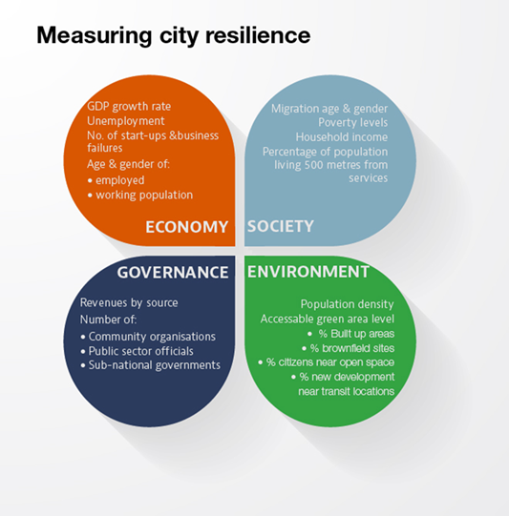
Resilient Cities
A resilient city might be considered one that has staying power and one that has transformative- resilience – i.e. flexibility and adaptability. It may also be one which can withstand and recover from multiple shocks and stresses
In considering resilience, three questions stand out:
•What is the desired characteristic or trait?
•What are the pathways/mechanisms to resilience?
• What do we want to be resilient from?
Resilience considers that development can bring about a new state within a city whereby there is no risk of regression or bouncing back to the previous state.

Slide 21
Urban Living
‘Urban systems and communities need to be able to withstand stress and survive, adapt, and bounce back after a crisis or disaster and, importantly, move on’ (Cadman 2011).
The capacity to do this is ‘resilience’.

Slide 22
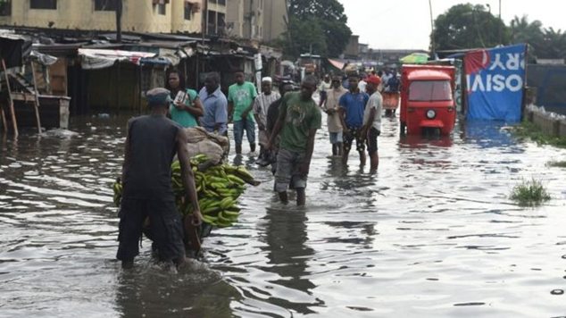
What functions in an urban area are affected by environmental hazards?
Water
Food
Energy
Trade
Infrastructure
Services – health / education

Slide 23
Water Systems
May lose water due to leakages – holes, cracks
Urbanites use a lot of water!
Where does waste water go?
Blocked drains, eroding soil, attract mosquitos/rats
Can even lead to impacts in rural areas
Minor floods can have huge impacts if they are near sites such as waste areas or leaking pipes.

Slide 24
Sustainable Drainage
https://www.youtube.com/watch?v=LMq6FYiF1mo
In natural environments, rain falls on permeable surfaces and soaks into the ground; a process called through infiltration.
In urban areas where many surfaces are sealed by buildings and paving, natural infiltration is limited. Instead, drainage networks consisting of pipes and culverts, divert surface water to local watercourses. In some cases, this has resulted in downstream flooding and deterioration in river water quality caused when foul sewers are overwhelmed by surface water leading to a release of dirty water into rivers.
Sustainable drainage systems aim to alleviate these problems by storing or re-using surface water at source, by decreasing flow rates to watercourses and by improving water quality.

Slide 25
Sustainable Drainage Solutions
Effective drainage
Water and sewage storage
Temporary collection of water points (reservoirs)
Temporary floodable zones – low lying areas/underground buildings/
Raised paths/housing/buildings
Floating houses
Greening of more urban spaces- reduce run off
Cleaning days to free storm drains of rubbish (dev world) ‘tax’ on plastic and other packaging

Slide 29
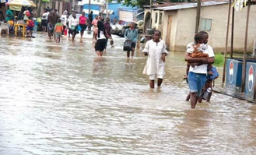
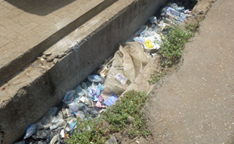
Use of SUDS in a Global Context
Seasonal rains
Frequent flooding
Governance and infrastructure
Cultural acceptance and will

Slide 30
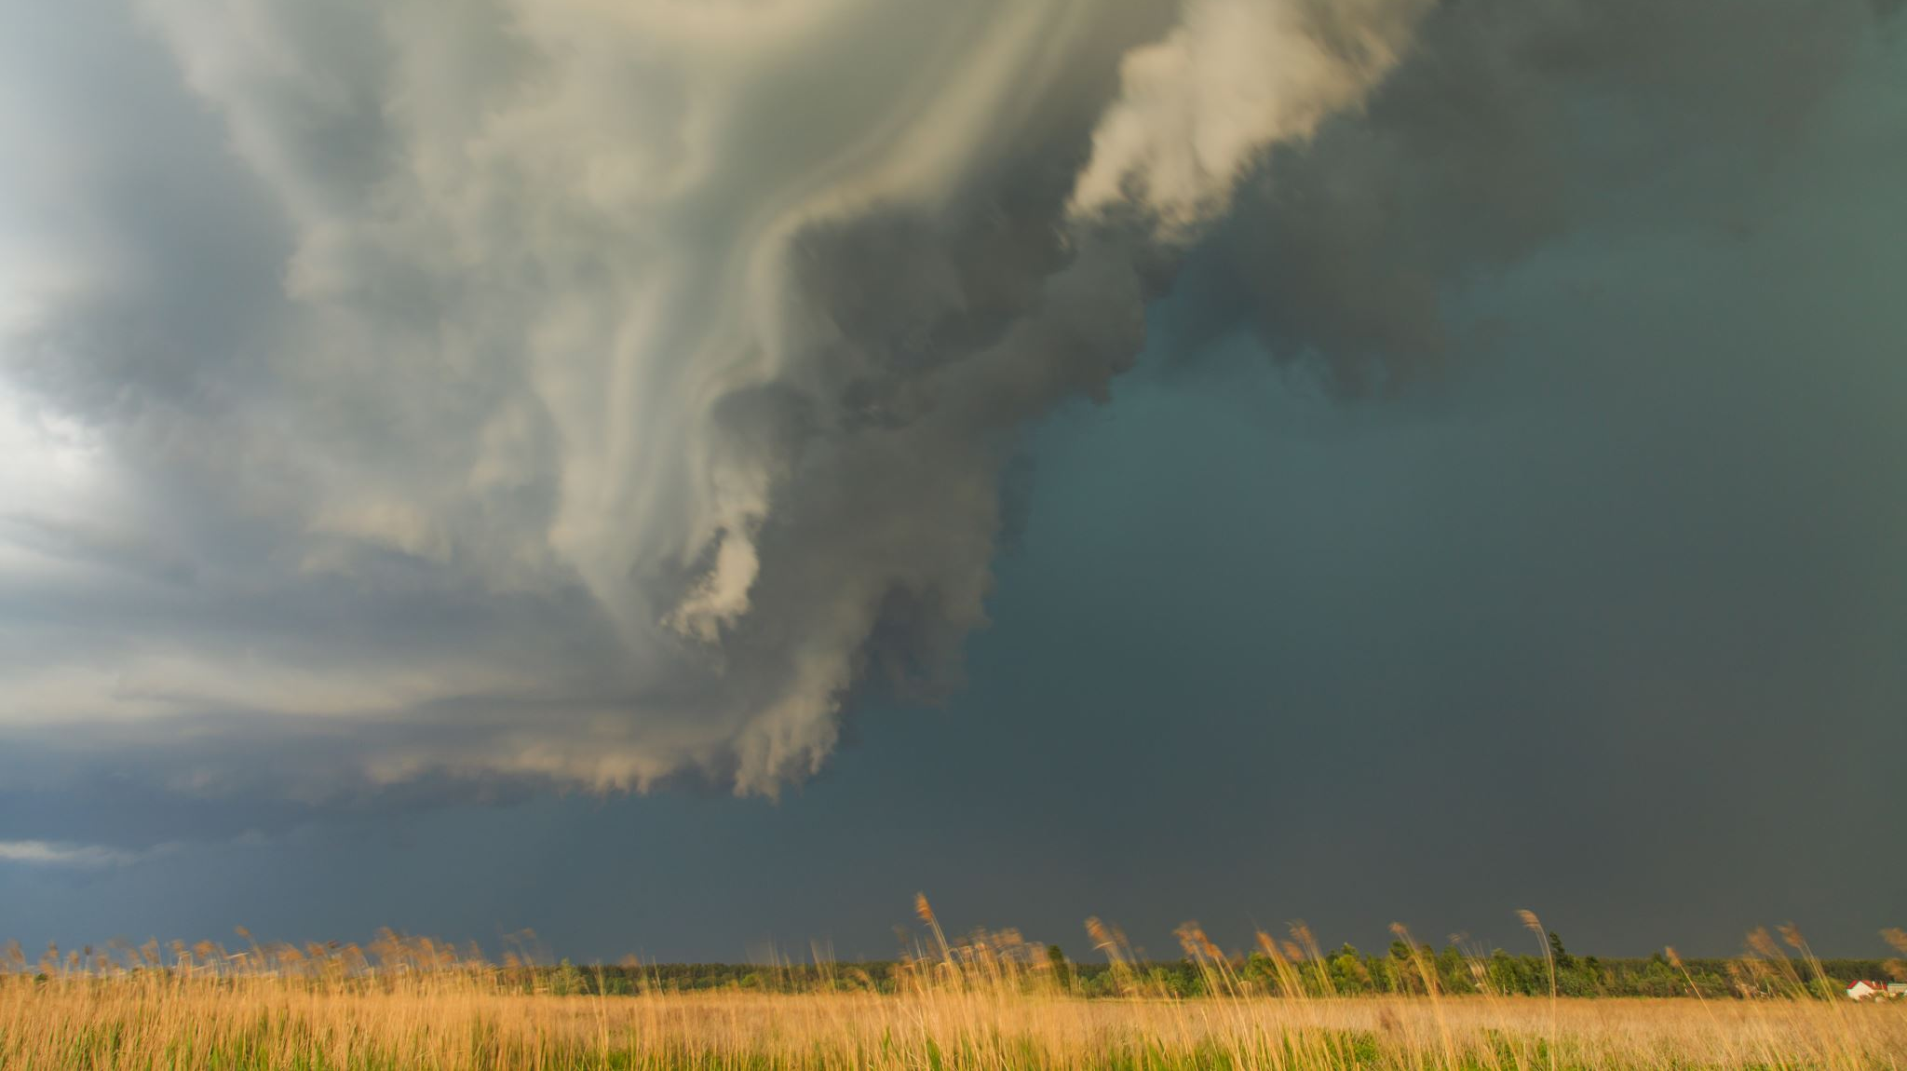
Climate-Induced Migration

Slide 31
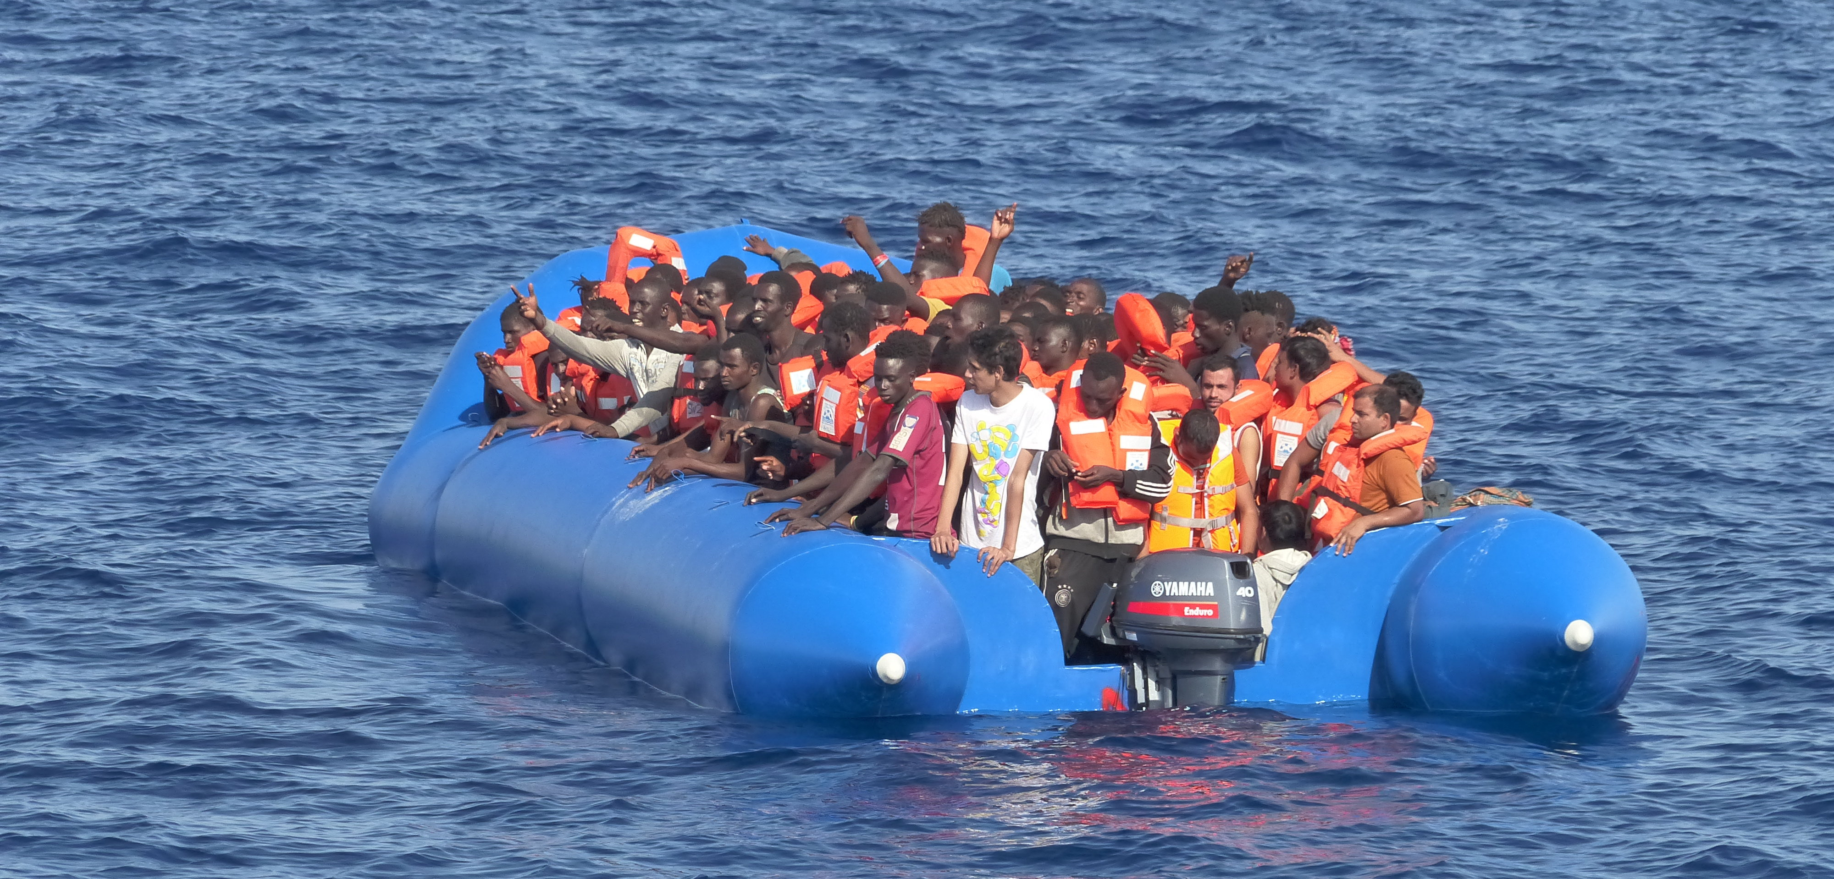
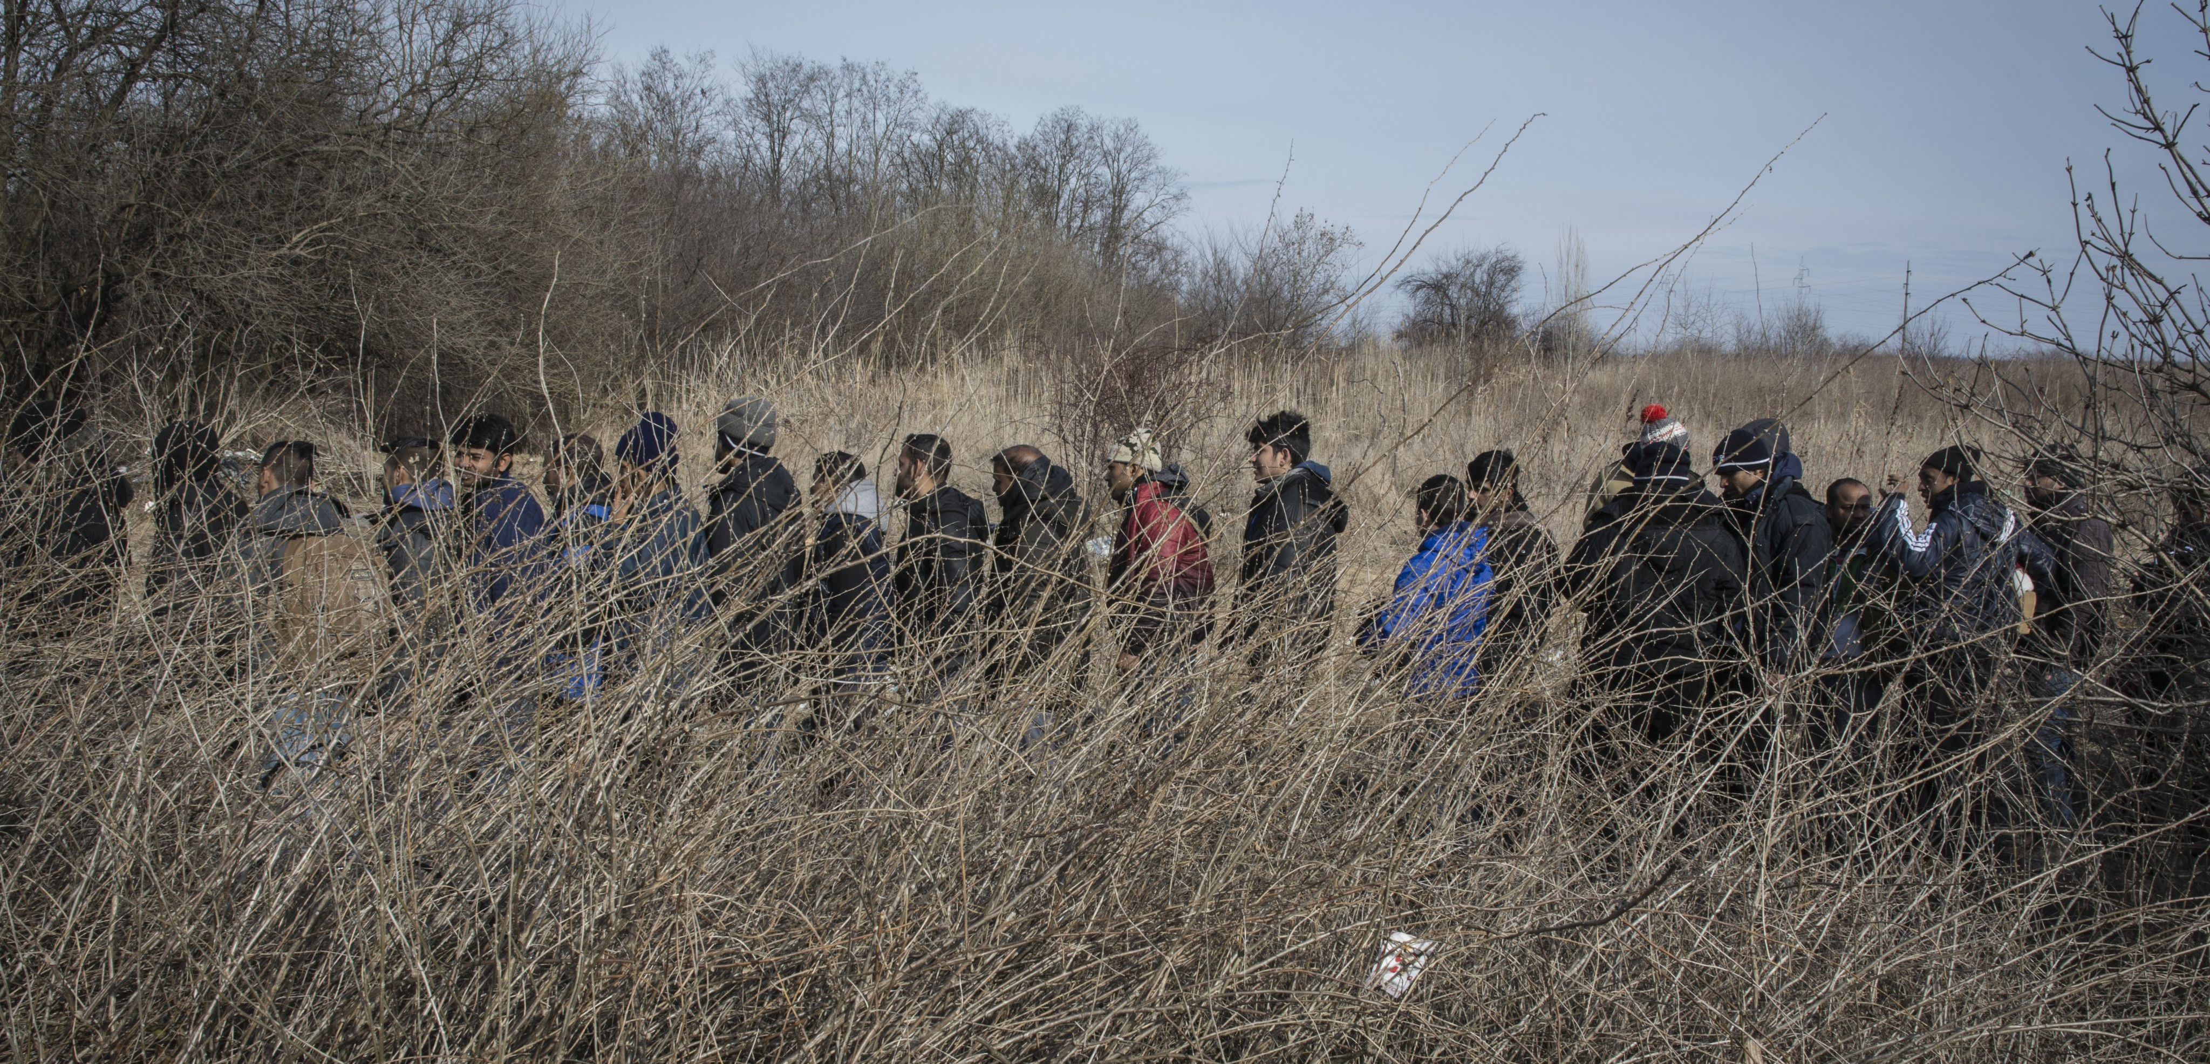
TERMINOLOGY
Climate Migration – “Multifaceted issue considered a new type of human displacement resulting from the domino effects of climate change (Singh 2012).”
Climate Refugee – “A person displaced by climatically induced environmental disasters like droughts, desertification, and sea level rise, as well as extreme weather events like cyclones, fires, flooding and tornadoes” (Matthews 2013).
Environmental Migrant – “Persons for reasons of sudden or progressive changes in the environment that adversely affect their lives or living conditions, are obliged to leave their habitual homes or choose to do so, either temporarily or permanently, and who move either within their territory or abroad (Brown 2008).”
What do you think a Protracted Refugee might be?

Slide 32
POLICY
The question of definition makes for a hotly contested debate amongst international human rights lawyers. However, in practice there is considerable resistance among the international community to any expansion of the definition of a “refugee”. Developed countries fear that accepting the term refugee would compel them to offer the same protections as political refugees; a precedent that no country has yet been willing to set
If the term “climate refugee” is problematic it is still used, in part, for lack of a good alternative. “Climate evacuee” implies temporary movement within national borders (as was the case with Hurricane Katrina). “Climate migrant” implies the “pull” of the destination more than the “push” of the source country and carries negative connotations which reduce the implied responsibility of the international community for their welfare.

Slide 34
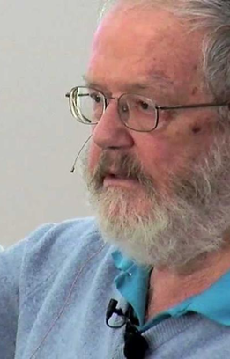
Norman Myers
Myers’ estimates of ‘environmental refugees’ are driven by three major sources: population growth, sea-level rise and an increase in extreme weather events (Myers 1993, 1997 and 2002). Myers’ scenario relies on Malthusian logic infused with theories of environmental change.
As such he cites predicted impacts of climate change and predictions for population growth to paint a picture of an increasingly large and climate stressed population that is reliant on an ever-dwindling resource base. By Myers’ account these problems will be most acute in the developing world where fertility rates are highest and where developmental inequalities have already generated greater vulnerability to environmental change.

Slide 35
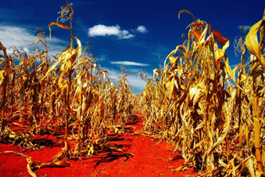
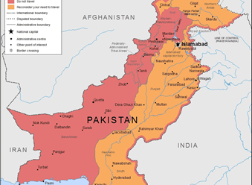
Climate change and migration
Pakistan is vulnerable to climate variability, change and subsequent hazardous events including flooding during the Monsoon. Heat stress, however, has become one of the biggest contributors to migration in the country, particularly for small scale farmers.
Extreme heat during ‘Rabi’ (Nov- April) wheat growing season can be responsible for wiping out one third of the land’s income due to crop loss and yield reduction.
Men and women move as a result of this to find other work. The poorest and most socially marginalised groups who are landless are usually the first to leave as farmers will no longer pay for their employment.
The study provided evidence that to some extent, climate change may play a role in pushing up rural to urban migration, which presently constitutes 40% of total internal migration in the country (Arif 2005).
(see. Mueller et al. (2014) and Saeed, Salik and Ishfaq (2015))

Slide 36
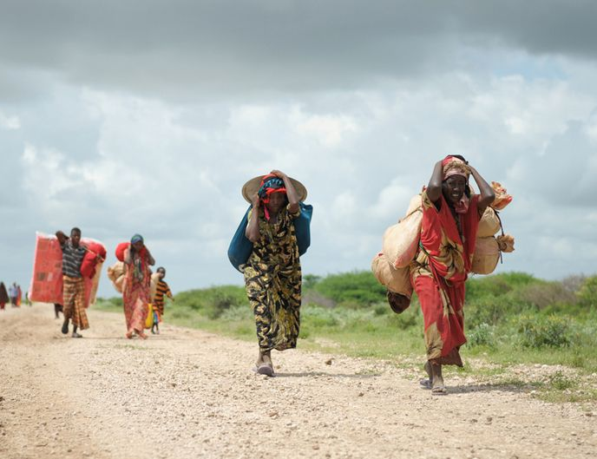
Displacement, Disaster in the Horn of Africa
A major drought developed into famine in the Horn of Africa and throughout 2011 and 2012, large numbers fled — in particular Somalis and Ethiopians — in search of assistance and protection. The majority went to Kenya or Yemen; some travelled to more-distant countries like Egypt. And now, recent reports say failing rains, severe malnourishment, enduring conflict and poor sanitation mean Somalia is again facing a humanitarian crisis, with 50,000 children “at death’s door” and 2.9 million Somalis at risk of hunger (Smith 2014).

Slide 37
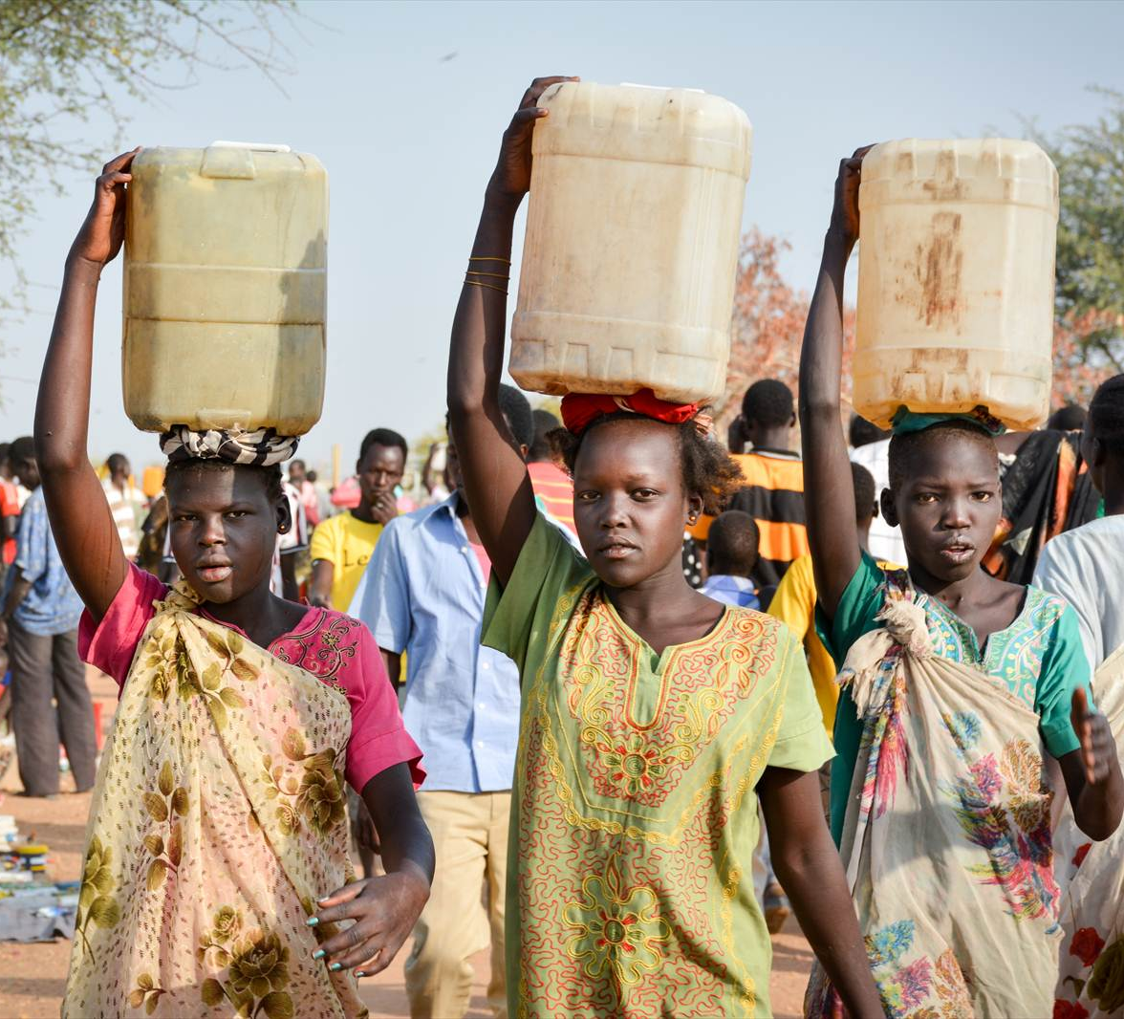
Displacement in the Horn of Africa
Most Somalis and Ethiopians displaced to Kenya, Egypt and Yemen were influenced in their cross-border movement by natural hazard-related disasters, which interacted with additional social and political factors, such as ethnic and politically based discrimination.
While a protection gap exists at the global level for those displaced by disasters, on the ground at the local and national level it was clear that climate factors interacted with other social and political factors to displace people. Therefore, existing human rights and refugee instruments often remain relevant in the case of disaster-related displacement.
*(Link this to Political and Cultural Vulnerability)

Slide 38
Displacement in the Horn of Africa
On the ground, rules and laws are dynamic and adaptive and vary in their local and national manifestations. For example, in Yemen, Islamic norms of hospitality may provide protection in some disaster situations by influencing the application of law and protection.
Laws hindering access to the formal labour market by refugees put them at risk of becoming exploitable informal labour. As a result, few refugees planned to remain in the receiving countries for the long-term. This suggests a need of exploring labour migration channels and potentially expanding them in the wider region, as many are moving in search of better livelihoods.
Without exception, displaced persons mentioned (lack of) livelihood options as one of the main reasons for leaving their homes and going to Kenya, Egypt or Yemen. Most respondents were pastoralists, small-scale farmers and agro-pastoralists. The displaced persons were mostly concerned about limited rights to work and lack of livelihood options — other concerns included shelter, food security, education, access to health care, security — including security against gender-based violence, and durable solutions, such as resettlement.

Slide 39
Horn of Africa: drought, displacement and conflict
A combination of an over-reliance on agriculture as a means of economic livelihood, coupled with climate changes has increased the levels of drought in areas around the Horn of Africa, namely, Ethiopia, Uganda, Kenya and Eritrea.
58% of disaster deaths have been in the top 30 fragile and conflict affected states
34% of disaster affected people have been in the top 30 fragile and conflict affected states
QUESTION: Why do you think this would be the case?
This also leads to food insecurity which has significant impacts on the health and well-being of those affected and can lead to further disease.*
Notes:
*This could also be linked to the session on Global Health.

Slide 41
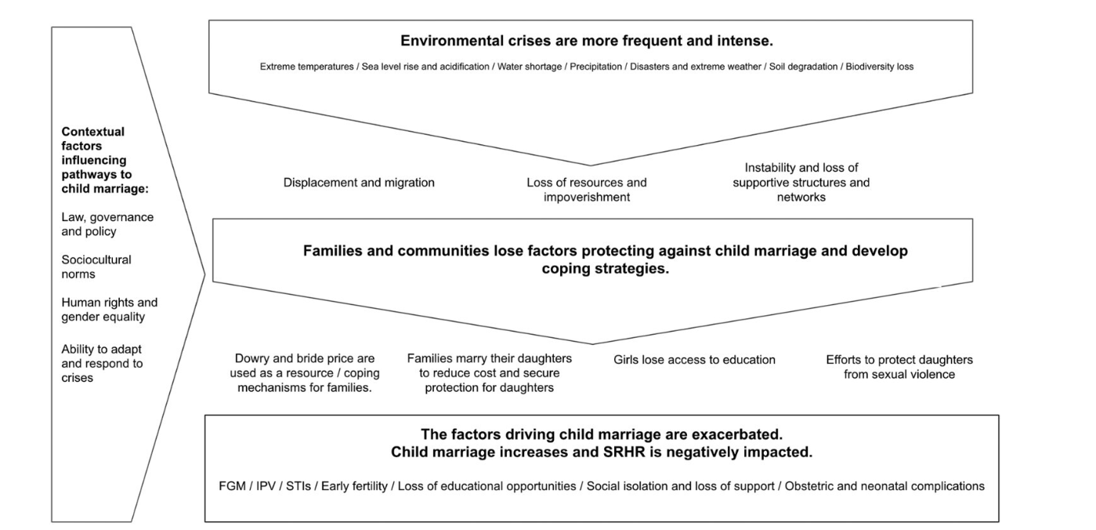
Child Brides and Climate Change

Slide 42
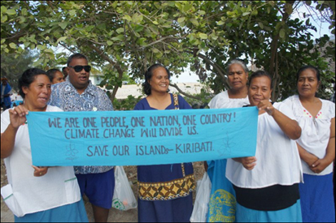
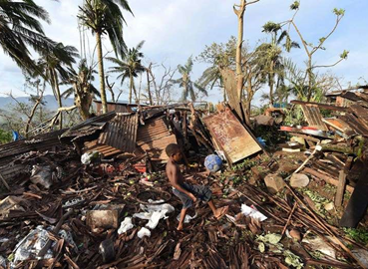
CASE STUDY: PACIFIC ISLANDS
In Pacific islands such as Kiribati, slow-onset climate hazards like saline intrusion are important factors influencing responses to migration and displacement.
Drought has reduced the level of the water table in Kiribati, pressure from water pumping, storm surges and low-lying land has meant that saline water has also entered the ground water reserve. This affects their crops and everyday livelihood.
For example, some Small Island Developing States (SIDS) have developed labour migration strategies that build on bilateral agreements with Australia and New Zealand for temporary seasonal work in horticulture (ILO, 2014).

Slide 43
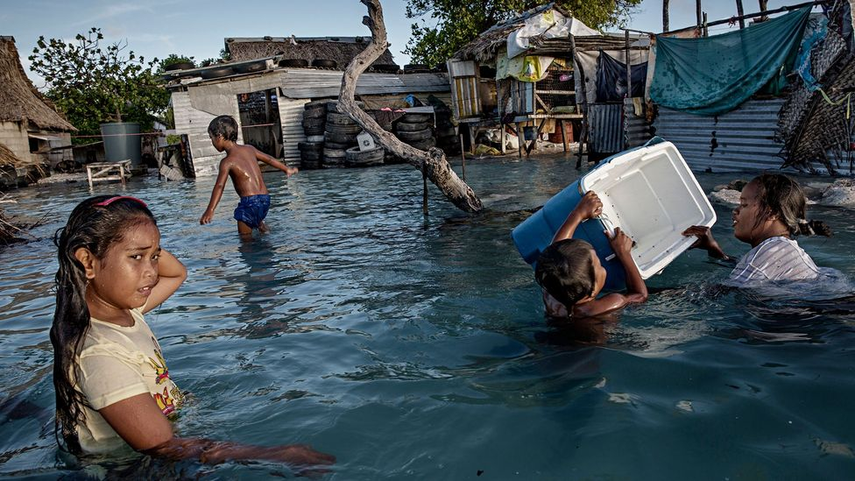
Kiribati Sea Level Rise
Kiribati and Tuvalu are faced by severe and numerous climatic hazards which have led to sea level rise, hurricanes and flooding.
The countries are two of the most at-risk nations in the world.
The 33 islands of Kiribati are notoriously vulnerable to sea level rise; the highest point on many of the islands like South Tarawa is just a few meters above sea level. The country is disappearing due to sea level rise.
Kiribati have bought some land in Fiji for relocation in the future and New Zealand have offered a visa for 75 people per year to move to the country per year.
Anote Tong, the ex-Prime Minister of Kiribati is a avid Climate activist, campaigning to save the nation.

Slide 44
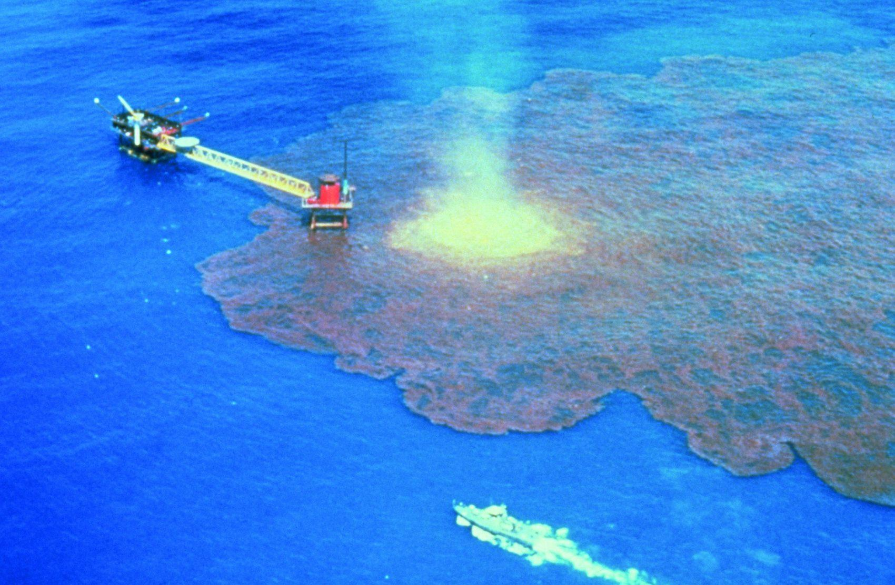
Fishing, Biodiversity Loss and Population Pressures along the Coast
Millions of people dwelling in coastal communities around the world already exist at the margins and are often contending with converging pressures that place them in a vulnerable position to make a decent living. These pressures can emanate both from land and the sea, leading to a ‘coastal squeeze’
For example, population increases in coastal areas, maritime and coastal space enclosures for offshore development, marine reserves for the purpose of conservation that marginalize small-scale fishers, the impacts of climate change and dwindling fish stocks in the ocean, overfishing by both small-scale and large-scale fishers, and increasing competition and conflicts over marine resources and coastal areas – including for large-scale tourism and port infrastructure – can all undermine the sustainability of resource-based livelihoods and the resilience and well-being of coastal communities (Andrews et al. 2021).
Many of these issues have been compounded further by a lack of governance, the emergence of exploitation and suggestions of neo-colonialism.
Organisations such as the Sea Shepherds have been working to tackle and challenge crimes to marine wildlife and protect and preserve all oceans and marine life.

Slide 45
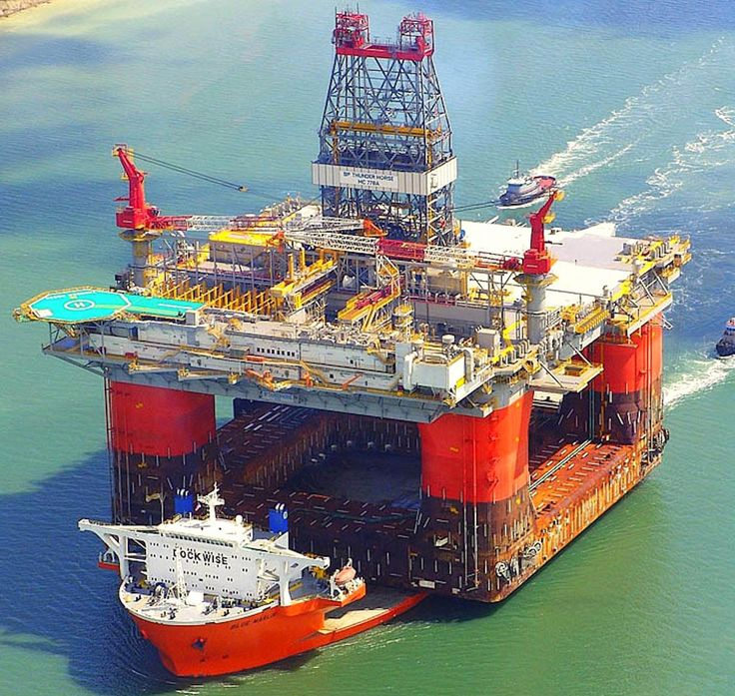
Oil Production and Pollution
Visual pollution can confuse wildlife and disrupt natural migratory pathways and hunting strategies among marine life.
Gas flaring can cause pollution by way of acid rain and particulates, carbon dioxide and methane contribute to anthropogenic climate change, which have impacts like algae blooms and coral bleaching.
Seismic surveys are used in oil prospecting and involves powerful air gun blasts.

Slide 46
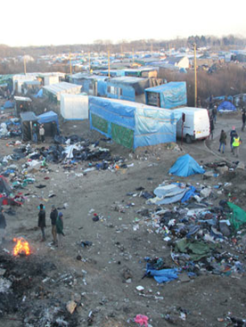
Refugee camps and environmental waste
https://www.youtube.com/watch?time_continue=206&v=84pT1uc690U&feature=emb_logo
Waste and debris left behind on shores of places such as Lesbos.
Make-shift camps made of cheap plastic tents.
No waste facilities.
Sudden on-set of large numbers of people moving to one place.
Karen Jacobsen’s work from 1997 is interesting on this – although an older piece – many of the issues are still relevant.

Slide 47
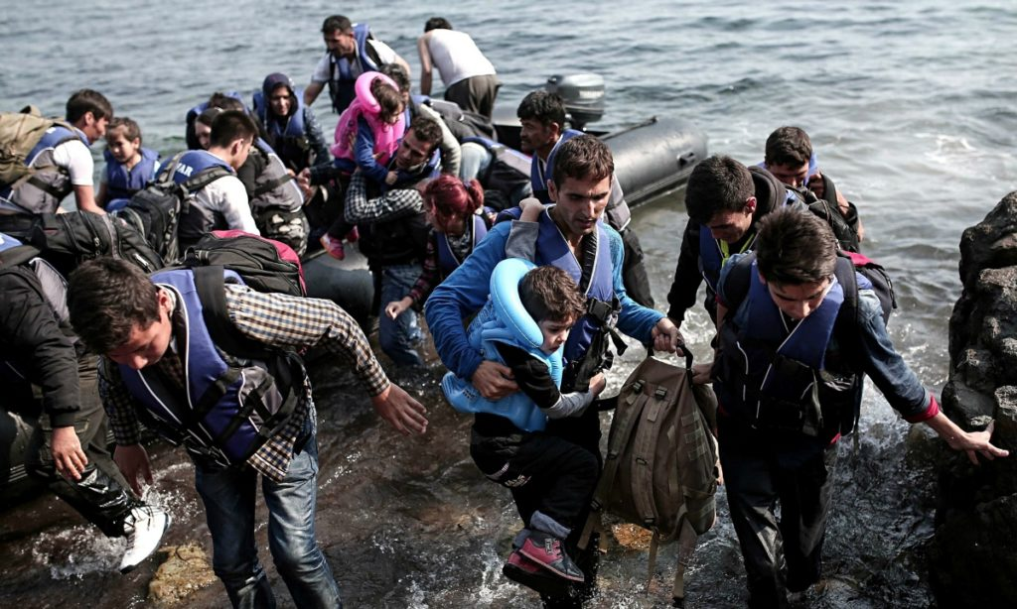
Lesvos (Lesbos) Refugee situation
Following the refugee and migration crisis in the Aegean Sea in 2015 where nearly 857,000 asylum seekers arrived in the Aegean islands by sea (UNCHR, 2018), two asylum seekers reception sites (commonly known as refugees’ camps) were constructed in Lesvos Island at the areas of Moria and Kara Tepe (Katsouli and Stasinakis 2019).
Managing the sewage, consumption waste and direct waste from the boats/life jackets/medical supplies needed to aid refugees on their arrival has caused environmental pressures for the island, alongside economic costs.
The government and local municipalities are working on approaches to prepare for and manage a large population density within the island.

Slide 48
Recap to the Livelihood Assets Model

Slide 49
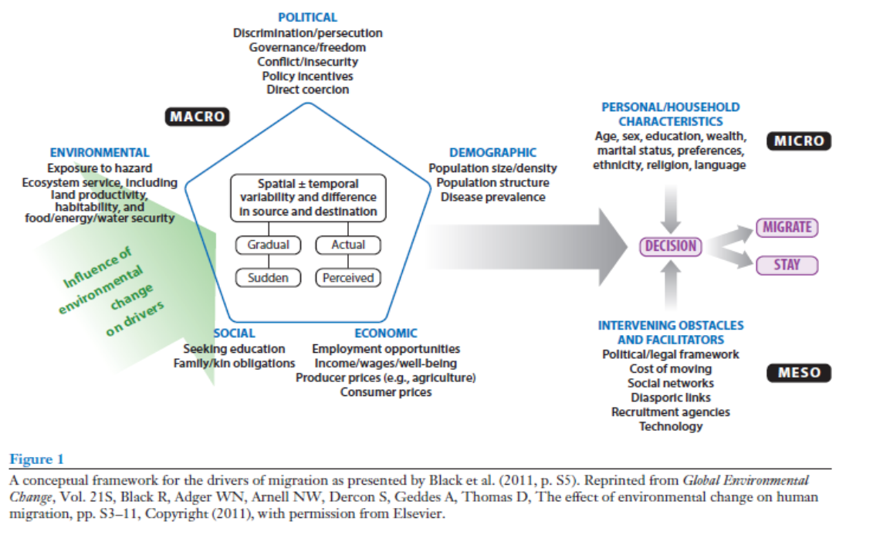

Slide 50
Case Studies Workshop (3 hours)
Choose 2 different case studies exploring the relationship between human activity and climate change, focusing specifically on migration and displacement. Your case studies can be from the ones discussed in class or one/two from your own research.
Create a PPT presentation lasting 15 minutes
Consider the relationship between human activity and a changing climate.
Consider the root causes and issues facing communities/governments and individuals prior to migration/displacement - use the Livelihood assets model to present your findings.
Identify the challenges facing communities/governments/individuals directly impacted.
Consider the wider implications of displacement/migration for the origin and destination countries.
Critically examine the further environmental impacts caused by displacement/migration.
Identify sustainable and feasible solutions or strategies to alleviate the impacts.

Slide 51
Conclusion
A key challenge facing our natural world and biodiversity is currently rapid population growth, rapid migration, urbanisation and inevitably consumption and industrialisation that emerges from that.
This can happen over a period and/or be recognised as a choice, i.e.: rural to urban migration for work opportunities, other times it can be displacement through dangerous and forced means.
The impact of such activities on marine life, coastal livelihoods, climate hazards and urban based issues like waste management and drainage can be catastrophic.
There are some positive and sustainable strategies emerging to tackle such issues such as sustainable drainage-based solutions, policy reforms and innovative technology.

Slide 52
Additional Reading
Andrews, N., Bennett, N. J., le Billon, P., Green, S. J., Cisneros-Montemayor, A. M., Amongin, S., Gray, N. J., & Sumaila, U. R. (2021). Oil, fisheries and coastal communities: A review of impacts on the environment, livelihoods, space and governance. In Energy Research and Social Science (Vol. 75). Elsevier Ltd. https://doi.org/10.1016/j.erss.2021.102009
Gimenez-Maranges, M., Breuste, J., & Hof, A. (2020). Sustainable Drainage Systems for transitioning to sustainable urban flood management in the European Union: A review. In Journal of Cleaner Production (Vol. 255). Elsevier Ltd. https://doi.org/10.1016/j.jclepro.2020.120191
Myers, N. (1997). Environmental Refugees. Population and Environment, 19(2), 167–182. https://www.jstor.org/stable/27503569
News in Focus, & Nature. (2023). Air Pollution in China is Falling...but there is a long way to go. In Springer Nature Limited. https://doi.org/j8k6;
Nuruzzaman, Md. (2015). Urban Heat Island: Causes, Effects and Mitigation Measures - A Review. International Journal of Environmental Monitoring and Analysis, 3(2), 67. https://doi.org/10.11648/j.ijema.20150302.15
Pfenning-Butterworth, A., Buckley, L. B., Drake, J. M., Farner, J. E., Farrell, M. J., Gehman, A. L. M., Mordecai, E. A., Stephens, P. R., Gittleman, J. L., & Davies, T. J. (2024). Interconnecting global threats: climate change, biodiversity loss, and infectious diseases. In The Lancet Planetary Health (Vol. 8, Issue 4, pp. e270–e283). Elsevier B.V. https://doi.org/10.1016/S2542-5196(24)00021-4

Slide 53
Additional Reading
Pope, D. H., McMullen, H., Baschieri, A., Philipose, A., Udeh, C., Diallo, J., & McCoy, D. (2022). What is the current evidence for the relationship between the climate and environmental crises and child marriage? A scoping review. In Global Public Health (Vol. 18, Issue 1). Taylor and Francis Ltd. https://doi.org/10.1080/17441692.2022.2095655
Rubinato, M., Nichols, A., Peng, Y., Zhang, J. min, Lashford, C., Cai, Y. peng, Lin, P. zhi, & Tait, S. (2019). Urban and river flooding: Comparison of flood risk management approaches in the UK and China and an assessment of future knowledge needs. Water Science and Engineering, 12(4), 274–283. https://doi.org/10.1016/j.wse.2019.12.004
Thompson, V., Mitchell, D., Hegerl, G. C., Collins, M., Leach, N. J., & Slingo, J. M. (2023). The most at-risk regions in the world for high-impact heatwaves. Nature Communications, 14(1). https://doi.org/10.1038/s41467-023-37554-1
Vousdoukas, M. I., Athanasiou, P., Giardino, A., Mentaschi, L., Stocchino, A., Kopp, R. E., Menéndez, P., Beck, M. W., Ranasinghe, R., & Feyen, L. (2023). Small Island Developing States under threat by rising seas even in a 1.5 °C warming world. Nature Sustainability, 6(12), 1552–1564. https://doi.org/10.1038/s41893-023-01230-5
Wyett, K. (2014). Escaping a Rising Tide: Sea Level Rise and Migration in Kiribati. Asia and the Pacific Policy Studies, 1(1), 171–185. https://doi.org/10.1002/app5.7

