Slide 1
CCP-LAW
Curricula development on Climate Change Policy and Law
Subject title: The Science of Climate Change: Mitigation and Adaptation
Instructor Name: Dr. Abhishek Gupta
Project No of Reference: 618874-EPP-1-2020-1-VN-EPPKA2-CBHE-JP:
The European Commission's support for the production of this publication does not constitute an endorsement of the contents, which reflect the views only of the authors, and the Commission cannot be held responsible for any use which may be made of the information contained therein.

Slide 2
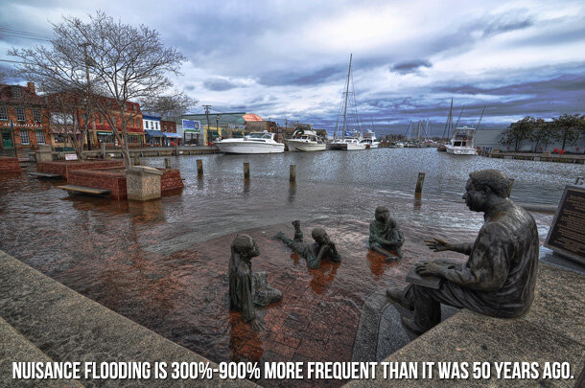
The Physical Basis of Climate Change

Slide 3
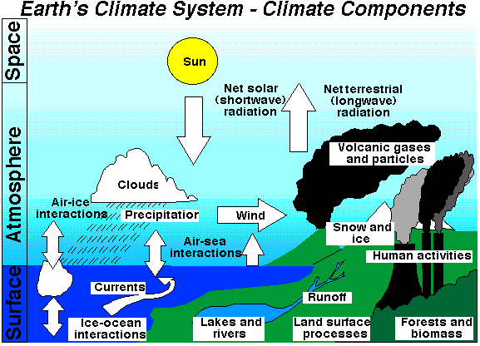
Introduction
Climate change refers to long-term alterations in temperature, precipitation, and other atmospheric conditions on Earth.
These changes are driven by both natural processes and human activities.
Understanding the physical basis of climate change involves examining how energy from the sun interacts with the Earth’s atmosphere, land, and oceans, and how this balance is affected by various factors.

Slide 4
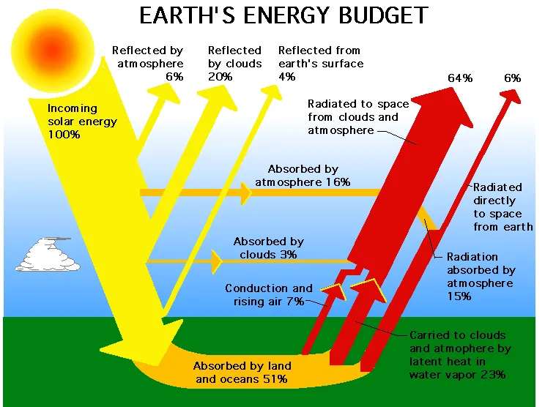
Earth’s Energy Budget

Slide 5
Earth’s Energy Budget
The Earth's climate system is driven by energy from the sun.
About 30% of the incoming solar radiation is reflected back into space by clouds, atmospheric particles, and bright ground surfaces like ice and snow.
The remaining 70% is absorbed by the Earth’s surface and atmosphere, warming the planet.
The absorbed energy is then re-emitted as infrared radiation (heat).
Greenhouse gases (GHGs) like CO₂, CH₄, N₂O, and water vapor absorb and re-radiate some of this infrared radiation back towards the Earth's surface, effectively trapping heat.

Slide 6
Key Greenhouse Gases
Carbon Dioxide (CO₂): Released by burning fossil fuels and deforestation; has increased by more than 40% since the industrial revolution.
Methane (CH₄): Emitted from livestock, rice cultivation, landfills, and fossil fuel extraction; has a higher global warming potential than CO₂.
Nitrous Oxide (N₂O): Emitted from agricultural and industrial activities; significant warming effect and contributes to ozone layer depletion.
Water vapor (H₂O): It is the most abundant greenhouse gas in the atmosphere, not directly controlled by human activities.
Ozone (O₃): It is found in the upper atmosphere (stratospheric ozone) and near the Earth's surface (tropospheric ozone). In the troposphere, it is a pollutant and a potent greenhouse gas.

Slide 7
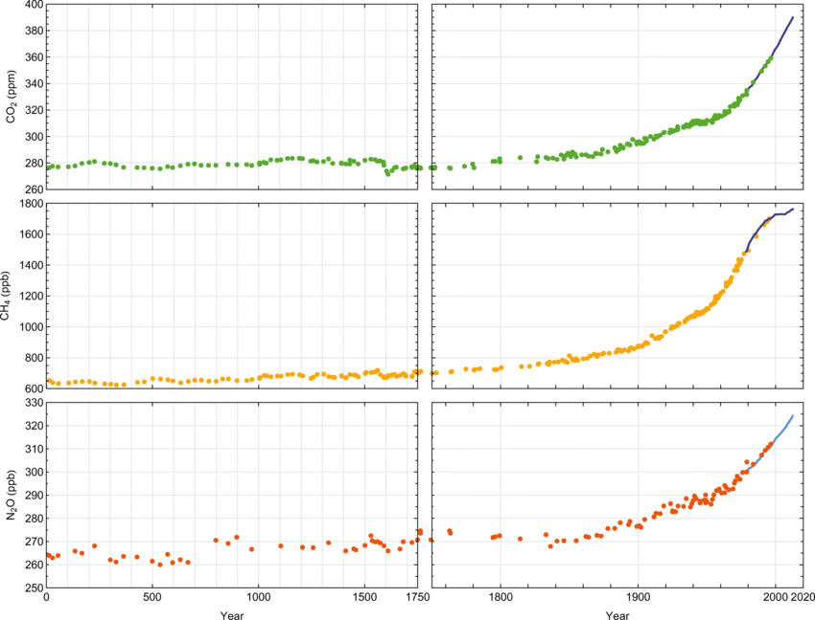
Source: https://link.springer.com/article/10.1007/s11356-020-10091-w

Slide 8
Radiative Forcing
Radiative forcing is a measure of the influence of a particular factor on the energy balance of the Earth’s atmosphere system.
Radiative forcing is typically measured in watts per square meter (W/m²).
Positive Radiative Forcing: Leads to warming (e.g., increased GHG concentrations).
Negative Radiative Forcing: Leads to cooling (e.g., aerosols reflecting sunlight).
Drivers: Main drivers include greenhouse gases (e.g., CO₂, CH₄), aerosols (e.g., sulfates, black carbon), and changes in solar radiation.
Examples:
Increased emissions lead to higher CO₂ concentrations, which exert positive radiative forcing.
Aerosols can have both positive and negative effects depending on their composition & location.

Slide 9
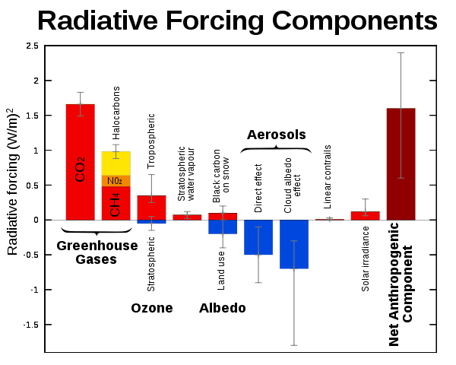

Slide 10
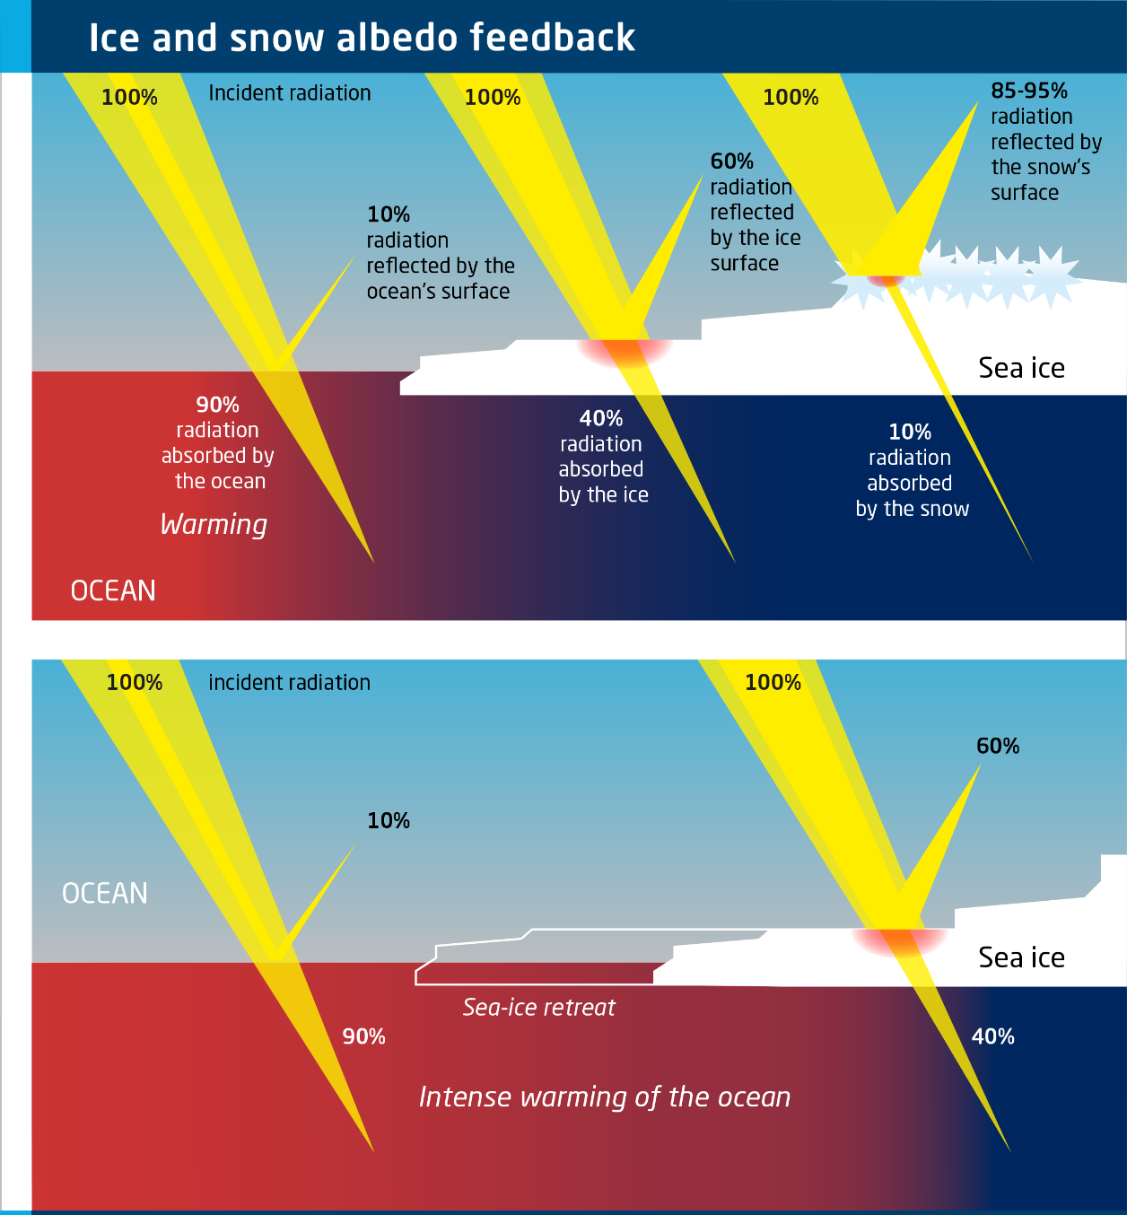
Feedback Mechanisms
Water Vapor Feedback: Rising temperatures increase evaporation, leading to more water vapor in the atmosphere and further warming.
Ice-Albedo Feedback: Melting ice reduces reflectivity, leading to more absorbed heat and further ice melt.
Cloud Feedback: Clouds can cool the Earth by reflecting sunlight or warm it by trapping heat; changes in cloud cover can have complex effects.

Slide 11
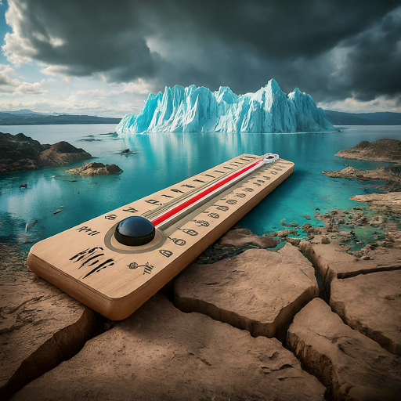
Observed Changes and Evidence
Temperature Increase: Global average surface temperatures have risen by about 1.2°C since the late 19th century.
Melting Ice and Snow: Glaciers and ice sheets are losing mass, contributing to sea level rise; Arctic sea ice extent has declined.
Sea Level Rise: Global sea levels have risen by about 20 cm over the past century due to thermal expansion and meltwater.
Changes in Weather Patterns: Increased frequency and intensity of extreme weather events like heatwaves, heavy rainfall, and hurricanes.

Slide 12
Mitigation Strategies
Reducing Greenhouse Gas Emissions: Transitioning to renewable energy sources, improving energy efficiency, and adopting sustainable land-use practices.
Carbon Sequestration: Enhancing natural carbon sinks (forests, wetlands) and developing carbon capture and storage technologies.
Policy Measures: Implementing international agreements (e.g., Paris Agreement), carbon pricing, and regulatory frameworks.
Individual action: Reduce your carbon footprint through energy-saving habits, sustainable consumption, and supporting climate-friendly businesses.
Invest in innovation: Develop carbon capture and storage technologies and fund research on clean technologies.

Slide 13
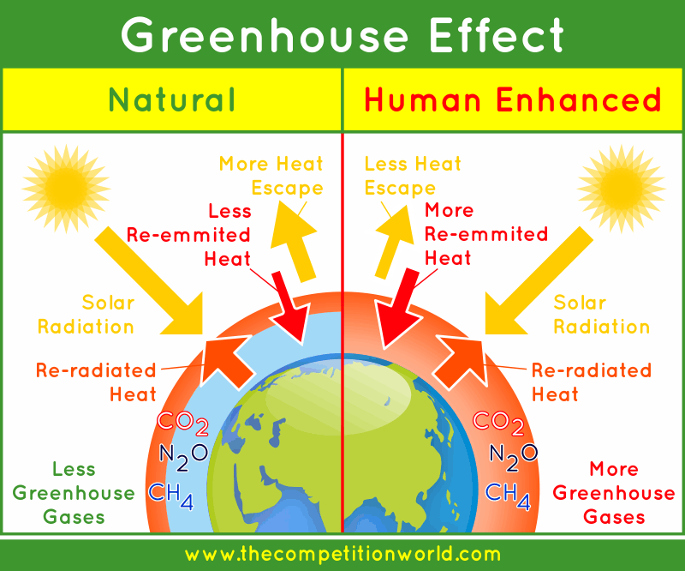
Greenhouse Effect and Enhanced Greenhouse Effect
Understanding Earth's Climate System

Slide 14
Understanding the Natural Greenhouse Effect
The greenhouse effect is a natural process that warms the Earth’s surface.
When the sun’s energy reaches the Earth, some of it is reflected back to space, and the rest is absorbed, warming the planet.
The Earth then emits this energy as infrared radiation.
Greenhouse gases in the atmosphere absorb and re-radiate this infrared radiation, trapping heat and keeping the Earth's surface warmer than it would be otherwise.
Key Points:
Essential for Life: Maintains an average surface temperature of about 15°C (59°F).
Without It: The Earth's average surface temperature would be about -18°C (0°F)

Slide 15
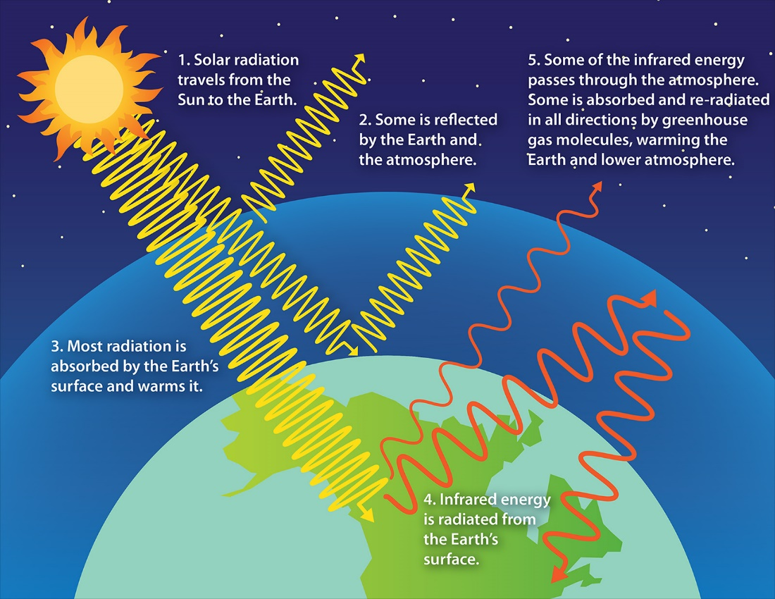

Slide 17
Key Greenhouse Gases
Water Vapor (H₂O): The most abundant greenhouse gas, which increases as the Earth's atmosphere warms.
Carbon Dioxide (CO₂): Released through natural processes such as respiration and volcano eruptions, and through human activities like deforestation and burning fossil fuels.
Methane (CH₄): Emitted during the production and transport of coal, oil, and natural gas, and by livestock and other agricultural practices.
Nitrous Oxide (N₂O): Released from agricultural and industrial activities, as well as during combustion of fossil fuels and solid waste.
Key Points:
Water Vapor: Amplifies the greenhouse effect because it increases as the atmosphere warms, but does not drive climate change on its own.
CO₂, CH₄, and N₂O: Have long-term effects and contribute significantly to the warming process.

Slide 18
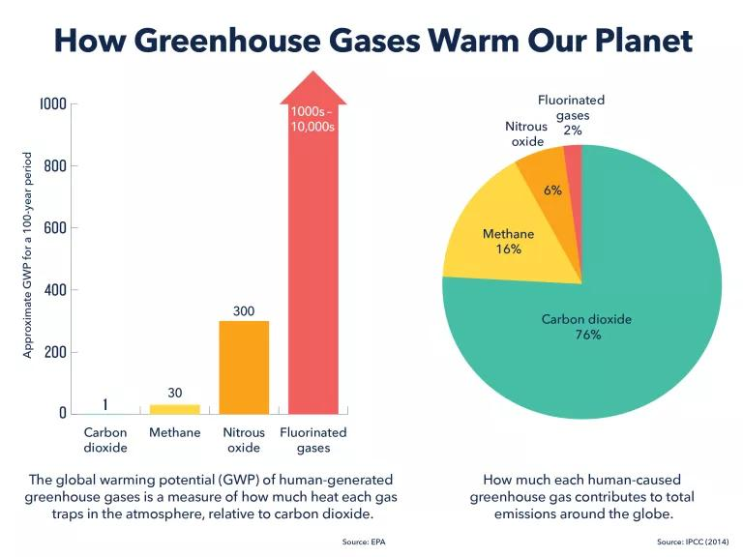

Slide 19
Enhanced Greenhouse Effect
The enhanced greenhouse effect refers to the additional warming caused by increased concentrations of greenhouse gases in the atmosphere due to human activities.
Activities such as burning fossil fuels, deforestation, and industrial processes increase the levels of greenhouse gases, amplifying the natural greenhouse effect.
This enhanced effect leads to global warming and significant changes in climate patterns.
The enhanced greenhouse effect refers to the additional warming caused by increased greenhouse gas concentrations, amplifying the natural greenhouse effect and leading to higher global temperatures.

Slide 20
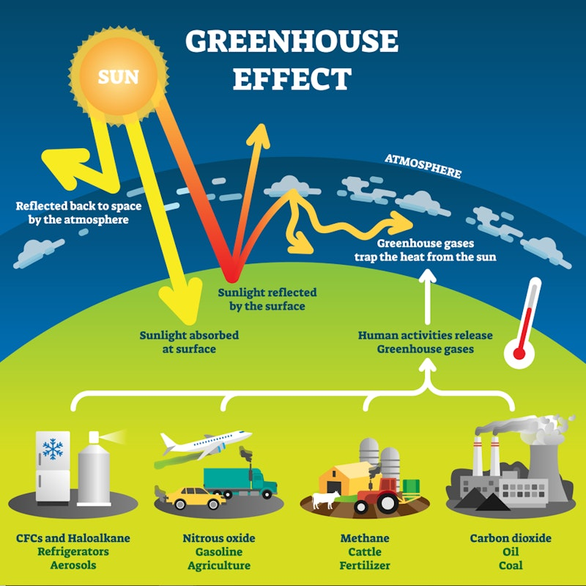

Slide 21
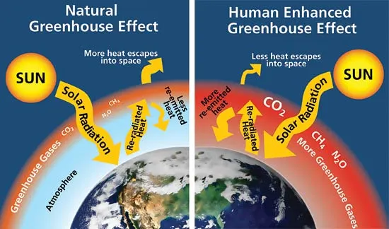

Slide 22
Major Human Contributions
Carbon Dioxide (CO₂): Primarily from burning fossil fuels (coal, oil, natural gas) and deforestation.
Methane (CH₄): Emitted during the production and transport of coal, oil, and natural gas, as well as from livestock and other agricultural practices.
Nitrous Oxide (N₂O): Released from agricultural and industrial activities, as well as combustion of fossil fuels and solid waste.
Fluorinated Gases: Synthetic gases used in various industrial applications.

Slide 23
Impacts
Global Temperature Rise: The enhanced greenhouse effect has led to an increase in global average surface temperatures by about 1.2°C since the late 19th century, contributing to global warming.
Ice Melt and Sea Level Rise: Melting glaciers and polar ice caps due to increased temperatures contribute to rising sea levels. Sea levels have risen by about 20 cm over the past century, impacting coastal regions.
Extreme Weather Events: There has been an increased frequency and intensity of extreme weather events such as heatwaves, heavy rainfall, hurricanes, and droughts, attributed to the enhanced greenhouse effect.
Ocean Acidification: Increased CO₂ levels are absorbed by the oceans, leading to ocean acidification, which negatively affects marine ecosystems and species.

Slide 24
Impacts
Impact on Ecosystems and Biodiversity: Climate change driven by the enhanced greenhouse effect disrupts ecosystems, leading to shifts in species distribution, altered migration patterns, and loss of biodiversity.
Human Health and Socioeconomic Impacts: The enhanced greenhouse effect has direct and indirect impacts on human health, including increased heat-related illnesses, respiratory issues due to poor air quality, and increased incidence of vector-borne diseases. Socioeconomic impacts include damage to infrastructure, agricultural losses, and displacement of populations.

Slide 25
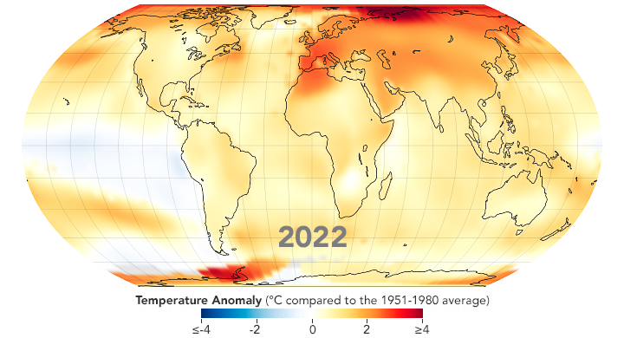
Climate Forcing and Drivers
Understanding Natural and Human influences on Climate

Slide 26
Introduction
Climate forcing refers to the various factors that influence the Earth's climate system.
These factors, known as climate drivers, can originate from both natural processes and human activities.
Understanding these drivers and their impacts is crucial for comprehending past, present, and future climate changes.
Key Points:
Climate Forcing: A measure of the influence a factor has in altering the balance of incoming and outgoing energy in the Earth-atmosphere system.
Climate Drivers: Natural or human-induced factors that cause changes in the Earth's climate.
Importance: Grasping these concepts is essential for predicting climate trends and developing strategies for mitigation and adaptation.

Slide 27
What is Climate Forcing?
Climate forcing is a measure of the influence a factor has in altering the balance of incoming and outgoing energy in the Earth-atmosphere system.
It is typically measured in watts per square meter (W/m²).
There are two types of climate forcing:
Positive Forcing: Leads to warming by increasing the amount of energy retained in the Earth’s system.
Negative Forcing: Leads to cooling by increasing the amount of energy lost from the Earth’s system.
Understanding the concept of climate forcing helps us quantify the impact of different factors on global climate change and predict future climate scenarios.

Slide 28
Natural Climate Drivers
Natural climate drivers are factors that originate from natural processes, influencing the Earth's climate over geological timescales.
These drivers include variations in solar radiation, volcanic activity, and natural greenhouse gas concentrations.
Key Points:
1 Solar Radiation:
Variability in Solar Output: The sun’s energy output fluctuates due to solar activity, including sunspots and solar flares, impacting the amount of solar energy reaching Earth.
Milankovitch Cycles: Long-term changes in Earth's orbit and tilt affect the distribution and intensity of solar radiation, contributing to cycles of ice ages and warmer periods.

Slide 29
Natural Climate Drivers

Slide 30
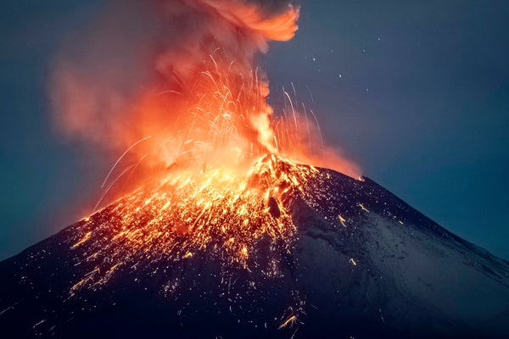
Natural Climate Drivers
2 Volcanic Activity:
Aerosols and Dust: Volcanic eruptions release aerosols and sulfur dioxide into the stratosphere, which can reflect sunlight and cause temporary cooling.
Greenhouse Gases: Volcanoes emit carbon dioxide (CO₂), a greenhouse gas, but in much smaller quantities compared to human activities.

Slide 31
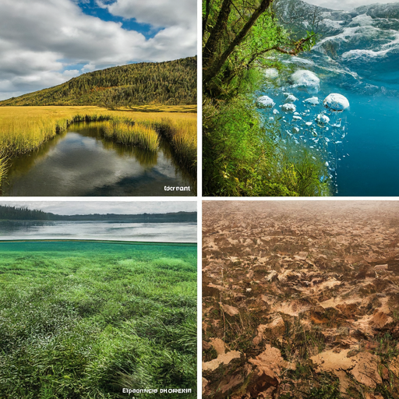
Natural Climate Drivers
3. Natural Greenhouse Gas Concentrations:
Carbon Dioxide (CO₂): Naturally released from oceans, soil, and respiration.
Methane (CH₄): Produced by natural wetlands, termites, and geological sources.
Nitrous Oxide (N₂O): Released from soils and oceans.

Slide 32
Human-Caused Climate Drivers
Human activities, primarily since the Industrial Revolution, have significantly impacted the Earth’s climate.
These activities introduce various climate drivers that contribute to global warming and climate change.
1. Greenhouse Gas Emissions:
Carbon Dioxide (CO₂): The primary driver of recent climate change, mainly from burning fossil fuels (coal, oil, and natural gas) and deforestation.
Methane (CH₄): Emitted from livestock digestion, rice paddies, landfills, and fossil fuel extraction.
Nitrous Oxide (N₂O): Released from agricultural activities, particularly the use of synthetic fertilizers.
Impact: CO₂ levels have risen from about 280 ppm (pre-industrial) to over 415 ppm today. Methane and nitrous oxide concentrations have also increased significantly due to human activities.

Slide 33
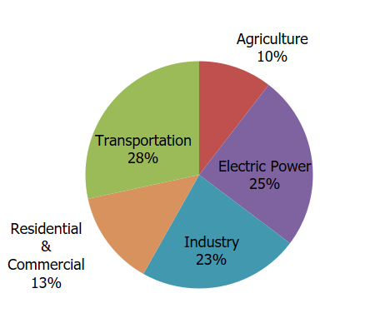
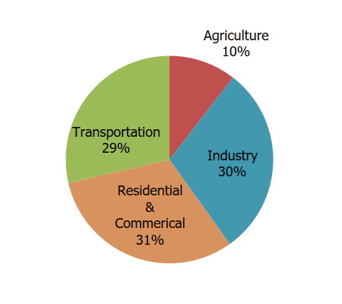
Total U.S. Greenhouse Gas Emissions by Economic Sector in 2022
Total U.S. Greenhouse Gas Emissions by Economic Sector
Total U.S. Greenhouse Gas Emissions by Economic Sector Including Electricity End-Use Indirect Emissions
Source: USEPA - https://www.epa.gov/ghgemissions/sources-greenhouse-gas-emissions

Slide 34
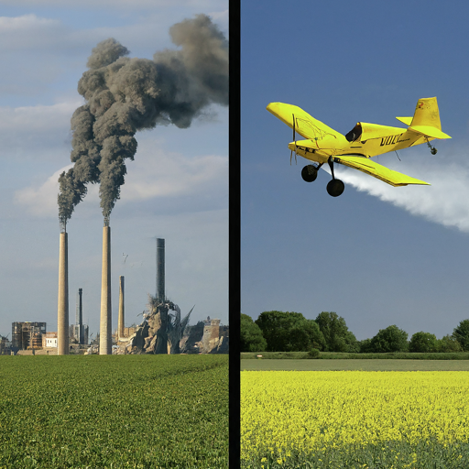
Human-Caused Climate Drivers
2. Aerosols and Particulates:
Sulfur Dioxide (SO₂): Emitted from burning fossil fuels and industrial processes, leading to sulfate aerosols that reflect sunlight and cool the atmosphere.
Black Carbon: Soot particles from incomplete combustion of fossil fuels and biomass, which can absorb sunlight and warm the atmosphere.
Impact: Aerosols can have both cooling (e.g., sulfates) and warming (e.g., black carbon) effects on the climate. The net effect of aerosols is complex and varies regionally and temporally.

Slide 35
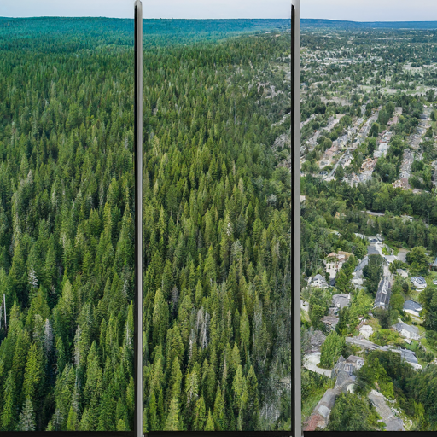
Human-Caused Climate Drivers
3. Land Use Changes:
Deforestation: Reduces the Earth's capacity to absorb CO₂ and changes the surface albedo, leading to warming.
Urbanization: Alters local climates through the urban heat island effect, where cities are warmer than surrounding rural areas due to human activities and infrastructure.
Impact: Deforestation and urbanization contribute to global and regional climate changes. Restoration of forests and sustainable land management practices can help mitigate climate change.

Slide 36
Summary Table
Climate Driver | Source | Impact on Climate | Key Points
Solar Radiation | Variability in solar output and Milankovitch cycles | Changes in the amount of solar energy reaching Earth, leading to warming or cooling | Solar variability can cause climate periods like the Medieval Warm Period and the Little Ice Age. Milankovitch cycles influence ice age cycles over geological timescales.
Volcanic Activity | Eruptions releasing aerosols and gases | Temporary cooling due to aerosols reflecting sunlight; minor warming from emitted CO₂ | Major eruptions like Mount Tambora can cause significant short-term climate anomalies.
Natural Greenhouse Gas Concentrations | Oceans, soils, wetlands, geological sources | Contribute to natural greenhouse effect, maintaining Earth's temperature | Natural processes release CO₂, CH₄, and N₂O, but at much lower rates compared to human activities.

Slide 37
Summary Table
Climate Driver | Source | Impact on Climate | Key Points
Greenhouse Gas Emissions | Fossil fuel burning, deforestation, agriculture | Significant warming due to increased CO₂, CH₄, and N₂O concentrations | CO₂ levels have risen from 280 ppm to over 415 ppm since the pre-industrial era. Methane and nitrous oxide levels have also increased due to human activities.
Aerosols and Particulates | Fossil fuel combustion, industrial processes | Cooling from sulfates reflecting sunlight; warming from black carbon absorbing sunlight | The net effect of aerosols is complex, with both cooling and warming effects, varying regionally and temporally.
Land Use Changes | Deforestation, urbanization | Warming from reduced CO₂ absorption and altered surface albedo; urban heat island effect | Sustainable land management and reforestation can mitigate climate change. Urban areas are typically warmer than rural areas due to human activities and infrastructure.

Slide 38
Thank You

