Slide 1
CCP-LAW
Curricula development on Climate Change Policy and Law
Subject title: Climate Change Policy
Instructor Name: Dr. Rahul Nikam
Project No of Reference: 618874-EPP-1-2020-1-VN-EPPKA2-CBHE-JP:
The European Commission's support for the production of this publication does not constitute an endorsement of the contents, which reflect the views only of the authors, and the Commission cannot be held responsible for any use which may be made of the information contained therein.

Slide 2
The Geopolitics of Decarbonization
How curbing reliance on fossil fuels will change the world
Political instability in oil-dependent states
U.S. disengagement from the Middle East.
It is certain that decarbonization- whenever it happens- will have a profound impact on world politics, in predictable and unpredictable ways.
A US- China Cold War effect.

Slide 3
The Geopolitics of Decarbonization
How curbing reliance on fossil fuels will change the world
Political instability in oil-dependent states
U.S. disengagement from the Middle East.
It is certain that decarbonization- whenever it happens- will have a profound impact on world politics, in predictable and unpredictable ways.
A US- China Cold War effect.
Small States and Climate Change: The Case of Qatar
The development of clean energy technology, Scaling-up low-carbon metals, ogis etc.
Qatari approach- need to reconcile multiple priorities from economic growth to environmental management to human and social development.

Slide 4
The Geopolitics of Decarbonization
Education and adaptation
The Geopolitics of Decarbonization: the Russian Case
More inventory than customers
The green recovery
Going down with the ships?
International community need to encourage a smooth energy transition for fuel resource rich economies like Russia’s.
The New Geopolitics of a decarbonizing World
A new type of transition i.e. energy replacement & not merely an energy addition, climate protection- driven transitions needs to occur significantly faster than previous transitions

Slide 5
The Geopolitics of Decarbonization
Geopolitics of fossil fuels in the modern world: what role does energy play today?
Money
Power
Relationships
What impacts will decarbonization have in these areas?
Relatively prepared
Facing risks and opportunities
Fragile

Slide 6
The Geopolitics of Decarbonization
How can we make the transition less bumpy?
Climate and energy policies
Trade and investment
Science and education
Finance and development
Security and peace
Unlike pandemic that strike suddenly, though, with decarbonization it is relatively easy to predict which exposed sectors in which fragile countries will fall into disarray.
Further reading

Slide 7
Migration & Displacement
Displacement and out-Migration: the Marshall Islands Experience
Our Giant, Distant Neighbour- USA
A framework for Mobility
Climate, Health and Safety
A climate Crisis and a World on he Move: Implications for Migration Management
Better climate Migration Management will help states weather the storm
Moving beyond a fear of more migration

Slide 8
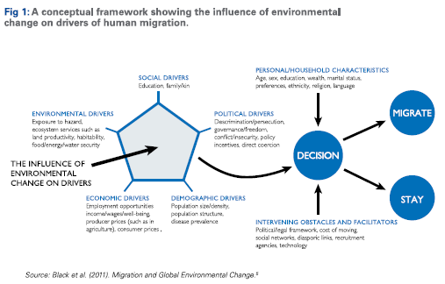
Migration & Displacement
Reorienting perceptions of climate change, migration & displacement

Slide 9
Migration & Displacement
Relevant Laws & governance Gaps
Informing more effective diplomatic responses
Explore state to state engagement
Loosen the security frame and expand the toolbox
Climate –induced displacement: South Asia’s Clear and Present Danger
Acute climate change vulnerability
Manifestations of climate induced migration
National responses

Slide 10
Migration & Displacement
Policy recommendations
Promote more livelihood opportunities in non-agricultural sectors
Empower non-federal authorities to better tackle climate induced displacement risks
Host and sponsor dialogues and other exchanges to generate grater regional cooperation, so that south Asian stats can jointly combat the shared and transactional threats of climate change and climate induced displacement.
Washington should integrate climate change mitigation assistance into Indo-Pacific strategy, the administration main Asia policy.
Further reading

Slide 11
Further Reading
21st Century Diplomacy: Foreign Policy is Climate Policy Full Report https://www.wilsoncenter.org/publication/21st-century-diplomacy-foreign-policy-climate-policy-full-report

