Slide 1
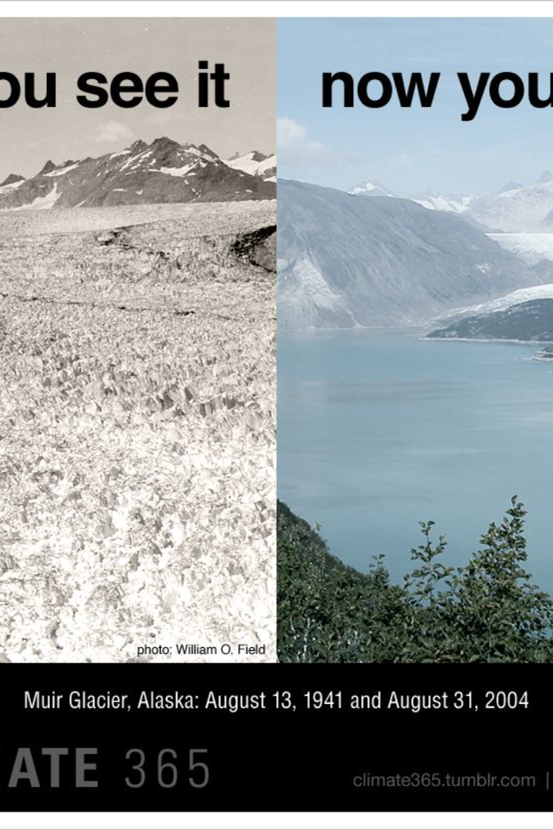
International Agreements and The Urgency of Climate Action
Over the past decades, the global community has recognized the pressing need to address climate change. With agreements like the Kyoto Protocol and the Paris Agreement, nations have pledged to reduce greenhouse gas emissions. Yet, the carbon dioxide levels continue to climb, leading to an alarming rate of Earth's warming. The consequences are dire, with potential environmental catastrophes including sea-level rise, extreme weather events, and loss of biodiversity. The world's response through international diplomacy and commitments reflects the urgency and complexity of the challenge ahead.

Slide 2
International Climate Agreements
1
Montreal Protocol, 1987
Set to protect the ozone layer, the Montreal Protocol successfully phased out 99% of ozone-depleting substances and later addressed HFCs, potent greenhouse gases.
2
UNFCCC, 1992
The first global treaty to address climate change, establishing the COP for annual discussions and leading to the Kyoto Protocol and Paris Agreement.
3
Kyoto Protocol, 2005
The first legally binding climate treaty, requiring developed countries to reduce emissions, but lacking commitments from developing nations.
4
Paris Agreement, 2015
The most significant climate agreement, requiring all countries to set emissions-reduction pledges with the goal of limiting global temperature rise.

Slide 3
Climate Diplomacy and the Paris Agreement
Strengthened Commitments
Concerns Over Absence
Global Participation
Every country has ratified the Montreal Protocol, showcasing a unified approach to environmental diplomacy.
Since the Paris accord in 2015, countries have enhanced their climate commitments, including emissions curbs and adaptation support.
The absence of key leaders from COP28 raises concerns about the commitment of the largest emitters to future climate goals.

Slide 4
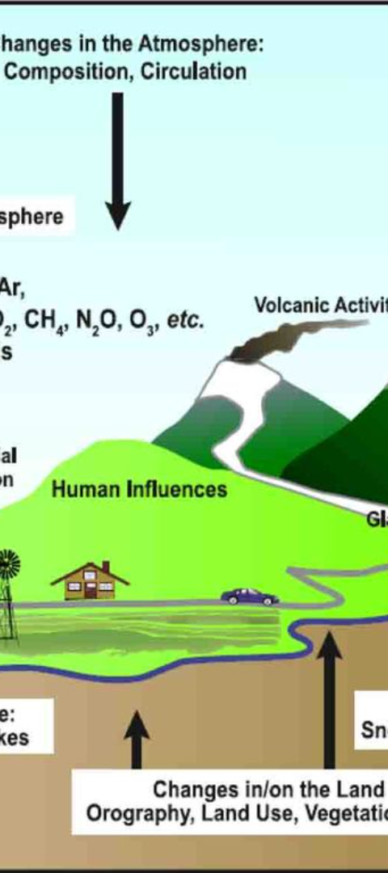
Understanding Climate Change Science
1
Rapid Warming
2
Human Influence
The Earth's average temperature is rising faster than at any point in the last 800,000 years due to human activities.
Activities like burning fossil fuels and deforestation have significantly increased greenhouse gases, causing warming.
3
Scientific Consensus
There is broad agreement among scientists on the basic facts of climate change, despite some political denial.

Slide 5
Why Limit Global Warming to 1.5°C?
Heat Waves
Droughts and Floods
Increased hot days leading to severe heat exposure for 14% of the global population every five years.
Greater susceptibility to extreme weather events, impacting agriculture and causing food shortages.
Rising Seas
Species Loss
Millions in coastal regions at risk, with small island nations facing significant threats.
Risk of extinction for more insects, plants, and vertebrates due to changing climates.

Slide 6
Responsibility for Climate Change
Historical Emissions
Current Top Emitters
Emissions Debate
Developed countries, led by the United States and the EU, have historically emitted more greenhouse gases.
China and India, along with the United States, are now the world's top annual emitters.
Climate talks have long debated the responsibility of developed versus developing countries in addressing climate change.

Slide 7
Progress Since the Paris Agreement
Global Stocktake
Loss and Damage Fund
Methane Emissions
The first report in 2023 warns that the world is not on track to meet the Paris Agreement's long-term goals.
Global efforts to cut methane emissions, including pledges by oil companies and international monitoring.
Established at COP27 to assist poorer countries most vulnerable to climate disasters.

Slide 8
Are Paris Agreement Commitments Sufficient?
2.7°C
50%
55%
Projected Rise
US Pledge
EU Pledge
Current policies may lead to a 2.7°C rise by 2100, exceeding the 1.5°C target.
President Biden's commitment to cut emissions by 50% compared to 2005 levels by 2030.
The EU's pledge to reduce emissions by at least 55% compared to 1990 levels by 2030.

Slide 9
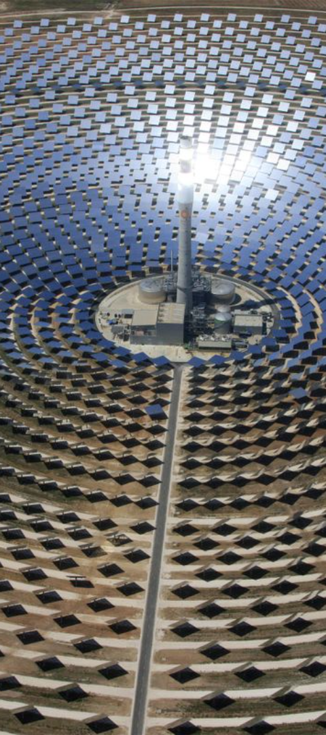
Alternatives to the Paris Agreement
1
Universal Carbon Price
2
Sector-Specific Agreements
Economists suggest negotiating a universal carbon price rather than focusing on emissions limits.
New agreements targeting specific emissions or sectors could complement the Paris Accord.
3
Local Initiatives
Cities and local governments worldwide are setting their own climate action plans with emissions-reduction targets.

Slide 10
Industry's Role in Climate Action
Corporate Pledges
Science Based Targets
Challenges Ahead
Many firms aim to reduce emissions or become carbon neutral, with some facing potential reporting requirements.
Questions remain over accounting methods and transparency in supply chains for corporate emissions.
Over three thousand firms have certified net-zero plans, with aims to increase this number significantly by 2025.

Slide 11
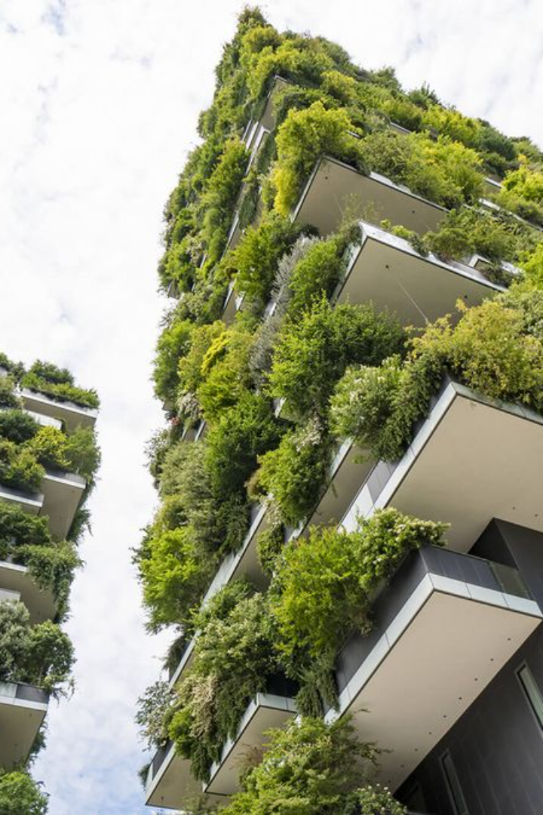
Government's Crucial Role in Climate Policy
Despite various efforts from different sectors, the role of policymakers remains paramount in setting and enforcing climate targets. Governments around the world are the most influential actors in the fight against climate change, with the power to implement forceful policies that can drive significant progress. The actions of national leaders, the legislation they pass, and the international agreements they forge are critical in shaping a sustainable future.

Slide 12
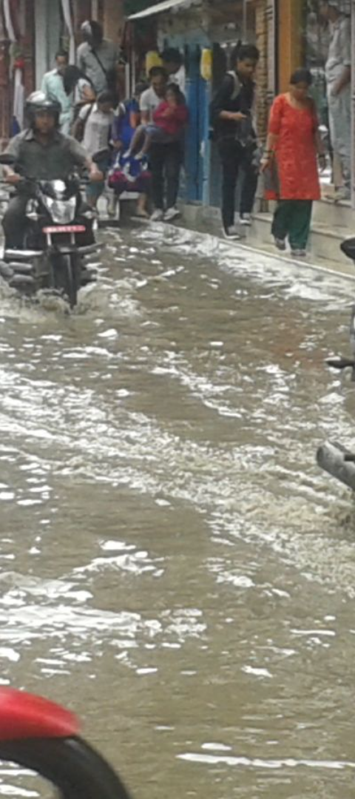
Climate Change and Extreme Weather
1
Heatwaves Intensify
Increasing frequency and severity of heatwaves pose health risks and strain resources.
2
Unprecedented Droughts
Extended periods of drought affect water supply, agriculture, and ecosystems.
3
Devastating Floods
Intense rainfall leads to floods, causing widespread damage and displacement.

Slide 13
Adapting to Rising Sea Levels
Coastal Defenses
Managed Retreat
Resilient Infrastructure
Building barriers and sea walls to protect against encroaching waters.
Relocating communities and infrastructure away from vulnerable coastal areas.
Designing buildings and cities to withstand higher sea levels and storm surges.

Slide 14
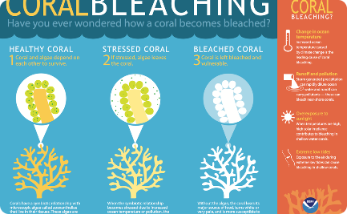
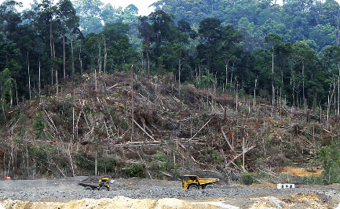
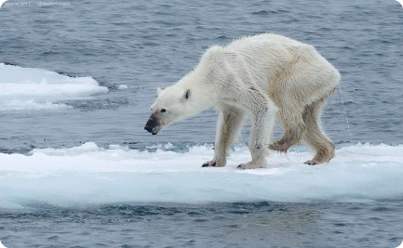
Climate Change and Biodiversity Loss
Coral Reefs at Risk
Deforestation Impact
Arctic Species Threatened
Ocean acidification and warming waters threaten the survival of coral reefs.
Habitat destruction from deforestation accelerates species extinction.
Melting ice and changing ecosystems put Arctic wildlife in peril.

Slide 15
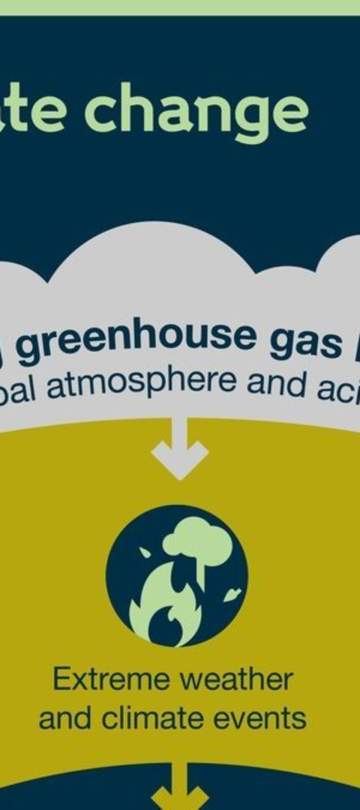
Climate Change and Human Health
Heat-Related Illnesses
Increased temperatures contribute to heat strokes and cardiovascular problems.
Respiratory Diseases
Poor air quality from wildfires and pollution exacerbates respiratory conditions.
Vector-Borne Diseases
Climate change expands the range of disease-carrying insects, increasing infection risks.

Slide 16
Climate Change and Global Inequality
Disproportionate Effects
Financial Assistance
Pressure on High Emitters
The Loss and Damage Fund aims to address the inequality by supporting affected countries.
Poorer nations face the brunt of climate impacts despite contributing less to emissions.
Contributions from wealthy nations may encourage other high-emitting countries to act.

Slide 17
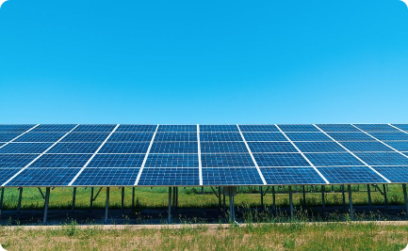
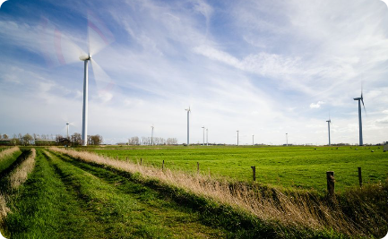
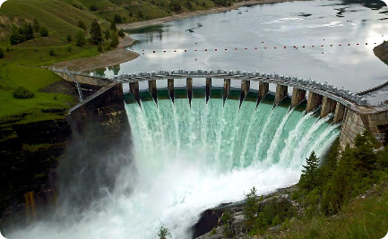
Renewable Energy and Climate Solutions
Solar Power
Wind Energy
Hydropower
Investment in solar energy as a clean alternative to fossil fuels.
Expanding wind farms to harness natural wind power for electricity.
Utilizing water flow to generate renewable energy with minimal emissions.

Slide 18
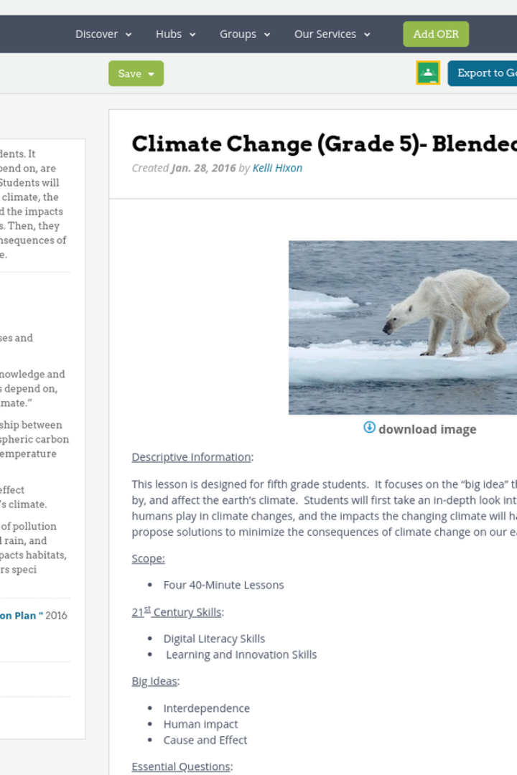
Climate Change Education
Education plays a vital role in understanding and addressing climate change. By learning about the causes, impacts, and solutions, individuals and communities can become empowered to take action. Educational initiatives, such as those provided by CFR Education, help to disseminate knowledge and foster a generation of informed citizens and leaders ready to tackle the climate crisis.

Slide 19
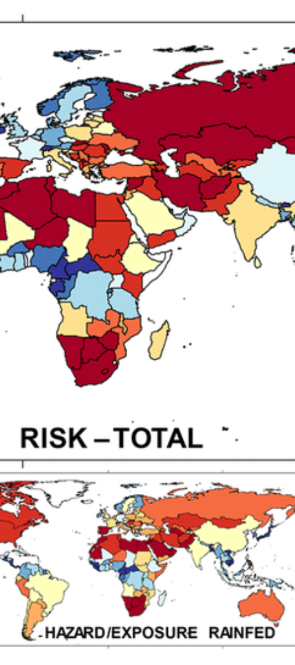
Climate Change and Agriculture
Water Scarcity
Changes in precipitation patterns affect water availability for irrigation.
Crop Yields
Extreme temperatures and weather events can lead to reduced agricultural productivity.
Food Security
Climate change poses a threat to global food supplies and nutrition.

Slide 20
Climate Change and the Economy
Cost of Disasters
Green Jobs
Economic losses from climate-related disasters are escalating.
The transition to a low-carbon economy is creating new employment opportunities.
Loading...
Investment Shifts
Financial markets are increasingly considering climate risks and sustainable investments.

Slide 21
Climate Change and Urban Planning
Green Spaces
Public Transport
Sustainable Buildings
Incorporating parks and green areas to improve city resilience and air quality.
Developing efficient public transportation systems to reduce emissions.
Designing energy-efficient buildings to lower the urban carbon footprint.

Slide 22
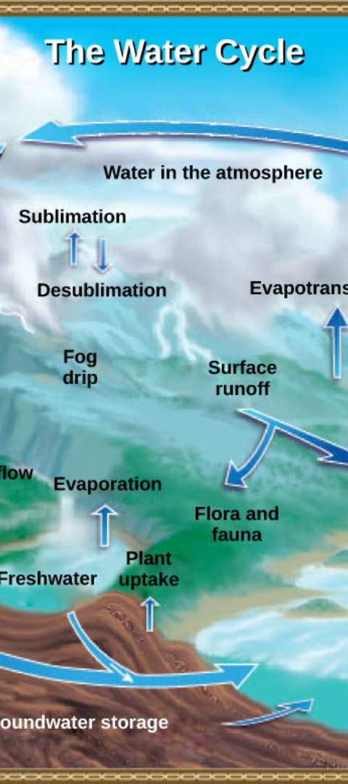
Climate Change and Water Resources
1
Glacial Melt
Accelerated melting of glaciers threatens freshwater supplies.
2
Sea Water Intrusion
Rising sea levels lead to saltwater contaminating freshwater aquifers.
3
Water Management
Adapting water management practices to ensure sustainability and access.

Slide 23
Climate Change and Energy Consumption
80%
2050
2030
Renewable Goal
Aviation Target
Methane Reduction
G20 aims to triple renewable energy capacity by the end of the decade.
Commercial aviation's goal of achieving net-zero emissions by 2050.
The Global Methane Pledge aims to cut methane emissions by 30% from 2020 levels by 2030.

Slide 24
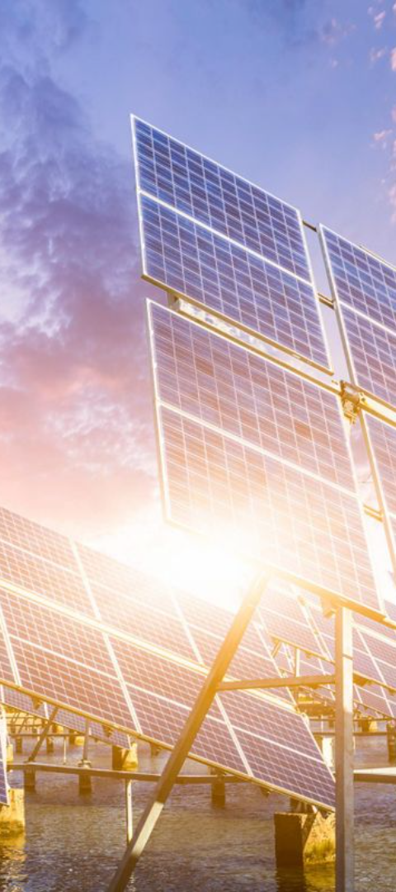
Climate Change and Technological Innovation
1
Carbon Capture
2
Energy Storage
Advancements in carbon capture and storage technology to reduce atmospheric CO2.
Developing better batteries and storage solutions for renewable energy.
3
Smart Grids
Implementing smart grids to optimize energy distribution and usage.

