Slide 1
CCP-LAW
Curricula development on Climate Change Policy and Law
Subject title: Climate Change Policy
Instructor Name: Dr. Rahul Nikam
Project No of Reference: 618874-EPP-1-2020-1-VN-EPPKA2-CBHE-JP:
The European Commission's support for the production of this publication does not constitute an endorsement of the contents, which reflect the views only of the authors, and the Commission cannot be held responsible for any use which may be made of the information contained therein.

Slide 2
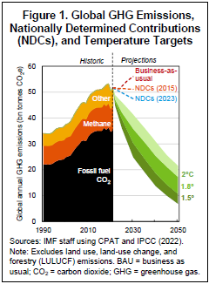
Climate Policy Assessment Tool
Background
Stabilizing the global climate requires rapid cuts in greenhouse gas (GHG) emissions this decade (Figure 1)
However, the world is not yet on track to ‘net zero’: major gaps in climate mitigation ambition and implementation persist.
Policy reforms are urgently needed across all countries to narrow climate mitigation ambition and implementation gaps.
What is holding back policymakers from implementing needed policies? Many government departments lack knowledge about climate policies and their impacts. These knowledge gaps, in turn, contribute to climate policy implementation gaps

Slide 3
Climate Policy Assessment Tool
Background
New tools are required to assist policymakers in designing, assessing, and implementing reforms to accelerate a ‘just transition’.
The IMF-World Bank (WB) Climate Policy Assessment Tool (CPAT) is a spreadsheet-based ‘model of models’. It allows for the rapid estimation of the effects of mitigation policies for over 200 countries.

Slide 4
Climate Policy Assessment Tool
How CPAT helps governments design and implement climate mitigation strategies
It allows for:
Quantification of many impacts
Energy production, consumption, trade, and prices; emissions of local and global pollutants including reductions needed to achieve NDCs; GDP and economic welfare; revenues; industry incidence (across many sectors); household incidence (across deciles, urban vs. rural samples, and horizontal equity); and development co-benefits (local air pollution and health impacts). This allows for the assessment of tradeoffs (e.g., among efficiency, equity, or administrative burden) and, hence, tailoring of policy design to each country’s context.
For many climate mitigation policies
Evaluate mitigation policies including carbon taxes, ETSs, fossil fuel subsidy reform, energy price liberalization, electricity and fuel taxes, removals of preferential VAT rates for fuels, energy efficiency and emission rate regulations, feebates, clean technology subsidies, and, most importantly, combinations of these policies (‘policy mixes’).

Slide 5
Climate Policy Assessment Tool
How CPAT helps governments design and implement climate mitigation strategies
…for many countries...
covers over 200 countries accounting for more than 95 percent of global GHG emissions
…in a transparent, user-friendly, and consistent framework
Results are presented rapidly via a chart-driven interface, allowing for experimentation (and sensitivity analyses) in designing new policies or assessing existing proposals and quick incorporation of results into reports.
Additionally, CPAT contributes to national and global analysis by:
Emphasizing the importance of a ‘just transition’ through the estimation of impacts on poverty, equity, and welfare across income groups and between urban and rural households.
Approximating the best available science
Allowing for cross-country analysis, including through quantitative comparisons of all NDCs.
Collating new, comprehensive datasets
Lastly, CPAT includes new datasets from the IMF’s Climate Change Indicators Dashboard9 and spreadsheets accompanying IMF products

Slide 6
Climate Policy Assessment Tool
How CPAT helps governments design and implement climate mitigation strategies
CPAT has been used extensively by IMF staff for climate mitigation policy analysis this includes:
Global analysis
Country-level analyses
Regional analyses
Thematic policy analyses
Training, e.g. the “Macroeconomics of Climate Change” by the IMF Institute for Capacity Development
CPAT is part of a growing climate policy analysis toolbox.

Slide 7
Climate Policy Assessment Tool
Overview of CPAT Structure
CPAT is a spreadsheet-based ‘model of models’ with four key components (‘modules’; Figure 2):
1. Mitigation module – a reduced-form macro-energy model for estimating impacts of climate mitigation policies on energy consumption, prices, GHGs, local air pollutants, revenues, GDP, and welfare;
2. Distribution module – a cost-push microsimulation model for estimating impacts of energy and non-energy price changes on industries and households (by consumption decile and region), net of revenues used (‘revenue recycling’) for public investment, transfers, or personal income tax (PIT) cuts;
3. Air pollution module – a reduced-form air pollution and health model for estimating impacts on premature deaths and disease from local air pollutants like fine particles (e.g., PM2.5) and ozone; and
4. Transport module – a reduced-form model for estimating the impacts of motor fuel price changes on congestion and road accidents/fatalities as well as their external costs.

Slide 8
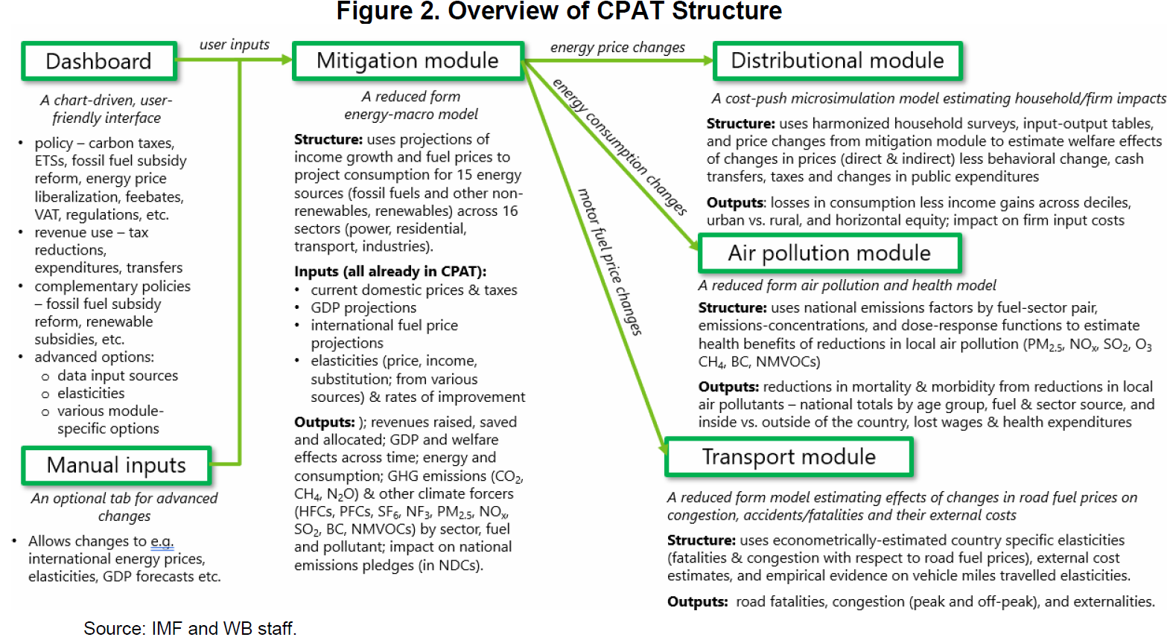
Climate Policy Assessment Tool
Overview of CPAT Structure

Slide 9
Climate Policy Assessment Tool
Example Outputs from CPAT Mitigation Module
(for US$50 Carbon Price/ton CO2e by 2030, Unspecified Country) Source: IMF staff using CPAT.

Slide 10
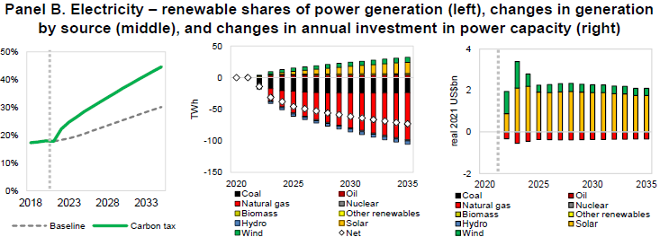
Climate Policy Assessment Tool
Example Outputs from CPAT Mitigation Module
(for US$50 Carbon Price/ton CO2e by 2030, Unspecified Country) Source: IMF staff using CPAT.

Slide 11
Climate Policy Assessment Tool
Example Outputs from CPAT Mitigation Module
(for US$50 Carbon Price/ton CO2e by 2030, Unspecified Country) Source: IMF staff using CPAT.

Slide 12
Climate Policy Assessment Tool
Example Outputs from CPAT Mitigation Module
(for US$50 Carbon Price/ton CO2e by 2030, Unspecified Country) Source: IMF staff using CPAT.

Slide 13
Climate Policy Assessment Tool
Example Outputs from CPAT Distribution Module
The distribution module estimates the incidence impacts of climate mitigation policy on industries (for many sectors) and households (across and within deciles). Source: IMF staff using CPAT. Note: LCU = local currency units.

Slide 14
Climate Policy Assessment Tool
Example Outputs from CPAT Distribution Module
The distribution module estimates the incidence impacts of climate mitigation policy on industries (for many sectors) and households (across and within deciles). Source: IMF staff using CPAT. Note: LCU = local currency units.

Slide 15
Climate Policy Assessment Tool
Example Outputs from CPAT Distribution Module
The distribution module estimates the incidence impacts of climate mitigation policy on industries (for many sectors) and households (across and within deciles). Source: IMF staff using CPAT. Note: LCU = local currency units.

Slide 16
Climate Policy Assessment Tool
Example Outputs from CPAT Air Pollution and Transport Modules
(for US$50 Carbon Price/ton CO2e by 2030, Unspecified Country)
The two remaining modules (air pollution and transport) capture the welfare spillovers from climate policy on health, congestion, and road safety (known as ‘development co-benefits’) Source: IMF staff using CPAT.

Slide 17
Climate Policy Assessment Tool
Example Outputs from CPAT Air Pollution and Transport Modules
(for US$50 Carbon Price/ton CO2e by 2030, Unspecified Country)
The two remaining modules (air pollution and transport) capture the welfare spillovers from climate policy on health, congestion, and road safety (known as ‘development co-benefits’) Source: IMF staff using CPAT..

Slide 18
Further Reading
WORKING PAPERS -The IMF-World Bank Climate Policy Assessment Tool (CPAT): a Model to Help Countries Mitigate Climate Change Prepared by Simon Black, Ian Parry, Victor Mylonas, Nate Vernon, and Karlygash Zhunussova
https://www.imf.org/en/Publications/WP/Issues/2022/07/28/Surging-Energy-Prices-in-Europe-in-the-Aftermath-of-the-War-How-to-Support-the-Vulnerable-521457

