Slide 1
CCP-LAW
Curricula development on Climate Change Policy and Law
Subject title: CLIMATE CHANGE DISPUTE RESOLUTION
Instructor Name: Tran Anh Tuan
Project No of Reference: 618874-EPP-1-2020-1-VN-EPPKA2-CBHE-JP:
The European Commission's support for the production of this publication does not constitute an endorsement of the contents, which reflect the views only of the authors, and the Commission cannot be held responsible for any use which may be made of the information contained therein.

Slide 2
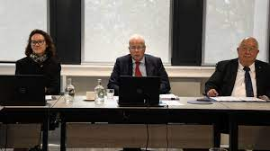
9.1. Mock arbitration/mediation
Module 9. Practical applications and simulations
Conduct mock arbitration or mediation sessions where parties attempt to resolve a simulated dispute over climate impacts and responsibilities.
Participants could take turns playing mediator or disputing parties.
Immersive mock simulations like these build first-hand experience with the intricacies of navigating multiparty climate disputes and understanding levers for constructive resolution.

Slide 3
9.1. Mock arbitration/mediation
Module 9. Practical applications and simulations
How to conduct:
Develop a hypothetical scenario based on real-world climate conflicts, like a lawsuit between a city and fossil fuel company over adaptation costs.
Assign participants roles as the different disputing parties and provide background details on their interests and positions.
Appoint 1-2 students to act as the mediator or arbitration panel. Provide guidelines on their role and process rules.

Slide 4
9.1. Mock arbitration/mediation
Module 9. Practical applications and simulations
How to conduct:
Allow time for the parties to prepare their opening statements and negotiation strategies.
Have the mediation/arbitration simulation with parties stating their cases, reacting to proposals, and the mediator facilitating discussions. Set a time limit.
Mediators/arbitrators should employ active listening, questioning, option creation and other dispute resolution tactics.

Slide 5
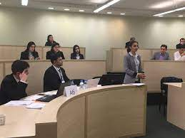
9.1. Mock arbitration/mediation
Module 9. Practical applications and simulations
How to conduct:
Observers take notes on the unfolding dynamics and tactics they observe.
Debrief by analyzing challenges, successes, alternative approaches. Swap mediator roles and run a new scenario.
Increase complexity by adding parties, using real climate science reports as evidence, or assigning external pressures.
Focus on realistically portraying parties' incentives and constraints to provide true negotiation experience.

