Slide 1
CCP-LAW
Curricula development on Climate Change Policy and Law
Subject title: Climate Change and Sustainable Development
Instructor Name: …
Project No of Reference: 618874-EPP-1-2020-1-VN-EPPKA2-CBHE-JP:
The European Commission's support for the production of this publication does not constitute an endorsement of the contents, which reflect the views only of the authors, and the Commission cannot be held responsible for any use which may be made of the information contained therein.

Slide 2
Concepts of sustainable development and sustainability/Introductory lecture

Slide 3
Concepts of sustainable development and sustainability/Introductory lecture
-What is sustainable development?
-Brutland Report 1987:
“Humanity has the ability to make development sustainable to ensure that it meets the needs of the present without compromising the ability of future generations to meet their own needs.”
“Yet in the end, sustainable development is not a fixed state of harmony, but rather a process of change in which the exploitation of resources, the direction of investments, the orientation of technological development, and institutional change are made consistent with future as well as present needs. We do not pretend that the process is easy or straightforward. Painful choices have to be made. Thus, in the final analysis, sustainable development must rest on political will.”
Notes:
Brundtland Report: Possibly, the most succinct articulation of the issue can be found in the Report of the World Commission on Environment and Development. The report entitled “Our Common Future” primarily addressed the closely related issue of Sustainable Development. The report, commonly know as the Brundtland Report after the Commission Chair Gro Harlem Brundtland, stated that “Humanity has the ability to make development sustainable to ensure that it meets the needs of the present without compromising the ability of future generations to meet their own needs.” Following the concept of Sustainable Development, the commission went on to add ” Yet in the end, sustainable development is not a fixed state of harmony, but rather a process of change in which the exploitation of resources, the direction of investments, the orientation of technological development, and institutional change are made consistent with future as well as present needs. We do not pretend that the process is easy or straightforward. Painful choices have to be made. Thus, in the final analysis, sustainable development must rest on political will.” Sustainability and the closely related concept of Sustainable Development are, therefore, very human constructs whose objective is to insure the very survival of humanity in a reasonably civilized mode of existence. Here, however, I will focus primarily on Sustainability. (Report of the World Commission on Environment and Development: Our Common Future. 1987. www.un-documents.net/wced-ocf.htm.)

Slide 4
Concepts of sustainable development and sustainability/Introductory lecture
Why?
to propose long-term environmental strategies for achieving sustainable development by the year 2000 and beyond;
to recommend ways concern for the environment may be translated into greater co-operation among developing countries and between countries at different stages of economical and social development and lead to the achievement of common and mutually supportive objectives that take account of the interrelationships between people, resources, environment, and development;
to consider ways and means by which the international community can deal more effectively with environment concerns; and
to help define shared perceptions of long-term environmental issues and the appropriate efforts needed to deal successfully with the problems of protecting and enhancing the environment, a long term agenda for action during the coming decades, and aspirational goals for the world community.
Notes:
Reason for the report:
It was an urgent call by the General Assembly of the United Nations:
to propose long-term environmental strategies for achieving sustainable development by the year 2000 and beyond;
to recommend ways concern for the environment may be translated into greater co-operation among developing countries and between countries at different stages of economical and social development and lead to the achievement of common and mutually supportive objectives that take account of the interrelationships between people, resources, environment, and development;
to consider ways and means by which the international community can deal more effectively with environment concerns; and
to help define shared perceptions of long-term environmental issues and the appropriate efforts needed to deal successfully with the problems of protecting and enhancing the environment, a long term agenda for action during the coming decades, and aspirational goals for the world community.

Slide 5
Concepts of sustainable development and sustainability/Introductory lecture
Population and human resources:
-population is growing at rates that cannot be sustained by available environmental resources
-World population has changed over time and is predicted to change over the future.
-current population is ~7 billion.
-peak population is expected to be ~9-10 billion, that it will reach this level between 2050 and 2100, and that it may be stable after this.
-mortality rates are decreasing
-Reasons of demographic transition: The shift from high to low mortality and fertility is known as the “demographic transition”.
-Age pyramids of the different demographic profiles: https://www.populationpyramid.net/world/2024/
Notes:
In many parts of the world, the population is growing at rates that cannot be sustained by available environmental resources, at rates that are outstripping any reasonable expectations of improvements in housing, health care, food security, or energy supplies.
Population was transformed in the 20th century as technological and social changes brought steep declines in birth rates and death rates around the world. One emphasizes the continued growth in the less developed regions, and the economic, social, environmental, and political strains associated. The other focus centers around the unprecedented low fertility in many countries. Population decline in low-fertility countries could be slowed by massive immigration—or even by a baby boom.
Recall that current population is ~7 billion.
Recall that peak population is expected to be ~9-10 billion, that it will reach this level between 2050 and 2100, and that it may be stable after this.
Identify that mortality rates are decreasing, in both developed and undeveloped countries: death rates plummeted and life expectancy soared first.
Explain the major reasons for the demographic transition: income, the level of female education, and the social structure of the country (greater educational and job opportunities for women, availability of effective contraception, shift away from formal marriage, acceptance of childbearing outside marriage, rise of individualism.)

Slide 6
Concepts of sustainable development and sustainability/Introductory lecture
Menti quiz:
https://www.mentimeter.com
Notes:
Which stage of the Demographic Transition Model is characterized by high birth rates and high death rates?
A. Stage 1: Pre-transition
B. Stage 2: Early transition
C. Stage 3: Late transition
D. Stage 4: Post-transition
Correct Answer: A

Slide 7
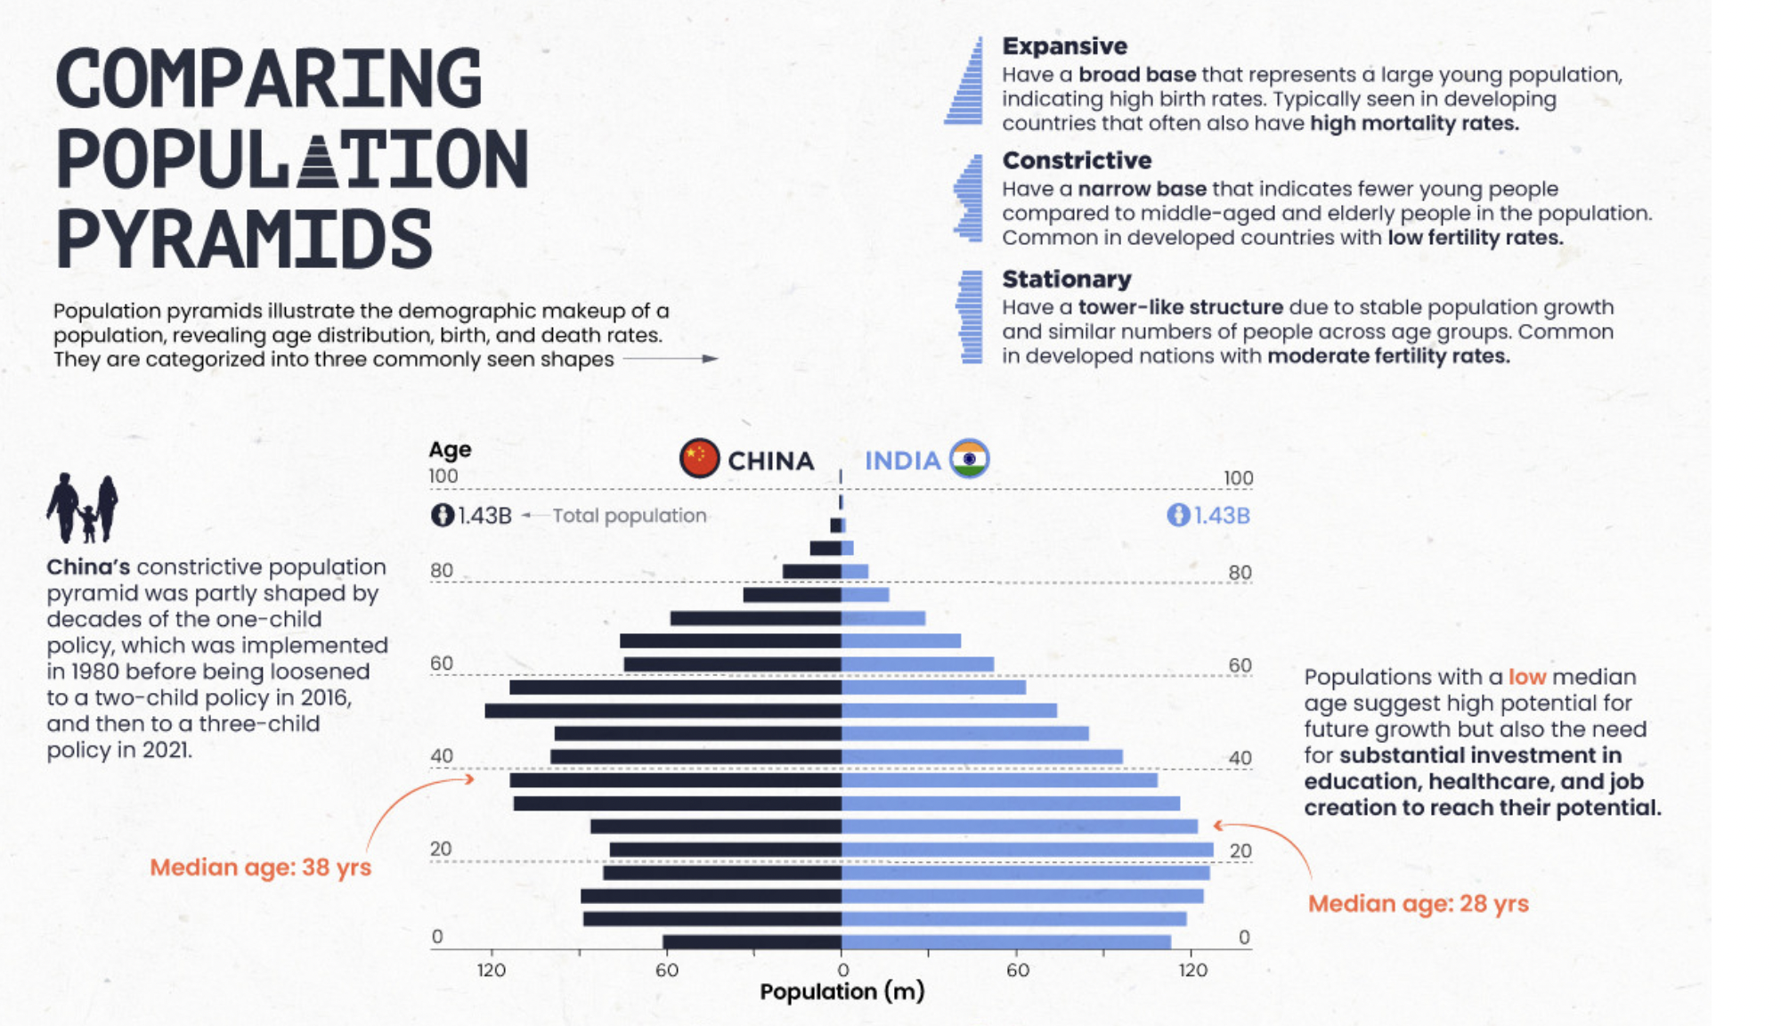
Concepts of sustainable development and sustainability/Introductory lecture
Notes:
Population pyramids are one of the best ways to visualize population data, and comparing the pyramids of various countries and regions side-by-side can reveal unexpected insights and differences between groups.
Discuss the implications of each stage in terms of country wealth and development, and implications for future population growth.
Discuss examples of policies that aim to alter population trends, such as the “one-child policy” in China and family planning approach in India.

Slide 8
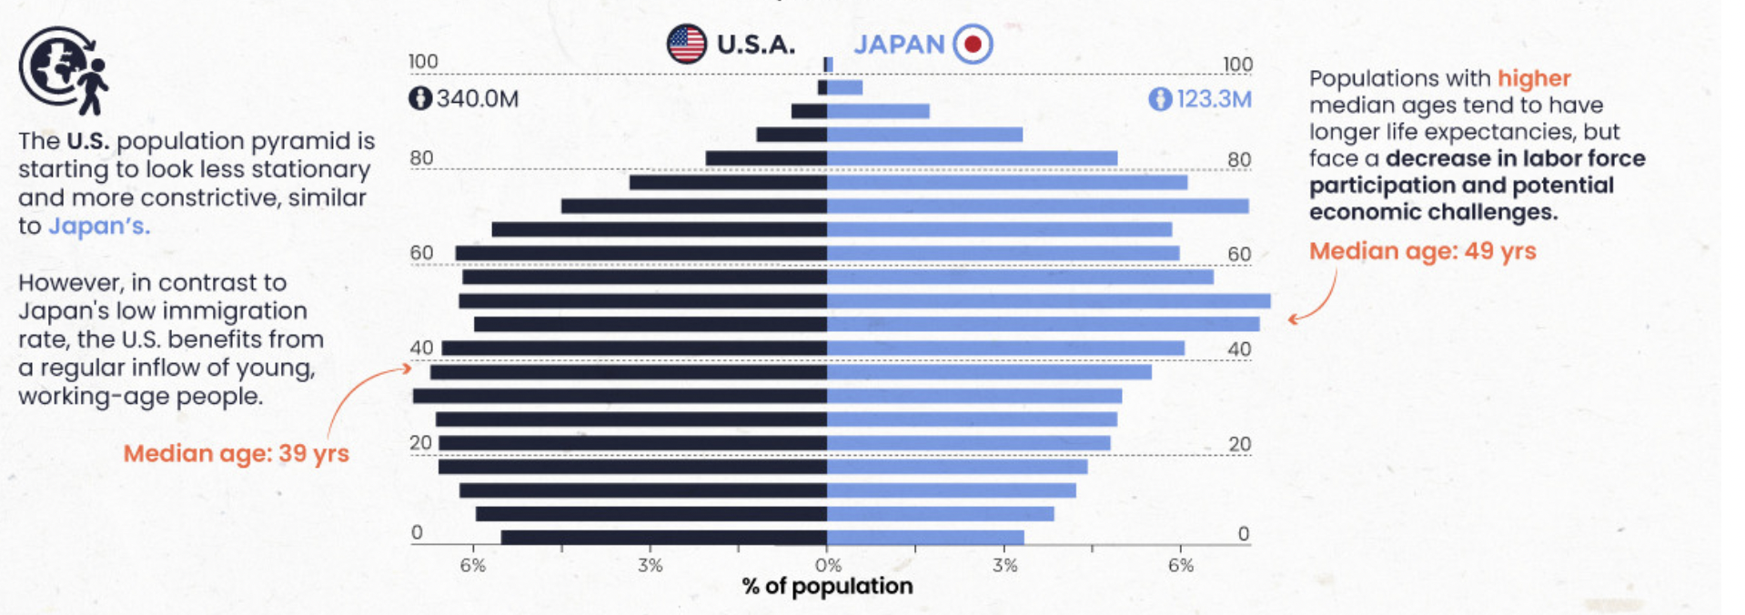
Concepts of sustainable development and sustainability/Introductory lecture
Notes:
Discuss the implications of each stage in terms of country wealth and development, and implications for future population growth.

Slide 9
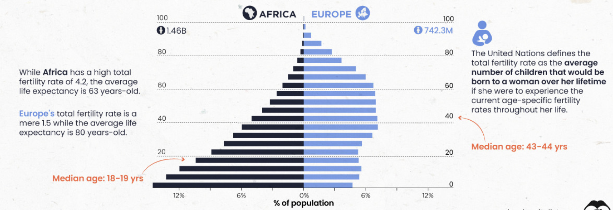
Concepts of sustainable development and sustainability/Introductory lecture
Notes:
Discuss the implications of each stage in terms of country wealth and development, and implications for future population growth.

Slide 10
Concepts of sustainable development and sustainability/Introductory lecture
-Per capita wealth and fertility
https://ourworldindata.org/grapher/children-per-woman-fertility-rate-vs-level-of-prosperity
-Women's educational attainment vs. fertility rate
https://ourworldindata.org/grapher/womens-educational-attainment-vs-fertility
-Implications of demographic change for economic growth:
improved sanitation
Investment in education
Government policies
Gender equality
-Immigration: migration affects the distribution of the population/ population shift from rural to urban.
Notes:
Explain the relationship between per capita wealth and fertility.
Discuss the implications of demographic change for economic growth.
Define the terms “developing countries” and “developed countries,” and discuss why most countries will not have “developing country” demographics by 2050, if current trends continue
■ Health. Improved sanitation, immunization programs, and antibiotics lead to declines in mortality that lead in turn to declines in fertility. Furthermore, research indicates that a healthy population can spur economic growth and lessen poverty.
■ Education. Transforming a youthful population into a productive work force requires investment in education at all levels.
■ Economic policy. A larger, better- educated work force will yield benefits only if the additional workers can find jobs. Government policies that lead to stable economies, labor-market flexibility, and open trade are associated with the growth of productive and rewarding jobs.
■ Good governance. In many countries, reaping the benefits of the demographic dividend requires strengthening the rule of law, improving the efficiency of government operations, reducing corruption, and guaranteeing contract enforcement.
■ Gender. Fertility declines more rapidly and health status improves more quickly where policies redress gender inequities in access to health and family planning services, education, and employment. And women can contribute more to the economy when their roles are not constrained.
Explain that changes in fertility are more important than changes in mortality in determining future population growth.
The early 21st century marks the first time that the majority of world population will live in urban areas. Cities offer many amenities and economies of scale that lower the costs of providing public services/ growing gap between rich and poor in the urban areas of many countries
Immigration makes up a significant part of the population growth in countries in which fertility has sunk so low that annual deaths outnumber annual births.

Slide 11
Concepts of sustainable development and sustainability/Introductory lecture
What is Sustainability?
In 1983 the United Nations General Assembly passed resolution 38/161 entitled “Process of Preparation of the Environmental Perspective to the Year 2000 and Beyond,” establishing a special commission “World Commission on Environment and Development” (WCED)
First credible and widely-disseminated study that probed its meaning in the context of the global impacts of humans on the environment.
Its main and often quoted definition refers to sustainable development as “...development that meets the needs of the present without compromising the ability of future generations to meet their own needs.”
Notes:
The commission later adopted the formal name “World Commission on Environment and Development” (WCED) but became widely known by the name of its chair Gro Harlem Brundtland, a medical doctor and public health advocate who had served as Norway’s Minister for Environmental Affairs and subsequently held the post of Prime Minister during three periods.
Although the Brundtland Report did not technically invent the term “sustainability,” it was the first credible and widely-disseminated study that probed its meaning in the context of the global impacts of humans on the environment. Its main and often quoted definition refers to sustainable development as “...development that meets the needs of the present without compromising the ability of future generations to meet their own needs.” The report uses the terms “sustainable development,” “sustainable,” and “sustainability” interchangeably, emphasizing the connections among social equity, economic productivity, and environmental quality. The pathways for integration of these may differ nation by nation; still these pathways must share certain common traits: “the essential needs of the world's poor, to which overriding priority should be given, and the idea of limitations imposed by the state of technology and social organization on the environment's ability to meet present and future needs.”

Slide 12
Concepts of sustainable development and sustainability/Introductory lecture
What is Sustainability?
Three dimensions: economic, environmental, and social (including sociopolitical)
https://www.youtube.com/watch?v=zx04Kl8y4dE
A social construct that seeks to improve the quality of life for the world’s peoples: physically, through the equitable supply of human and ecological goods and services, aspirationally, through making available the widespread means for advancement through access to education, systems of justice, and healthcare; and strategically, through safeguarding the interests of generations to come.
Basis of social equity
US Environmental Protection Agency (US EPA): distinction between sustainability and sustainable development
Notes:
Economic interests define the framework for making decisions, the flow of financial capital, and the facilitation of commerce, including the knowledge, skills, competences and other attributes embodied in individuals that are relevant to economic activity.
Environmental aspects recognize the diversity and interdependence within living systems, the goods and services produced by the world’s ecosystems, and the impacts of human wastes.
Socio-political refers to interactions between institutions/firms and people, functions expressive of human values, aspirations and well-being, ethical issues, and decision-making that depends upon collective action. The report sees these three elements as part of a highly integrated and cohesively interacting, if perhaps poorly understood, system.
The intersection of social and economic elements can form the basis of social equity. In the sense of enlightened management, "viability" is formed through consideration of economic and environmental interests. Between environment and social elements lies “bearability,” the recognition that the functioning of societies is dependent on environmental resources and services. At the intersection of all three of these lies sustainability.
The US Environmental Protection Agency (US EPA) takes the extra step of drawing a distinction between sustainability and sustainable development, the former encompassing ideas, aspirations and values that inspire public and private organizations to become better stewards of the environment and that promote positive economic growth and social objectives, the latter implying that environmental protection does not preclude economic development and that economic development must be ecologically viable now and in the long run.

Slide 13
Concepts of sustainable development and sustainability/Introductory lecture
UN Commissions:
United Nations Commission on Sustainable Development (CSD)
https://www.youtube.com/watch?v=_mfif5TMTMk
United Nations Sustainable Development Solutions Network (SDSN)
United Nations Environment Programme (UNEP)
United Nations Framework Convention on Climate Change (UNFCCC)
Notes:
United Nations Commission on Sustainable Development (CSD): The CSD was established in 1992 to ensure effective follow-up of the Earth Summit (Rio Summit) commitments on environment and development. It aimed to review progress in the implementation of Agenda 21, the Rio Declaration on Environment and Development, and the Johannesburg Plan of Implementation.
United Nations Sustainable Development Solutions Network (SDSN): SDSN mobilizes global scientific and technological expertise to promote practical solutions for sustainable development, including the implementation of the Sustainable Development Goals (SDGs).
United Nations Environment Programme (UNEP): the leading environmental authority within the United Nations system. UNEP's role is to set the global environmental agenda, promote the implementation of sustainable development, and help governments achieve environmental protection.
United Nations Framework Convention on Climate Change (UNFCCC): an international treaty adopted at the Rio Earth Summit with the objective of stabilizing greenhouse gas concentrations in the atmosphere at a level that would prevent dangerous anthropogenic interference with the climate system.

Slide 14
Concepts of sustainable development and sustainability/Introductory lecture
Menti quiz:
https://www.mentimeter.com
Notes:
What does the term "sustainable development" mean?
A. Development using non-renewable resources
B. Development that meets the needs of the present without compromising the ability of future generations to meet their own needs
C. Development that focuses only on economic growth
D. None of the above
Correct Answer: B
Which of the following is NOT one of the three pillars of sustainability?
A. Environmental protection
B. Economic growth
C. Social inclusion
D. Technological advancement
Correct Answer

