Slide 1
CCP-LAW
Curricula development on Climate Change Policy and Law
Module 9: Climate Change and Sustainable development
Subject title: How sustainability can be implemented from a practical perspective? conservation, management, and protection of water resources in the context of climate change.
Instructor Name: Regina Kalodiki
Project No of Reference: 618874-EPP-1-2020-1-VN-EPPKA2-CBHE-JP:
The European Commission's support for the production of this publication does not constitute an endorsement of the contents, which reflect the views only of the authors, and the Commission cannot be held responsible for any use which may be made of the information contained therein.

Slide 2
Content
Content
Effects of Climate Change on Water Resources:
Importance of water resources
Observed and projected climate-induced changes in the water cycle
Management Strategies for Adapting to Climate Change:
Water conservation techniques
Integrated Water Resources Management
Other strategies of climate change adaptation
Key international agreements and frameworks

Slide 3
Effects of Climate Change on Water Resources
Key messages
Water resources are crucial for maintaining natural equilibrium, human existence, and socioeconomic growth and are critical for human consumption, agricultural irrigation, energy, and industrial production.
The Global Risks Report by the World Economic Forum lists water crisis as one of the top five risks in all its reports since 2015
Water also features prominently in the SDGs (Section 4.8) and plays a central role in various systems transitions needed for climate resilient development
The degradation and loss of wetlands is more rapid than that of other ecosystems. Similarly, the status of both
freshwater and coastal wetland species is deteriorating faster than those of other ecosystems.
The primary indirect drivers of degradation and loss of inland and coastal wetlands have been population
growth and increasing economic development
Global climate change is expected to exacerbate the loss and degradation of many wetlands and the loss or
decline of their species and to increase the incidence of vector-borne and waterborne diseases in many regions.
Conserving, maintaining, or rehabilitating wetland ecosystems can be a viable element to an overall climate change mitigation strategy.
Notes:
Kong M, Zhao J, Zang C, Li Y, Deng J. Characteristics and Driving Mechanism of Water Resources Trend Change in Hanjiang River Basin. International Journal of Environmental Research and Public Health. 2023; 20(4):3764. https://doi.org/10.3390/ijerph20043764
Millennium Ecosystem Assessment, 2005.
ECOSYSTEMS AND HUMAN WELL-BEING: WETLANDS AND WATER Synthesis. World Resources Institute, Washington, DC.
https://hlpf.un.org/sites/default/files/mediaandpress/2023/HLPF%202023%20SDG%206%20Factsheet_1.pdf

Slide 4
Effects of Climate Change on Water Resources
Video by WWF International:
The importance of Water
Notes:
Kong M, Zhao J, Zang C, Li Y, Deng J. Characteristics and Driving Mechanism of Water Resources Trend Change in Hanjiang River Basin. International Journal of Environmental Research and Public Health. 2023; 20(4):3764. https://doi.org/10.3390/ijerph20043764
Millennium Ecosystem Assessment, 2005.
ECOSYSTEMS AND HUMAN WELL-BEING: WETLANDS AND WATER Synthesis. World Resources Institute, Washington, DC.
https://hlpf.un.org/sites/default/files/mediaandpress/2023/HLPF%202023%20SDG%206%20Factsheet_1.pdf

Slide 5
Effects of Climate Change on Water Resources
Video Why Care About Water? | National Geographic
Notes:
Kong M, Zhao J, Zang C, Li Y, Deng J. Characteristics and Driving Mechanism of Water Resources Trend Change in Hanjiang River Basin. International Journal of Environmental Research and Public Health. 2023; 20(4):3764. https://doi.org/10.3390/ijerph20043764
Millennium Ecosystem Assessment, 2005.
ECOSYSTEMS AND HUMAN WELL-BEING: WETLANDS AND WATER Synthesis. World Resources Institute, Washington, DC.
https://hlpf.un.org/sites/default/files/mediaandpress/2023/HLPF%202023%20SDG%206%20Factsheet_1.pdf

Slide 6
Effects of Climate Change on Water Resources
Importance of water resources
1. Sustaining life and ecosystems
Human Health: Access to clean water is essential for drinking, sanitation, and hygiene, preventing waterborne diseases. Sustainable Development Goal target 6.1 calls for universal and equitable access to safe and affordable drinking water
According to the UN
- 2.2 billion people still lacked safely managed drinking water services, 3.5 billion lacked safely
managed sanitation services and 2.0 billion lacked basic hygiene services in 2022
-Water scarcity is worsening in many parts of the world due to conflicts and climate change.
-Water pollution poses a significant challenge to human health and the environment in many
countries.
Ecosystem Services: Wetlands ecosystems including rivers, lakes, marshes, rice fields, and coastal areas
provide essential services like
-Water purification and detoxification of waste
-Climate regulation
-Mitigation of climate change.
Notes:
Kong M, Zhao J, Zang C, Li Y, Deng J. Characteristics and Driving Mechanism of Water Resources Trend Change in Hanjiang River Basin. International Journal of Environmental Research and Public Health. 2023; 20(4):3764. https://doi.org/10.3390/ijerph20043764
https://hlpf.un.org/sites/default/files/mediaandpress/2023/HLPF%202023%20SDG%206%20Factsheet_1.pdf

Slide 7
Effects of Climate Change on Water Resources
2. Supporting Agriculture and Food Security
Crop Irrigation: Agriculture accounts for the largest share of global water use, with irrigation being vital for crop production.
Livestock and Fisheries: Water resources support livestock watering and fisheries, contributing to food production and livelihoods.
3. Driving Economic Activities
Industry and Manufacturing: Water is used in various industrial processes, including manufacturing, energy production, and mining.
Tourism and Recreation: Water bodies attract tourists and support recreational activities like swimming, boating, and fishing, contributing to local economies.
4. Cultural and Spiritual Significance
Cultural Practices: Many cultures have deep connections to water bodies, with rituals, ceremonies, and traditions centered around them.
Spiritual Beliefs: Water is often regarded as sacred in various religions and spiritual practices, symbolizing purity, renewal, and life.
Notes:
FAO. (2020). AQUASTAT - FAO's global water information system. Food and Agriculture Organization of the United Nations.
FAO. 2020. The State of World Fisheries and Aquaculture 2020. Sustainability in action. Rome. https://doi.org/10.4060/ca9229en
UNIDO, ICSHP (2022). World Small Hydropower Development Report 2022. United Nations Industrial Development Organization,
Vienna, Austria; International Center on Small Hydro Power, Hangzhou, China. Available at www.unido.org/WSHPDR2022.
UNWTO. (2018). Tourism for Development Volume I: Key Areas for Action. World Tourism Organization.
UNESCO. (2009). Water-related cultural heritage: A preliminary study. United Nations Educational, Scientific and Cultural Organization

Slide 8
Effects of Climate Change on Water Resources
Water is, in fact, the first resource impacted by climate change, which is exacerbating other environmental, economic and social problems that threaten the development of economies and people’s livelihoods.
Observed and projected climate-induced changes in the water cycle
Observed Changes in the Hydrological Cycle Due to Climate Change
Changes in Precipitation, Evapotranspiration and Soil Moisture
Changes in the Cryosphere (Snow, Glaciers and Permafrost)
Changes in Streamflow
Changes in Floods
Changes in Droughts
Changes in Groundwater
Changes in Water Quality
Changes in Soil Erosion and Sediment Load
Notes:
https://www.ipcc.ch/report/ar6/wg2/chapter/chapter-4/
Douville, H., Raghavan, K., Renwick, J., Allan, R. P., Arias, P. A., Barlow, M., . . . Zolina, O., 2021: Water Cycle Changes. In: Climate Change 2021: The Physical Science Basis. Contribution of Working Group I to the Sixth Assessment Report of the Intergovernmental Panel on Climate Change. [Masson-Delmotte, V., P. Zhai, A. Pirani, S. L. Connors, C. Péan, S. Berger, N. Caud, Y. Chen, L. Goldfarb, M. I. Gomis, M. Huang, K. Leitzell, E. Lonnoy, J. B. R. Matthews, T. K. Maycock, T. Waterfield, O. Yelekçi, R. Yu and B. Zhou (eds.)]. Cambridge University Press, Cambridge.

Slide 9
Effects of Climate Change on Water Resources
Observed and projected climate-induced changes in the water cycle
B. Observed Sectoral Impacts of Current Hydrological Changes
Observed Impacts on Agriculture
Observed Impacts on Energy and Industrial Water Use
Observed Impacts on Water, Sanitation and Hygiene
Observed Impacts on Freshwater Ecosystems
Observed Impacts on Water-Related Conflicts
Observed Impacts on Human Mobility and Migration
Observed Impacts on the Cultural Water Uses of Indigenous Peoples, Local Communities and Traditional Peoples
Notes:
https://www.ipcc.ch/report/ar6/wg2/chapter/chapter-4/
Douville, H., Raghavan, K., Renwick, J., Allan, R. P., Arias, P. A., Barlow, M., . . . Zolina, O., 2021: Water Cycle Changes. In: Climate Change 2021: The Physical Science Basis. Contribution of Working Group I to the Sixth Assessment Report of the Intergovernmental Panel on Climate Change. [Masson-Delmotte, V., P. Zhai, A. Pirani, S. L. Connors, C. Péan, S. Berger, N. Caud, Y. Chen, L. Goldfarb, M. I. Gomis, M. Huang, K. Leitzell, E. Lonnoy, J. B. R. Matthews, T. K. Maycock, T. Waterfield, O. Yelekçi, R. Yu and B. Zhou (eds.)]. Cambridge University Press, Cambridge.

Slide 10
Effects of Climate Change on Water Resources
Observed and projected climate-induced changes in the water cycle
B. Observed Sectoral Impacts of Current Hydrological Changes
Observed Impacts on Agriculture
Observed Impacts on Energy and Industrial Water Use
Observed Impacts on Water, Sanitation and Hygiene
Observed Impacts on Freshwater Ecosystems
Observed Impacts on Water-Related Conflicts
Observed Impacts on Human Mobility and Migration
Observed Impacts on the Cultural Water Uses of Indigenous Peoples, Local Communities and Traditional Peoples
Notes:
https://www.ipcc.ch/report/ar6/wg2/chapter/chapter-4/
Douville, H., Raghavan, K., Renwick, J., Allan, R. P., Arias, P. A., Barlow, M., . . . Zolina, O., 2021: Water Cycle Changes. In: Climate Change 2021: The Physical Science Basis. Contribution of Working Group I to the Sixth Assessment Report of the Intergovernmental Panel on Climate Change. [Masson-Delmotte, V., P. Zhai, A. Pirani, S. L. Connors, C. Péan, S. Berger, N. Caud, Y. Chen, L. Goldfarb, M. I. Gomis, M. Huang, K. Leitzell, E. Lonnoy, J. B. R. Matthews, T. K. Maycock, T. Waterfield, O. Yelekçi, R. Yu and B. Zhou (eds.)]. Cambridge University Press, Cambridge.

Slide 11
Effects of Climate Change on Water Resources
Main points:
Projected changes
Global warming of 2°C would lead to an expansion of the area affected by flood hazards, compared to conditions at 1.5°C global warming (Hoegh-Guldberg et al., 2018)
the total land area subject to increasing drought frequency and severity would expand (high confidence), and in the Mediterranean, southwestern South America and western North America, future aridification will far exceed the magnitude of change seen in the last millennium (Douville et al., 2021)
Water insecurity due to water quality degradation is projected to increase under climate change due to warming, enhanced floods and sea level rise (Arnell and Lloyd-Hughes, 2014; Dyer et al., 2014; Whitehead et al., 2015)
Climate change is estimated to be responsible for 30–66% increase of soil erosion by 2070, while socioeconomic developments impacting land use may lead to ± 10% change of soil erosion (Borrelli et al., 2020).
Climate change impacts agriculture through various pathways (5.4 – Crop-based Systems), with projected yield losses of up to 32% by 2100 (RCP8.5) due to the combined effects of temperature and precipitation. (Ren et al., 2018a).
Climate change is expected to compromise Water Sanitation and Hygiene (WaSH) services, compounding existing vulnerabilities and increasing water-related health risks
Notes:
https://www.ipcc.ch/report/ar6/wg2/chapter/chapter-4/

Slide 12
Management Strategies for Adapting to Climate Change
Management Strategies for Adapting to Climate Change
1. Water Conservation policies
Programs for water conservation often combine vegetative and mechanical techniques to control erosion, repair damaged soil, and enhance soil productivity
In urban areas, water conservation is typically achieved through regulations like water rationing and technology requirements (Olmstead & Stavins, 2009). These measures are aimed at reducing water usage and promoting efficient water management.
Water conservation is a key component in the design of green buildings to meet the increasing demand for water while minimizing freshwater consumption (Talpur et al., 2020).
Advancements in technology, such as Geographic Information Systems (GIS) and machine learning, have played a crucial role in identifying suitable areas for water conservation technologies and analyzing data for effective water management (Nganga et al., 2019; Rahim et al., 2020).
Understanding human behavior and the factors influencing water conservation practices are vital for the successful implementation of conservation strategies. By considering psychological elements such as attitudes, beliefs, and social norms, water management authorities can tailor conservation techniques to be more effective and practical.
Notes:
Sarminah, S., Timo, P. N., & Aipassa, M. I. (2023). Design of soil and water conservation techniques to minimize soil erosion on degraded land in samarinda tenggarong axis road. IOP Conference Series: Earth and Environmental Science, 1282(1), 012022. https://doi.org/10.1088/1755-1315/1282/1/012022
Rahim MS, Nguyen KA, Stewart RA, Giurco D, Blumenstein M. Machine Learning and Data Analytic Techniques in Digital Water Metering: A Review. Water. 2020; 12(1):294. https://doi.org/10.3390/w12010294

Slide 13
Management Strategies for Adapting to Climate Change
Management Strategies for Adapting to Climate Change
Examples of water conservation policies:
Improving Irrigation Efficiency: Implementing precision irrigation techniques, such as drip and micro-sprinkler systems, to minimize water wastage in agriculture.
Reducing Non-Revenue Water: Upgrading water supply infrastructure and implementing leakage detection and repair programs to minimize losses in distribution systems.
What is Non-Revenue Water?
Non-revenue water is the difference between the volume of water put into a water distribution system and the volume that is billed to customers. NRW comprises three components: physical (or real) losses, commercial (or apparent) losses, and unbilled authorized consumption.
How Much Water Is Lost?
It is widely acknowledged that NRW levels in developing countries are very high. However, few data are available in the literature regarding the actual figures, largely because most water utilities in the developing world do not have adequate monitoring systems for assessing water losses and many countries lack national reporting systems that collect and consolidate information on water utility performance.
What Are the advantages from Reduced NRW?
Reducing NRW to just half the current level in the developing world would deliver the following benefits:
Eight billion cubic meters of already treated water would be available to service customers.
Ninety million more people could gain access to water supply, without increasing demand on endangered water resources.
Water utilities would gain access to an additional US$2.9 billion in self-generated cash flow
Fairness would be promoted among users by acting against illegal connections8 and those who engage in corrupt meter-reading
practices.
Notes:
World Bank. (2019). Reducing Non-Revenue Water to Strengthen Urban Water Utilities: Case Studies of Reform and Innovation in Urban Water Management.

Slide 14
Management Strategies for Adapting to Climate Change
Reducing Non-Revenue Water
How to implement Non –Revenue water strategies
Private sector involvement in NRW reduction activities
Long-term PPP arrangements
service contracts or
subcontracting of certain tasks
The private sector can bring the following:
New technology and the know-how to utilize it efficiently
• Better incentives for project performance
• Creative solutions for the design and implementation of the program
• Qualified human resources
• Flexibility for field work (for example, night crews)
• Investment, under certain conditions
Notes:
World Bank. (2019). Reducing Non-Revenue Water to Strengthen Urban Water Utilities: Case Studies of Reform and Innovation in Urban Water Management.

Slide 15
Management Strategies for Adapting to Climate Change
Reducing Non-Revenue Water
How to implement Non –Revenue water strategies
Example:
Outsourcing of leak detection. Many water utilities in Europe, the United States, and even in some developing countries use private leak detection contractors to survey the distribution network periodically.
Performance-Based Service Contracting: contract a private firm to implement an NRW reduction program, as for the outsourcing approach described above, but with the difference that the private firm is not paid solely in exchange for services delivered, but paid also against meeting contractually enforced operational performance measures. This measure is in line with the Output-based aid (OBA) approach advocated by the World Bank based on the idea of paying the private sector for delivering results (that is, outputs), instead of for just a series of activities/inputs.
International Case study:
State of Selangor (Malaysia), where a large-scale contract for reducing physical and commercial losses has been in place since 1998 between the (at that time state owned) water utility serving Kuala Lumpur and its surroundings, and a consortium led by a Malaysian company
Notes:
World Bank. (2019). Reducing Non-Revenue Water to Strengthen Urban Water Utilities: Case Studies of Reform and Innovation in Urban Water Management.

Slide 16
Management Strategies for Adapting to Climate Change
2. Integrated Water Resources Management
Is a process which promotes the coordinated development and management of water, land and related resources in order to maximize economic and social welfare in an equitable manner without compromising the sustainability of vital ecosystems and environment.
IWRM is a framework designed to improve the management of water resources based on four key principles adopted at the 1992 Dublin Conference on Water and the Rio de Janeiro Summit on Sustainable Development. These principles hold that:
fresh water is a finite and vulnerable resource essential to sustain life, development, and the environment;
water development and management should be based on a participatory approach, involving users, planners, and policy makers at all levels;
women play a central part in the provision, management, and safeguarding of water; and
water has an economic value in all its competing uses and should be recognized as an economic good.
IWRM is not, therefore, a prescriptive description of how water should be managed, but rather it is a broad framework in which decision makers can collaboratively decide the goals of water management and co-ordinate the use of different instruments to achieve them.
Notes:
1. International Conference of Water and the Environment (ICWE) (1992), The Dublin Statement on Water and Sustainable Development, http://www.wmo.int/pages/prog/hwrp/documents/english/icwedece.html.
2. Lenton, R. and M. Muller (eds.) (2009), Integrated Water Resources Management in Practice: Better Water Management for Development, Earthscan Publications, London.

Slide 17
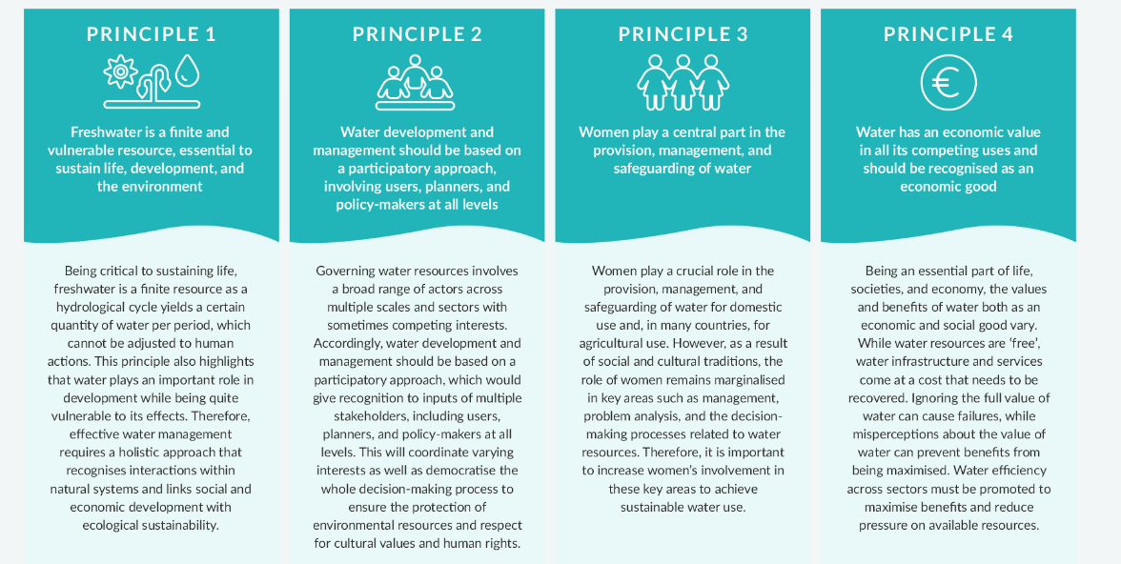
Management Strategies for Adapting to Climate Change
2. Integrated Water Resources Management
Source: Dublin Conference, 1992
Notes:
1. https://iwrmactionhub.org/about/iwrm-explained

Slide 18
Management Strategies for Adapting to Climate Change
2. Integrated Water Resources Management
The IWRM vision is aligned and contributes to the principles and realization of the :
UN Declaration on the Human Right to Water and Sanitation (UN, 2010) strengthened the social equity dimension of IWRM and the need to consider a Human Rights Based Approach as part of the ‘integrated’ vision for improving water governance (UNDP-SIWI, 2017).
Paris Agreement: underlines, alike IWRM, the need to collaborate and build partnership across scales to enhance understanding and action towards building a resilient and sustainable future (UNFCCC, 2015).
Agenda 2030 and the SDG: IWRM is strongly aligned with the principles and ambitions set by Agenda 2030 and is recognised as a cornerstone in the realisation of the Sustainable Development Goal 6 on ensuring access to water and sanitation for all (UN, 2018), being explicitly encapsulated as SDG target 6.5.
Notes:
1. https://iwrmactionhub.org/about/iwrm-explained

Slide 19
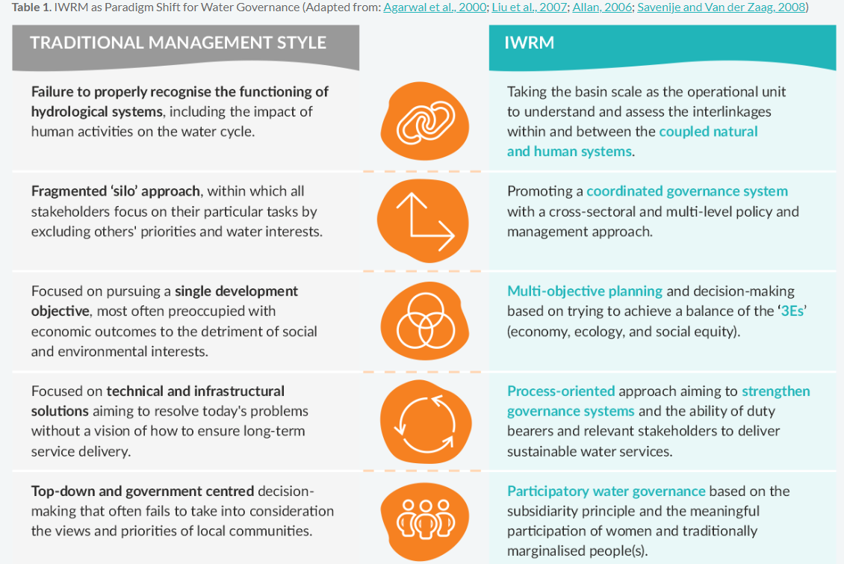
Management Strategies for Adapting to Climate Change
2. Integrated Water Resources Management

Slide 20
Management Strategies for Adapting to Climate Change
2. Integrated Water Resources Management
Is a process which promotes the coordinated development and management of water, land and related resources in order to maximize economic and social welfare in an equitable manner without compromising the sustainability of vital ecosystems and environment.
Objectives:
Economic Efficiency: to make scarce water resources go as far as possible and to allocate water strategically to different economic sectors and uses
Social Equity: to ensure equitable access to water and to the benefits from water use, between women and men, rich people and poor, across different social and economic groups both within and across countries which involves issues of entitlement, access and control
Environmental Sustainability: to protect the water resources base and related aquatic ecosystems and more boradly to help address global environmental issues such as climate change mitigation & adaptation, sustainable energy and sustainable food security
(Lenton and Muller, 2009)

Slide 21
Management Strategies for Adapting to Climate Change
2. Integrated Water Resources Management
Action Framework
Enabling environment refers to securing the rights and assets of all stakeholders and protecting public assets. This category involves the general framework of national policies, legislation, and regulation.
The institutional roles involve the consideration of a whole range of formal rules and regulations, customs and practices, ideas and information, and interest and community group networks, which together provide the institutional framework or context within which decision-makers operate.
The management instruments, include operational instruments for effective regulation, monitoring, and supporting decision-makers.
Financing: Include the budgeting and financing principles, instruments and strategies used to support sustainable investments in water resources and management at all levels
Notes:
GWP. (2004). Catalyzing change: A handbook for developing integrated water resources management (IWRM) and water efficiency strategies. Technical advisory committee (TAC) background paper no. 5. Stockholm, Sweden: Global Water Partnership.

Slide 22
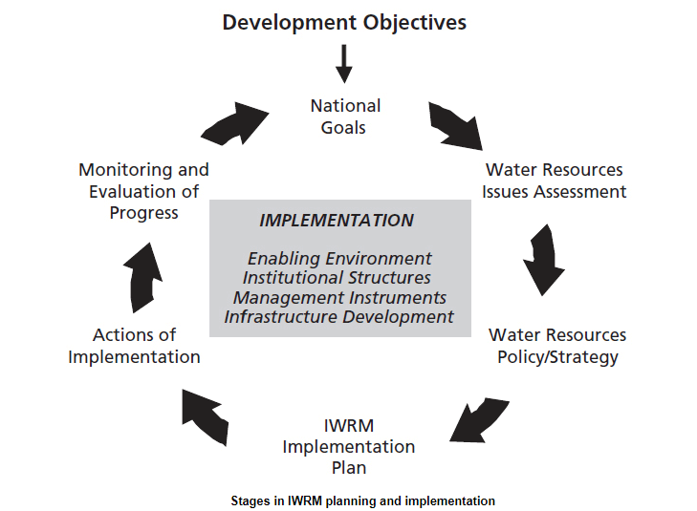
Management Strategies for Adapting to Climate Change
2. Integrated Water Resources Management
Source: https://www.un.org/waterforlifedecade/iwrm.shtml
Notes:
This is the rationale for the Integrated Water Resources Management (IWRM) approach that has now been accepted internationally as the way forward for efficient, equitable and sustainable development and management of the world's limited water resources and for coping with conflicting demands.

Slide 23
Management Strategies for Adapting to Climate Change
2. Integrated Water Resources Management
Challenges
lack of coordination and alignment of policies and institutional collaboration between water-related sectors and stakeholders, and between national, subnational and basin levels;
insufficient financing, including poor coordination between water related initiatives, and lack of capacity to absorb and disburse funds;
weak capacity of institutions to enforce legislation, and of water professionals to develop and implement cross-sector programmes;
insufficient monitoring, and data- and information-sharing in practice;
outdated or ineffective legal frameworks;
Lack of appreciation of the value of implementing IWRM among water related sectors and across government
ministries, including those responsible for national planning and financing.
Notes:
UNEP (2021). Progress on Integrated Water Resources Management. Tracking SDG 6 series: global indicator 6.5.1 updates and acceleration needs

Slide 24
Management Strategies for Adapting to Climate Change
2. Integrated Water Resources Management
Recommendations for advancing integrated water resources management
-Strengthening of political will through advocacy and communication
-Action planning: Countries can develop IWRM Action Plans, or similar, in order to focus, prioritize and coordinate efforts. Each country should identify and formalize their own pathway to make progress. A useful source of inspiration is the SDG 6 IWRM Support Programme; its Acceleration Package, contains guidance and is available to all countries. See www.gwp.org/en/sdg6support
-Coordination and alignment: Example: adopt integrated approaches to policies related to investments and management of water supply, wastewater treatment and reuse, water use and water-use efficiency in agriculture, industry and energy production, ecosystem protection and restoration, and water-related disasters. Identify opportunities to integrate water resources management into sectoral programs and planning processes – such as climate change, agriculture and poverty reduction – and establish formal coordination mechanisms, with clear institutional mandates, responsibilities, and incentives for coordination.
-Financing: Options include focusing on: (a) increasing direct central government investment backed by good policy; (b) raising revenue from traditional and non-traditional water and ecosystem services;
Notes:
UNEP (2021). Progress on Integrated Water Resources Management. Tracking SDG 6 series: global indicator 6.5.1 updates and acceleration needs

Slide 25
Management Strategies for Adapting to Climate Change
2. Integrated Water Resources Management
Recommendations for advancing integrated water resources management
-Capacity development: Identify and address the capacity gaps within and between key institutions and create incentives to retain qualified staff and encourage gender balance.
-Data and information management: Options include: (a) developing an online national information system (or similar) for IWRM, which compiles and standardizes relevant data and information on water use and allocation from different entities;
-Inclusive participation: The best ways and means to promote inclusive stakeholder participation in order to ensure the fairness and sustainability of water management and use are context-specific
-Legal frameworks: Develop or update laws to reflect progressive, coordinated water resources management approaches, and ensure policy alignment between existing or new legislation related to the use or pollution of water.
-Transboundary cooperation
Notes:
UNEP (2021). Progress on Integrated Water Resources Management. Tracking SDG 6 series: global indicator 6.5.1 updates and acceleration needs

Slide 26
Management Strategies for Adapting to Climate Change
Video: UN/ Implementing Integrated Water Resources Management: SDG Indicator 6.5.1

Slide 27
Management Strategies for Adapting to Climate Change
2. Integrated Water Resources Management
Discussion
What principles of IWRM are being implemented in your
local context?
2. Discuss the main challenges in implementing IWRM in your
local context.
3. Suggest how you can enhance the implementation of all
principles of IWRM in your own local context.
30 min
Notes:
1. International Conference of Water and the Environment (ICWE) (1992), The Dublin Statement on Water and Sustainable Development, http://www.wmo.int/pages/prog/hwrp/documents/english/icwedece.html.
2. Lenton, R. and M. Muller (eds.) (2009), Integrated Water Resources Management in Practice: Better Water Management for Development, Earthscan Publications, London.

Slide 28
Management Strategies for Adapting to Climate Change
3. Other strategies of climate change adaptation
1.Flood Management measures:
Flood-related disasters have risen by 134% since 2000 when compared with the two previous decades (WMO, 2021). The insufficient attention paid to flood risk management has resulted in a dramatic increase in the number of people affected and the economic damages related to floods (APFM, 2017).
Measures
-Structural: Constructing or enhancing flood defenses, such as levees, floodwalls, and stormwater drainage systems, to protect against increased flood risks due to climate change.
-Non structural: Policies and laws, raising public awareness, flood forecasting and warnings, evacuation, education and training etc.
Steps for Management flood planning
Framing of flood risk
Flood-risk analysis
Flood risk evaluation
Flood-risk management
Notes:
https://www.iwrmactionhub.org/learn/iwrm-tools/integrated-flood-management-plans
Lihong Wang, Shenghui Cui, Yuanzheng Li, Hongjie Huang, Bikram Manandhar, Vilas Nitivattananon, Xuejuan Fang, Wei Huang, A review of the flood management: from flood control to flood resilience, Heliyon, Volume 8, Issue 11, 2022,
https://sdgs.un.org/partnerships/implementation-nature-based-solutions-climate-resilient-and-flood-risk-management

Slide 29
Management Strategies for Adapting to Climate Change
3. Other strategies of climate change adaptation
2. Nature-Based Solutions (NBS)
Actions that protect, sustainably manage, and restore natural and modified ecosystems to address societal challenges. NBS can help to mitigate the negative impacts of floods, such as erosion, sedimentation, and loss of vegetation cover. NBS can provide benefits for both people and the environment.
Examples of nature-based solutions that can be used for flood risk management
Reforestation and afforestation: Planting trees and restoring woodland cover can help to reduce surface water runoff and soil erosion, regulate water flow, and enhance soil structure.
Wetland restoration: Wetland restoration can help alleviate flood risks and offer various advantages such as enhancing water quality, promoting biodiversity, and providing recreational opportunities.
Sustainable land management: These methods encompass soil conservation, terracing, contour farming, and crop diversification. Sustainable land management can aid in diminishing soil erosion, augmenting soil water retention capabilities, and enhancing crop yield.
Green infrastructure: Green infrastructure can serve as a valuable nature-based approach for flood risk management. Green infrastructure comprises natural or engineered elements such as green roofs, rain gardens, and permeable pavements. These features can mitigate runoff, promote infiltration, and enhance water quality.
Benefits:
Cost-effective: Nature-based solutions (NBS) can be more cost-effective than traditional infrastructure-based approaches to flood risk management.
Multiple benefits: NBS can provide multiple benefits such as carbon sequestration, biodiversity conservation, and livelihood improvement.
Resilience: NBS can enhance the resilience of ecosystems and communities to flood risks.
Adaptability: NBS can be adapted to various environmental and social contexts.
Notes:
https://sdgs.un.org/partnerships/implementation-nature-based-solutions-climate-resilient-and-flood-risk-management
https://www.worldbank.org/en/news/feature/2023/02/03/water-storage-is-at-the-heart-of-climate-change-adaptation

Slide 30
Management Strategies for Adapting to Climate Change
3. Other strategies of climate change adaptation
3. Water Storage Facilities:
As demand for fresh water rises, the world is experiencing a widening water storage gap, with more water storage needed than is available in many places.
Water storage provides three main services: (a) improving the availability of water during drier periods, (b) mitigating the impacts of floods, and (c) regulating flows for other purposes, such as hydropower, transportation, or recreation
Examples:
Dams and Reservoirs: Large-scale dams and reservoirs are among the most common water storage facilities. These structures impound water in reservoirs, which can then be used for various purposes such as hydroelectric power generation, irrigation, municipal water supply, and flood control. One example is the Hoover Dam in the United States, which creates Lake Mead, the largest reservoir in the country.
Water Tanks: Water tanks are commonly used for storing water at smaller scales, such as individual households, businesses, or communities
Ponds and Lakes: Natural or artificial ponds and lakes can also serve as water storage facilities. These water bodies can be used for irrigation, livestock watering, aquaculture, and recreational purposes. For example, the Saylorville Lake in Iowa, USA, serves multiple purposes, including flood control, recreation, and water supply.
Groundwater Recharge Basins: These are shallow depressions or infiltration basins designed to capture and store surface water, allowing it to percolate into the ground and recharge groundwater aquifers.
Notes:
World Bank. 2023. “What the Future Has in Store: A New Paradigm for Water Storage.” World Bank, Washington, DC

Slide 31
Key international agreements and frameworks
Key international agreements and frameworks related to water and climate change:
1. United Nations Framework Convention on Climate Change (UNFCCC)
Purpose: The UNFCCC, established in 1992, aims to address climate change by stabilizing greenhouse gas concentrations in the atmosphere.
Relevance to Water: The UNFCCC recognizes the significance of water resources in climate change adaptation and mitigation efforts, particularly regarding vulnerability to droughts, floods, and sea-level rise.
2. Paris Agreement
Purpose: Adopted in 2015 under the UNFCCC, the Paris Agreement sets out global action to limit global warming and enhance adaptive capacity to climate change.
Relevance to Water: The Paris Agreement acknowledges the importance of water-related adaptation measures and emphasizes the need for climate-resilient water infrastructure and management practices.
3. Sendai Framework for Disaster Risk Reduction
Purpose: The Sendai Framework, adopted in 2015, aims to reduce disaster risk and enhance resilience to disasters worldwide.
Relevance to Water: The Sendai Framework recognizes the role of water-related hazards, such as floods and droughts, in disaster risk and calls for integrated water management approaches to reduce vulnerability.

Slide 32
Key international agreements and frameworks
Key international agreements and frameworks related to water and climate change:
4. Sustainable Development Goals (SDGs)
Purpose: The SDGs are a set of 17 global goals adopted by the United Nations in 2015 to address social, economic, and environmental challenges.
Relevance to Water: SDG 6 specifically focuses on ensuring access to clean water and sanitation for all and calls for sustainable water management, including climate resilience and water-related ecosystem protection.
5. Ramsar Convention on Wetlands
Purpose: The Ramsar Convention, established in 1971, is an intergovernmental treaty for the conservation and wise use of wetlands.
Relevance to Water: The Ramsar Convention highlights the importance of wetlands in climate regulation, water purification, and flood control, emphasizing their role in climate change adaptation and mitigation.
6. Convention on the Law of the Non-Navigational Uses of International Watercourses
Purpose: This convention, adopted in 1997, provides a framework for the equitable and reasonable utilization of international watercourses.
Relevance to Water: The convention promotes cooperation among riparian states in managing shared water resources, considering the potential impacts of climate change on water availability and quality.
These agreements and frameworks reflect the recognition of the interconnectedness between water and climate change at the global level and the importance of collaborative efforts to address the challenges posed by climate impacts on water resources.

